Slide 1
e+/e- electron cloud tune shift measurements for 45 bunch trains
Tune Shift versus current: Measured the tune shift for 45 bunch electron and positron trains with 14ns bunch spacing at various bunch currents.
These results are from measurements made by M. Billing, M. Palmer, G. Dugan, and R. Holtzapple on 2/1/2009.

Slide 2
Vertical Tune along a 45 bunch e+ train between I=0.25-1.0mA/bunch
-Varied the current from 0.25 to 1mA/bunch.
-Measured the vertical orbit 5 times for all 45 bunches over 1024 turns at each current setting.
-FFT orbit to determine the single bunch tune for all 45 bunches in the train.
Linear vertical tune shift along train at the lower bunch currents.
A positive tune shift along the train, the width of the vertical tune spectrum increases along the train at high I.
Vertical damping along the train is noted at the higher currents
When I=1.0mA/bunch, a hint of a vertical instability is detected in the vertical orbit near the end of the train.
Movies

Slide 3
Vertical Tune along a 45 bunch e+ train with bunch current up to I=1.4mA/bunch
When I>1.0mA/bunch, a vertical instability is detected in orbit neat the end of the train. In addition, a second peak in the vertical spectrum appears around bunch 25 and is ~4kHz higher in frequency.
Movies

Slide 4
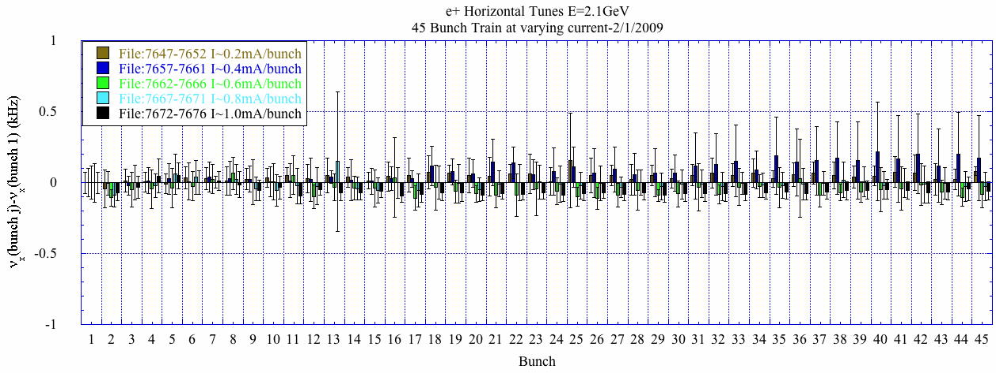
Horizontal Tune along a 45 bunch e+ train between I=0.25-1.0mA/bunch
No horizontal tune shift is detected.
When I=1.0mA/bunch, a hint of an instability is detected in the horizontal orbit neat the end of the train.
Movies

Slide 5
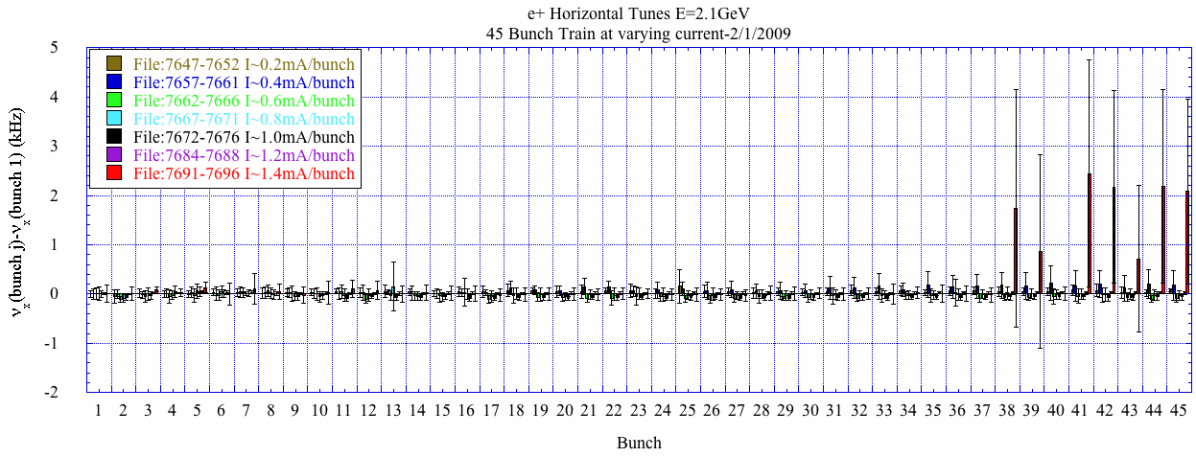
Horizontal Tune along a 45 bunch e+ train between I=0.25-1.4mA/bunch
No horizontal tune shift is detected.
When I~1.0mA/bunch, a hint of an instability is detected in the horizontal orbit near the end of the train. This instability is evident by a new peak in the horizontal spectrum ~7kHz away. The peak in the spectrum occurs earlier in the train at higher bunch current.
Movies

Slide 6
Vertical Tune along a 45 bunch e- train with bunch current up to I=1.6mA/bunch
Negative vertical tune shift along the train increases with current.
Growth in the vertical orbit is observed at several currents.
Movies

Slide 7
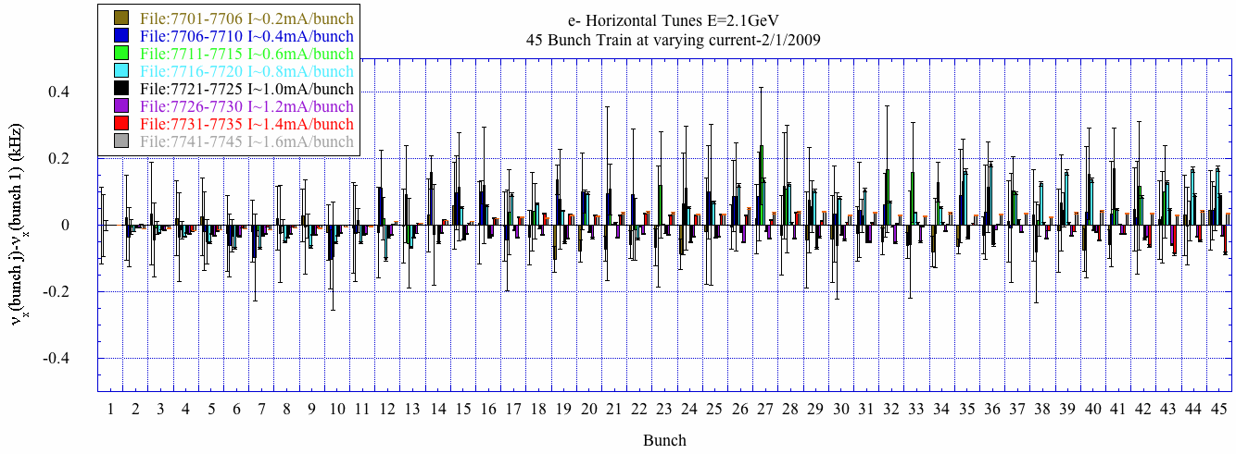
Horizontal Tune along a 45 bunch e- train with bunch current up to I=1.6mA/bunch
No horizontal tune shift is observed along the train.
Growth in the horizontal orbit is observed at several currents.
Movies

