Slide 1
e+ Tune Measurements for 4-ns Spaced Bunches
Tune Measurements of 4-ns spaced bunches: An update of the strides made using the digital BPM system to measure single bunch tunes of 4-ns spaced CesrTA bunches.
These results are from measurements during the August-September 2009 CesrTA run by M. Billing, M. Palmer, M. Rendina, N. Rider, C. Strohman, G. Dugan, M. Forster, L. Fabrizio, M. Randazzo, and R. Holtzapple .

Slide 2
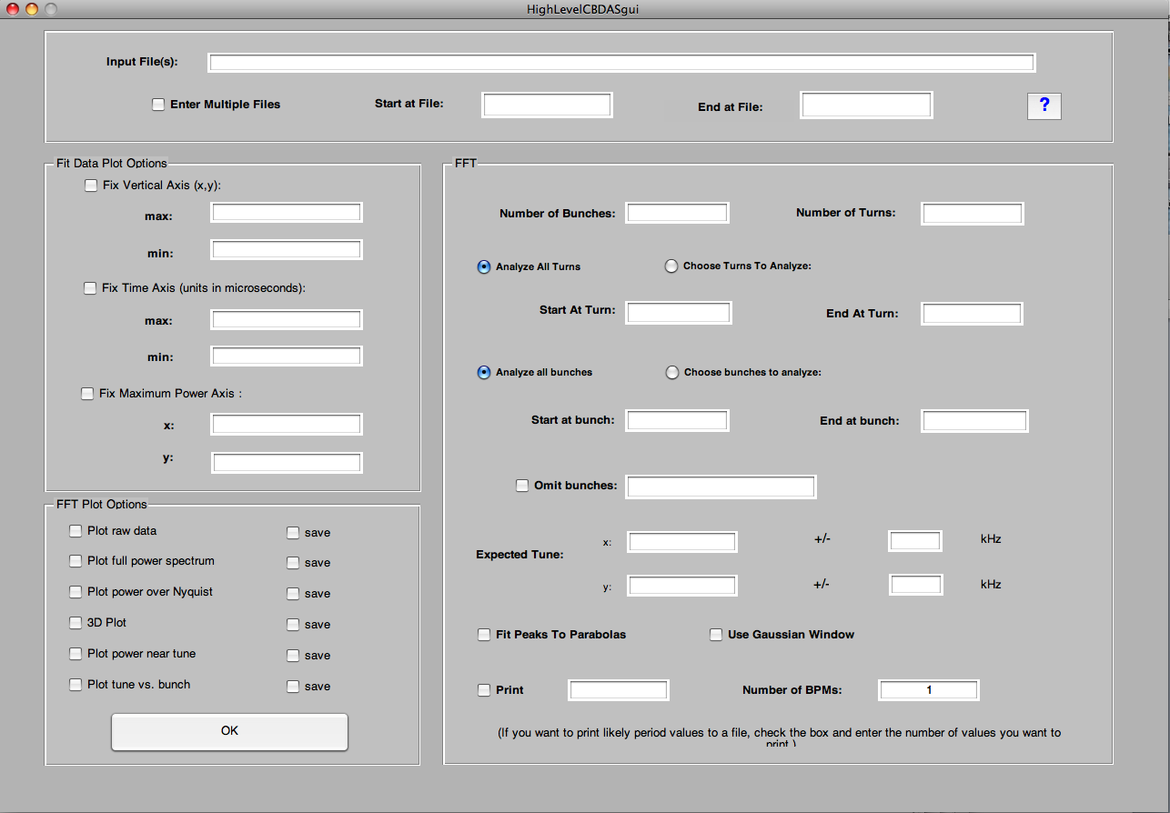
Data analysis software for 4-ns spaced bunches
Part of the commissioning the digital BPM system was to measure the tunes of 4-ns spaced bunches. To process the BPM data a Matlab software package was written to analyze the data files. The software package has the following features:
Data files can contain data from multiple BPM’s and can process multiple data files.
User specifies the number of bunches and number of turns in the BPM data file.
Plots either the full FFT power spectrum or the power spectrum near the expected tune.
Peak in the spectrum can be determined by fitting it to a parabola and the result is saved in a text file.
The position, power spectrum, 3D power spectrum, tune vs. bunch can be plotted and saved with specified fixed axis.
Matlab GUI for BPM Data Analysis Software

Slide 3
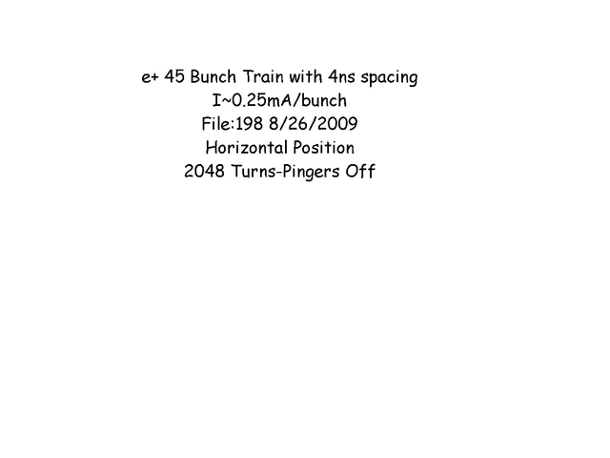
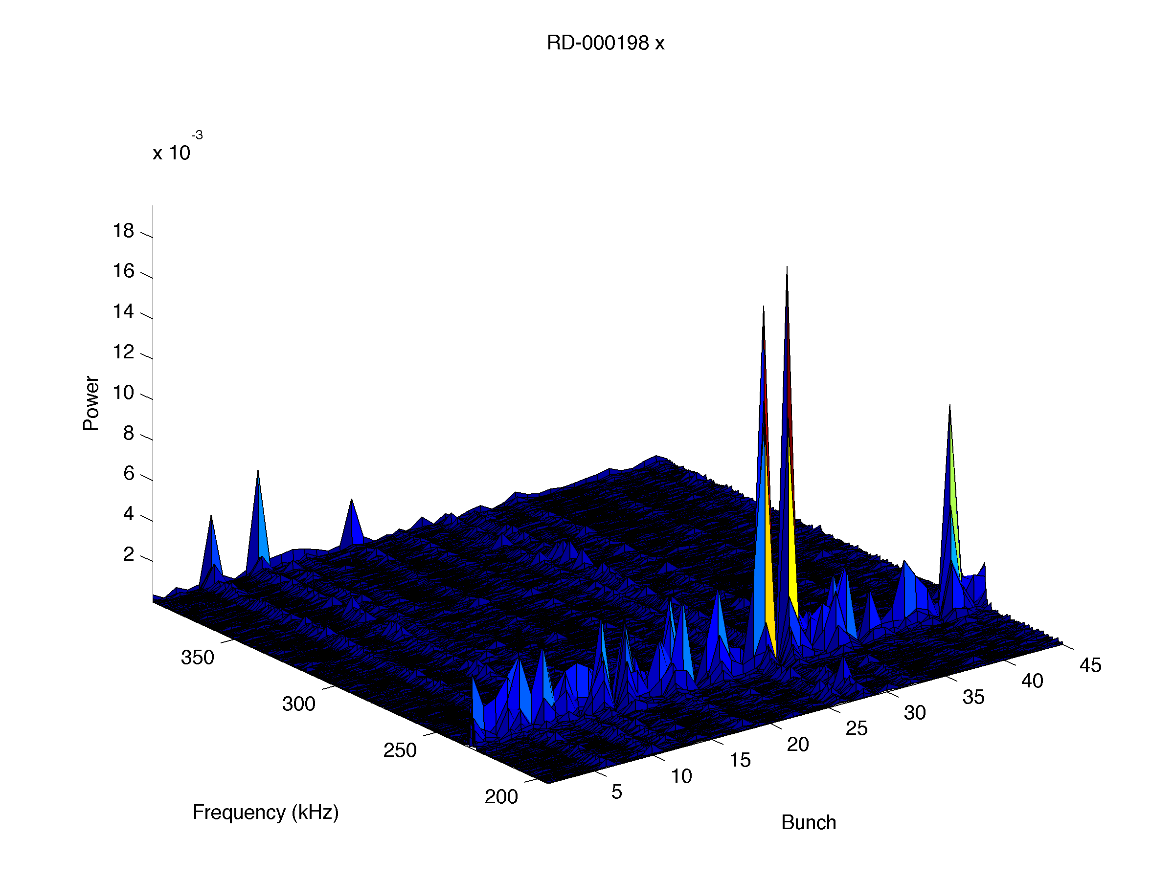
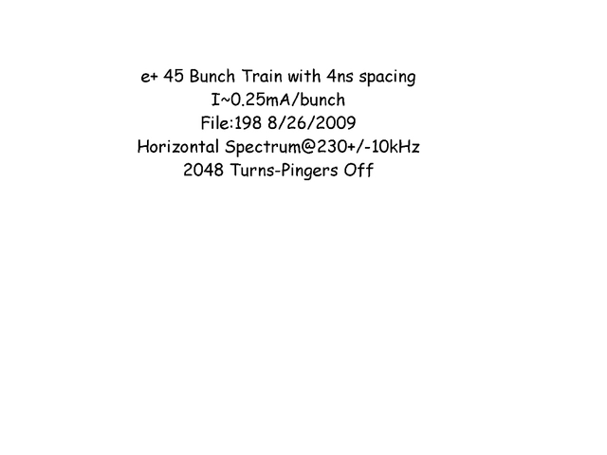
1. Motion detection without excitation
Horizontal Motion along a 4-ns spaced 45 bunch e+ train without exciation
I~0.25mA/bunch.
Large jumps in the orbit are observed.
Took data with 1024, 2048, 4096, and 8192 turns. The BPM signal when turns>2048 has large oscillations and an increased offset between even and odd bunches.
Small horizontal tune signal is observed (expect Q_{x}~233kHz).
Movies
FFT of horizontal position

Slide 4
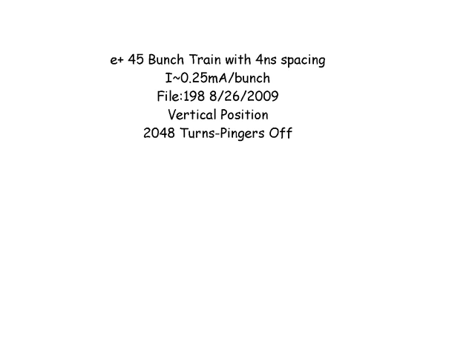
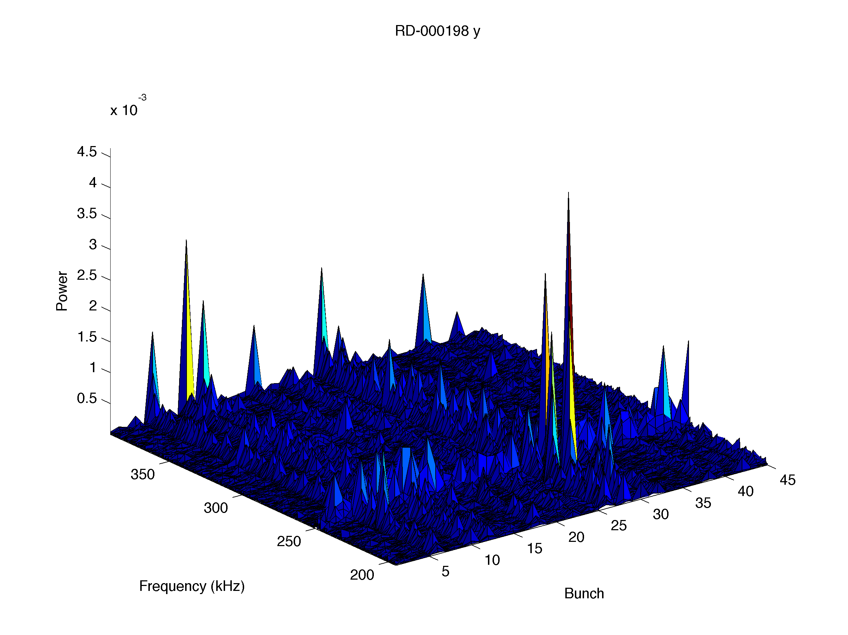

Vertical Motion along a 4-ns spaced 45 bunch e+ train without pinging
I~0.25mA/bunch.
Large jumps in the orbit are observed.
Small vertical tune signal is observed (expect Q_{y}~249kHz).
FFT of vertical position
Movies

Slide 5
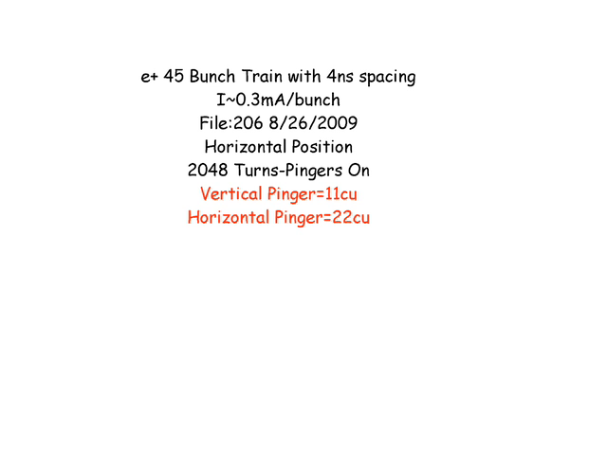
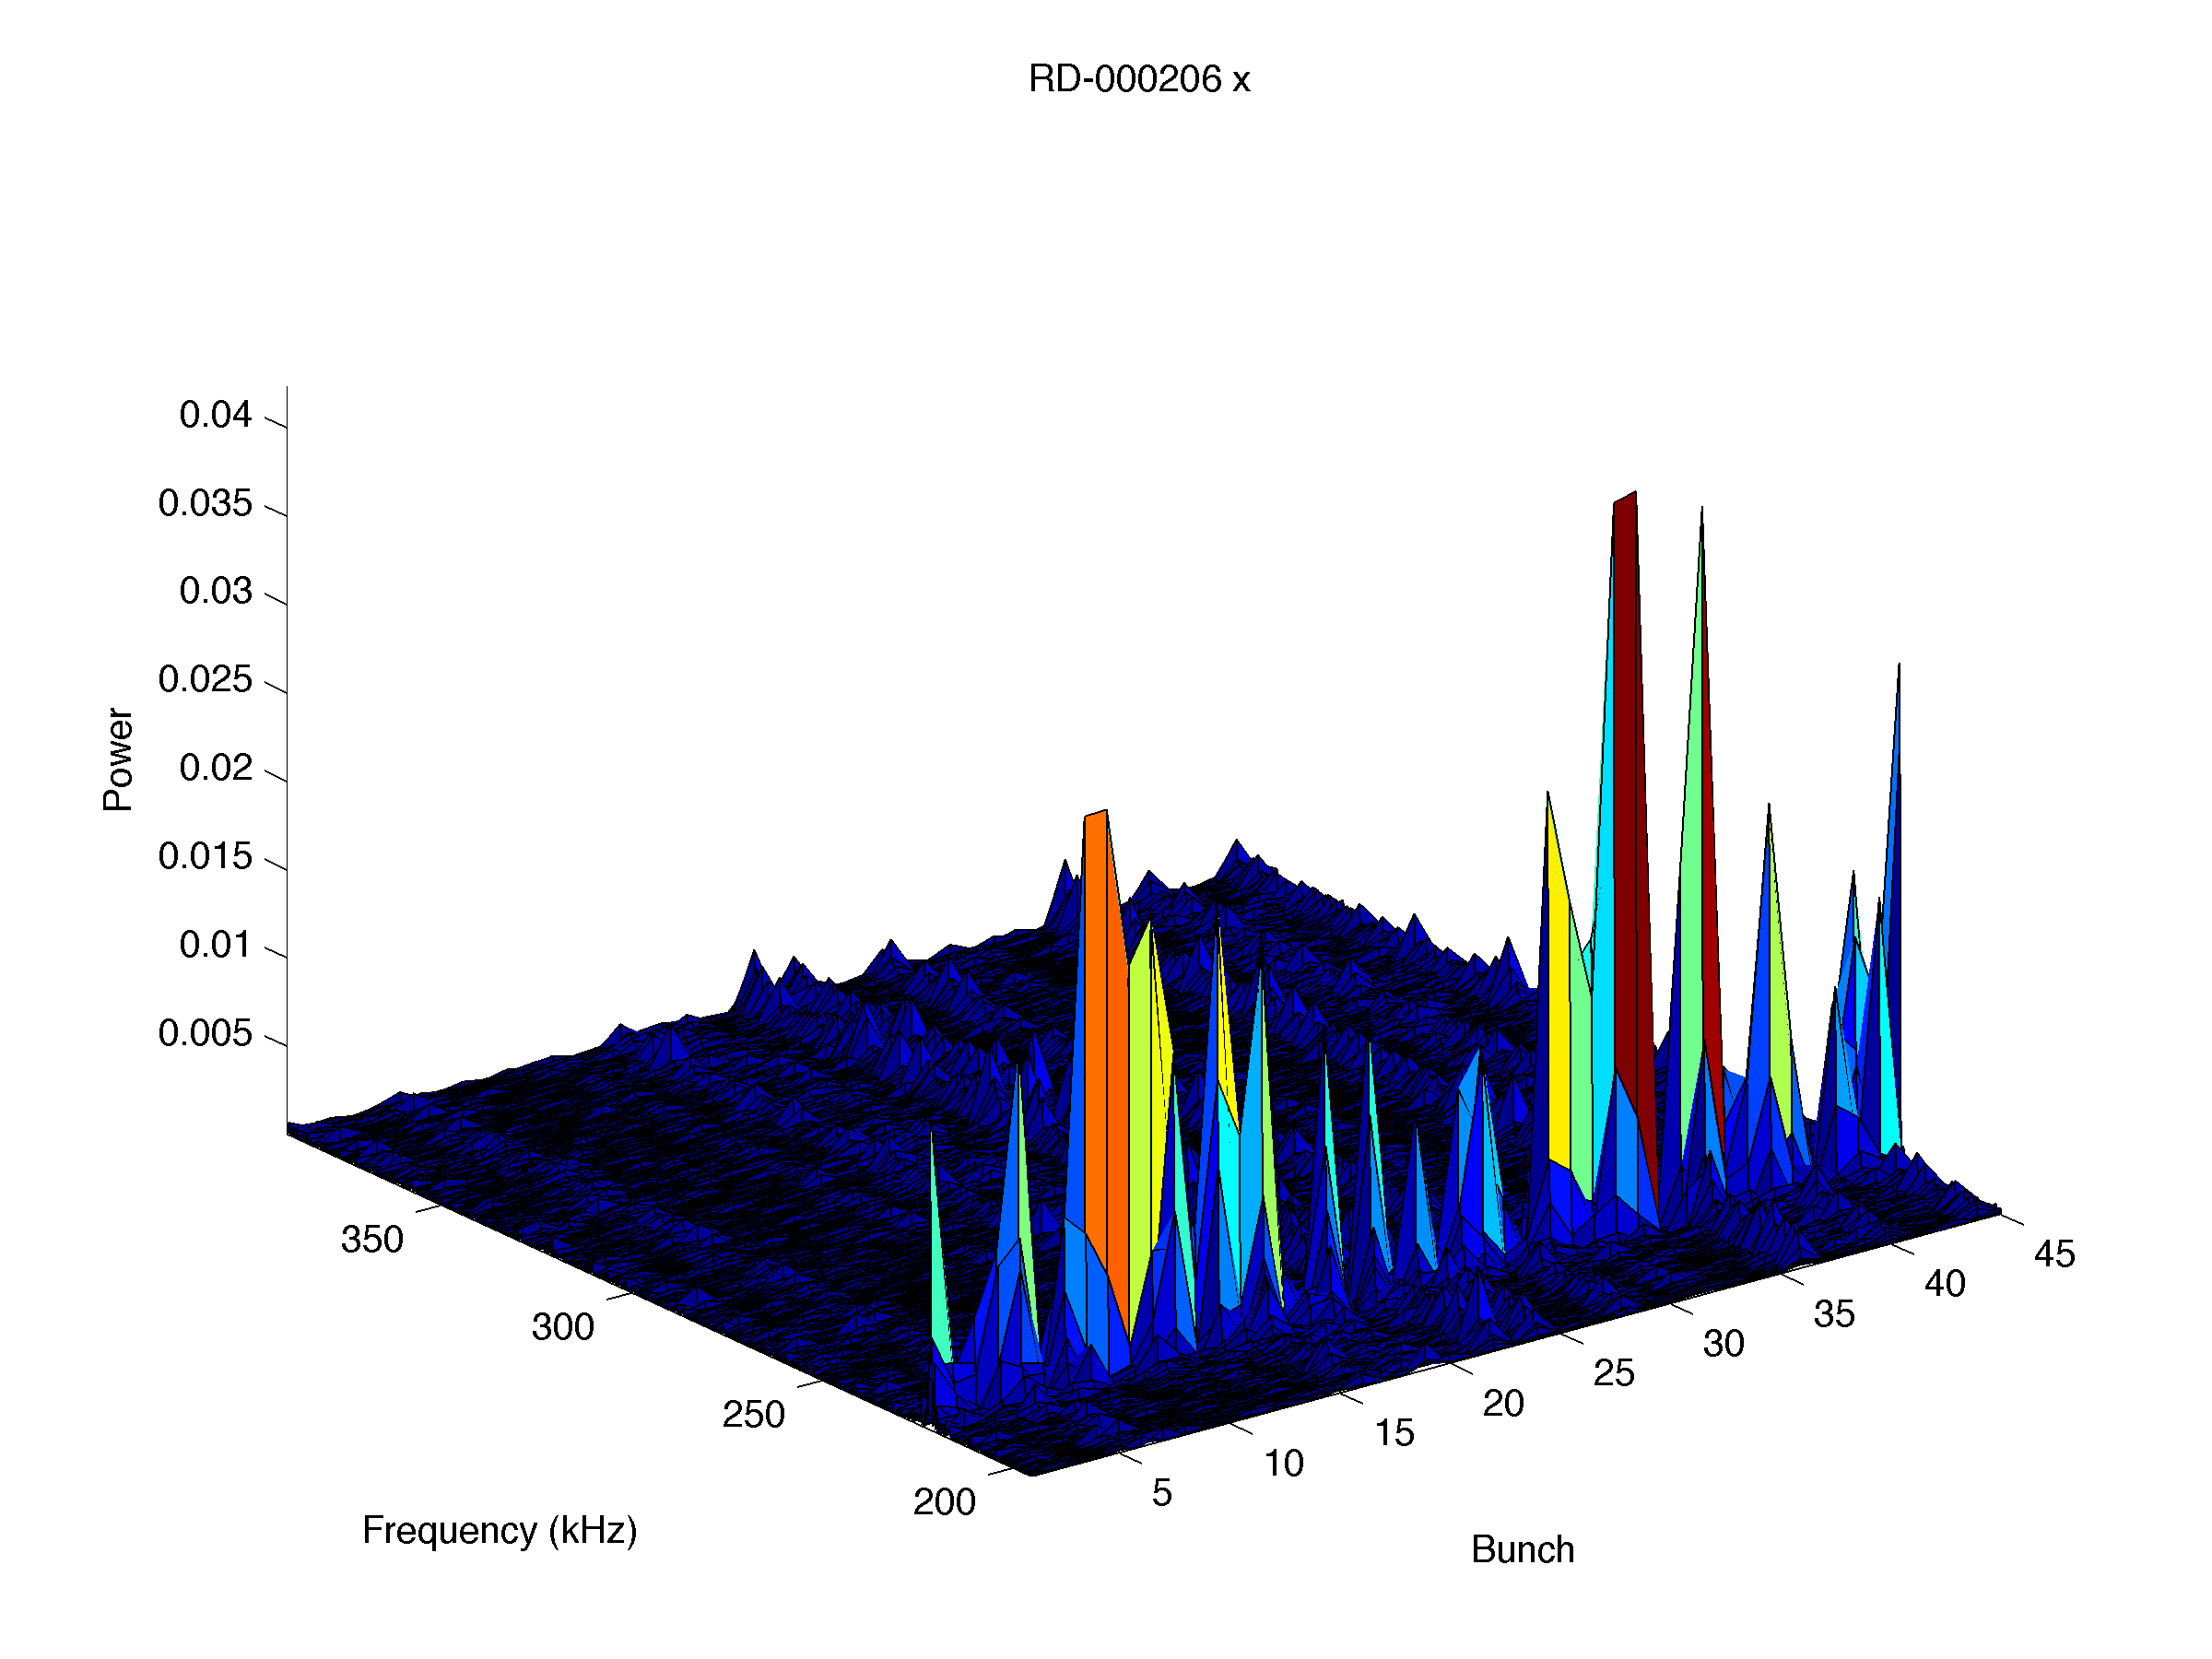
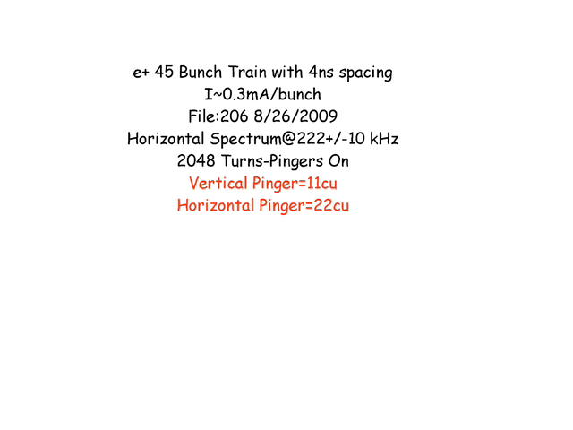
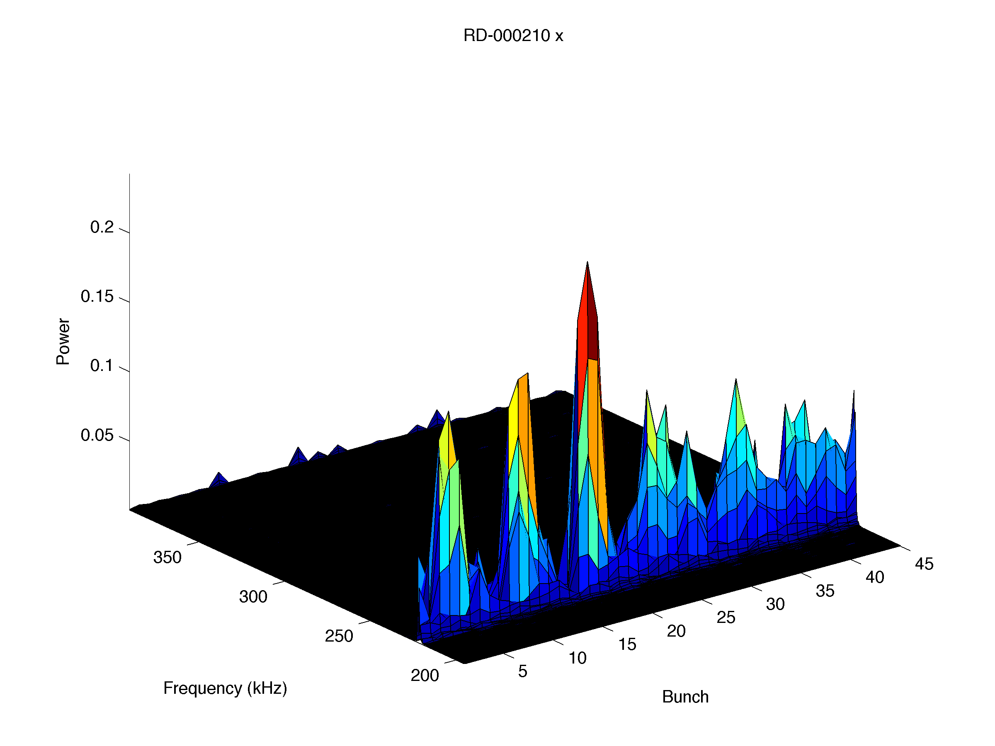
2. Motion detection with excitation-Vertical/Horizontal Pingers
Horizontal Motion with a 4-ns spaced 45 bunch e+ train when the bunches are horizontally/vertically pinged.
I~0.3mA/bunch.
Increased the horizontal pinger amplitude in four steps (22, 35, 135, and 268cu).
FFT peak signal is visible but easily determined at the lower pinger amplitudes.
FFT@22cu pinger amplitude
Movies
FFT@268cu pinger amplitude

Slide 6

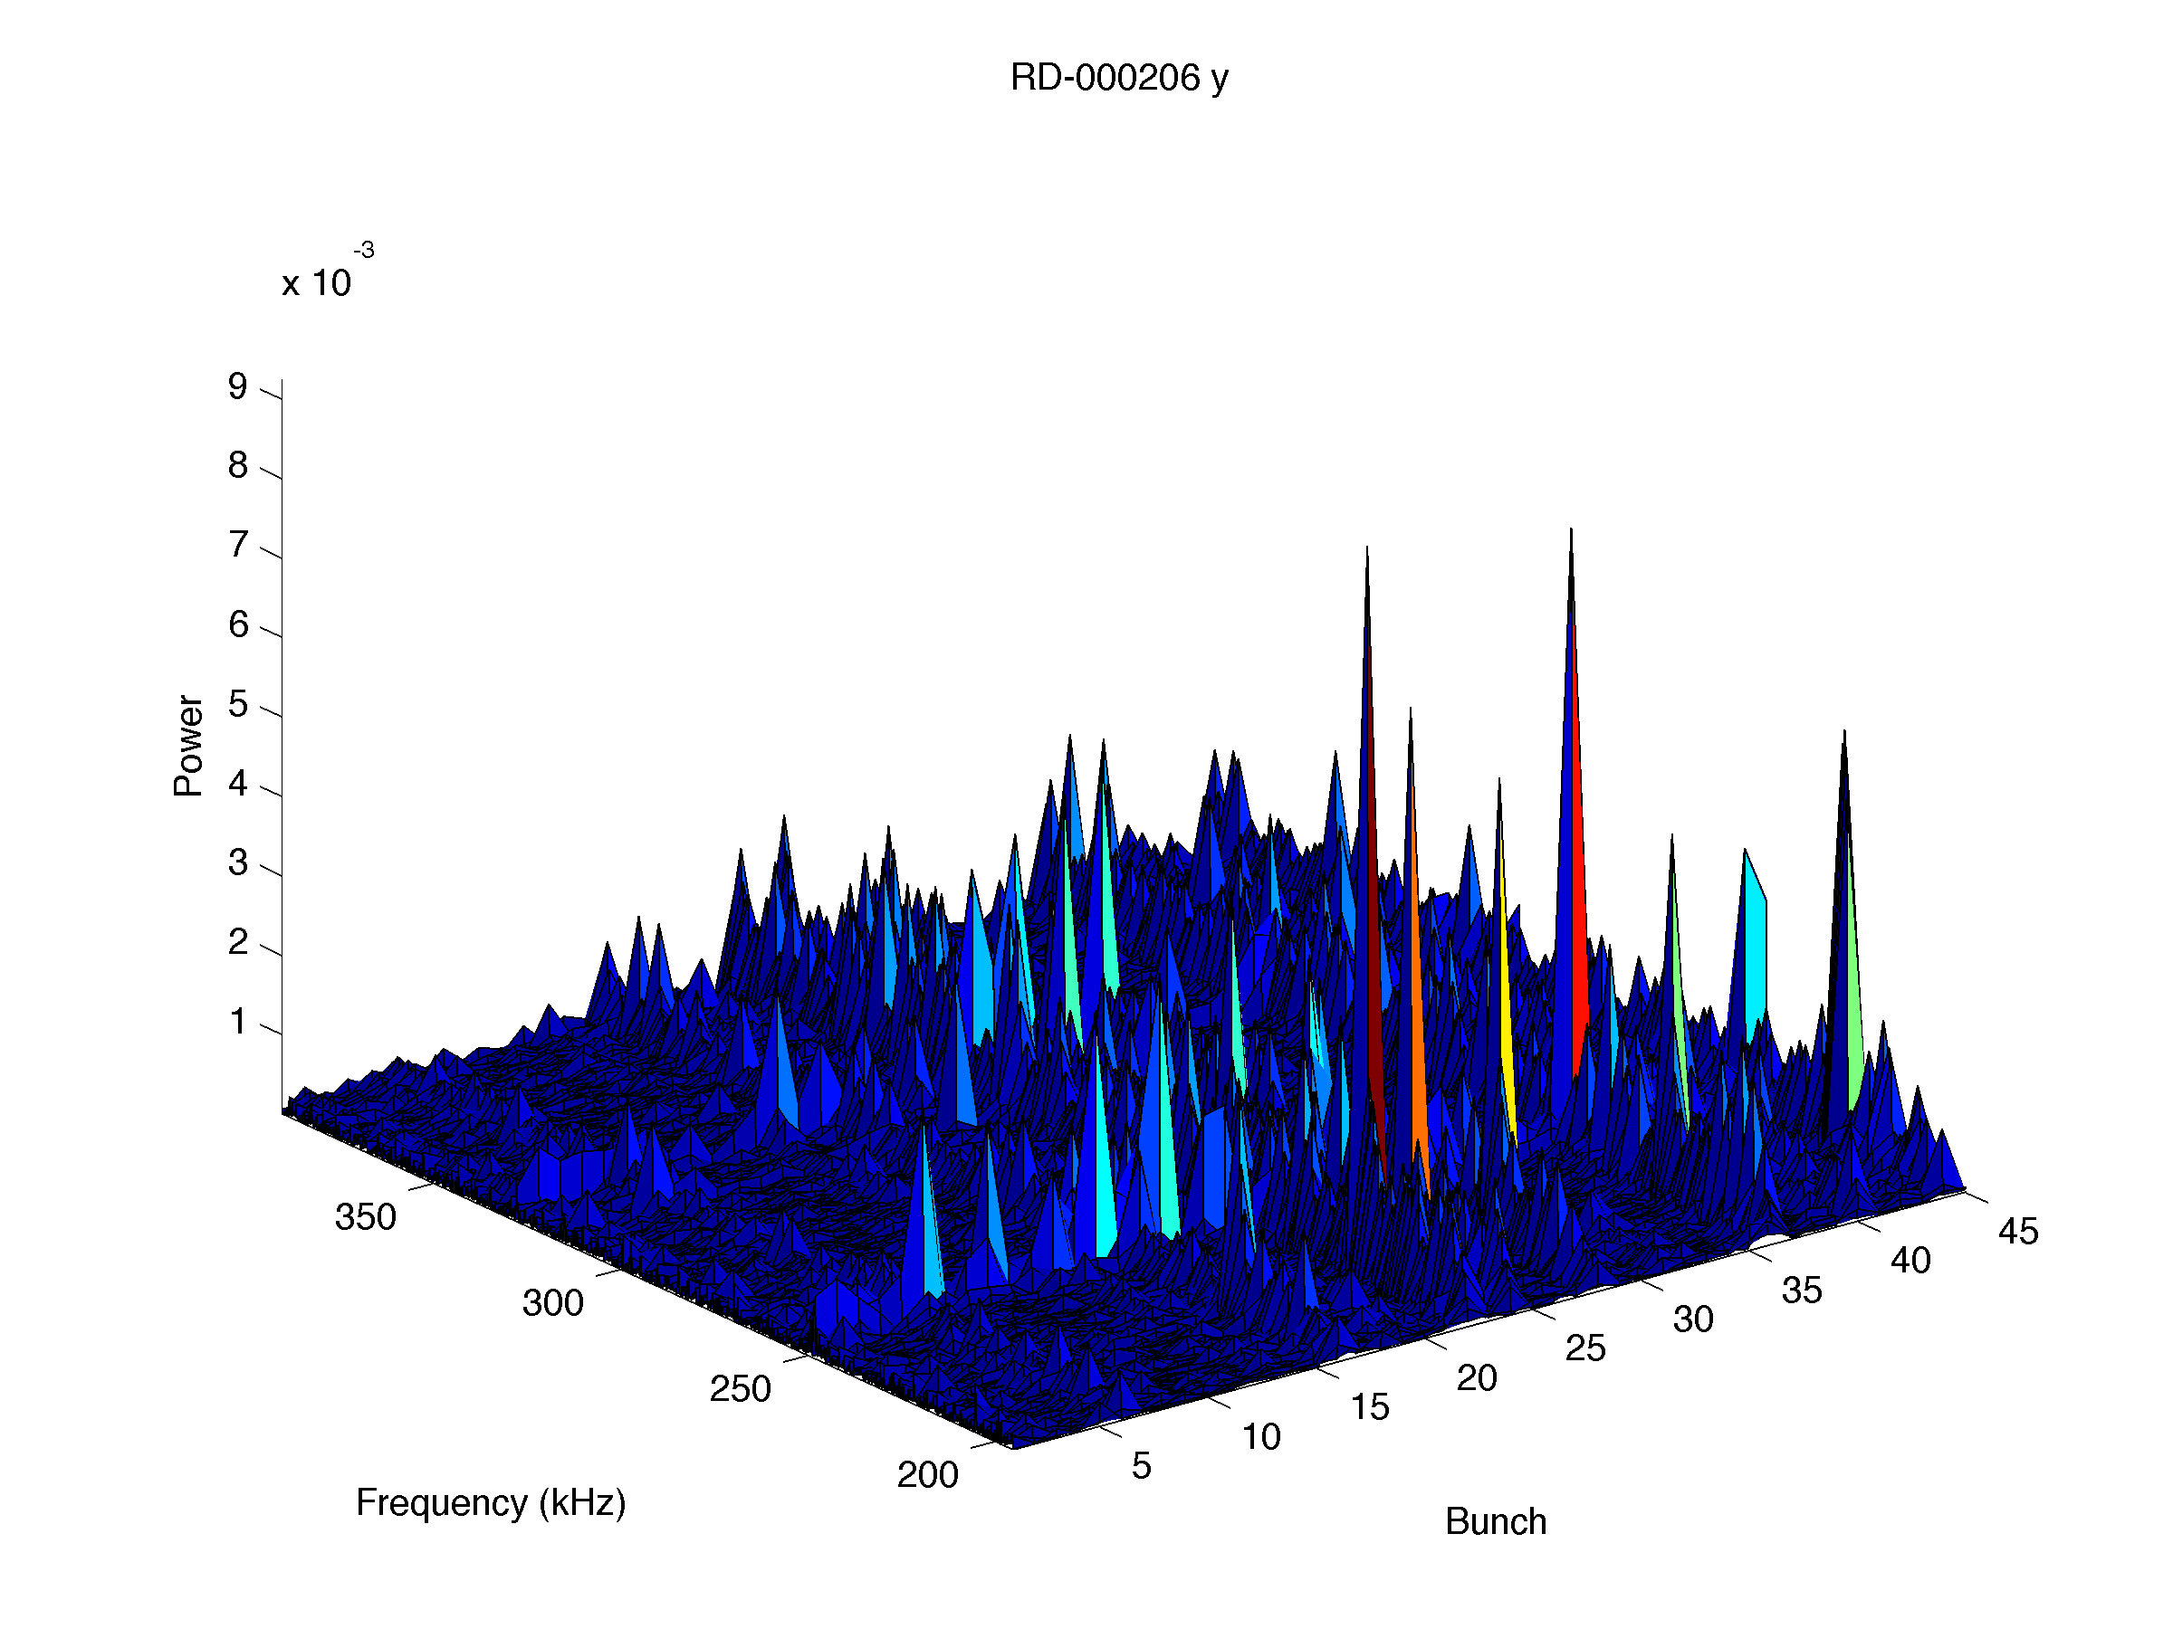
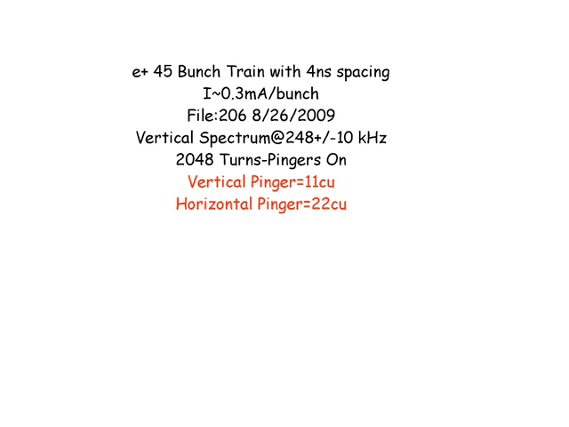
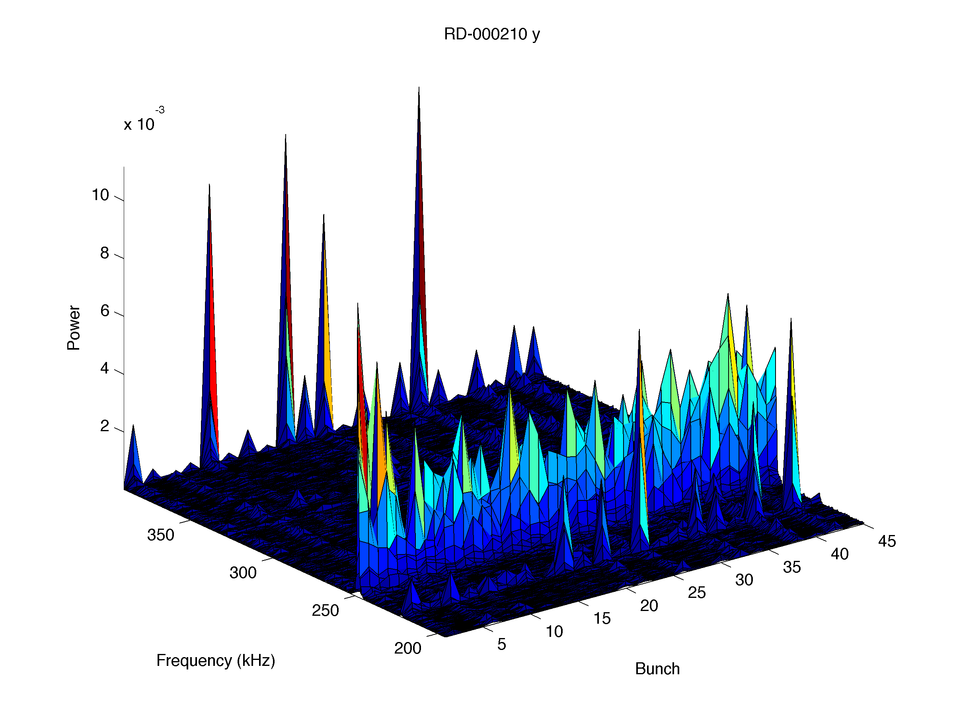
Vertical Motion with a 4-ns spaced 45 bunch e+ train when the bunches are horizontally/vertically pinged.
I~0.3mA/bunch.
Increased the vertical pinger amplitude in two steps (11 and 27cu).
FFT peak signal is hard to detect with the pinger at 11cu. Acceptable pinger amplitudes are 27cu (vertical) and 268cu (horizontal).
FFT@11cu pinger amplitude
Movies
FFT@27cu pinger amplitude

Slide 7
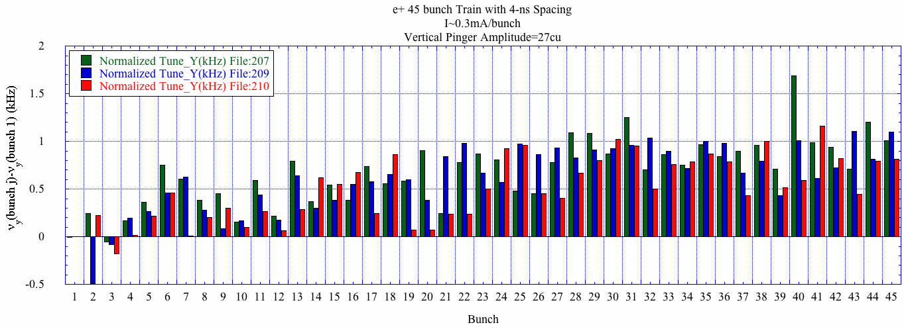
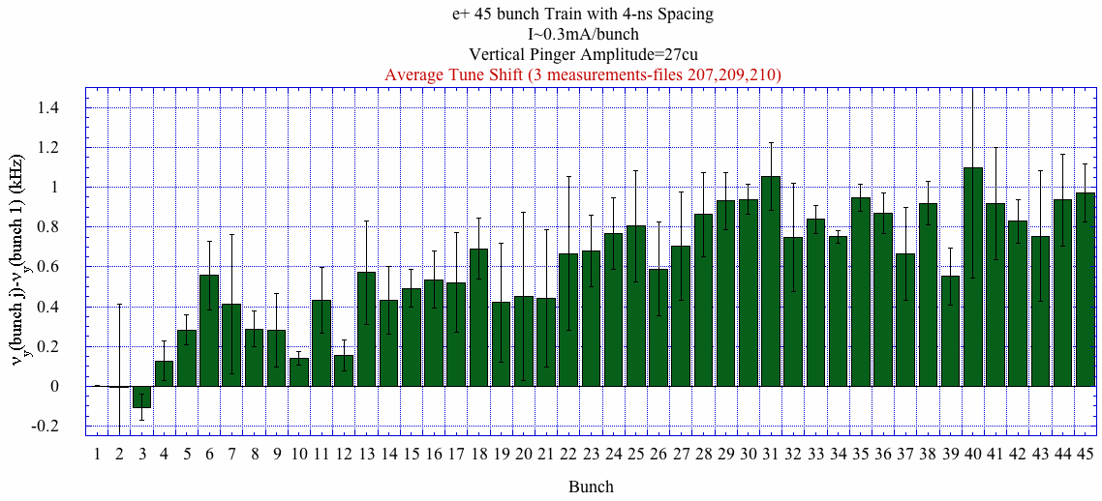
Single shot vertical tune shift
Average vertical tune shift
The pingers causes the whole train of bunches to oscillate coherently which gives a different tune shift than is a single bunch is oscillating (especially in the horizontal plane). The Dimtel feedback system has the capability to excite a single bunch so we can measure the tune of singe bunches along the train.

Slide 8
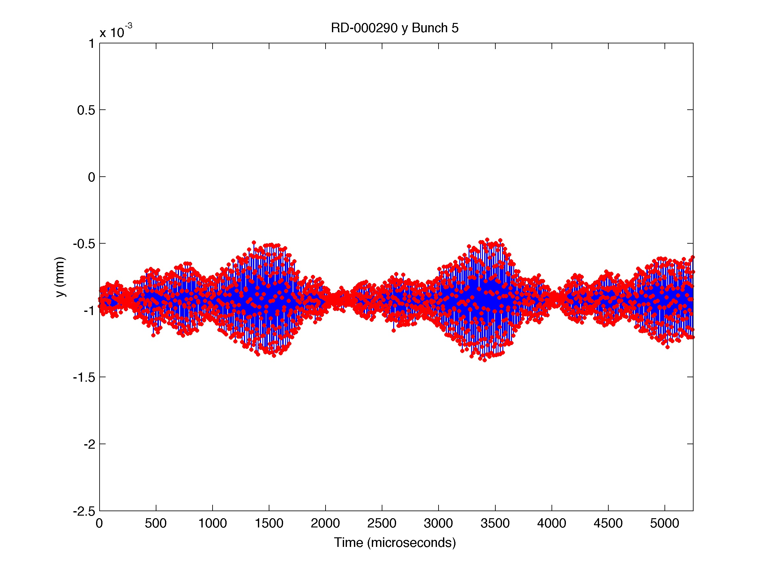
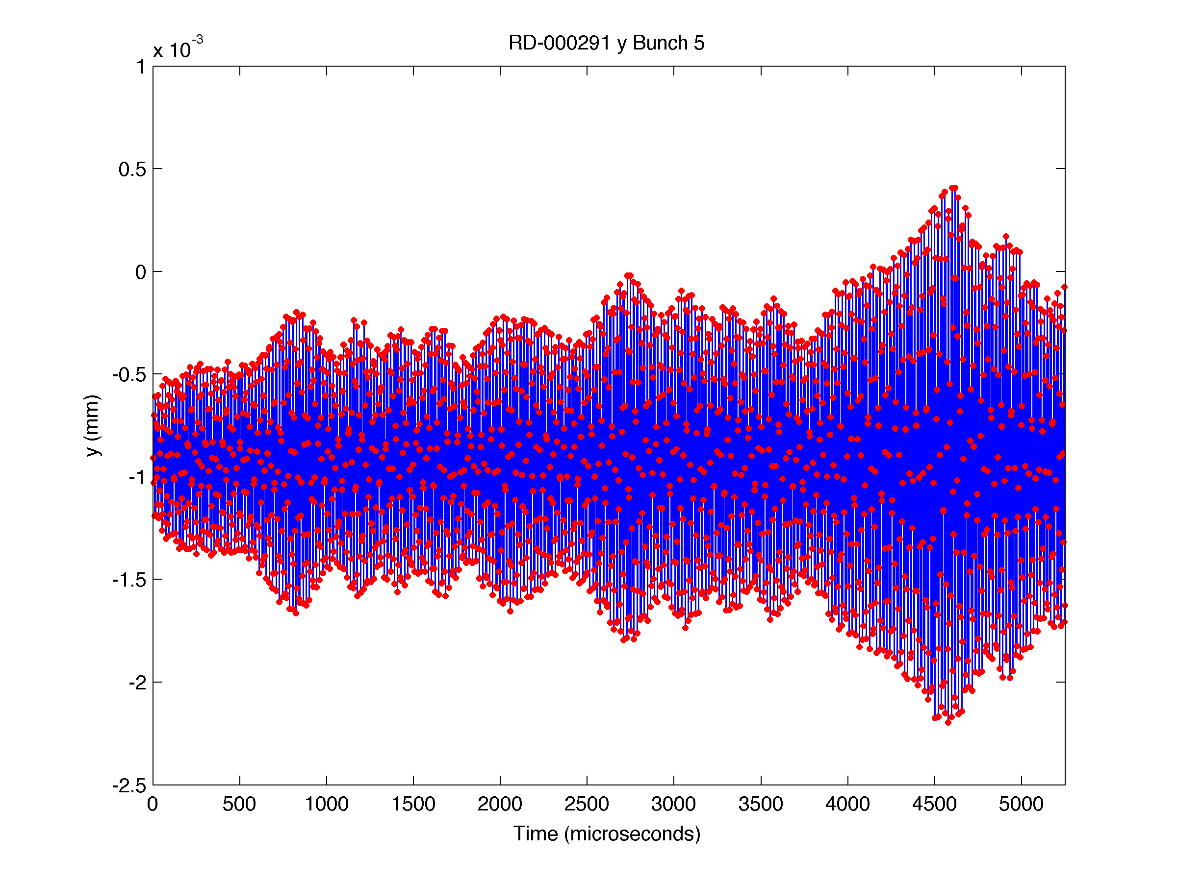
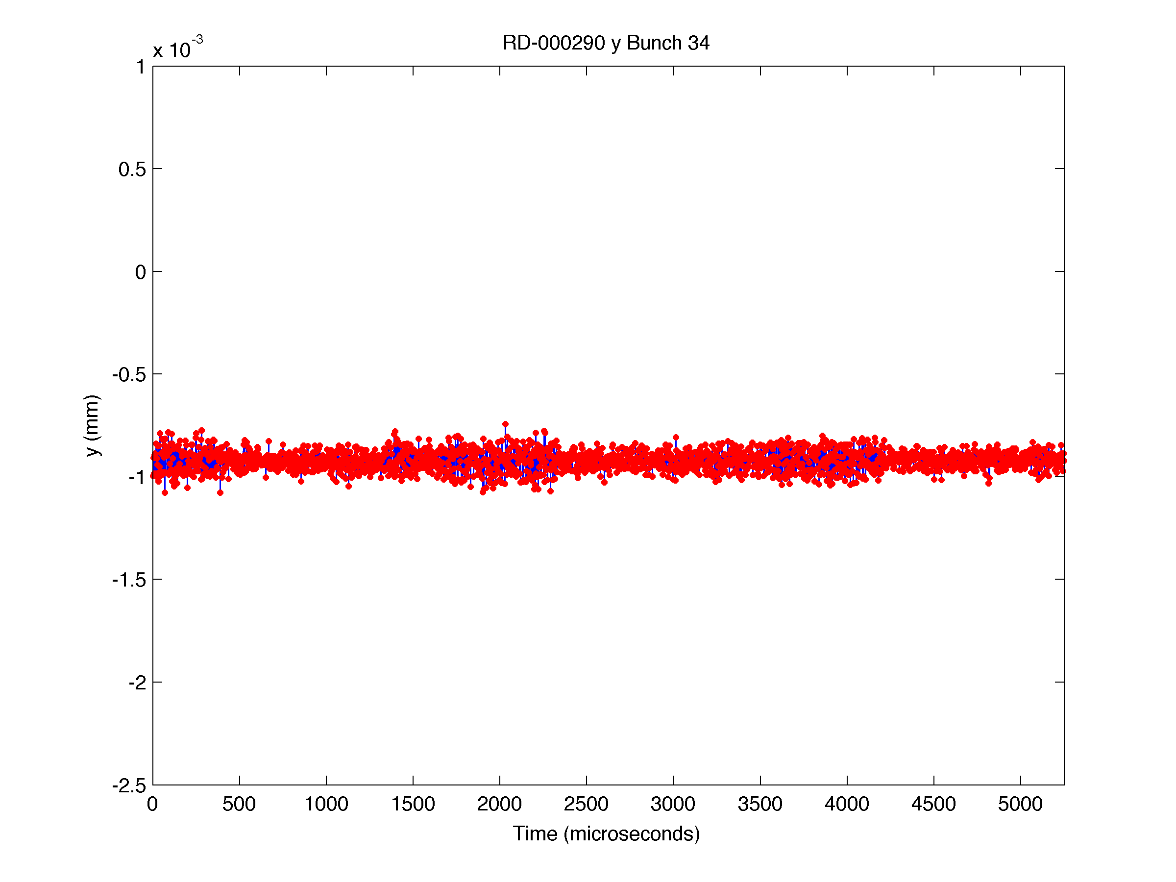
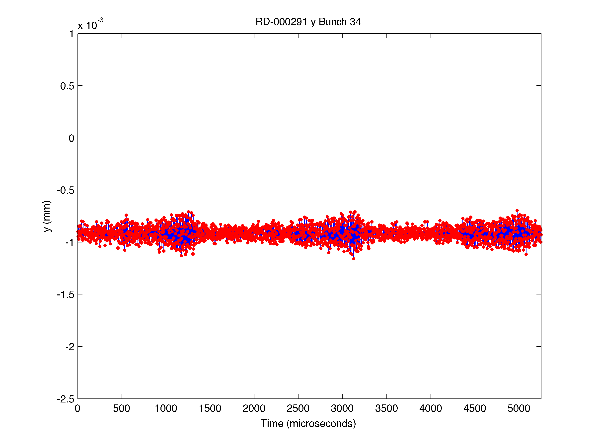
3. Motion detection with excitation from Dimtel feedback system
Vertical Motion with 4-ns spaced 37 bunch e+ train when all 37 bunches are vertically excited using the Dimtel feedback system.
I~1mA/bunch. Excited the train at center freq. of 220kHz, with a sweep span of 10kHz, and period of 2ms at two different drive amplitudes (0.5 and 1). Took 2048 turns of data (>2 periods).
Several excitations are evident over the 5.25ms orbit sample. The excitation amplitude decreases over the train.
Bunch 8, Amp=1
Bunch 8, Amp=0.5
Bunch 37, Amp=1
Bunch 37, Amp=0.5

Slide 9
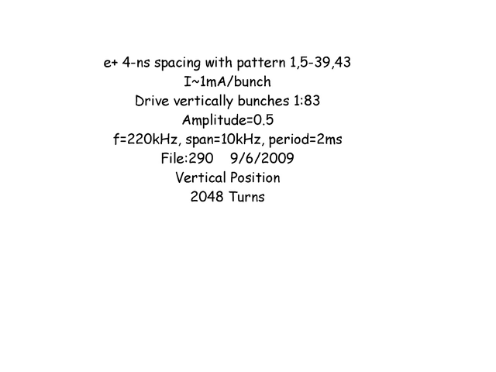
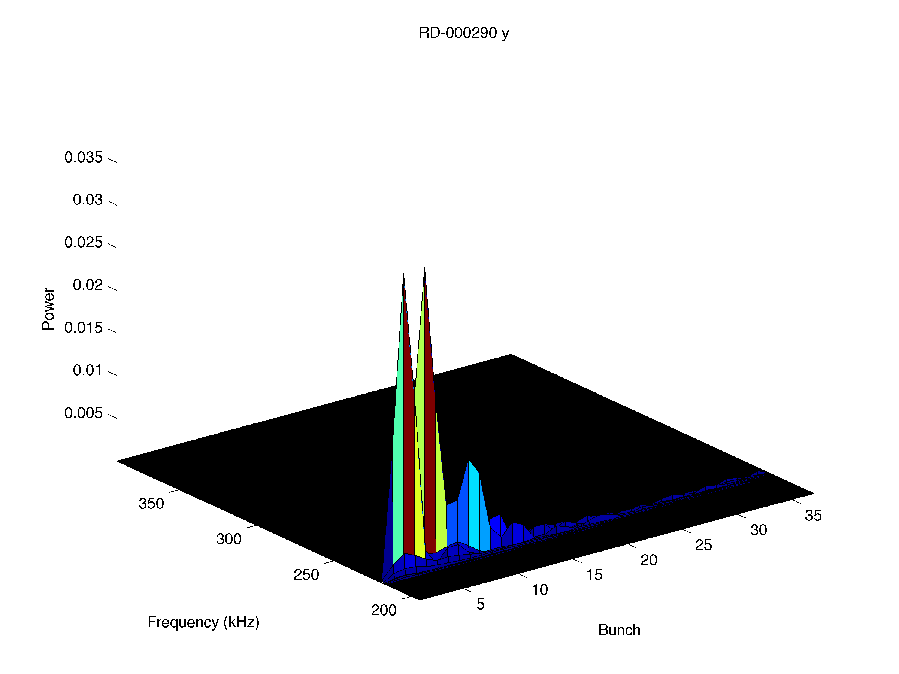
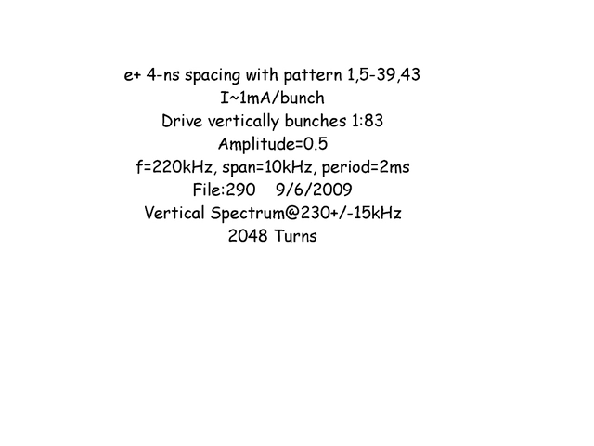
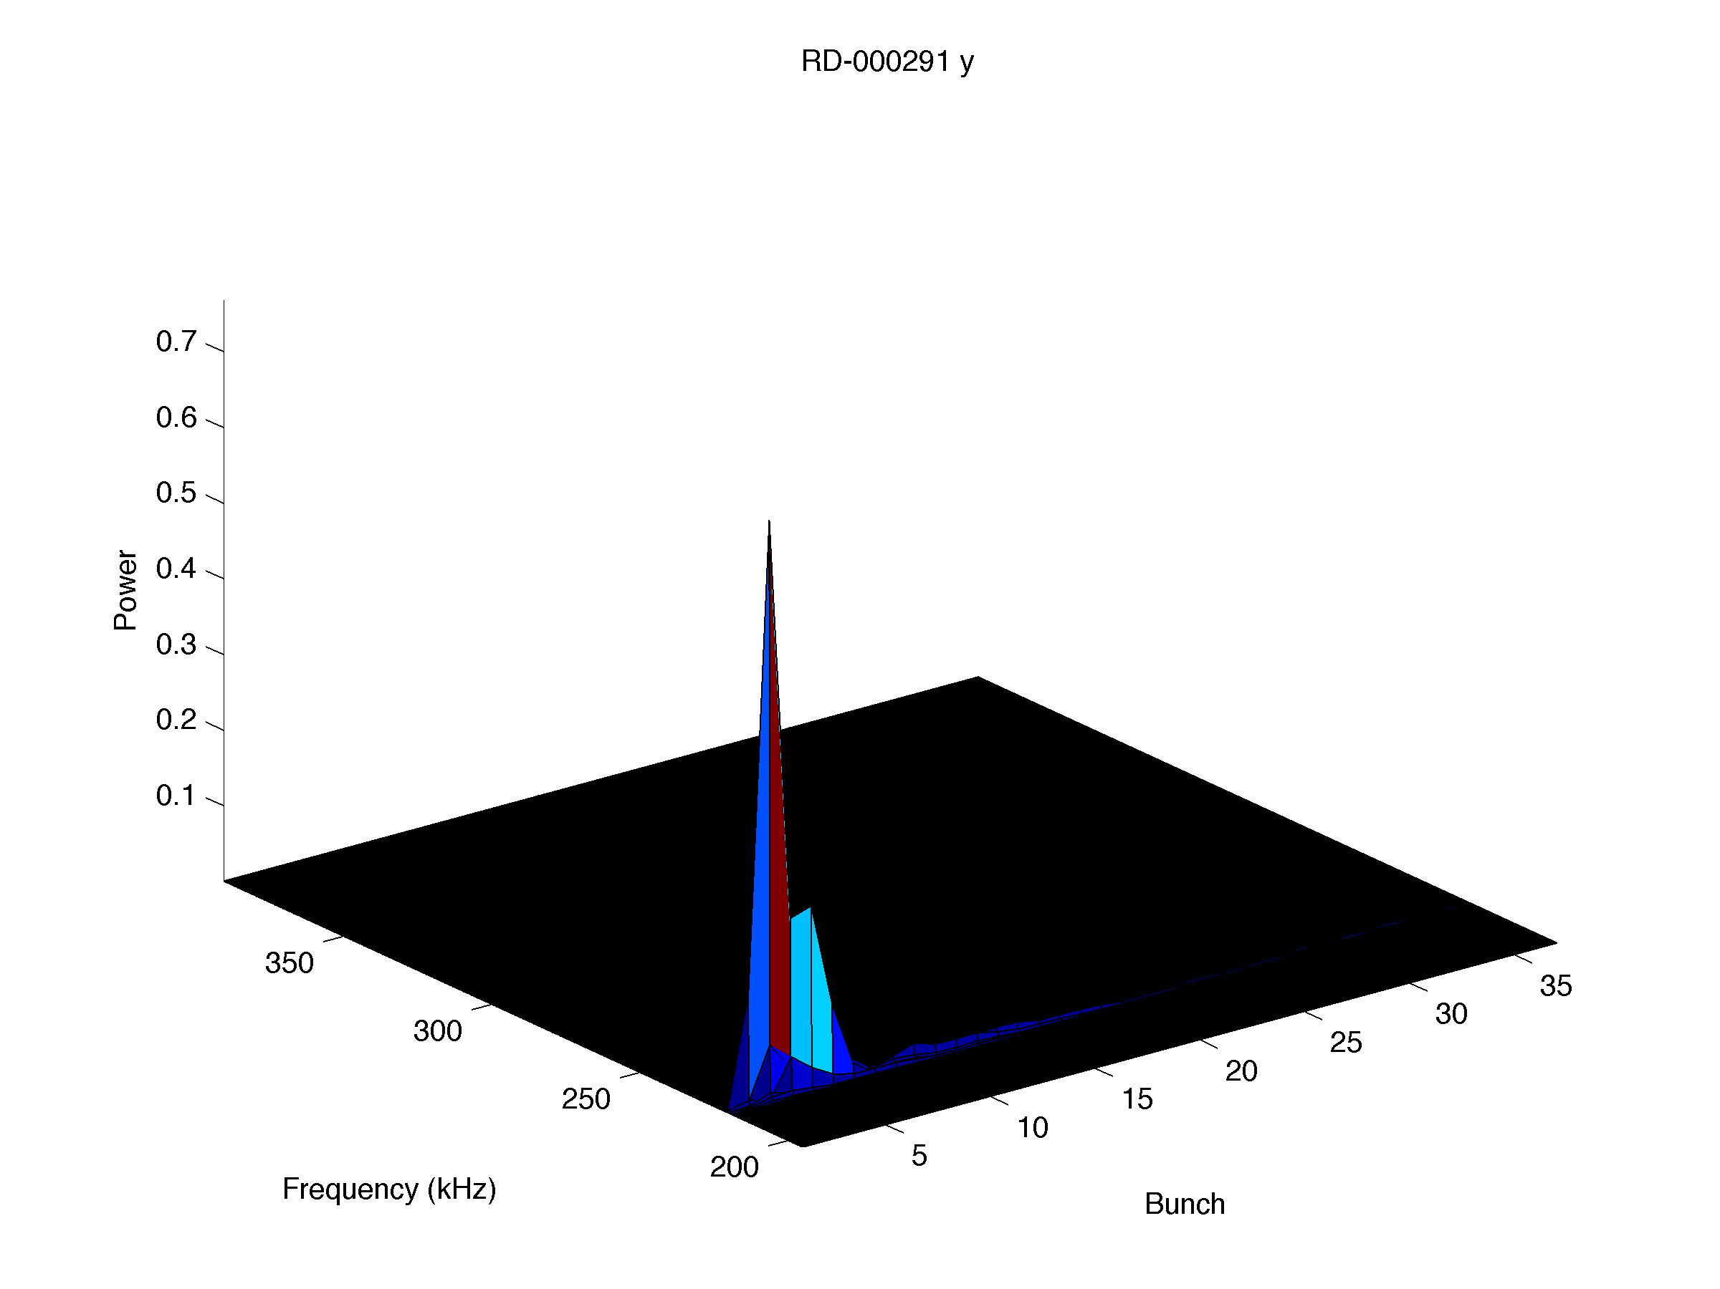
Noticed that the beam lifetime did not change while driving the beam.
Three BPM’s took data (8AW, 47AE, and 12W3). Only one BPM (12W3) was working properly.
A strong signal was detected in the vertical spectrum that certainly changed with amplitude. The signal is strong for bunches at the front of the train and dies out along the train.
In addition, a strong signal is also detected in the horizontal plane most likely due to coupling (not shown).
Amp=0.5
Movies of position and beam spectrum with an amplitude of 0.5 and 1.
Amp=1

Slide 10
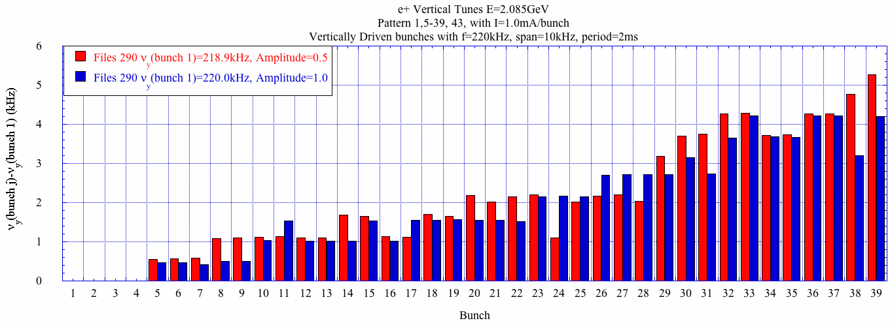
Single shot vertical tune shift along the train. A vertically tune shift of ~5kHz along the train with I~1mA/bunch.

Slide 11
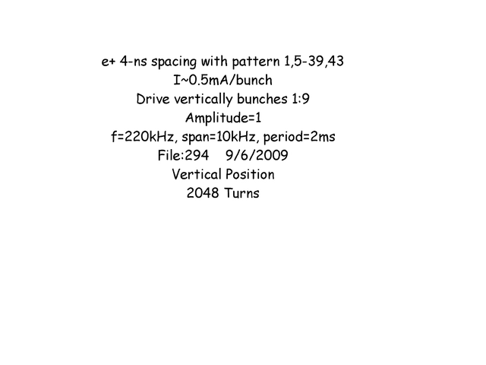
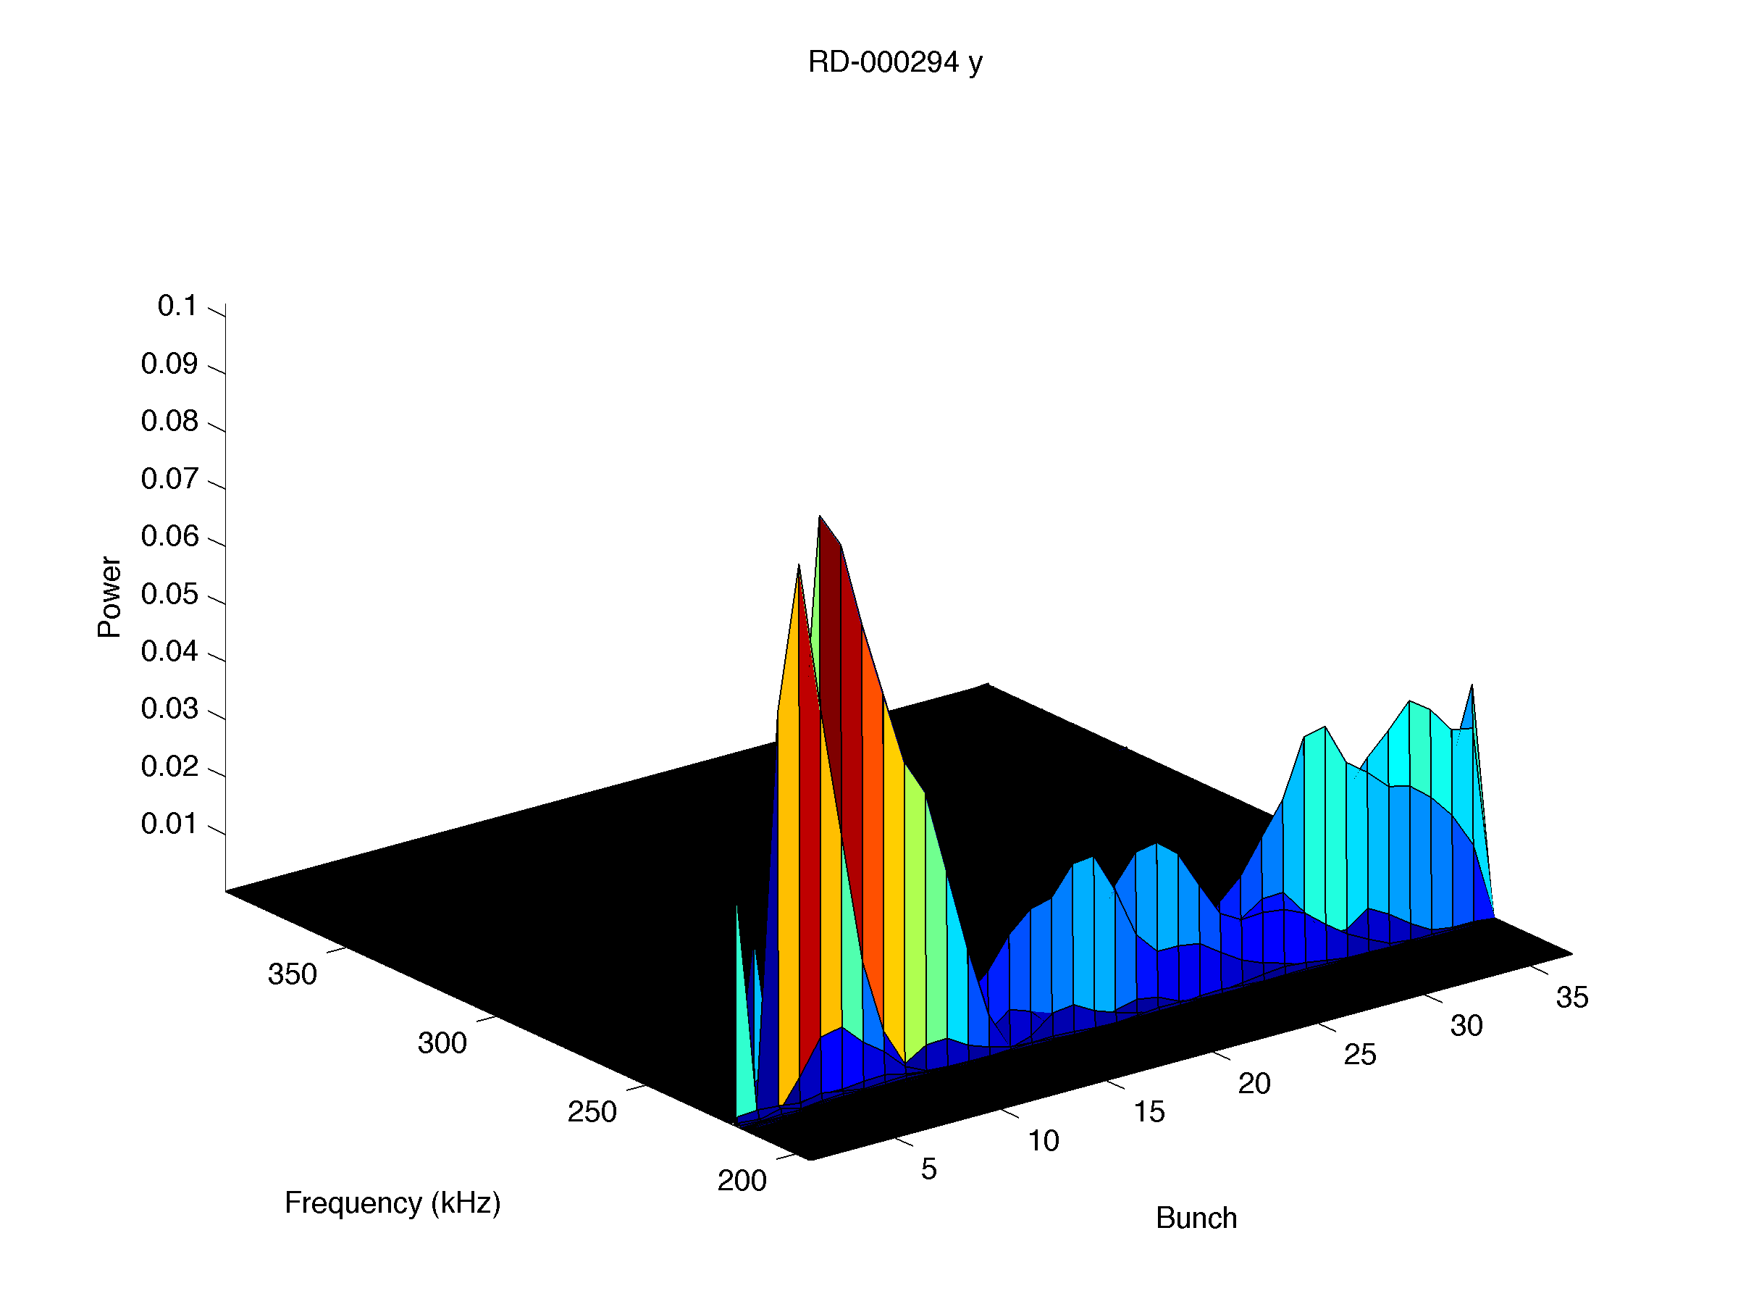
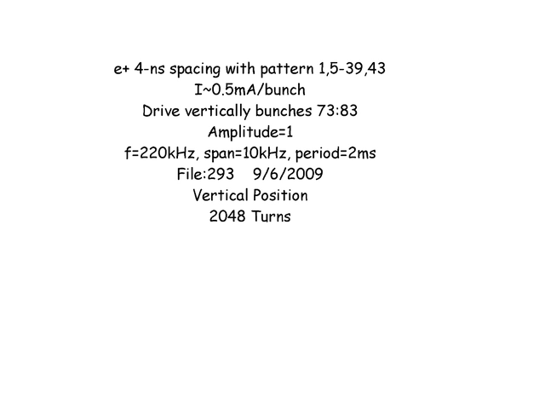
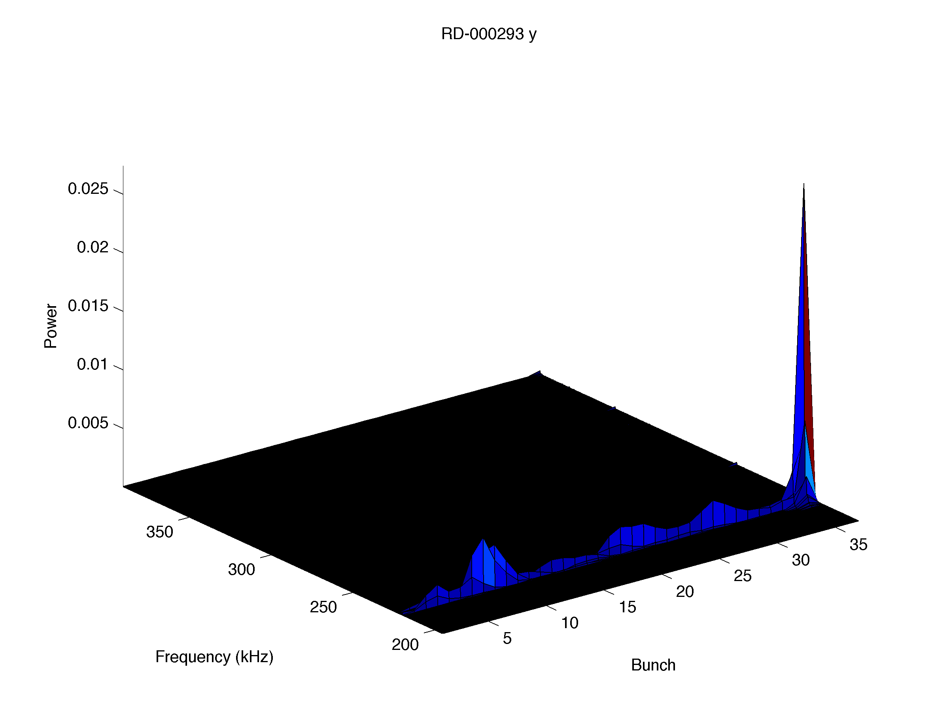
Vertical excited front/back of a 4-ns spaced 37 bunch e+ train using the Dimtel feedback system.
I~0.5mA/bunch. Excited front/back of train at center freq. of 220kHz, with a sweep span of 10kHz, and period of 2ms at two different drive amplitudes (0.5 and 1). Took 2048 turns of data (>2 periods).
When bunches 37-42 are excited (Dimtel bunches 73:83 in the 2-ns world) vertically only bunches 37-38 are excited (bunch 38 has a much higher amplitude than bunch 37). A strong horizontal oscillation is detected near the front of the train when this data was taken.
When only bunches 1 and 5 are excited vertically (Dimtel bunches 1:9) it is evident that bunches 1, 5-6 are driven and subsequent bunches are self excited. A large horizontal oscillation amplitude is also evident at the front of the train.
Movies
Amp=1, excite bunches 1,5-6.
Amp=1, excite bunches 37-42.

Slide 12
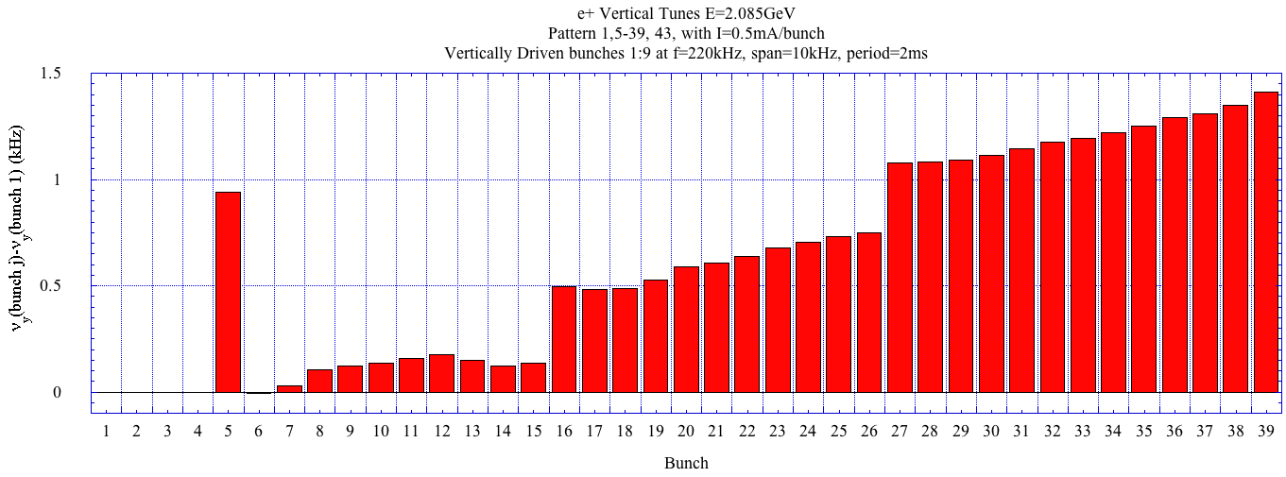
Comparing the tune at the front of the train (Q_{y}=220.1kHz-file #294) and the end of the train (Q_{y}=221.5kHz-file #293) gives a vertical tune shift of ~1.4kHz with I~0.5mA/bunch. The tune shift across the train is also be determined to be 1.4kHz from the data when the front of the bunch is shaken.

Slide 13

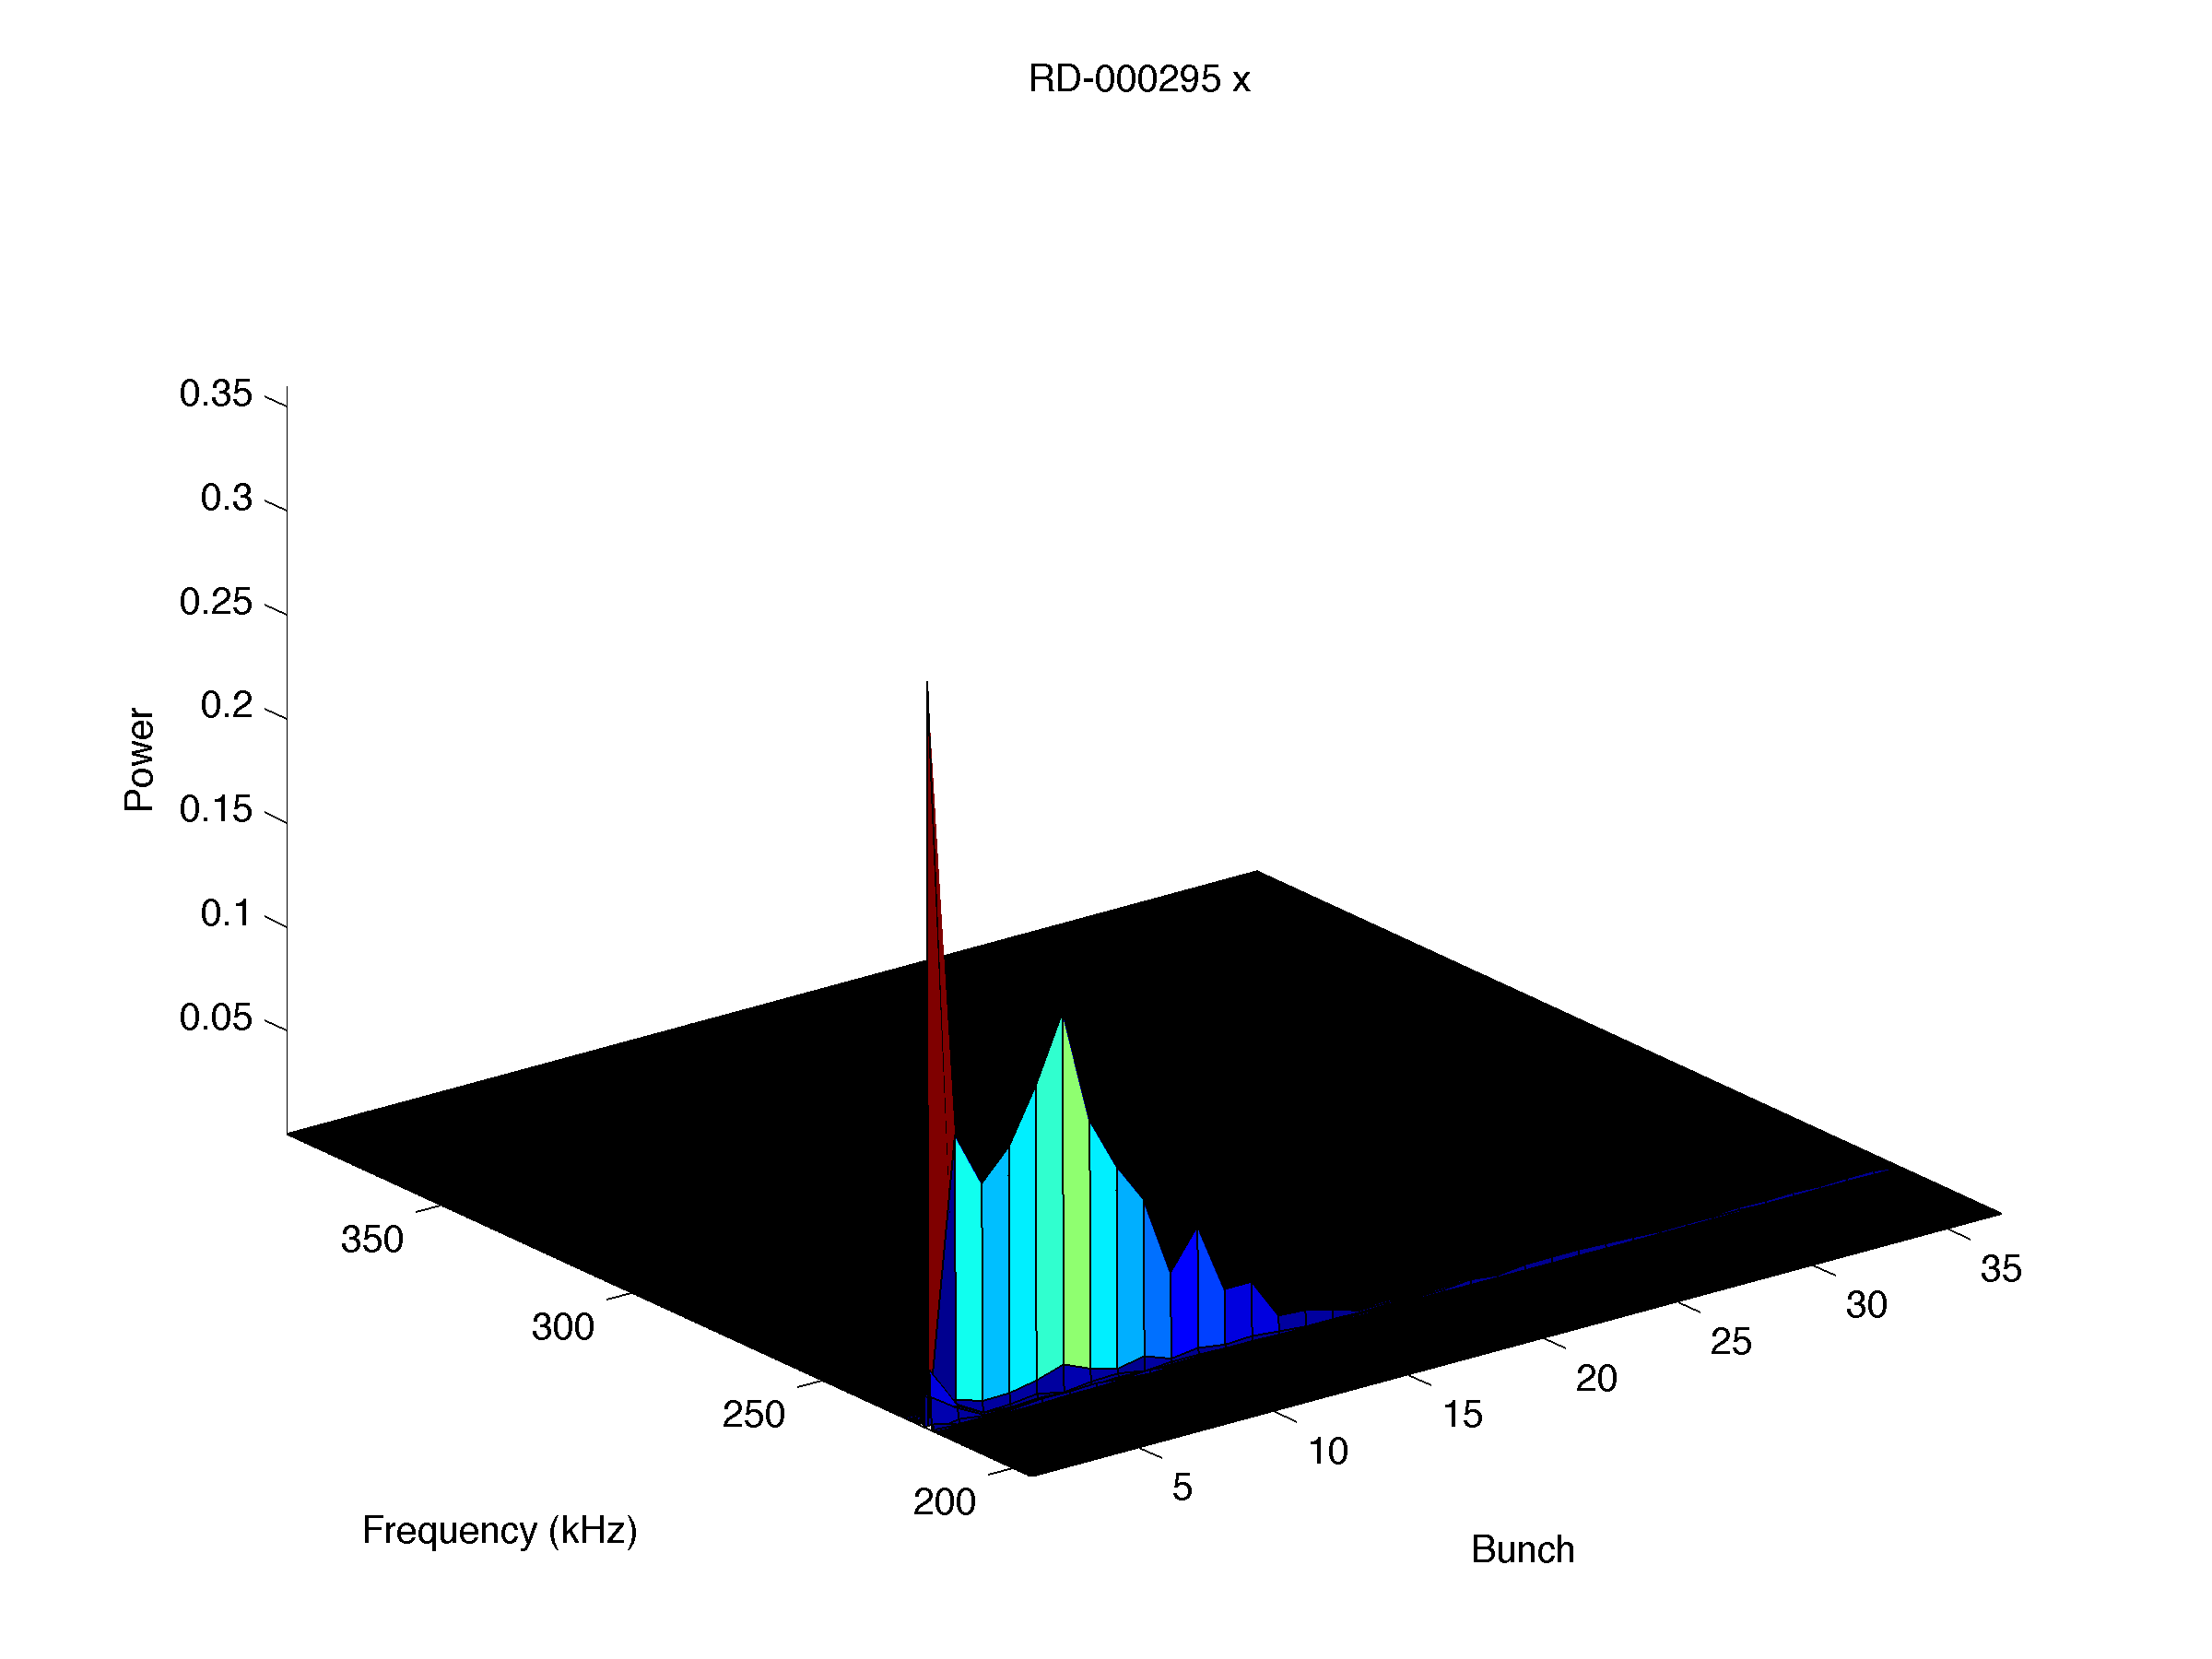
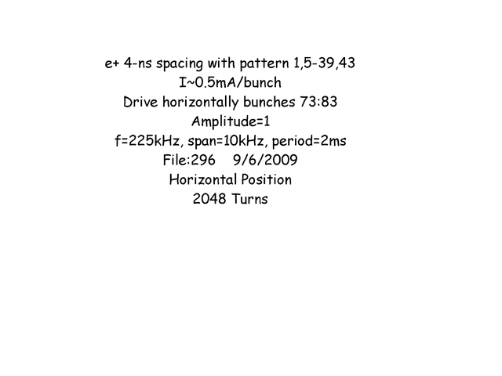
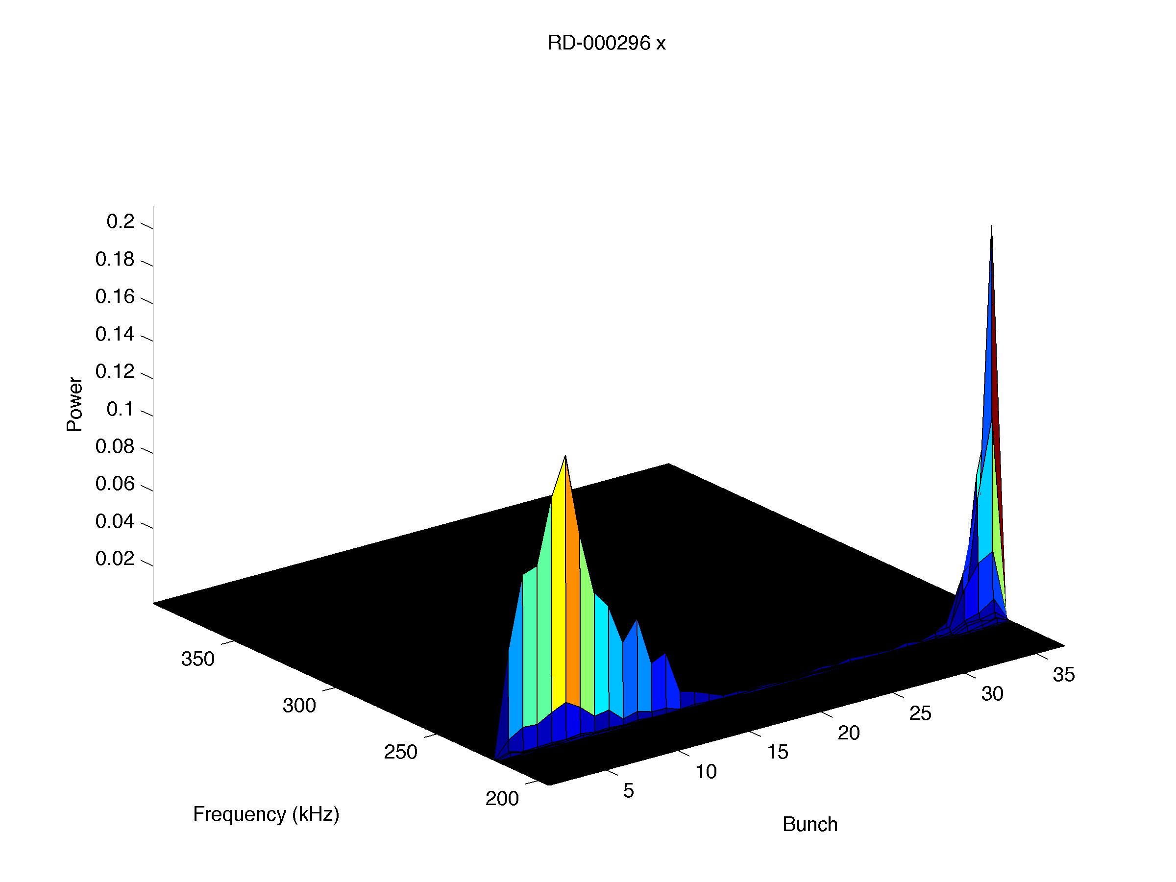
Horizontally excited front/back of 4-ns spaced 37 bunch e+ train using the Dimtel feedback system.
I~0.5mA/bunch. Excited front/back of train at center freq. of 225kHz, with a sweep span of 10kHz, and period of 2ms at two different drive amplitudes (0.5 and 1). Took 2048 turns of data (>2 periods).
The horizontal spectrum displays the excitation at the front and tail of the train.
Comparing the horizontal tune at the front of the train (Qx=222.2) and the end of the train (Qx=224.0kHz) which gives a horizontal tune shift of ~1.8kHz (looks promising compared to pinged method)
Movies
Amp=1, excite bunches 1,5-6.
Amp=1, excite bunches 37-42.

Slide 14
Summary
The 4-ns BPM data analysis software is operational.
Single bunch orbit data taking using the digital BPM system for 4-ns spaced bunches is working. The following upgrades/fixes will help taking tune data in the future:
- When taking BPM data for more than 2048 turns, large oscillations and large offset between even and odd bunches is present.
- Determine if the jumps in the orbit are real.
- BPM system limits data files to 135 bunches at one time.
-Update the BPM data acquisition to make consecutive measurements (up to 10).
The vertical tune shift along the train can be determined by exciting the 4-ns bunches with the pinger and FFT the vertical orbit. The horizontal tune cannot be determined due to the coherently oscillation of the train.
Preliminary studies using the Dimtel feedback system to excite single bunches in the train to determine their single bunch tune looks promising and should be pursued in the future. Further studies of this method should include:
-Comparing the vertical tune shift measurements with pinger and Dimtel for consistency check.
-Do a detailed measurement of the horizontal tune by single bunch excitation and compare with simulation.
-Automate the bunch selection for the Dimtel so it steps through the train while taking BPM data (concerned about amount of data and acquisition time).

