Slide 1
Dipole Corrector for CBETA-FFAG
Eddy current study

Slide 2
Why this study:
The rate of measurements of the BPM’s is 10 Hz.
Assuming the same rate of 10 Hz in orbit correction
What is the effect on the magnetic field and the Voltage increase required by the Power Supply, due to Inductance of the magnet?
I assume the current of the corrector varies in a cosine manner by ±10%I_{max} with f=10 Hz.
Examine the Steady State

Slide 3
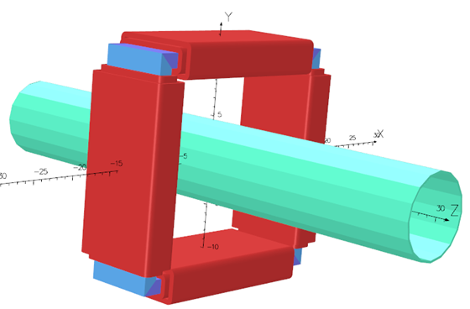
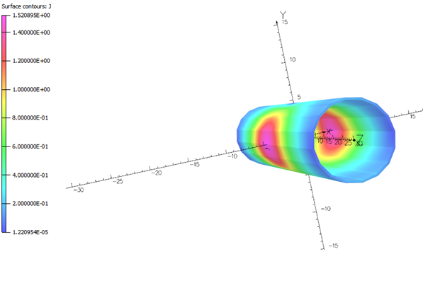
3D model
Current amplitude = 10%I_{max} with frequency=10 Hz
σ_{iron}=0.75x10⁵ Siemens/cm
σ_{Al} = 2.50x10⁵ Siemens/cm

Slide 4
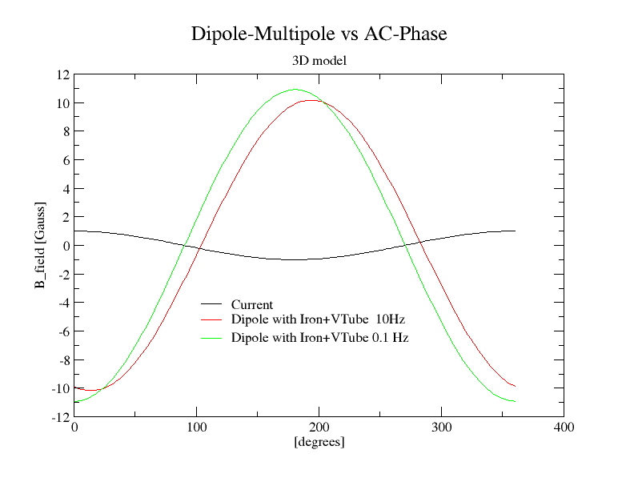
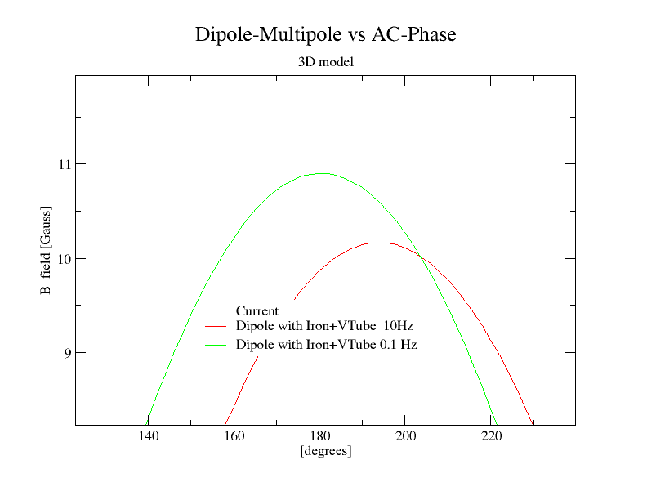

Slide 5
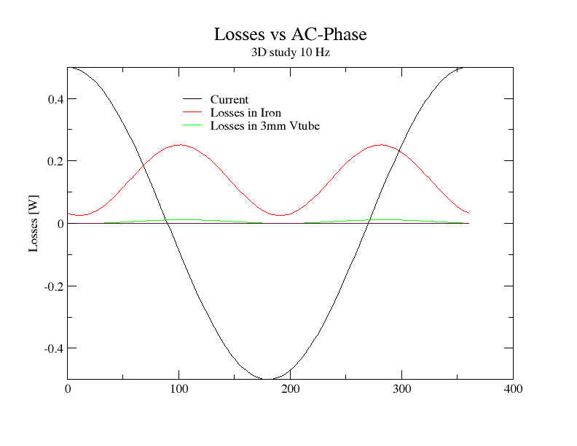

Slide 6
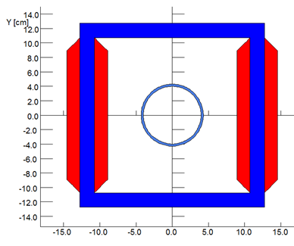
Iron σ=0.75x10⁷ Simmens/m
3 mm Al σ=2.5x10⁷ Simmens/m

Slide 7
I=2.3 A
B_{int}=3000 Gauss.cm
W=1.9 J
I=0.23 A
B_{int}=300 Gauss.cm
W=0.016 J
The maximum current is 2.30 A
L=(2*W)/(I²)=0.6 H
If we want to vary the current by 10%X2.2A=0.2 A in 0.05 sec
Or equivalently vary field by 300 Gauss.cm in 0.05 sec
The Voltage required is: V=L(dI/dt)+I*R=2.4+I*R

Slide 8
Measure Resistance and Inductance of the Corrector Dipoles

Slide 9
The End

Slide 10
Iron σ=0.75x10⁷ Simmens/m
3 mm Al σ=2.5x10⁷ Simmens/m

Slide 11
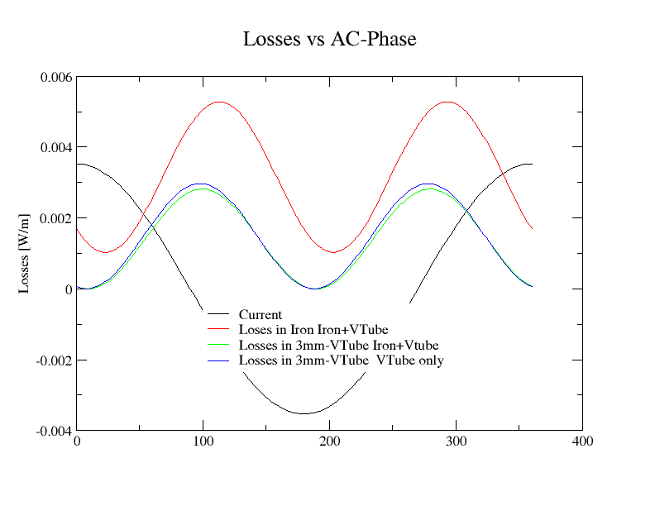
F=10 Hz cosine

Slide 12
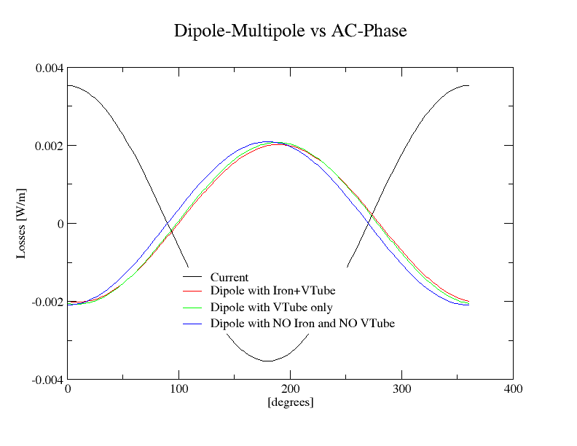
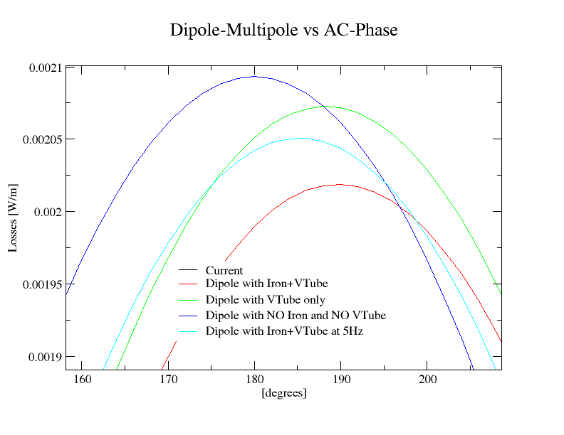
Radius R=2.5 cm
Dipole Multipole [Gauss]
Dipole Multipole [Gauss]

Slide 13
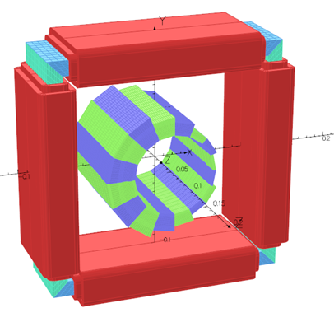
I=2.3 A
The maximum current is 2.30 A
W=1.9 J
L=(2*W)/(I²)=0.72 H
If we want to vary the current by 0.2 A in 0.1 sec
Or equivalently vary field by 3000 Gauss.cm in 0.1 sec
The Voltage required is: V=L(dI/dt)+I*R=1.44+I*R
488 turns
485 turns
The Eddy currents generated in the iron core and the wall
of the vacuum will be calculated.

Slide 14
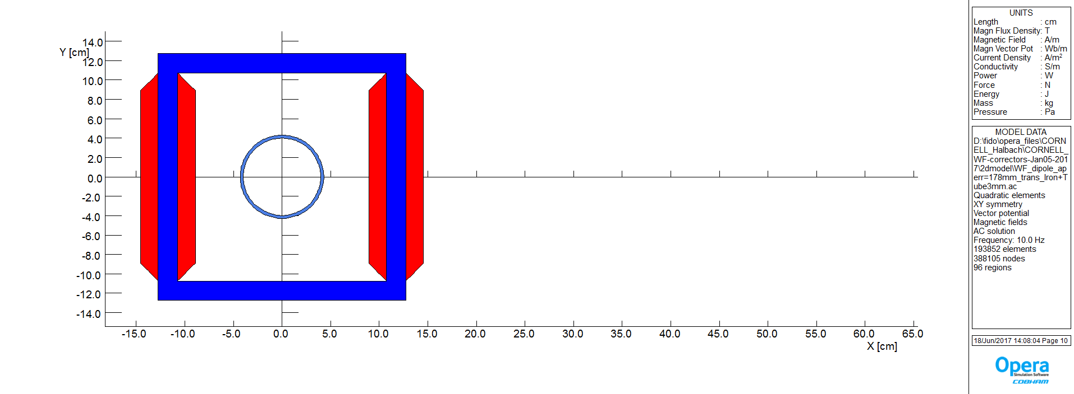

Slide 15
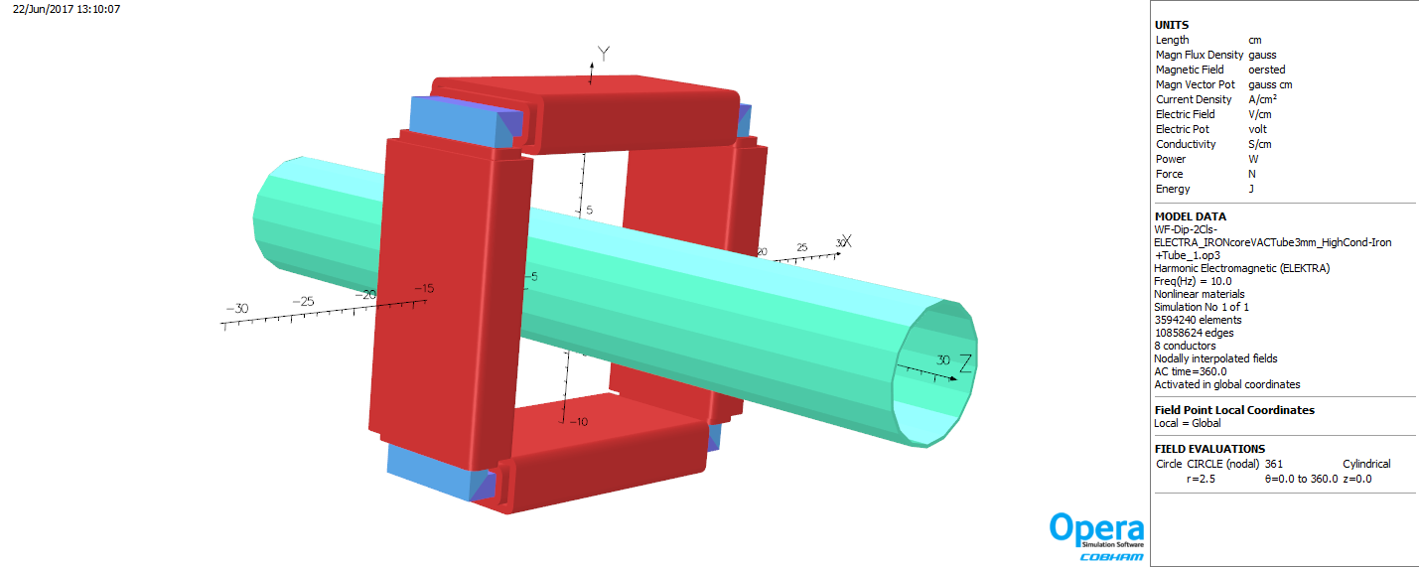
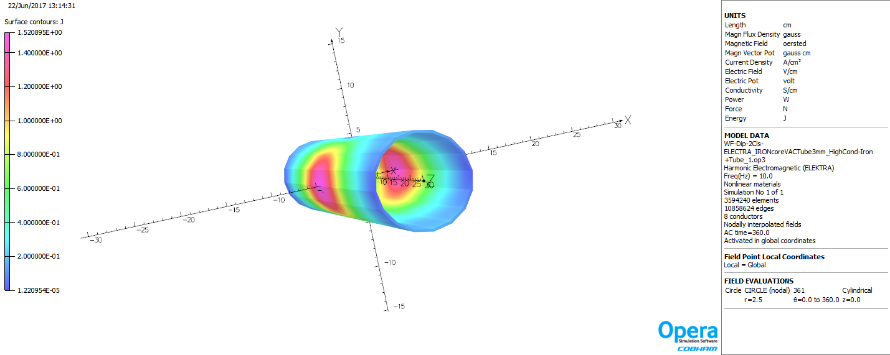
3D model

