Slide 1

BNL Technical Update
Oversight Board Meeting
October 3, 2017
Rob Michnoff

Slide 2
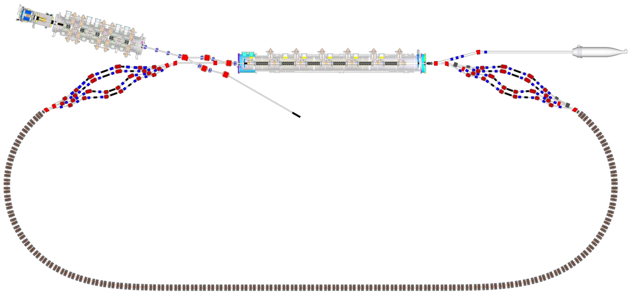

CBETA Machine Layout
Injector cryomodule
Electron source
Main linac cryomodule
LA
DU
Dump
Merger
IN
Splitter B
DI
Diagnostic line
Splitter A
RX
SX
FFAG
arc B
FFAG
arc A
FB
FA
FFAG
Transition B
FFAG
Transition A
TB
ZB
FFAG straight
ZA
TA

Slide 3
Recent progress
FFAG Halbach Permanent Material ordered
  Unfortunately cost is significantly higher than anticipated due to dramatic price increase of magnetic material
Bids received 9/25 for Assembly of Halbach magnets
  6 received, pricing is in ballpark of estimate
Statement of work for corrector coils is complete and bid preparation is underway
Drawings for FFAG girder plates is in progress

Slide 4
Milestone 5 – Test production FFAG magnets
Plan for completing by December 31, 2017
Assumption: the intention of this milestone is to test 1 production Halbach magnet
BNL will assemble the half length BDH Halbach magnet that is required for the fractional arc test and this will be called the 1st production magnet
  Major challenge: permanent magnet material is not expected to be received until mid-December 2017, which leaves very little time to assemble and test the magnet

Slide 5
Issues / Concerns
Satisfying milestone 5 by the 12/31/2017 deadline will be challenging
Project schedule still needs work in order to align sub-milestone dates with contract milestone dates
  Many finish dates in the schedule are later than what is actually required
FFAG Halbach magnet assembly schedule spans 11 months, bringing delivery of the last batch to October 2018 assuming that the order is placed by late October.
  This is about 3-4 months later than hoped
  Any vendor delays will be problematic
  Alternatives need to be considered

Slide 6
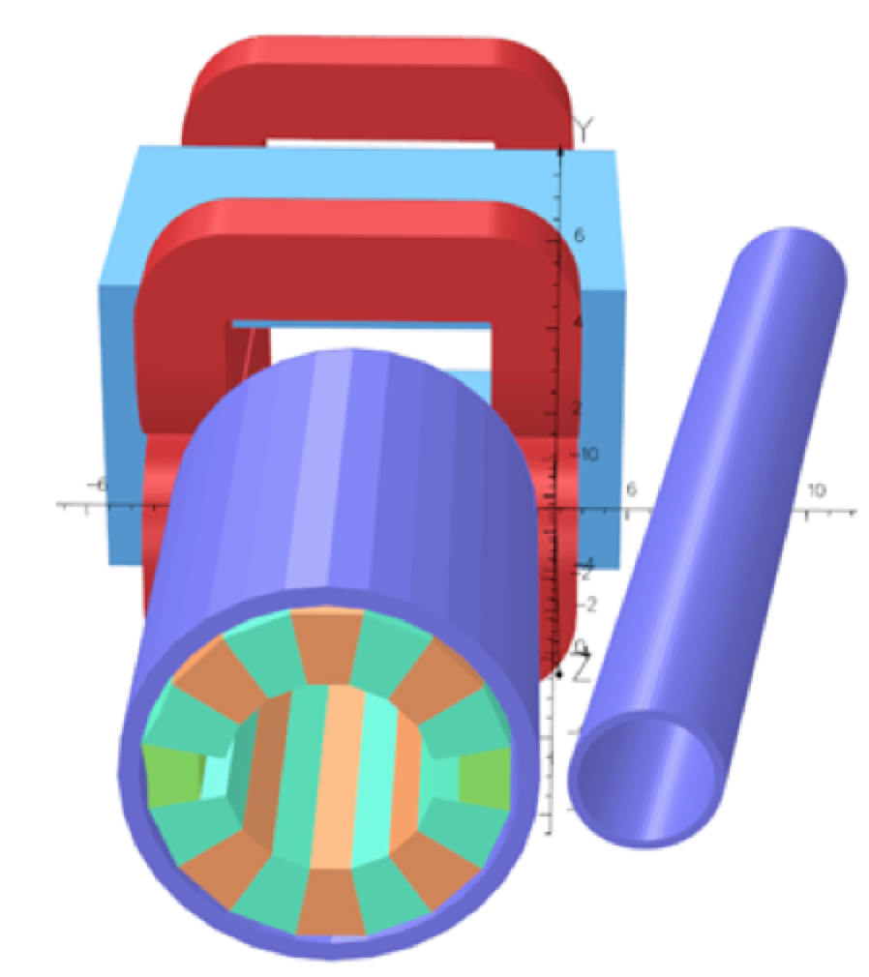
Issues / Concerns
Septum Magnets
BNL is responsible for designing one of the 2 types of Septum magnets (qty required: 4)
  Required for testing in about 10 months
  The general physics design is complete but the engineering and design work has not yet begun
Image of splitter line 4 septum magnet, combining a Halbach magnet with an electromagnet (N. Tsoupas)

Slide 7
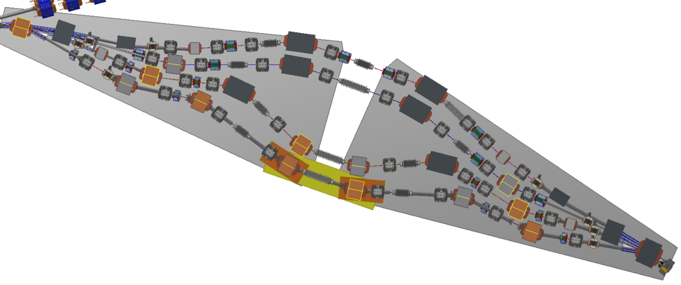
Location of Septum magnets in splitter lines
Septum magnets designed by Cornell
Septum magnets designed by BNL
(Image created by D. Burke, Cornell)

Slide 8
Issues / Concerns
The complete machine needs to be fully constructed by end of December 2018 in order to be prepared for one-pass beam tests beginning March 1, 2019.
  Completing all of the required work on schedule will be very challenging
    Timely (early) delivery of Halbach magnets and corrector magnets is critical
    2 Halbach magnets need to be measured and tuned per day for a period spanning about 6 months (215 magnets total)
      Need to determine how to make this happen
    One girder plate assembly needs to be completed each week for a period spanning about 6 months (24 girders)
      Need to determine how to make this happen

