Slide 1

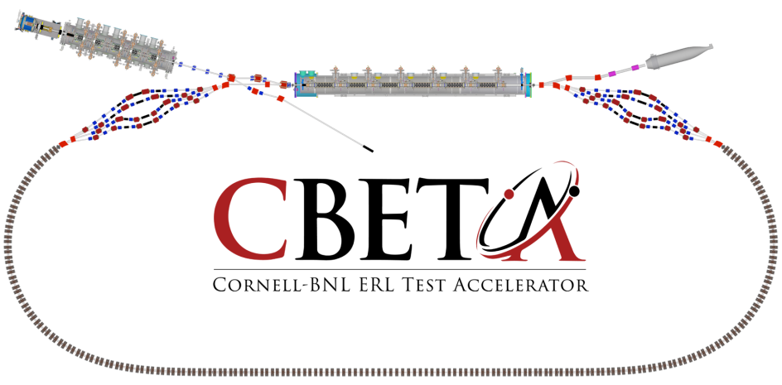
Page Headline
First Girder Status March 27,2017

Slide 2
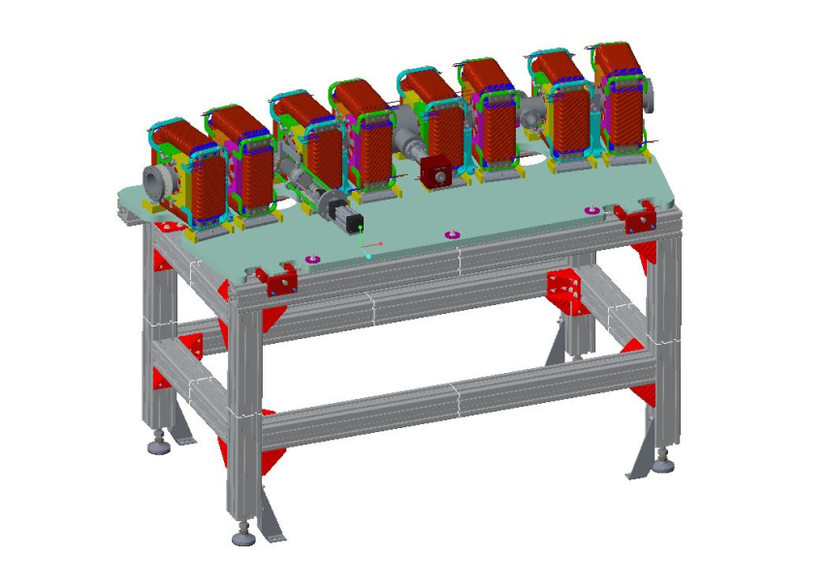
Outline
Completed components
Currently in progress
Out for procurement

Slide 3
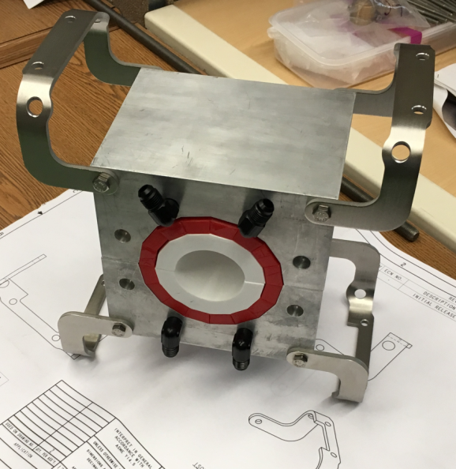
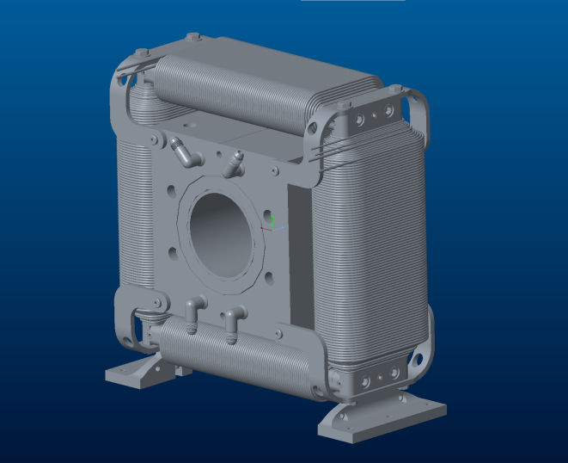
Completed Components
Physics Design
Engineering
Drafting / Drawing Package
Hallbach Supports Machined
Corrector Steel Machined
Bracketry Machined
Water Fittings

Slide 4

In Progress / Out for Procurement
In Progress
Vacuum Chamber
Aluminum Girder Top-plate
Corrector Coil Winding
Hallbach Assembly
Girder Assembly
Out for Procurement
Permanent Magnet Blocks
Extruded Aluminum Stand

