Slide 1
CBETA Vacuum System
For PM Arc - Interconnects
Yulin Li, CLASSE

Slide 2
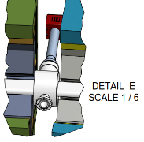
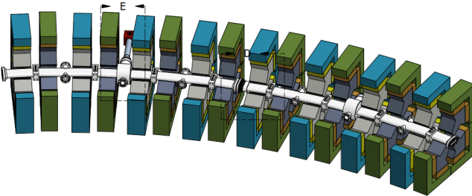
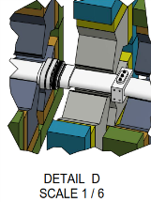
Conceptual 4-Cell PM Arc Assembly
Two 4-cell beampipes (on two girders) is connected via sliding joints
One of the vacuum beampipe design challenges is satisfying both the beam aperture and magnet clearance requirements, while hosting a large suite of functional components (BPMs and beam instrument, vacuum pumping and gauging)
The 4-cell beampipe designs for the hybrid magnets (shown here) meet these requirement.
This work will be repeated when the Halbach FFAG cell geometry/lattice becomes available.

Slide 3
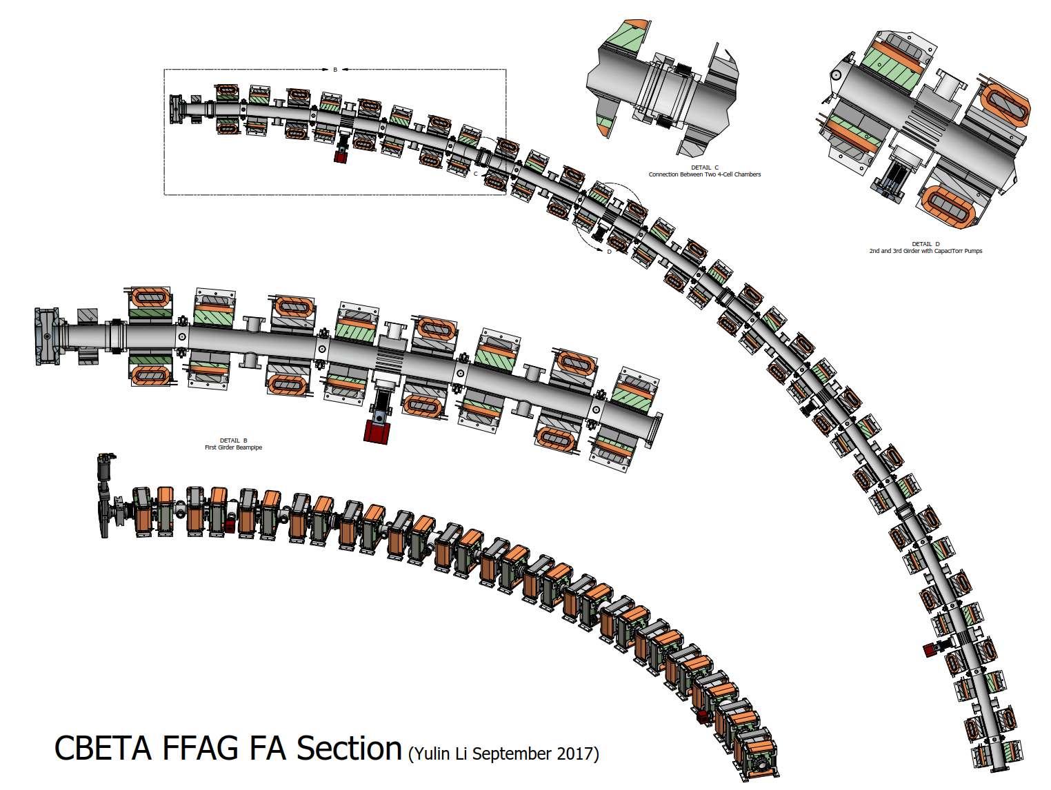
FA Section - 4 girder PM Arc Assembly
Four 4-cell beampipes (four girders) is connected via sliding joints

Slide 4
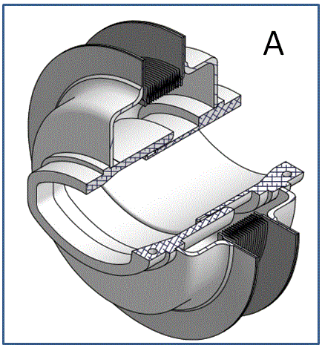
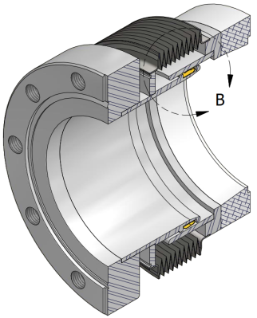
RF-Shielded Bellows
Bellows with RF shields are needed to provide adequate flexibility of the vacuum system in vacuum component installation and operations.
A – CESR-Style
A Design for PM Arc Sections

Slide 5
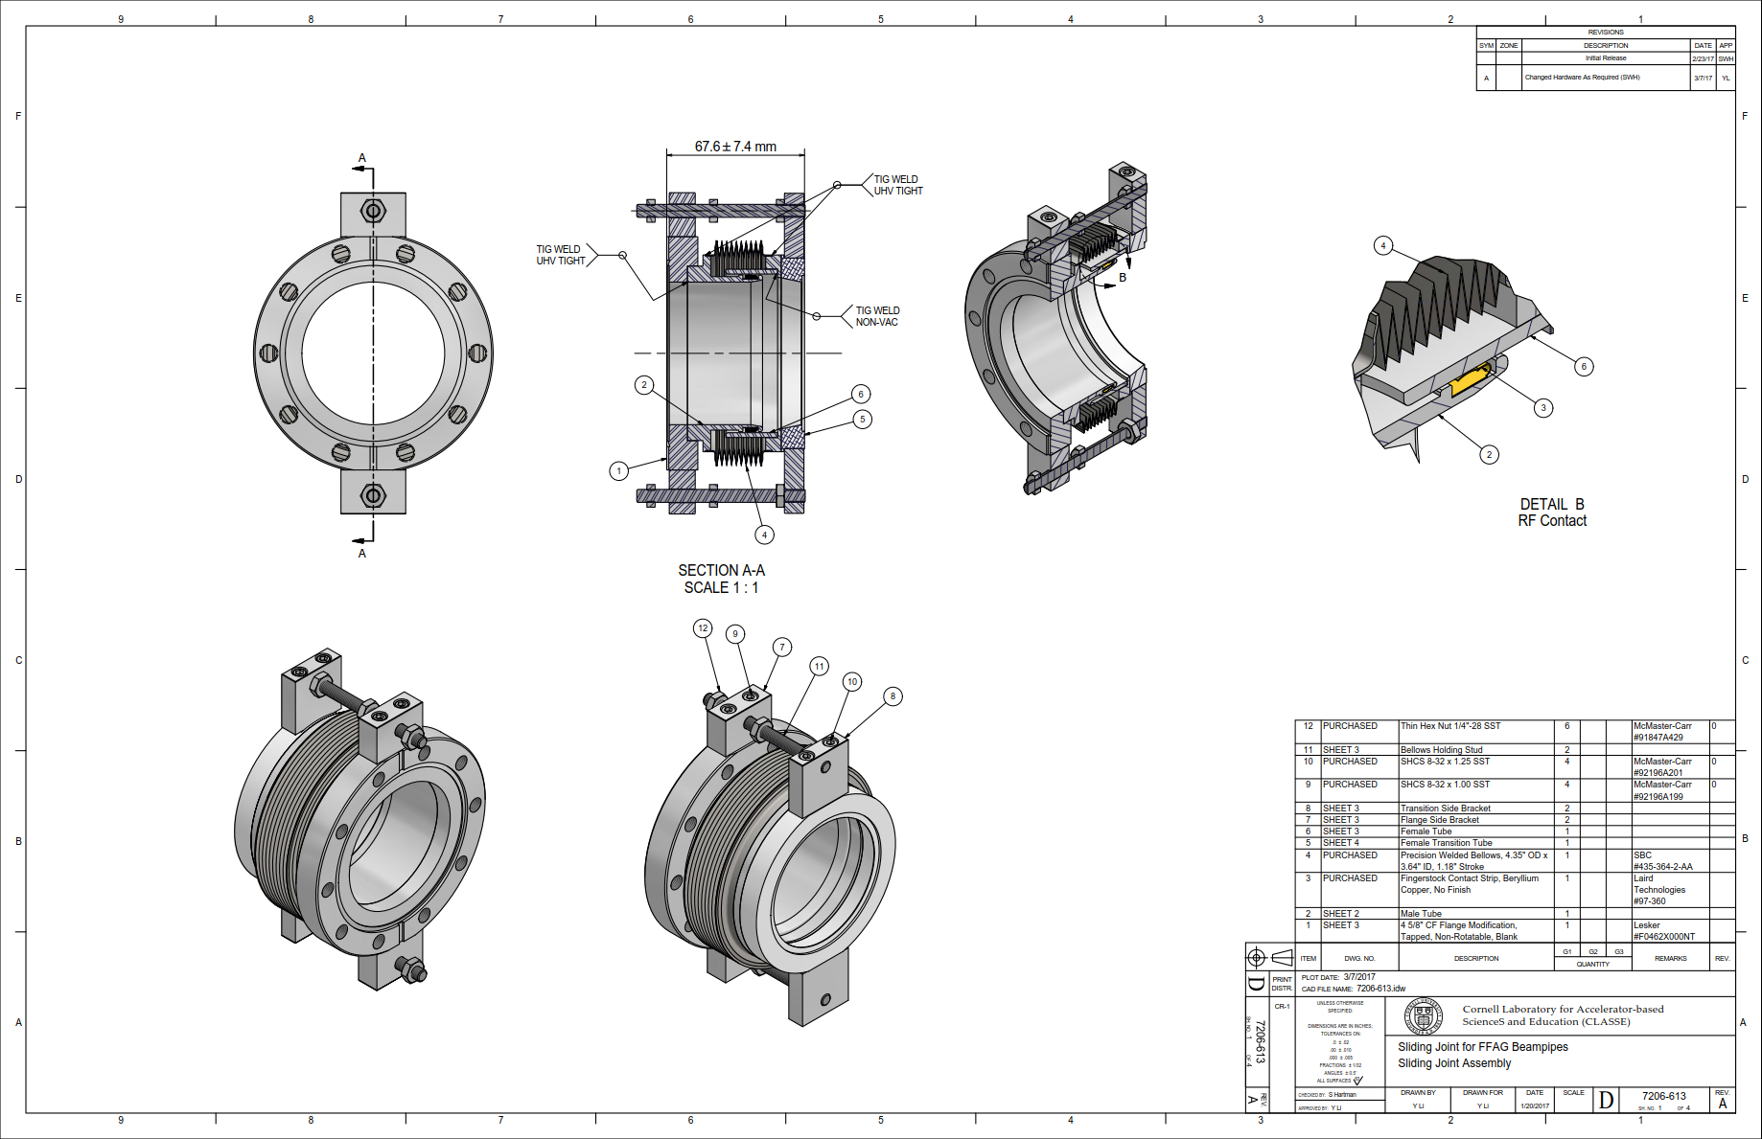
Sliding Joint – PM Arc

Slide 6
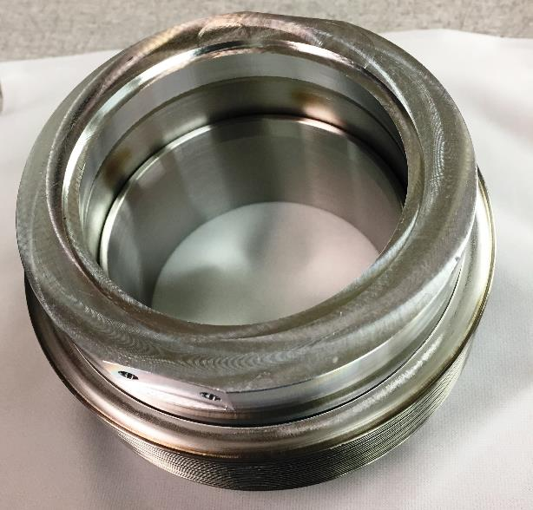
Sliding Joint – PM Arc

Slide 7
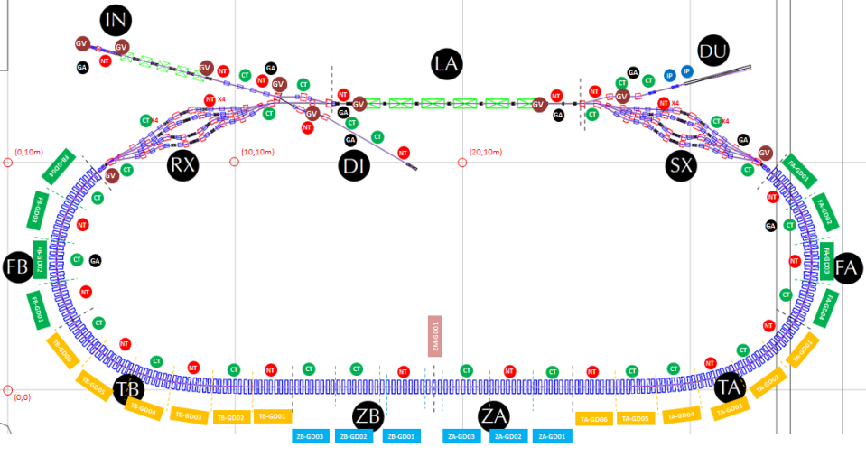
CBETA Vacuum – Pumping & Instrumentation
GUN
ICM
MLC
24 Sliding Joints
Most existing critical accelerator components are already equipped with RF-GVs. ICM and MLC have no build-in vacuum pumping and instrumentation, so need to be staged into the CBETA vacuum system.
Signals from ion pumps are to be used to monitor (and interlock) vacuum system performances, but a few additional vacuum gauges will be installed as cross checks.
A pair of new RF-GVs is to be installed to isolate PM Arc sections from the splitter sections.

