Slide 1



FRACTIONAL ARC TEST
GIRDER DESIGN REVIEW

Slide 2
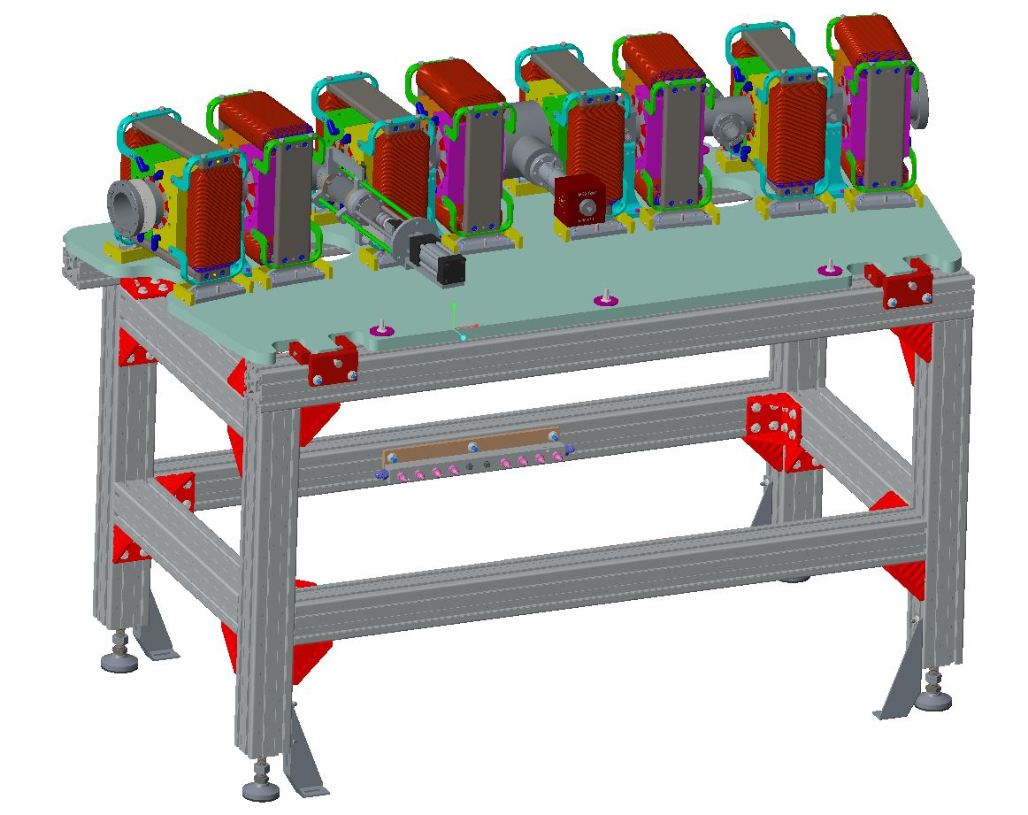
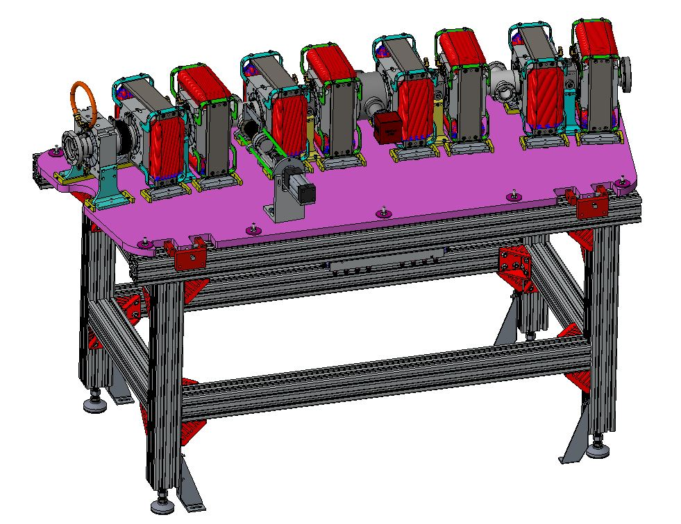
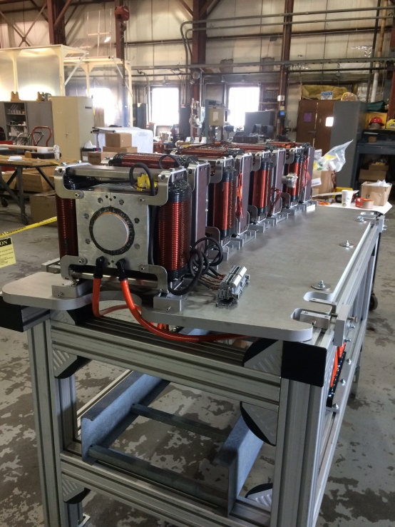
PROTOTYPE GIRDER
FRACTIONAL ARC TEST GIRDER
Same design except 6’’ longer to accommodate half magnet BDH

Slide 3
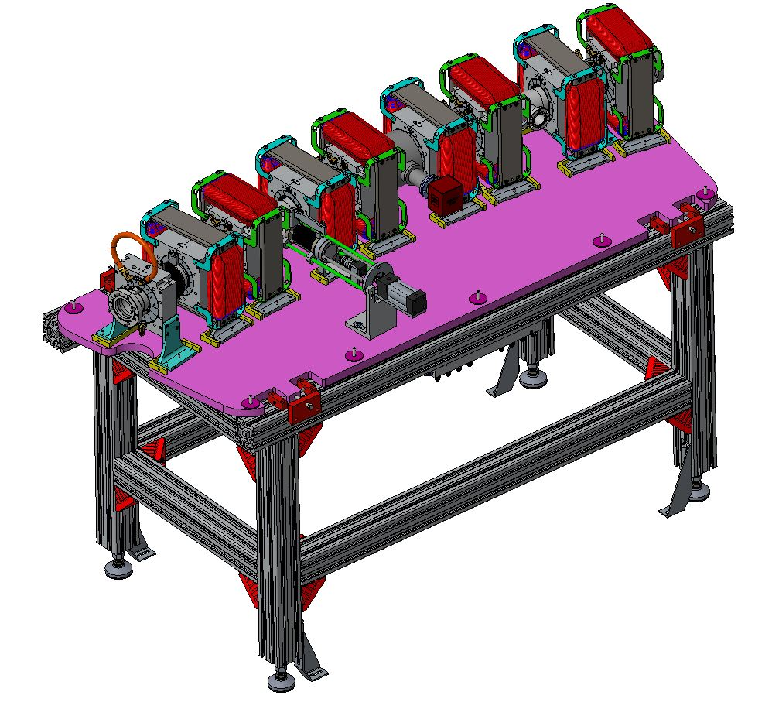
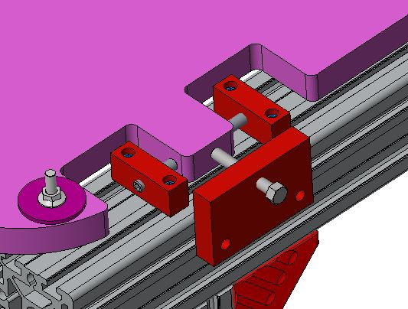
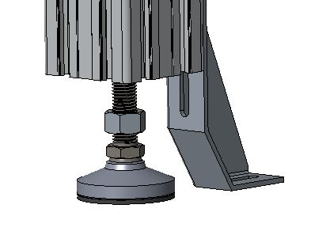
± ∞’’
(T-bolt slides in slot)
± .5’’
+2’’
-2’’

Slide 4
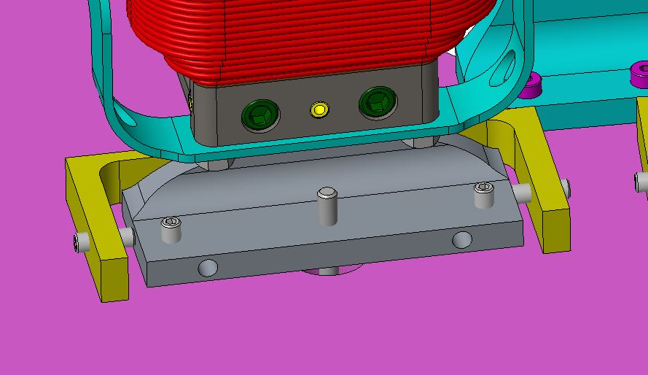
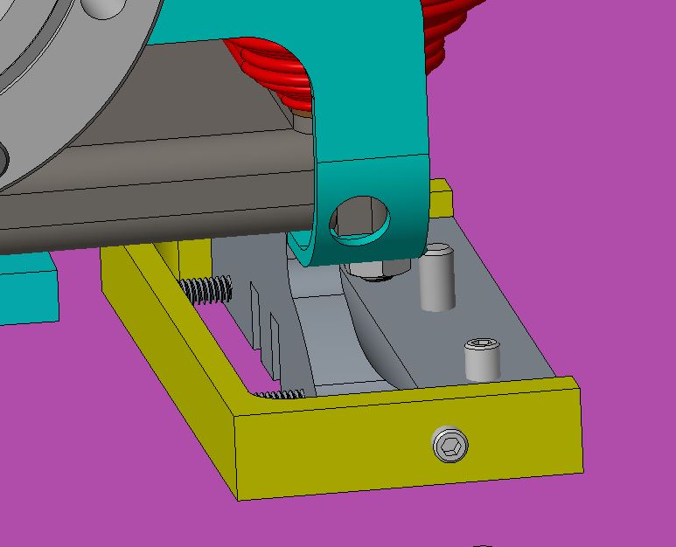
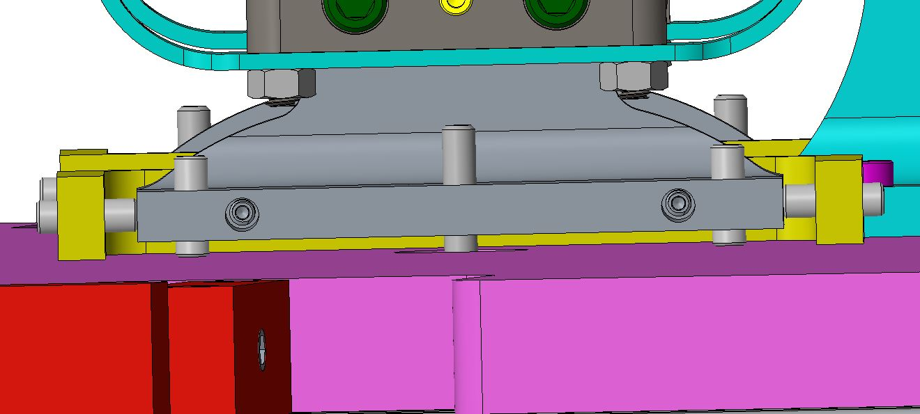
±.25’’
±.5’’
±.13’’
Each magnet is supported on three points with three tie-down bolts

Slide 5
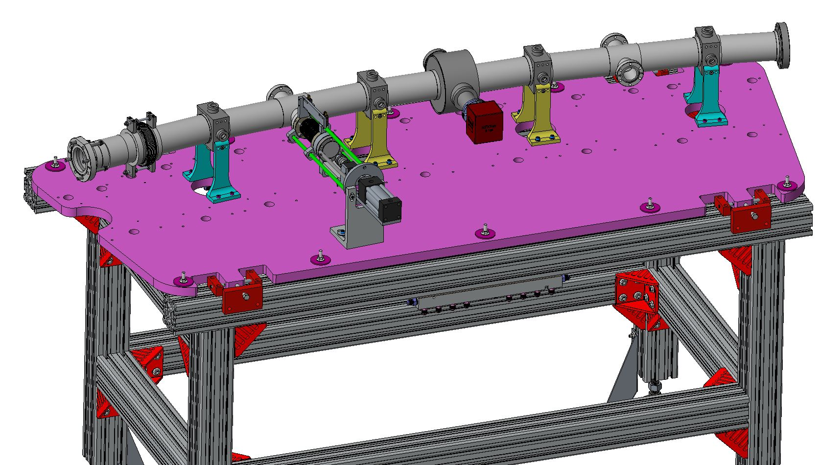
Chamber location/mounting
These angles (yellow) just provide support. Have oversized holes to allow for small misalignment of BPMs
These angles (blue) locate BPMs with shoulder screws
Chamber is fixed in location on plate.

Slide 6
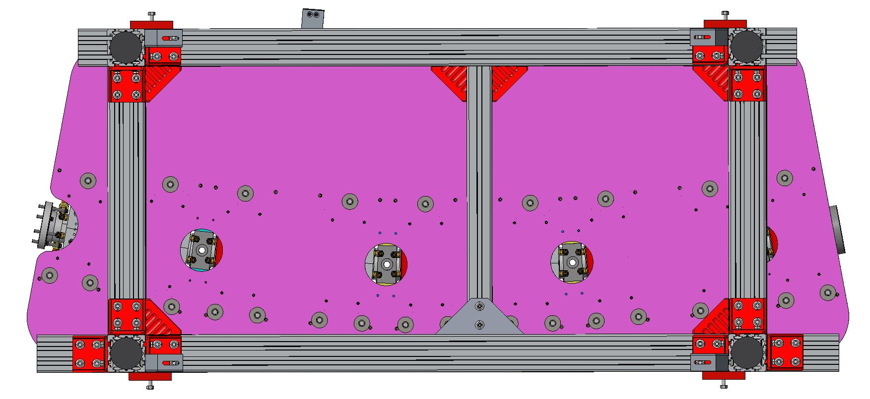
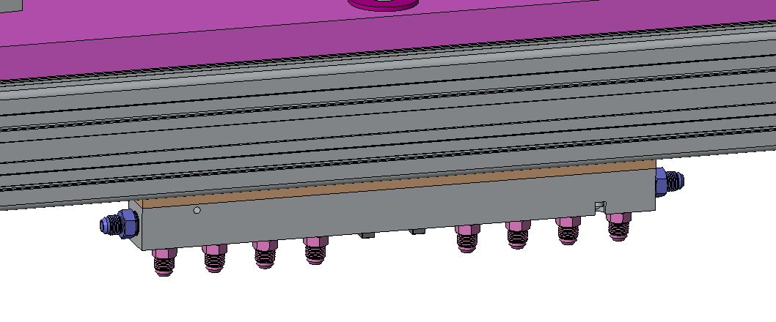
Water Tubing
Water hoses and beam instrumentation cable feed through here
Brass water manifold

Slide 7
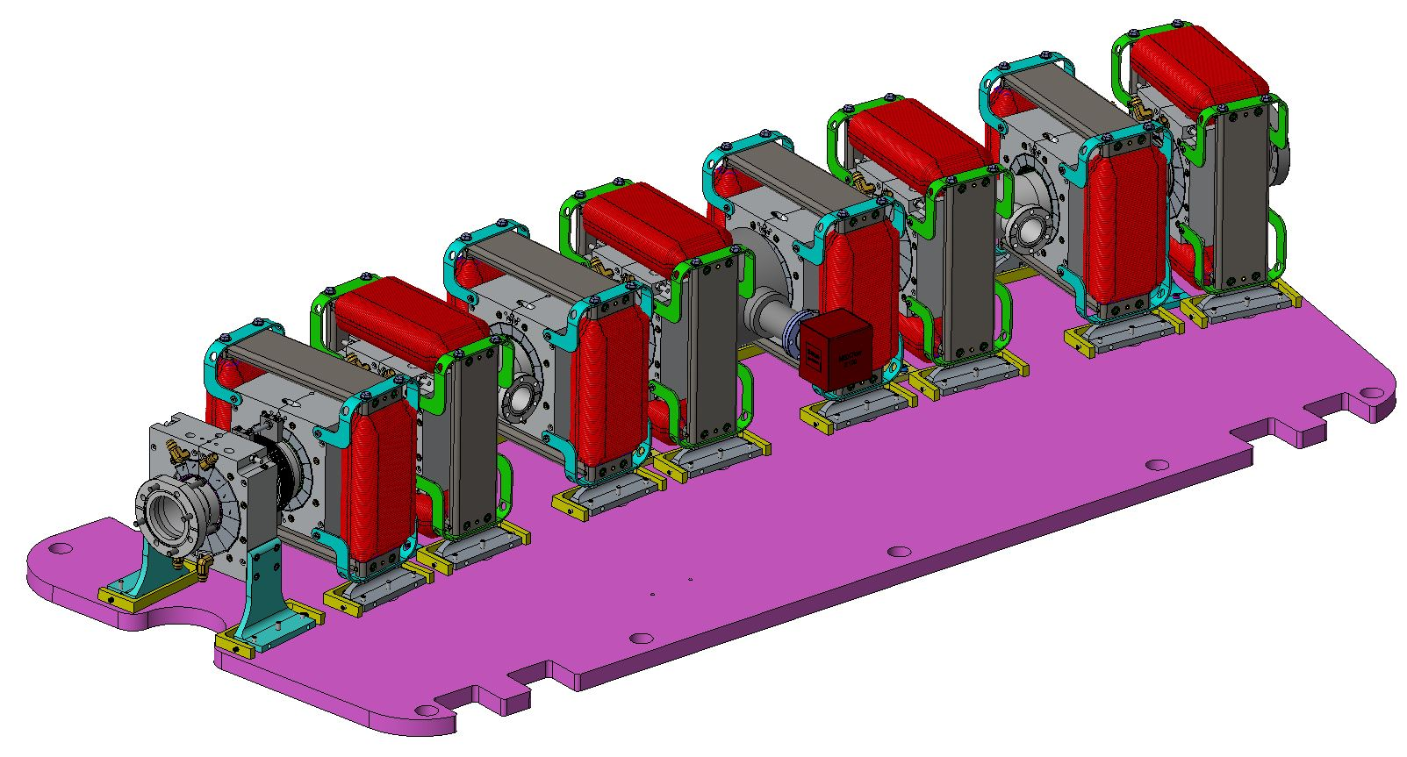
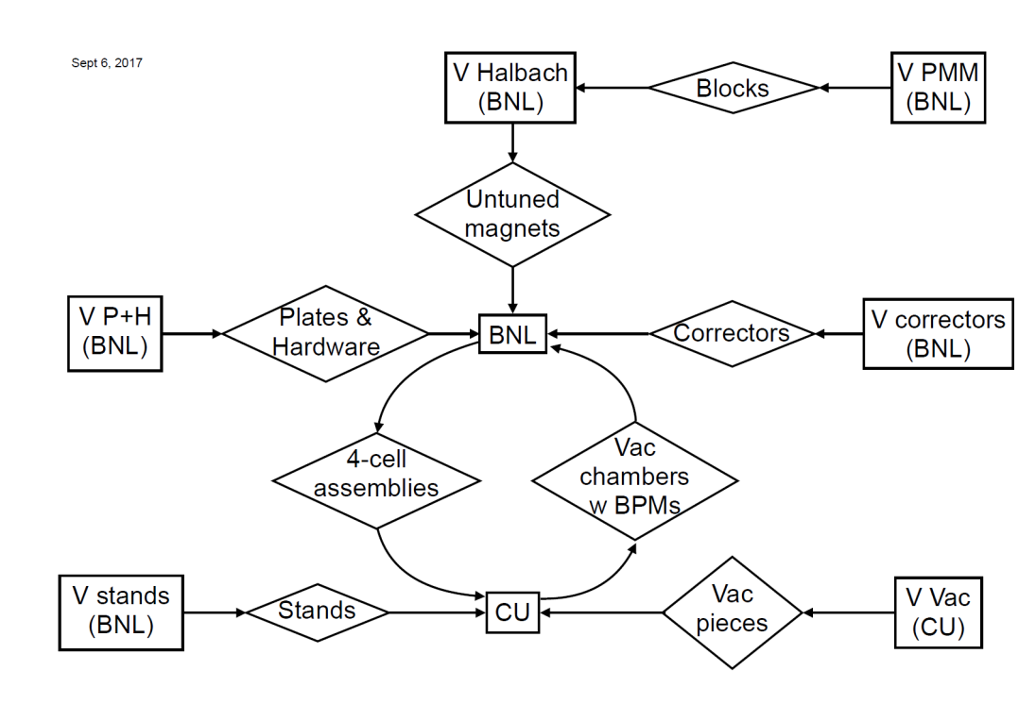

Survey/Shipment
Workflow
Cornell ships vacuum chamber to BNL.
BNL assembles magnets and chamber to plate.
BNL ships assembly at left to Cornell (un-surveyed).
Cornell receives Rexroth stand assembly from outside vendor.
Cornell joins plate to Rexroth stand.
Cornell does survey and positioning of magnets relative to chamber.
Cornell surveys/positions stand and plate into ring.

Slide 8
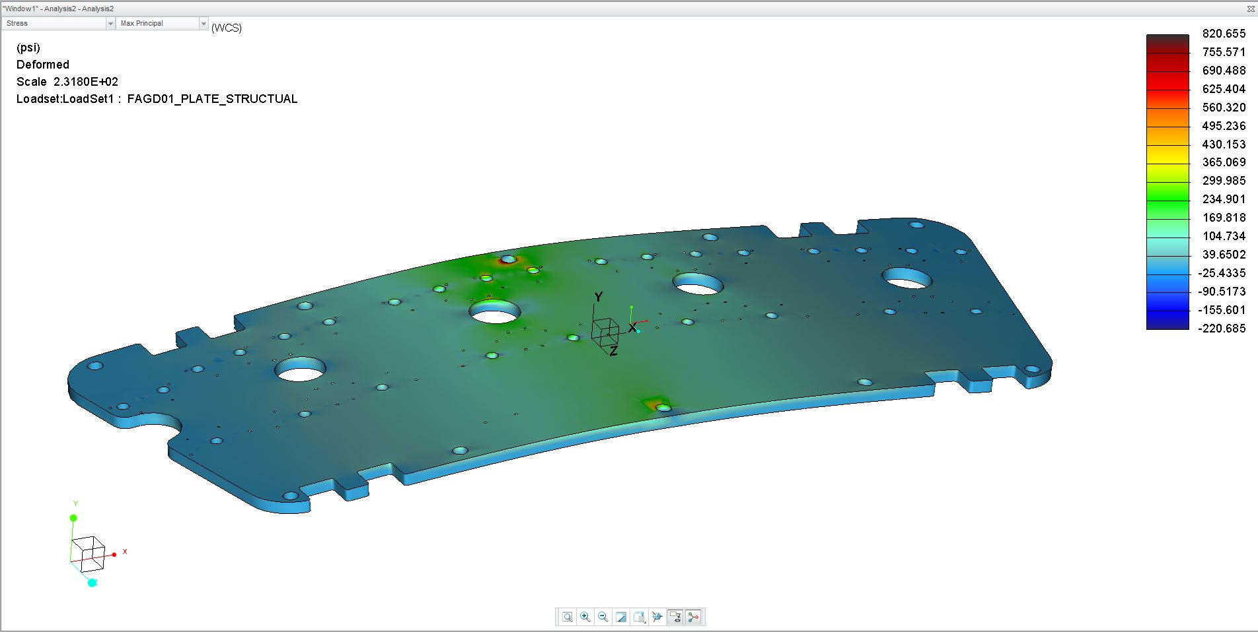

Slide 9
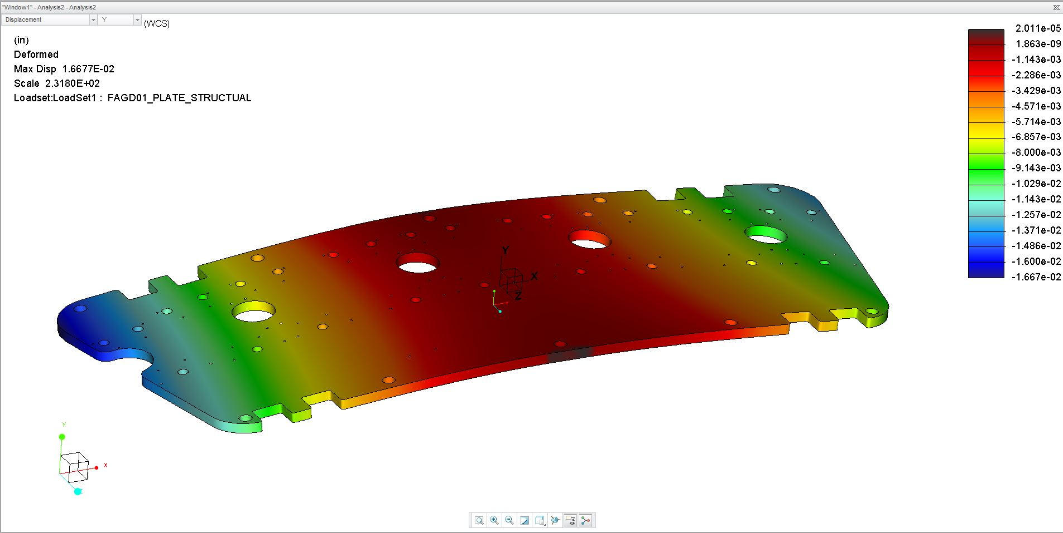

Slide 10
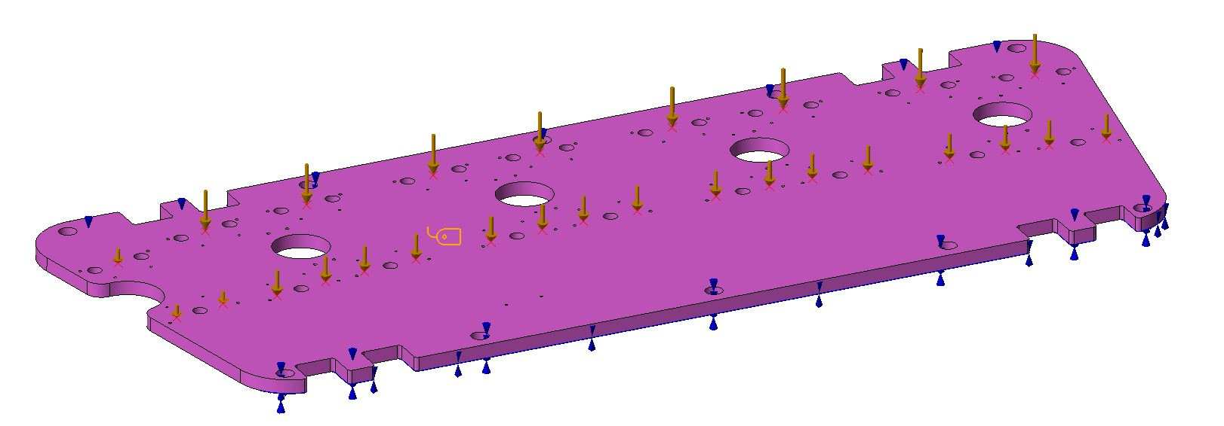
Deflection Analysis
-QF, BD = 100 lb. Ea (actual weight 91 lb.)
-Supported by Rexroth
-BDH = 15 lb.

Slide 11
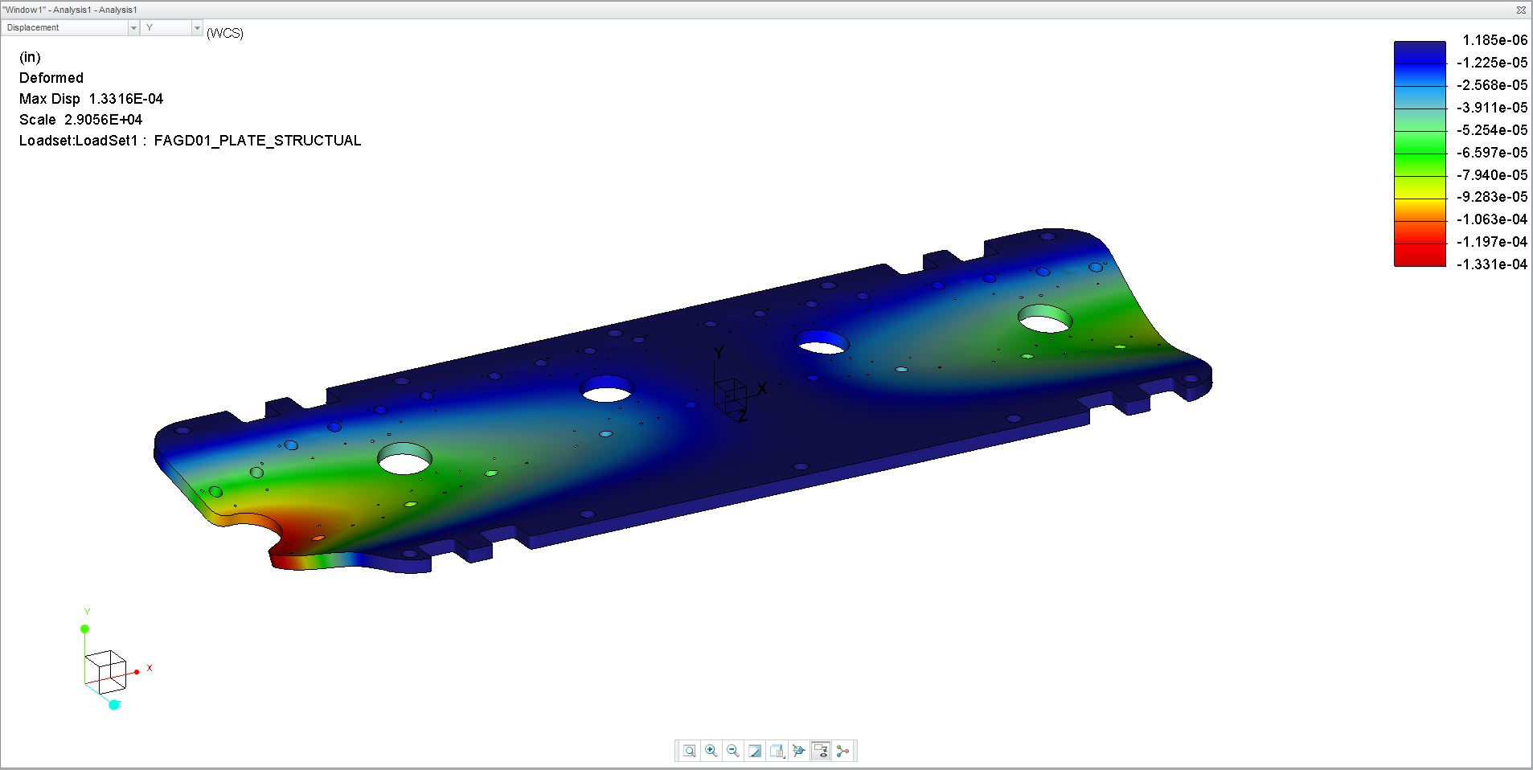

Slide 12
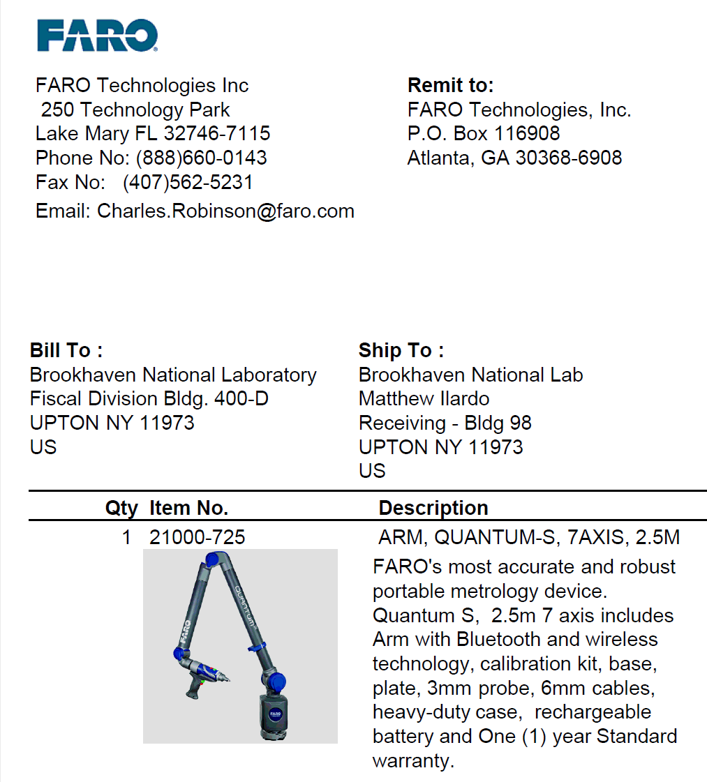
Locate mount for FARO survey arm.
Used to survey magnets in place.

Slide 13
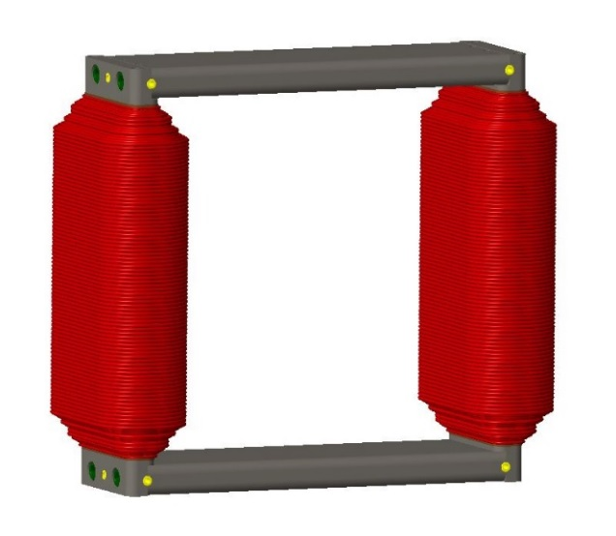
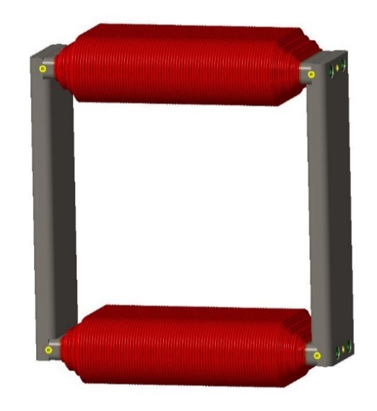
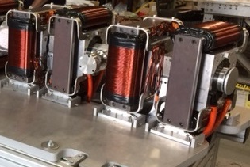
Corrector Magnets
Case 1
Case 2
Winding (per one coil) | AWG Gauge | # of Turns | Resistance (Ω) | Max Current (A) | Max Current (A)
"Dipole" (Inner) Winding | 14 | 480 | 0.81 | 2.29 | 3
"Quadrupole" (Outer) Winding | 11 | 463 | 0.50 | 4.75 | 3
Vertical Corrector
Case 1:
Maximum operating currents for
separate operation of dipole and
quadrupole correctors.
Case 2:
Maximum operating current for
dipole only operation with both windings in series.
Horizontal Corrector

