Slide 1
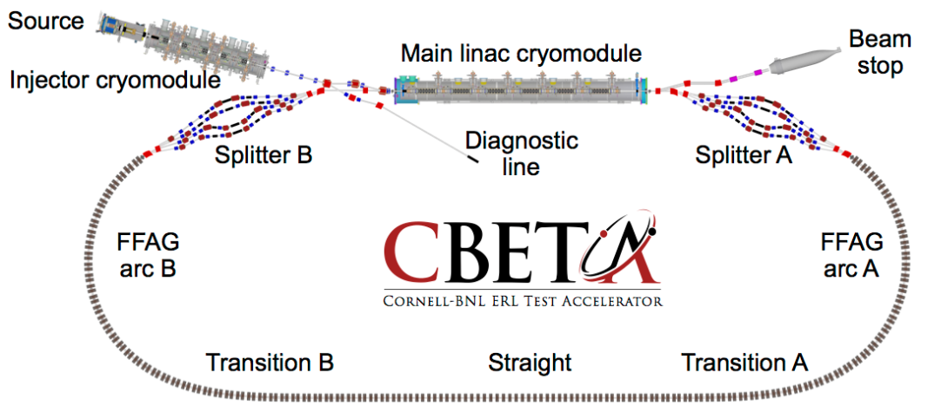
Design Review
FFAG Magnets & Girders
Scope of work
Progress to date – FAT preparation
Interface issues
Plan & Schedule for Magnet & Girder Production

Slide 2
WBS 1.05 FFAG Magnets & Girders
WBS Element Description
Responsible for ensuring that the Halbach magnets and girder assemblies satisfy the CBETA project goals.
Define and design Halbach magnets with corrector magnets that meet the accelerator physics optics specifications.
Design a girder assembly to support the magnets, vacuum chamber, and other supporting components.
Build and test pre-production magnet assemblies and a girder assembly to confirm field strength and quality.
After approval of pre-production magnets, responsible for building and testing production magnet assemblies, support girders, and installing them on the girder with the vacuum chamber (Supplied by Vacuum WBS 1.10).
The girders will be shipped to Cornell as the final deliverable under this WBS.
Final installation is done through System Integration WBS 1.11.

Slide 3
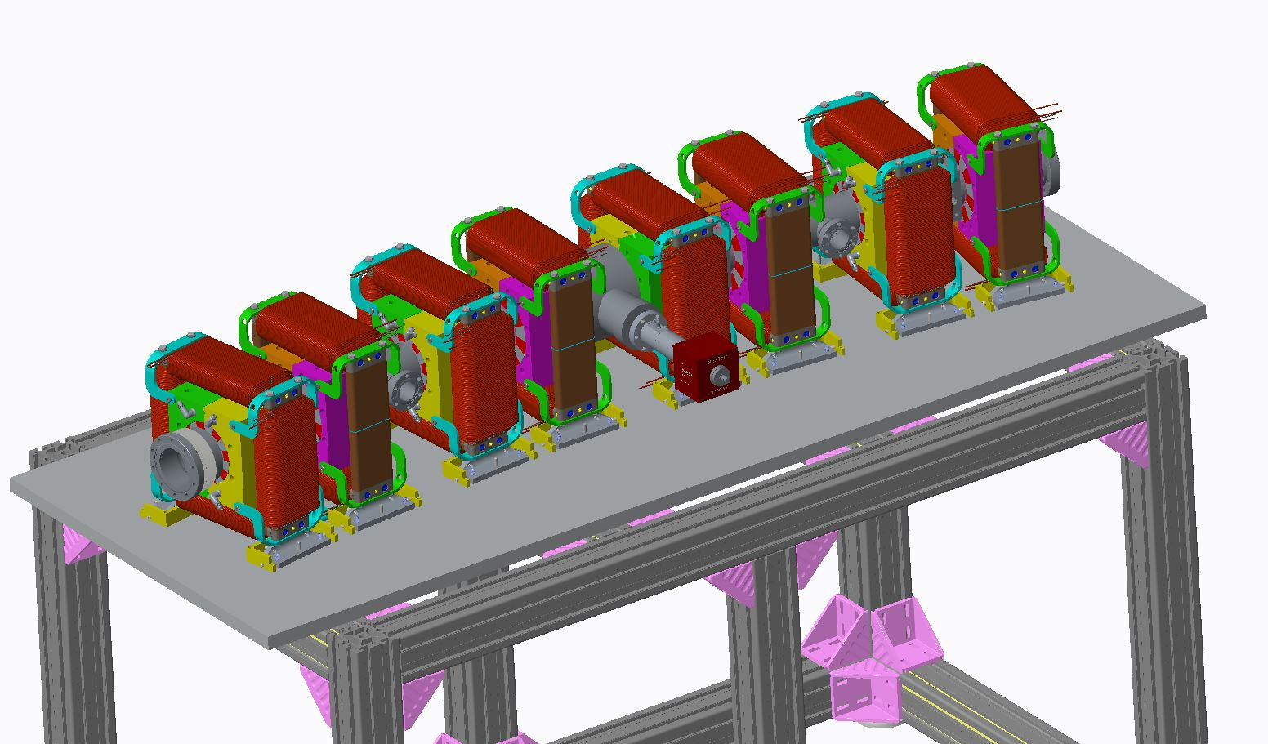
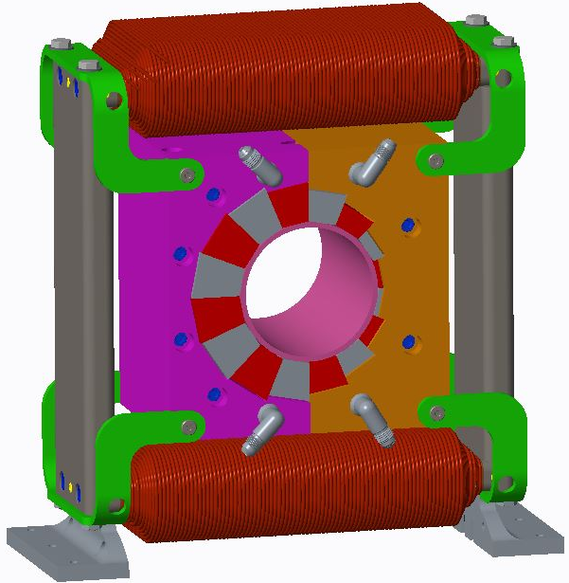
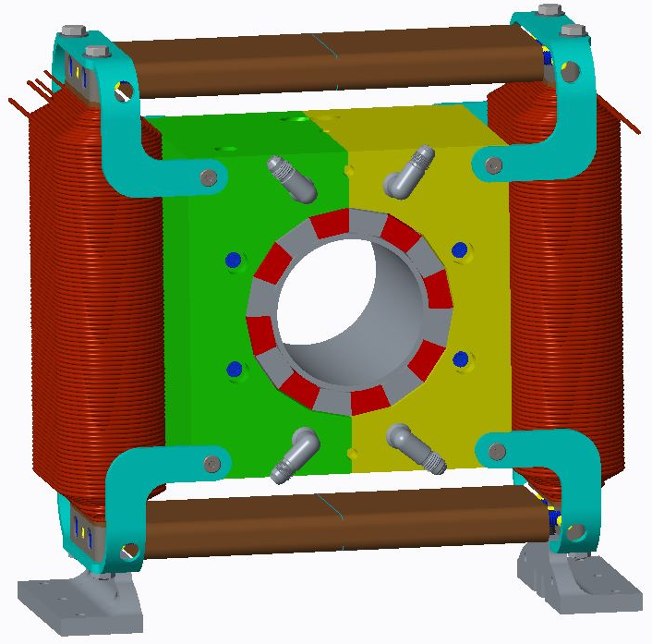
BNL Scope
Design, Fabricate, and Test:
216 Consistent Halbach permanent magnets, (5 types + 2 half magnets)
214 Powered correctors for beam line, (2 types – H&V, with Quadrupole upgrade path)
QA inspect, magnetically measure, tune, and accept all magnets
Install and align 8 Halbach magnets with dipole correctors on 4 lattice cell assemblies with vacuum chamber and ship to Cornell
24 - “standard” 8 magnet assemblies (6 - GFX, 6 - GTA 1-6, 6 - GZX, 6 - GTB 1-6)
1 - 6 magnet assembly (GZ1)
2 - 9 magnet assemblies (GFA1 and GFB1)

Slide 4
Magnet Procurement Quantities “August 18, 2017”
MAGNET COUNT PER Multi-Cell Assembly
Cells | Girder | Cells | QF | BD | BDT2 | BDT1 | QD | QFH | BDH
1 | GFA1 | 4.5 | 4 | 4 |  |  |  |  | 1
1 | GFX | 4 | 4 | 4
1 | GFX | 4 | 4 | 4
1 | GFX | 4 | 4 | 4
1 | GTA1 | 4 | 4 |  | 4
1 | GTA2 | 4 | 4 |  | 4
1 | GTA3 | 4 | 4 |  | 2 | 2
1 | GTA4 | 4 | 4 |  |  | 4
1 | GTA5 | 4 | 4 |  |  | 4
1 | GTA6 | 4 | 4 |  |  | 4
1 | GZX | 4 | 4 |  |  |  | 4
1 | GZX | 4 | 4 |  |  |  | 4
1 | GZX | 4 | 4 |  |  |  | 4
1 | GZ1 | 3 | 3 |  |  |  | 3
1 | GZX | 4 | 4 |  |  |  | 4
1 | GZX | 4 | 4 |  |  |  | 4
1 | GZX | 4 | 4 |  |  |  | 4
1 | GTB1 | 4 | 4 |  |  | 4
1 | GTB2 | 4 | 4 |  |  | 4
1 | GTB3 | 4 | 4 |  |  | 4
1 | GTB4 | 4 | 4 |  | 2 | 2
1 | GTB5 | 4 | 4 |  | 4
1 | GTB6 | 4 | 4 |  | 4
1 | GFX | 4 | 4 | 4
1 | GFX | 4 | 4 | 4 |  |  |  |  |  | 4 cell assemblies = 24
1 | GFX | 4 | 4 | 4 |  |  |  |  |  | 4.5 cell assemblies = 2
1 | GFB1 | 4.5 | 4 | 4 |  |  |  | 1 |  | 3 cell assembly = 1
27 | 216 | 108 | 107 | 32 | 20 | 28 | 27 | 1 | 1 | total assemblies = 27
 | Block Lot minimums |  | 107.5 | 32.5 | 20 | 28 | 27
 | + 10% order Quantity |  | 118.25 | 35.75 | 22.00 | 30.80 | 29.70 | Total
 | Order Quantity |  | 119 | 36 | 23 | 31 | 30 | 239

Slide 5
Pre-production Goals (June 6)
Showed:
A split aluminum frame aluminum Halbach can meet specifications
Corrector dipole meets specification
Continuing testing:
Water stabilization testing Halbach magnet
Tuning results for all magnets complete
Reassembled 2 pre-production BD magnets
Split and reassembly testing
Concerns:
Production style assembly fixtures were not designed or demonstrated.
(Contractor Requirement)
Need force calculations and diagrams in SOW for fixture design.
Epoxy attachment of the blocks is difficult and not successful on all pre-production magnets. Magnets redone & (Contractor Requirement)
BD magnets can be manufactured that meet specifications.

Slide 6
Schedule
Two project milestones in the (too) near future:
First arc production magnet tested Jan 1, 2018
PMM procurement 1st magnet lot delivered
Halbach HBD components fabricated by BNL
Halbach HBD assembled by BNL
Halbach HBD magnetically measured by BNL
Fractional Arc Test: beam through MLC (splitter magnets) & “prototype” girder May 1, 2018
In hand - pre-production stand assembly, BD & QF magnets
Need HBD magnet (from above)
Need new 4.5 cell assembly mounting plate (to August 18 lattice)
Need production vacuum chamber
“Far future” milestone
Girder Production Run Complete Dec 1, 2018

Slide 7
Halbach Schedule for FAT Test
What must be determined:
Final approved lattice/magnet count. Done – August 18
Are the QF magnets in the pre-production assembly the “April 10” configuration? Maybe Yes
Are the BD’s good enough for FAT? No – need 3/BDs & 1/BDT2
Yes, 2 BD magnets have been tuned and 2 rebuilt, then tuned
Does the base plate need to be reconfigured for FAT? Yes, new base plate will be fabricated
Is the temperature controlled water needed for the FAT? Maybe
Is temperature monitoring of the Halbachs needed? No??
Do the corrector magnets need separate Quad coils? Yes
What are the acceptance criteria for the tuned Halbach Magnets? Acceptance committee – does it affect measurement time or tuning effort?
Can 2 Halbach magnets be measured and tuned in a day?

Slide 8
Production Manufacturing Plan
PMM: Request for Proposal, build to print & specification.
PMM Contractor inspection & magnetization vector measurement.
BNL will sample test/verify.
Halbach Magnets: Request for Proposal, build to print & specification.
BNL supplied PMM, PMM shimming specified by BNL.
Contractor fabricates frames, shims and installs PMM, installs water fittings.
First article magnets, then release for production, option to cancel after 1st article.
Contractor option magnetic field measurement for final QA
Corrector Magnets: Request for Bids, build to print.
First article magnets, then release for production, option to cancel.
BNL magnetic field testing of random magnets.
BNL Final Tuning:
BNL magnetic measurement
Review measurement, specify wire rod multipole reduction tuning and install.
BNL magnetic measurement – approval for final assembly
4 Cell Assembly Top Plates and Stands: RFQ, build to print.
Component machining and hardware by Contractor
BNL assembly with Cornell vacuum chamber
“Far future” milestone
Girder Production Run Complete Dec 1, 2018

Slide 9
Halbach Magnet Assembly
16 Permanent Magnet Material (PMM) block radial distribution for dipole and quadrupole Halbachs x 2 deep (32 blocks/magnet total)
PMM Contractor: PMM for shipment to BNL.
PMM Contractor: Helmholtz measurement all blocks.
BNL: ships blocks to Halbach magnet assembly contractor.
Halbach Contractor: Manufactures Aluminum frame with inner dimensions machined per BNL guidance after Helmholtz measurement.
Halbach Contractor: designs and fabricates necessary tooling for inserting the blocks (block forces provided by BNL)
Halbach Contractor: Blocks are shimmed per BNL guidance
Halbach Contractor: Blocks are put in place in ½ frames per part number distribution guide for the blocks
Halbach Contractor: Assembly is vacuum impregnated with bonding agent
Halbach Contractor: Block halves are inspected, joined, inspected, and magnet is shipped to BNL for measurement.
“Far future” milestone
Girder Production Run Complete Dec 1, 2018

Slide 10
Halbach Magnet Assembly/ 4 Cell Assembly
BNL: Inspects and measures the magnets – approves 1st articles & payments
BNL: Measurement results are evaluated, tuning rod configuration is defined, and tuning rod holders with rods are installed in the magnet.
BNL: Tuned magnet is measured, results are reviewed and approved.
BNL: Surveys magnet to establish magnetic center (for final Cornell survey).
BNL: Sample magnets are split and reassembled and measured again, results are reviewed and approved.
Corrector Contractor: Fabricates wire wound corrector magnets.
Stand Contractor: Fabricates 4 cell stands and ships directly to Cornell
Cell Assembly Contractor: Fabricated Mounting Plate and hardware and ships to BNL
BNL: Vacuum chambers are mounted on plates, Halbach magnets are split and mounted on plates and reassembled with corrector magnets, water connections are made to the manifold, and corrector connections are made on terminal blocks
BNL: Inspects, packs, and ships 4 cell assemblies to Cornell.
“Far future” milestone
Girder Production Run Complete Dec 1, 2018

Slide 11
4 Cell Assembly and Installation
Cornell: Surveys and installs stands in final location.
Cornell: Installs cable tray, procures and pulls cables (correctors, diagnostics, and vacuum).
Cornell: Installs water piping/water system.
Cornell: Installs 4 cell assemblies on stands, surveys to BPM position average (or 2 chosen BPM’s) and locks plate position.
Cornell: Locates all BPM’s.
Cornell: Surveys individual Halbach magnet (magnetic) centers to lattice location.
Cornell: Connections to corrector power supplies and Halbach magnet water system manifold.
Cornell: Installs vacuum pumps and gauges and makes connections.
“Far future” milestone
Girder Production Run Complete Dec 1, 2018

Slide 12
Interface Issues
4 Cell Assembly and Vacuum chamber location, survey points.
Survey stand to lattice centerline & set height and bolt down to floor.
Place 4 cell assembly plate, center end BPM’s to lattice centerline & set to lattice height; bolt 4 cell assembly plate to stand.
Survey to identify the location of inner BPM’s.
Survey/adjust Halbachs to lattice centerline.
Are there “preferred” BPM’s (2 of 4) to be on the lattice centerline?
Survey equipment at Cornell, need a survey arm and laser tracker.
Cornell: What is the maximum density of cables in the stand cable tray?
Corrector magnet cables and PS rack location
Vacuum pump and instrumentation cables and vacuum rack location
Beam diagnostics and instrumentation cable and rack location
BNL: Halbach magnet temperature control water requirements (85F +/- 0.5) and water feed location. Flow rate, temperature control, pressure limit, pressure drop.

Slide 13
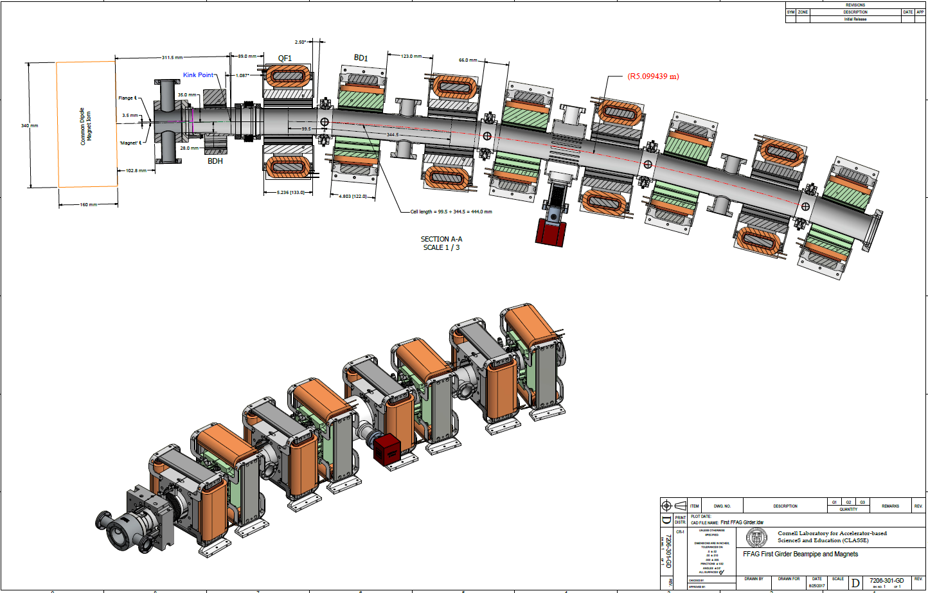
Lattice Centerline
1st Align outer BPM’s
2nd Locate inner BPM’s
3rd Align All Halbach magnets

Slide 14

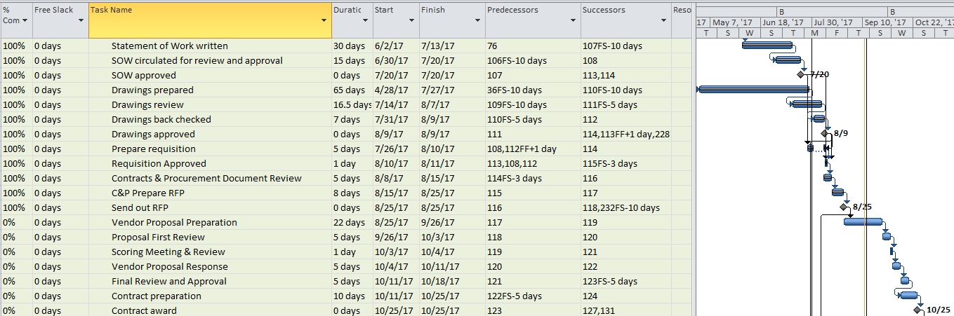
Procurement Schedule (June 7)
Critical Path
Production PMM procurement: RFP to Contractors 7/4/17, 7/3/17
– contract awarded 9/8/2017 (RFP to RFQ)
– (Neodymium cost)
Production Magnet procurement: RFP to Contractors 7/25/17, 8/25/17
– Bids due 9/26/17 (one extension provided)
– Proposal review and contract preparation & award 10/25/17

Slide 15
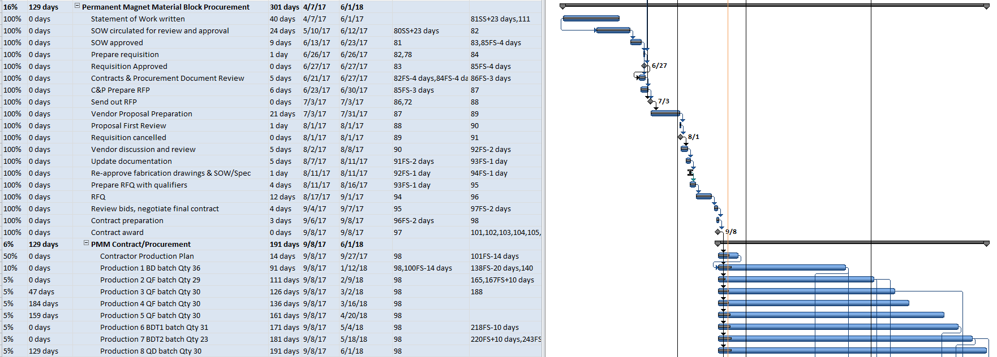
Production Schedule
Critical Path
Production PMM procurement:
– first batch delivery (BD blocks) 12/28/17 (16 weeks ARO)
– need first magnet PMM early delivery 12/1/17 (13 wks)
– will use for early verification test & BDH
Awaiting PMM Contractors production plan
Awaiting Halbach magnet assembly proposals – schedule.

Slide 16
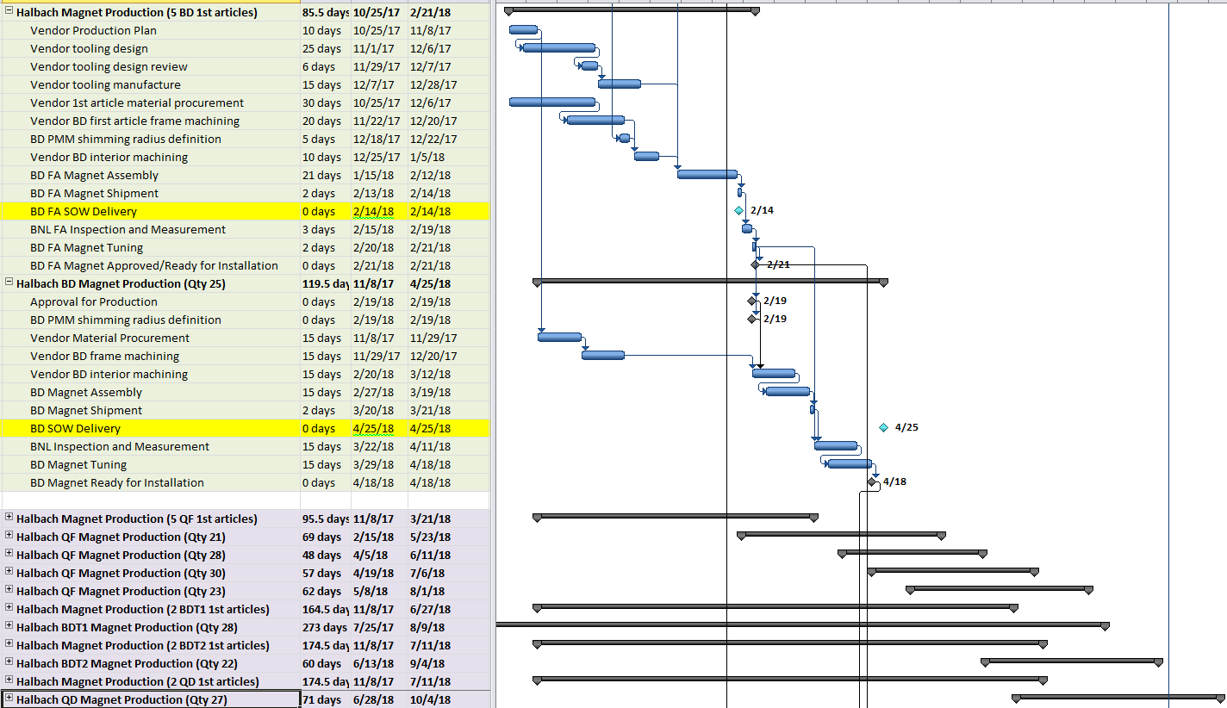
Schedule Magnet Production (SOW Dates)
First Contractor produced 1st article (2/14/18)
Last Contractor produced magnet (8/29/18)
Last magnetic measurement 9/5/18 to 10/4/18 (6.8 magnets/week want 8/week)

Slide 17
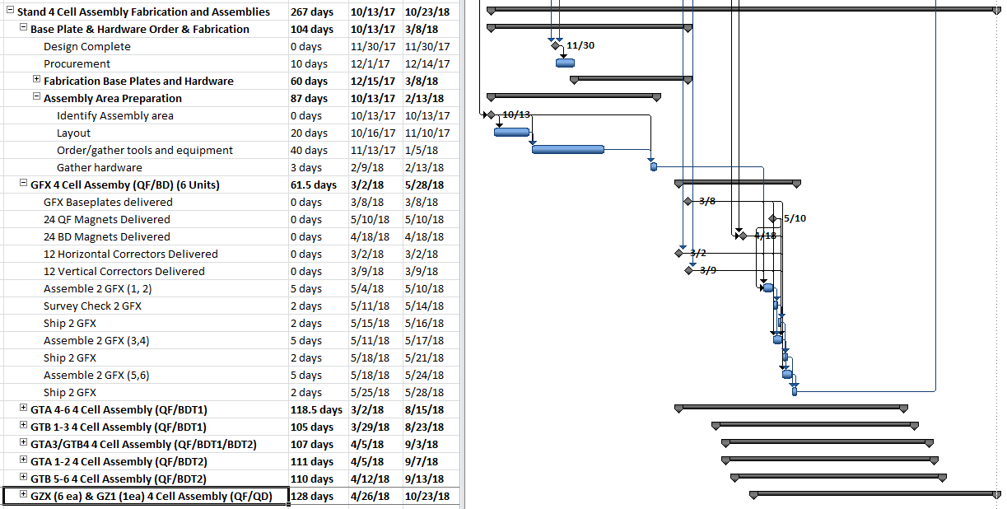
Schedule 4 Cell Assembly Production
PMM > Magnet Production > Magnetic measurement are on the critical path
Last Contractor produced (Qty 27) magnet batch 8/15/18 (SOW 8/29/18)

Slide 18
Schedule, Critical Path – Critical Items
Production PMM procurement
Contractor production plan
First PMM delivery for BDH magnet and Helmholtz results
Approve aluminum block final drawings: PMM location
Production Halbach procurement
Receive and evaluate proposals: place order
Contractor production plan
First article delivery, fast BNL evaluation, no changes in PMM location
Will PMM production keep up with magnet production?
Will magnetic measurement and tuning keep up with magnet production?
4 Cell Assemblies
Complete and approve lattice
Complete component drawings, order plates, brackets, and hardware
Set-up assembly area, assign staff for assembly (complete RHIC shutdown).

Slide 19
Things to Do
This meeting:
Mahler, Trabocchi: complete August 18, 2017 lattice layout & compare with Dave (June OK)
For PMM procurement:
Verify delivery schedule (Review Contractor Production Plan)
Get early PMM delivery for BDH
For Halbach procurement/production
RFP evaluation – place order
Update schedule - (Review Contractor Production Plan)
Design and order tuning rod holder and tuning rods
Magnet Measurement
Define criteria
Planning: timing, measurement equipment, survey >> to define staffing and equipment needs
Goal 2 magnets/day: measured, tuned, accepted
For 4 cell assemblies
Check vacuum chamber interface (GFA1 chamber ok!!) for all assemblies, finish assembly drawings
Planning: task list for assembly >> to define staffing and equipment needs
Location: building 905 next to magnetic measurement area

Slide 20
Lattice Centerline
1st Align outer BPM’s
2nd Locate inner BPM’s
3rd Align All Halbach magnets

Slide 21
Extra Slides

Slide 22
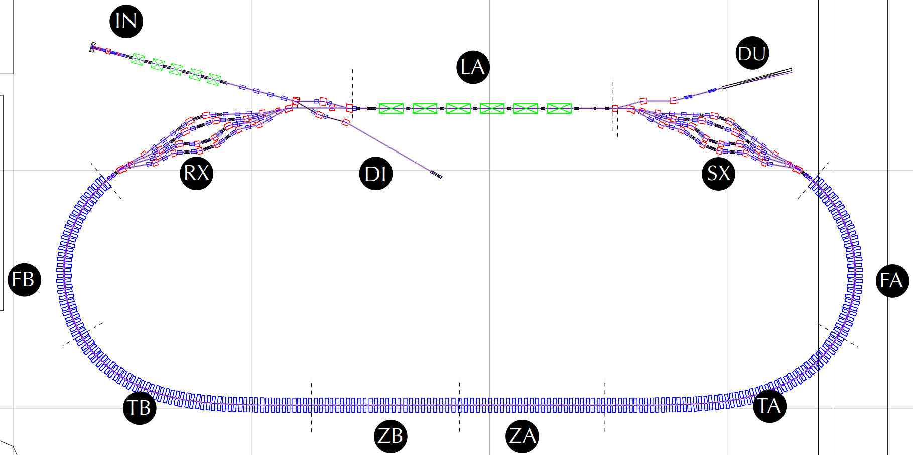
Girder Types and Positions (Old)
Gate Valves (11)
10 RF shielded
3 New to CBETA
NT
NexTorr Pump (28)
GV
CT
CapaciTorr Pump (34)
IP
Ion Pump (2)
GA
Ion and Pirani Gauges (8)
GV
GV
NT
GV
NT
GA
GA
IP
CT
CT
IP
NT
CT
GV
CT
NT
NT
NT
GV
NT X4
GV
GV
NT X4
CT X4
CT
GV
GA
GA
CT
CT X4
NT
CT
GA
CT
GA
(0,10m)
(10,10m)
NT
(20,10m)
GV
FB-GD04
CT
CT
FA-GD01
GV
FB-GD03
CT
NT
FA-GD02
NT
GA
CT
CT
GA
FB-GD02
FA-GD03
NT
FB-GD01
NT
CT
FA-GD04
CT
NT
TB-GD06
NT
ZB-GD02
ZB-GD01
ZA-GD03
ZA-GD02
CT
TA-GD01
CT
NT
CT
NT
CT
CT
NT
CT
CT
NT
CT
CT
NT
CT
CT
NT
TB-GD05
TA-GD02
(0,0)
TB-GD04
TA-GD03
TB-GD03
TB-GD02
TB-GD01
ZB-GD03
ZM-GD
ZA-GD01
TA-GD06
TA-GD05
TA-GD04

Slide 23
Project Schedule Items
Tuozzolo | BNL | A1.05.01.02.01.11 | T-2 | Milestone: PreProd FFAG Magnets - Procurements complete | 100% | 4/18/2017 | FY17Q3 | FY17Q3(A)
Tuozzolo | BNL | A1.05.01.02.02.06 | T-2 | Milestone: PreProd FFAG Girder - Procurements complete | 100% | 4/26/2017 | FY17Q3 | FY17Q3(A)
Tuozzolo | BNL | A1.05.01.03.01.06 | T-2 | Milestone: PreProd FFAG Magnets - Assembly complete | 100% | 4/27/2017 | FY17Q3 | FY17Q3(A)
Tuozzolo | BNL | A1.05.01.03.02.02 | T-2 | Milestone: PreProd FFAG Girder - Assembly complete | 100% | 4/27/2017 | FY17Q3 | FY17Q3(A)
Tuozzolo | BNL | A1.05.01.03.03.03 | T-2 | Milestone: Pre-Production Magnet/Vacuum Chamber Assembly on Girders Complete | 100% | 5/3/2017 | FY17Q3 | FY17Q3(A)
Tuozzolo | BNL | A1.05.01.03.03.05 | T-2 | Milestone: PreProd FFAG Magnets and Girder - Halbach Magnets & Girder Assembly & Testing complete | 100% | 7/7/2017 | FY17Q4 | FY17Q4(A)
Tuozzolo | BNL | A1.05.02.01.01.05 | T-2 | Milestone: Production FFAG Magnets - Halbach w/ corrector design revisions complete | 100% | 8/2/2017 | FY17Q4 | FY17Q4(A)
Tuozzolo | BNL | A1.05.02.01.02.03 | T-2 | Milestone: Production FFAG Girders - Design Complete | 0% | 8/25/2017 | FY17Q4
Tuozzolo | BNL | A1.05.02.02.02.12 | T-2 | Milestone: Production FFAG Girders Procurements complete | 0% | 3/23/2018 | FY18Q2
Tuozzolo | BNL | A1.05.02.02.01.03.04 | T-2 | Milestone: Contractor Procurement [BNL]: Production FFAG Magnets - Permanent Magnet Blocks -All Lots Received @ BNL | 0% | 6/25/2018 | FY18Q3
Tuozzolo | BNL | A1.05.02.02.01.07.04 | T-2 | Milestone: Production FFAG Magnets Halbach Magnets Assembly (Magnet, Housing, Windowframe Corrector) - ALL Sectors Received @ BNL [Qty: xx] | 0% | 11/27/2018 | FY19Q1
Tuozzolo | BNL | A1.05.02.02.01.08 | T-2 | Milestone: Production FFAG Magnets ALL Procurements complete and received from Contractor | 0% | 11/27/2018 | FY19Q1
Tuozzolo | BNL | A1.05.02.03.01.01.03 | T-2 | Milestone: ALL Sectors - Measuring and adjusting Halbach Magnet Assemblies Complete [Qty: xx] | 0% | 12/4/2018 | FY19Q1
Tuozzolo | BNL | A1.05.02.03.01.01.04.02.07 | T-2 | Milestone: ALL Sectors - Survey & Testing of Halbach Magnet Assemblies Complete [Qty: xx] | 0% | 1/4/2019 | FY19Q2
Tuozzolo | BNL | A1.05.02.03.03.03.07 | T-2 | Milestone: Production FFAG Magnets and Girders - ALL Sectors - Halbach Magnets & Girder Ship to Cornell complete | 0% | 1/24/2019 | FY19Q2
Tuozzolo | BNL | A1.05.02.03.02.04.02.07 | T-2 | FFAG Production Magnets and Girders - ALL Sectors - ALL Halbach Magnet & Girder Assembly, Survey, Testing, and Documentation Complete [Qty: xx] | 0% | 3/8/2019 | FY19Q2
Tuozzolo | BNL | A1.05.02.03.01.01.04.04 | T-2 | Milestone: Production FFAG Magnets - Pre-Girder Halbach Magnet Assembly tests & documentation complete | 0% | 3/12/2019 | FY19Q2
Tuozzolo | BNL | A1.05.01.01.01.04 | T-3 | Milestone: PreProd FFAG Magnets - Halbach magnet w/ corrector design complete | 100% | 3/1/2017 | FY17Q2 | FY17Q2(A)
Tuozzolo | BNL | A1.05.01.01.02.03 | T-3 | Milestone: PreProd FFAG Girder - Design Complete | 100% | 3/17/2017 | FY17Q2 | FY17Q2(A)
Tuozzolo | BNL | A1.05.01.03.01.02 | T-3 | Milestone: PreProd FFAG Magnets - PMM measurements complete and documented | 100% | 4/24/2017 | FY17Q3 | FY17Q3(A)
Tuozzolo | BNL | A1.05.01.03.03.01 | T-3 | Milestone: Vacuum Chambers Received from Cornell for Pre-Production FFAG Magnet Assembly as of 4/24 | 100% | 4/24/2017 | FY17Q3 | FY17Q3(A)
Tuozzolo | BNL | A1.05.02.02.02.08 | T-3 | Milestone: Production FFAG Girders - 1st Article Table Top plate Procurement complete and received @ BNL | 0% | 1/25/2018 | FY18Q2
Tuozzolo | BNL | A1.05.02.02.02.09 | T-3 | Milestone: Production FFAG Girders - ALL Top plate Procurement complete and received @ BNL | 0% | 3/23/2018 | FY18Q2
Tuozzolo | BNL | A1.05.02.02.02.10 | T-3 | Milestone: Production FFAG Girders - 1st Article Frame/Stand Procurements complete and received @ Cornell in time for FAT | 0% | 1/25/2018 | FY18Q2
Tuozzolo | BNL | A1.05.02.02.02.11 | T-3 | Milestone: Production FFAG Girders - ALL Frame/Stand Procurements complete and received @ Cornell | 0% | 3/23/2018 | FY18Q2
Tuozzolo | BNL | A1.05.02.03.01.01.04.03 | T-3 | Milestone: Production FFAG Magnets - Pre-Girder Halbach Magnet Assembly 1st Article tests & documentation complete | 0% | 2/26/2018 | FY18Q2
Tuozzolo | BNL | A1.05.02.03.02.01 | T-3 | Milestone: Vacuum Chambers Received from Cornell for Production Magnet Assembly (1st Article) - FAGD1 | 0% | 4/10/2018 | FY18Q3
Tuozzolo | BNL | A1.05.02.03.02.02 | T-3 | Milestone: FFAG Arc&Transition Vacuum Chambers Received from Cornell for Production Magnet Assembly (Remainder) (Multiple shipments per diagram on Yulins layout) | 0% | 5/18/2018 | FY18Q3
Tuozzolo | BNL | A1.05.02.03.02.03 | T-3 | Milestone: FFAG Straight Vacuum Chambers Received from Cornell for Production Magnet Assembly (Remainder) | 0% | 3/28/2018 | FY18Q2

Slide 24
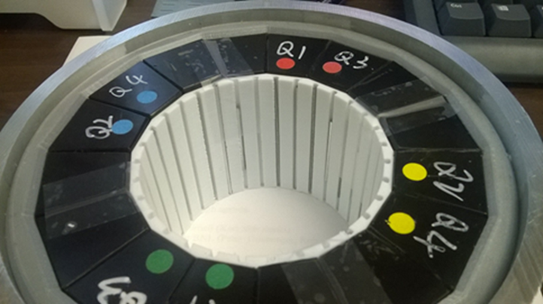
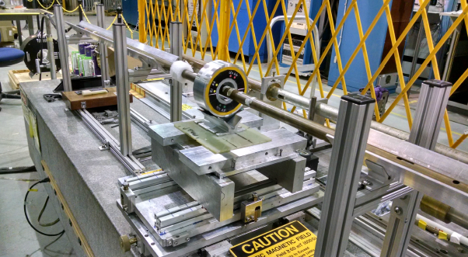
Magnetic Measurement – Multipole Reduction
This step would be performed at BNL with the delivered magnets
Details in Stephen Brooks talk
To reduce multipole errors, the magnets are tuned with steel rods inserted in the inner radius of the magnet aperture after magnetic measurement.
Steel wires of various diameters and lengths inserted into the magnet bore., shown in Figure below.
There are 32 wire holders evenly-spaced around the bore of the magnet
If necessary wire holders for 48 or 64 wires can be used to increase multipole reduction strength & accuracy.
Inner (white) holder for steel rods

