Slide 1

FFAG Magnets and Girders Meeting
September 6, 2017

Slide 2
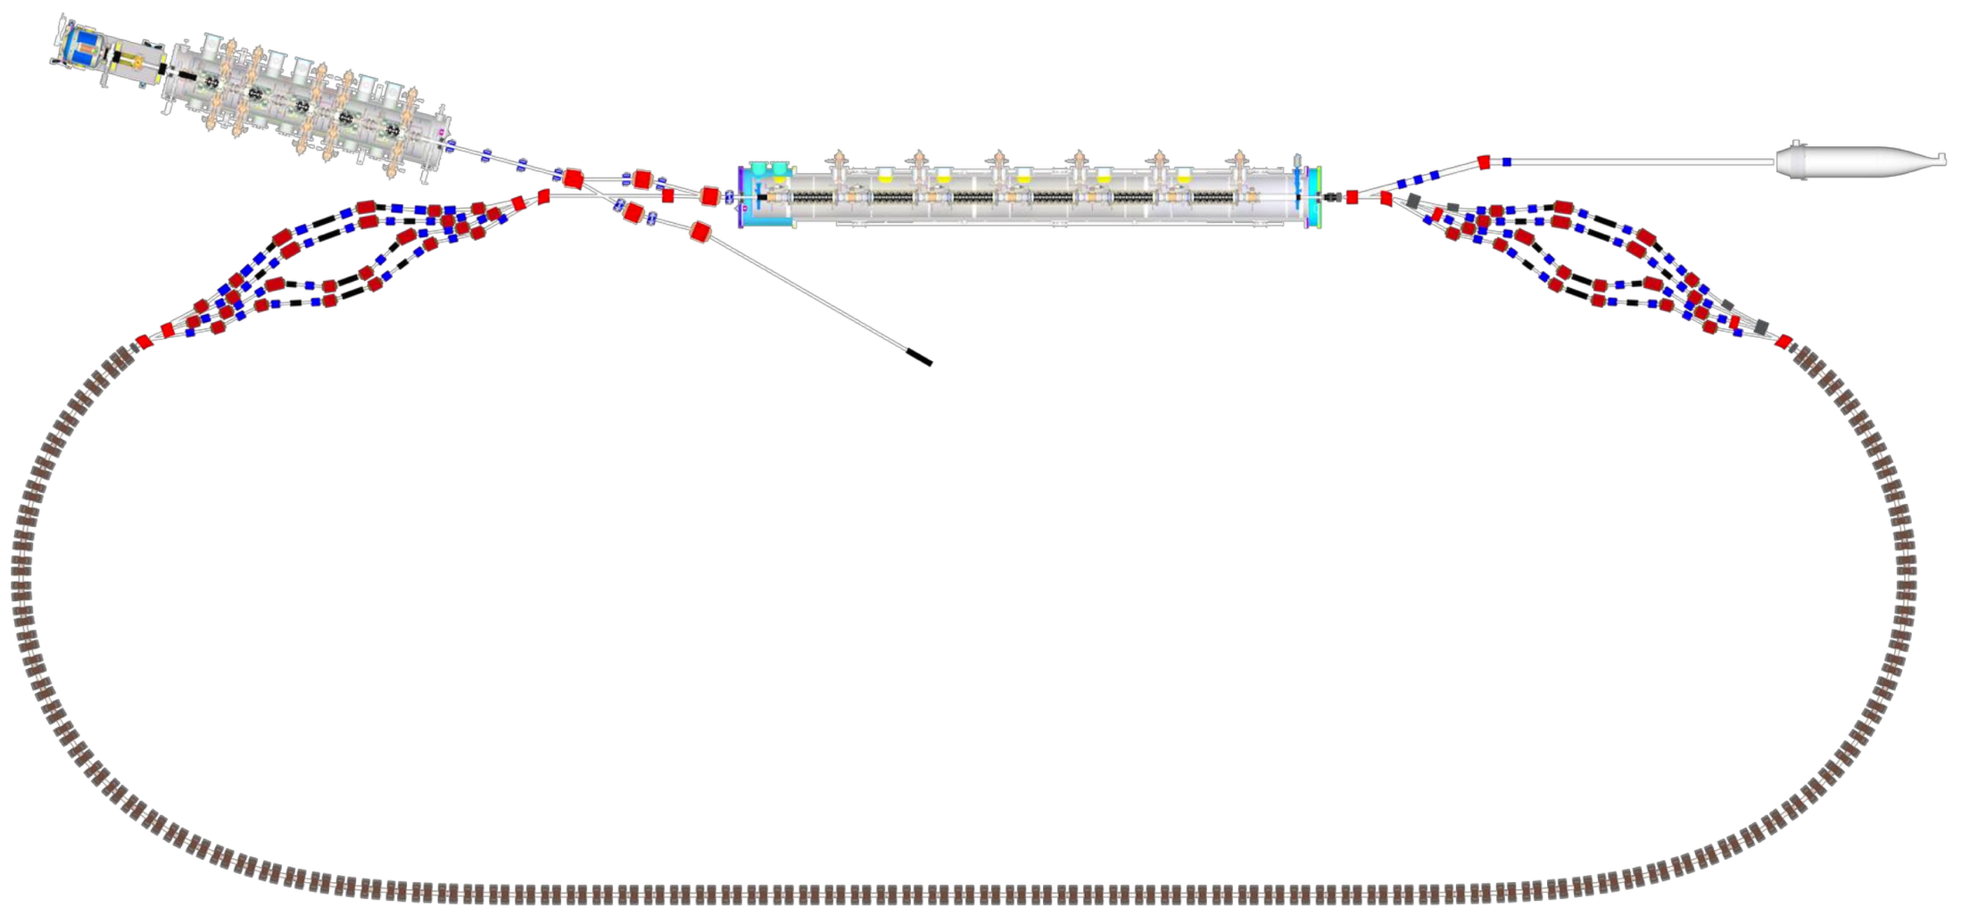

CBETA Machine Layout
Injector cryomodule
Electron source
Main linac cryomodule
LA
DU
Dump
Merger
IN
Splitter B
DI
Diagnostic line
Splitter A
RX
SX
FFAG
arc B
FFAG
arc A
FB
FA
FFAG
Transition B
FFAG
Transition A
TB
ZB
FFAG straight
ZA
TA

Slide 3
Agenda
Girder for fractional arc test
Design review / status and procurement review, Wednesday September 20, 2017, 9am
Magnet procurement and assembly plan
Schedule

Slide 4
Fractional Arc Test Girder
Construction of ½ magnet
Design and construction of girder plate (Is this a special plate for fractional arc test only?)
  Plate drawing with all drill holes
Water connections
Power supply connections and terminal blocks
Rebuilding of preproduction magnets
Testing and acceptance of preproduction magnets for fractional arc test
  Magnet tuning
  Disassemble, re-assemble Halbach magnet test

Slide 5
Design Reviews
FFAG magnets, girders, power supplies
Halbach magnets
  Magnet design
  Definition of types, layout
Corrector magnets
  Magnet design
  Power supplies – specifications, manufacturer model number options, etc., controls interface
Halbach and corrector magnet assembly details
Procurement plan
Girder assembly plan
  Magnet adjustability design
  Girder plate final dimensions, number of different configurations for beam pipe mounting
  Surveying plan – what will be done at BNL/CU?
  Will beam pipe need to be shipped to BNL for installation on girder, or can that be done at CU after girder preassembly? If beam pipe is shipped back and forth, at what stages will leak checks be performed?
  Plan for vertical split assembly/disassembly
  Extension plates (bolted on to standard plate?) for first and last arcs to accommodate beam pipe section between splitters and FFAG
Shipment plan and staged schedule

Slide 6
Halbach Assembly Plan
Bid is out for quote (9/15 or 9/18 bids due)
As an alternative, we should consider building the Halbach magnets in house
  What would it take to design good tooling?
  How should we proceed to develop this plan with cost estimate?
  Is manpower available?
What is the realistic cost of aluminum housings?

Slide 7
FFAG girder assembly and test plan
Need to define a good written plan
  Permanent magnet material
  Halbach assembly, testing, survey and acceptance
  Corrector construction, testing and acceptance
  Girder table construction
  Girder plate construction
  Assembly of beam pipe, magnets, wiring, piping, etc. on girder plate
  Shipping to Cornell
  Water connections and manifold design
  Final installation and surveying at Cornell
  Cable tray design
  Interconnecting wiring layout

Slide 8
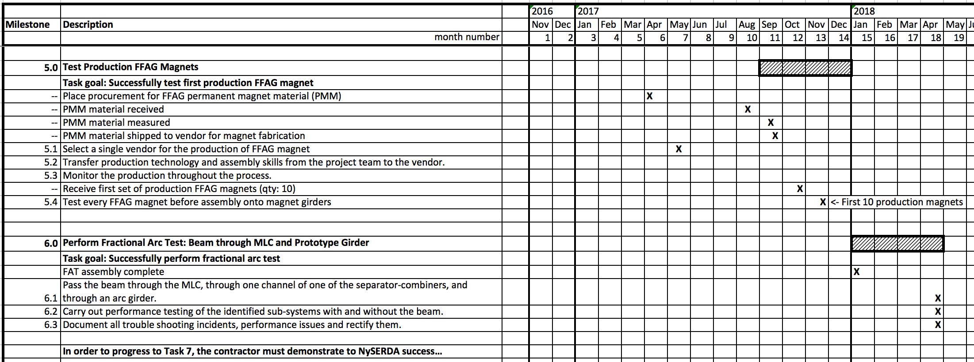
Schedule – Milestones 5-6
First article production magnet milestone: 12/2017

Slide 9
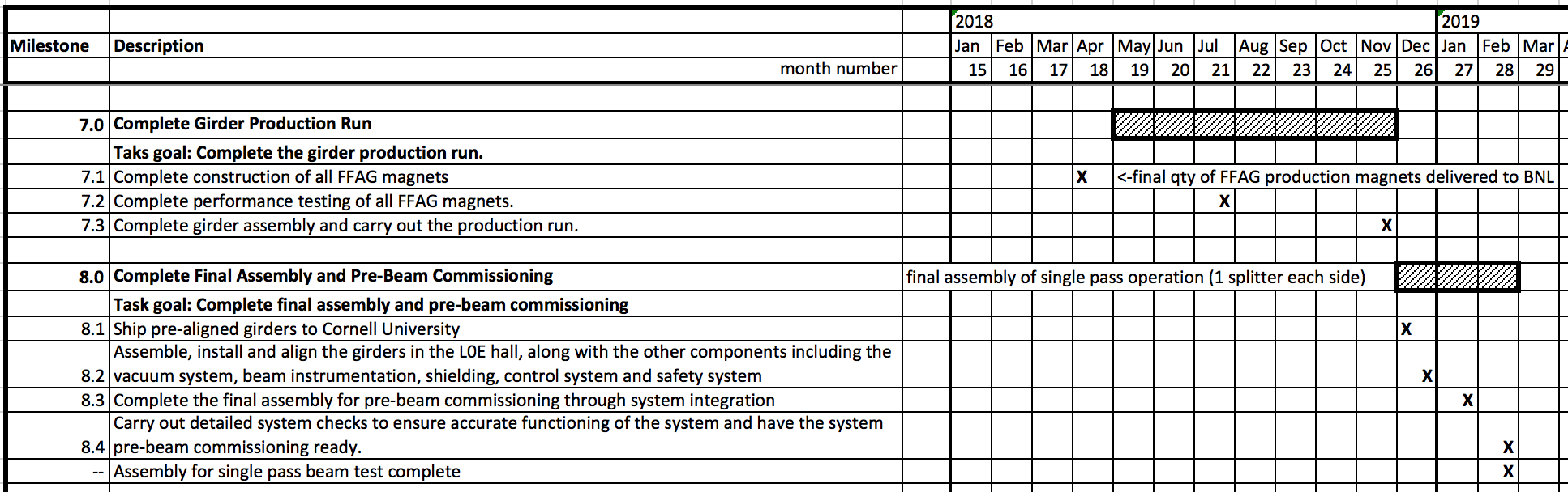
Schedule – Milestones 7-8
Complete girder production: 11/2018 (should try to complete by 9/2018)
Note 7.1, 7.2, 7.3
Complete final assembly: In order to satisfy 2/2019 milestone, installation of FFAG beam-line with all girders should be complete by 12/2018 or sooner.

