Slide 1
How the BAMs might work
Adam Bartnik

Slide 2
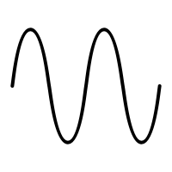
Beam 1
Beam 2
Basic Idea
Raw button signal is put through bandpass filters at two frequencies
Result is mixed to lower frequency
Low frequency data is sampled with ADC for amplitude / phase
Time
1.3 GHz
2.6 GHz

Slide 3
Case 1: Well separated beams
Time
…
Case 2: Overlapping beams
Time

Slide 4
Case 1: Well separated beams
Time
…
CBETA roundtrip time is ~200 ns
With a bunch train < 200 ns, they will not overlap in the BAM
Currently, minimum bunch length for our BPM electronics is around 300 ns.
If we use a slightly faster mixing frequency and ADC, we should be able to see both beams individually
Then, the problem is the same as what we do now, and we can consider that “done.”
This should be the primary “tuning” mode of operation– infrequent bunch trains with <200 ns train length.

Slide 5
Eventually, in CW mode, we will have overlapping beams in the BAMs
Now, how do we disentangle the two ADC readings at 1.3 GHz and 2.6 GHz?
Basic problem: For each button, given the I&Q of the sum of both beams at 1.3 GHz and 2.6 GHz:
Can we reconstruct I&Q of each beam individually at 1.3 GHz?
How sensitive is it to noise?
Does it work for all phases / intensities of each beam?
Case 2: Overlapping beams
Time

Slide 6
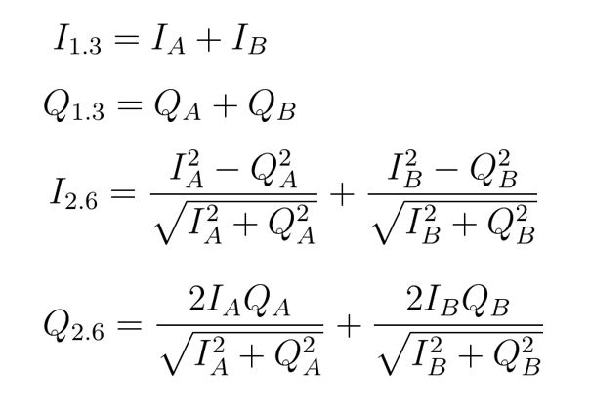
In other words: can you invert these equations?
I_{A}, Q_{A} = I,Q of the first beam at 1.3 GHz
I_{B}, Q_{B} = I,Q of the second beam at 1.3 GHz
I_{1.3}, Q_{1.3} = I,Q of both beams at 1.3 GHz
I_{2.6}, Q_{2.6} = I,Q of both beams at 2.6 GHz
Algorithm:
Solve first two equations for I_{B}, Q_{B}
Find the best fit I_{A}, Q_{A} that best produce I_{2.6}, Q_{2.6} in the least-squares sense.
Nonlinear fit, needs a starting guess
Two questions:
With a good guess, how sensitive is it to noise?
How robust is it to starting guess?
Measure these
Solve for these

Slide 7
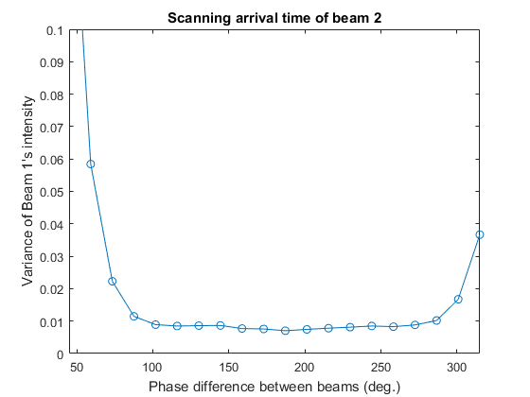
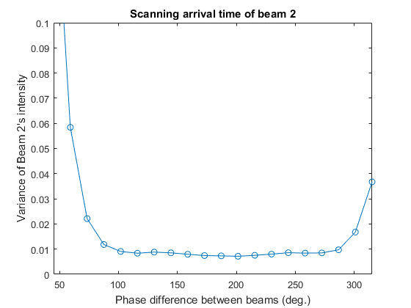
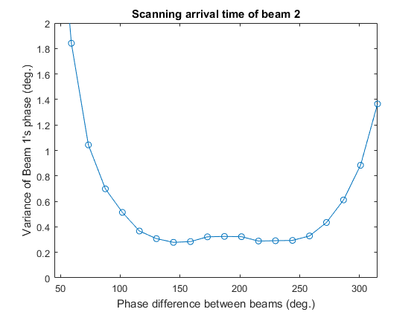
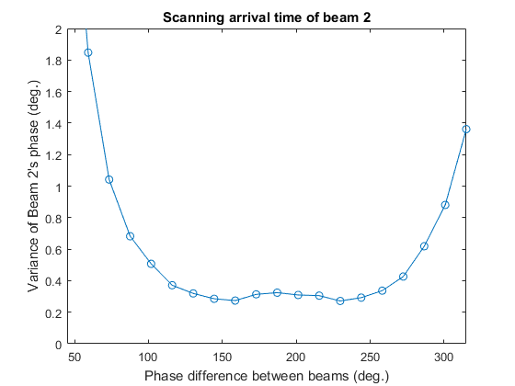
Test 1: Arrival time of beam 2
Beams have equal intensity
Add noise to I,Q at the 1% level
Result:
For equal intensity beams, algorithm works well for arrival phase differences from ~90-270 degrees.
When the beams are close to overlapping, solution becomes degenerate and method breaks down

Slide 8
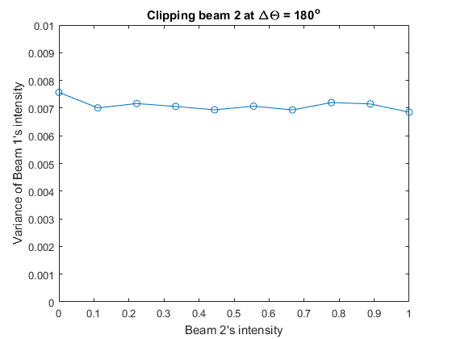
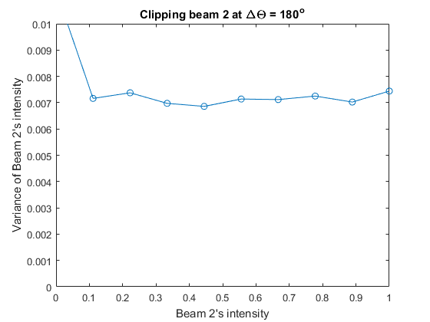
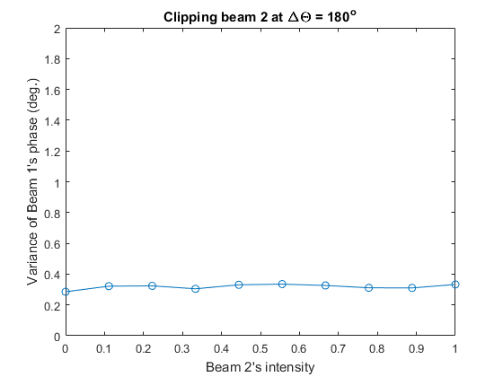
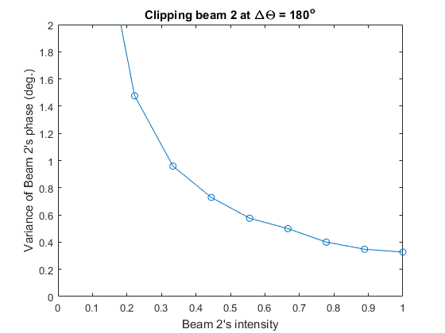
Test 1: Intensity of beam 2
Beams are 180º out of phase
Add noise to I,Q at the 1% level
Result:
Intensity is well-determined for both beams
Phase has ~degree level error or better for transmission greater than 20%

Slide 9
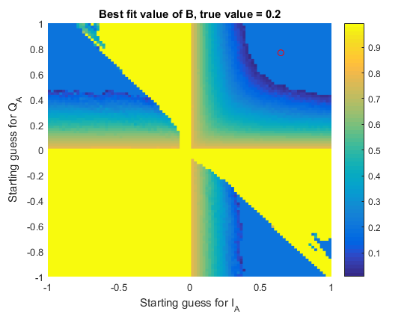
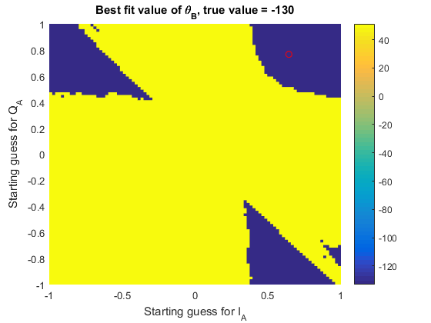
How robust is the fitting algorithm to initial guess?
Test: Try many I,Q guesses and see over what region it converges to the correct root
Result: need a sufficiently good guess what the first beam is doing for any accuracy.

Slide 10
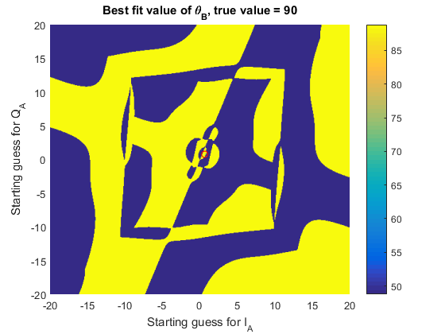
Most ridiculous plot yet made for CBETA…

