Slide 1
CBETA BPM
Comparison of different non-linear correction methods
Bartnik, R. Michnoff
December 14, 2018

Slide 2
The correction methods
Beam position and intensity is corrected using 4 different methods
  Difference/sum
  Colwyn’s analytic model
  Peter Thieberger’s analytic model
  Poisson fieldmap lookup table (for oval pipe case only)

Slide 3
The different BPMs
Three different BPMs were used for this analysis, each with a different design
  IS1BPM01 – V301 BNL electronics, buttons, oval pipe, in the splitter
  ID1BPC01 - CU electronics, striplines, round pipe, right after the MLC
  IB1BPC03 - CU electronics, buttons, round pipe, right before the MLC

Slide 4
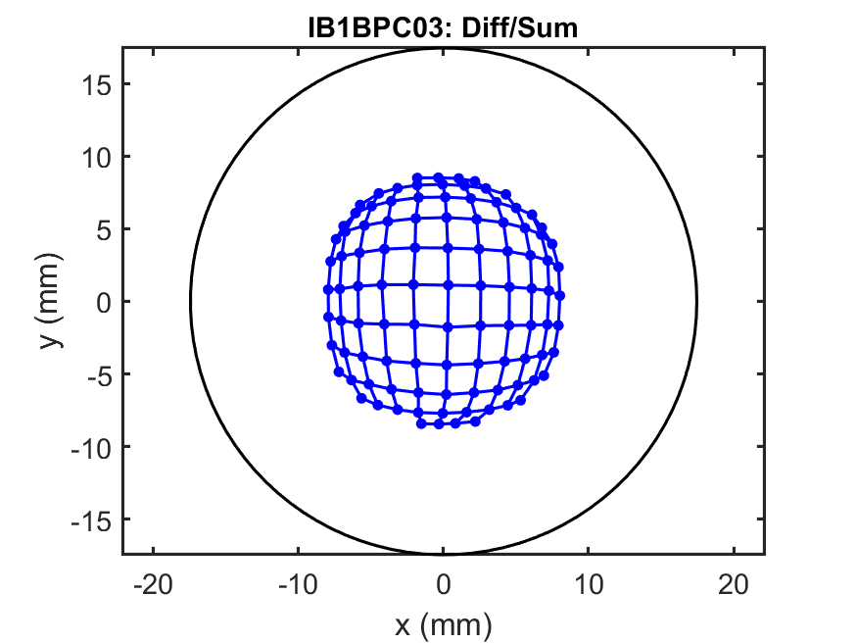
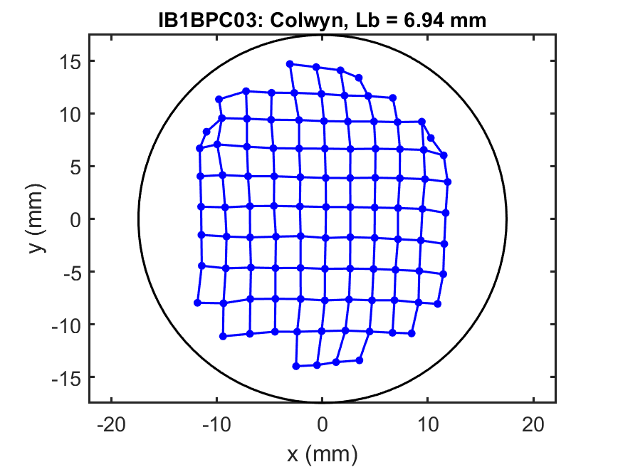
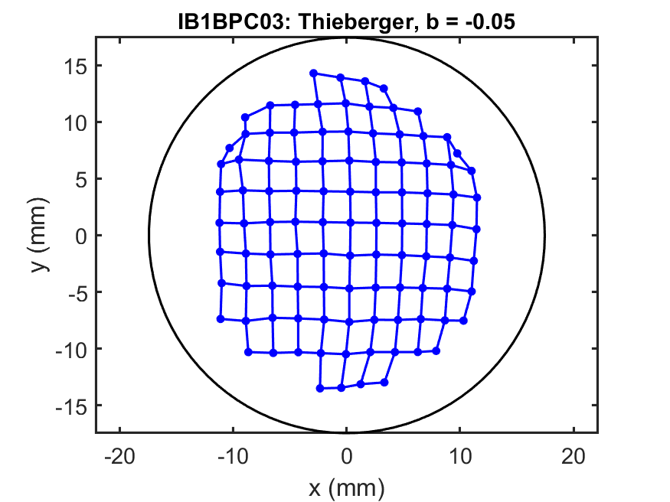
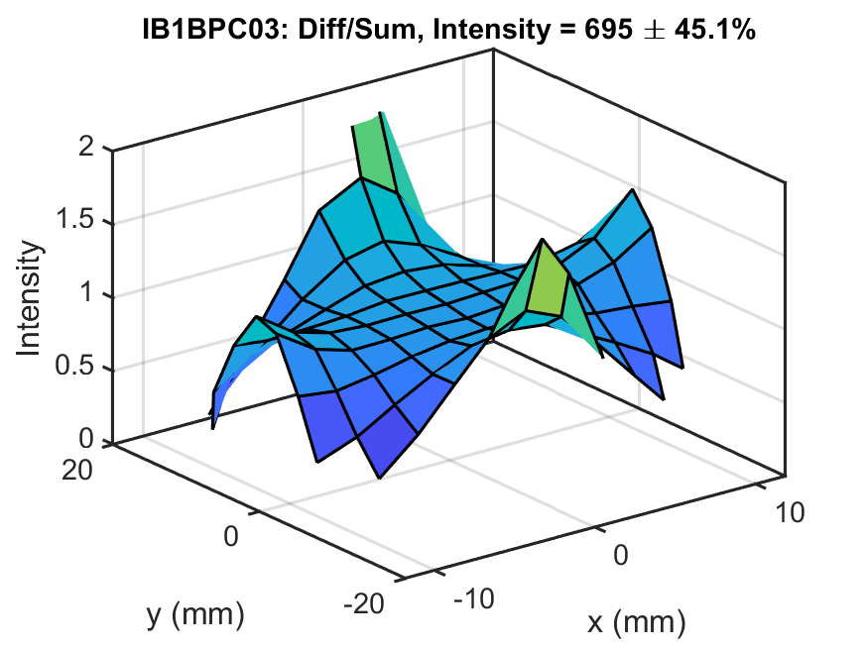
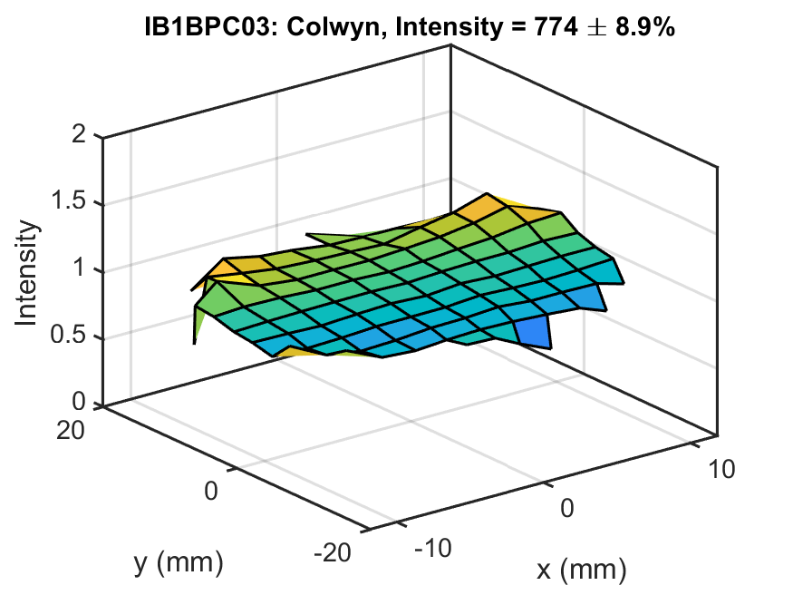
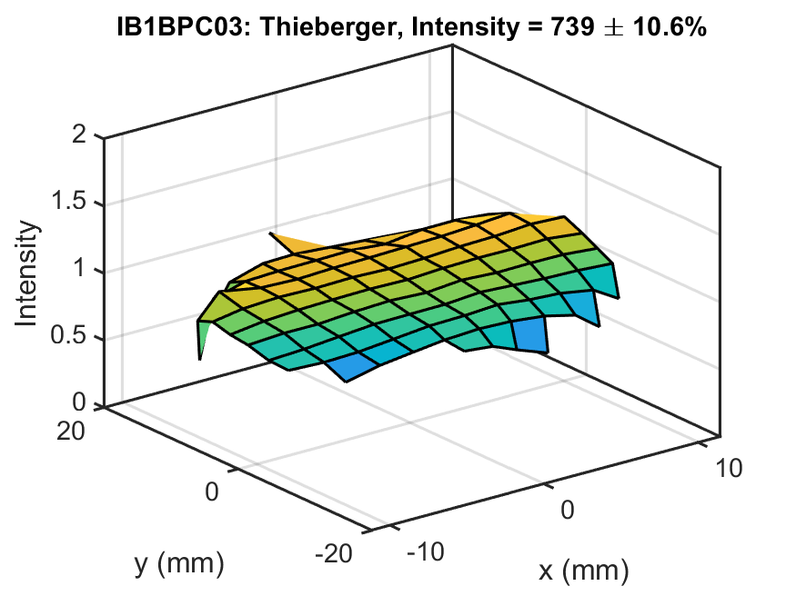
IB1BPC03

Slide 5
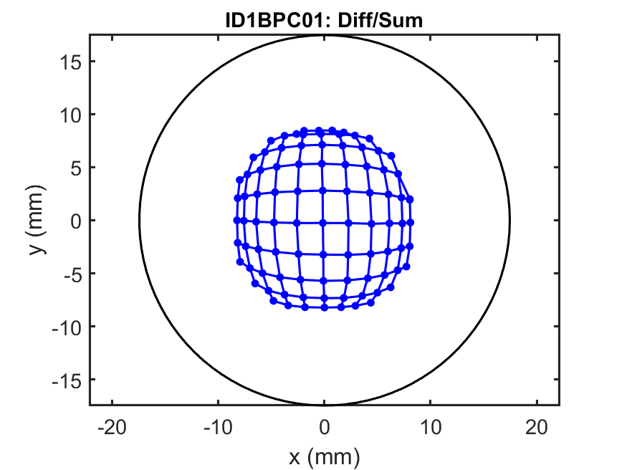
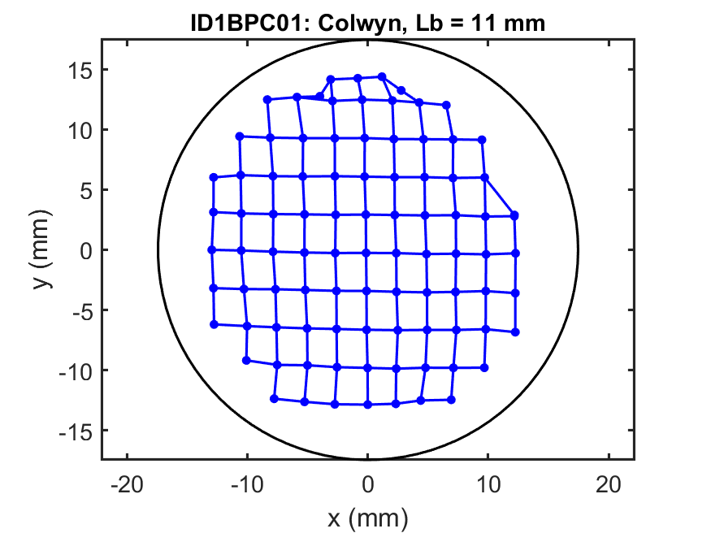
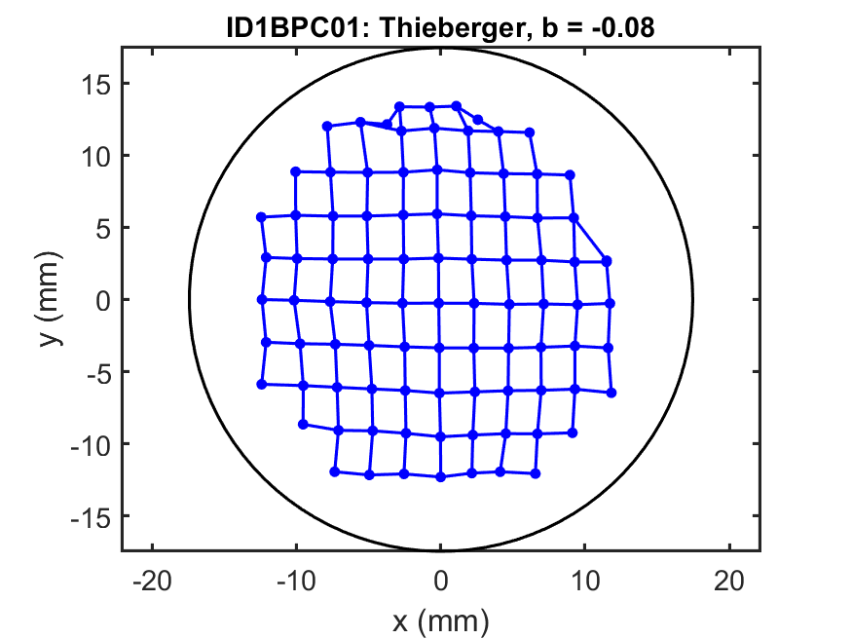
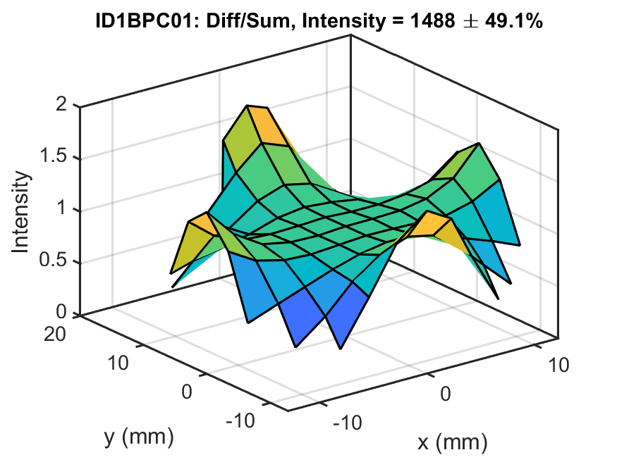
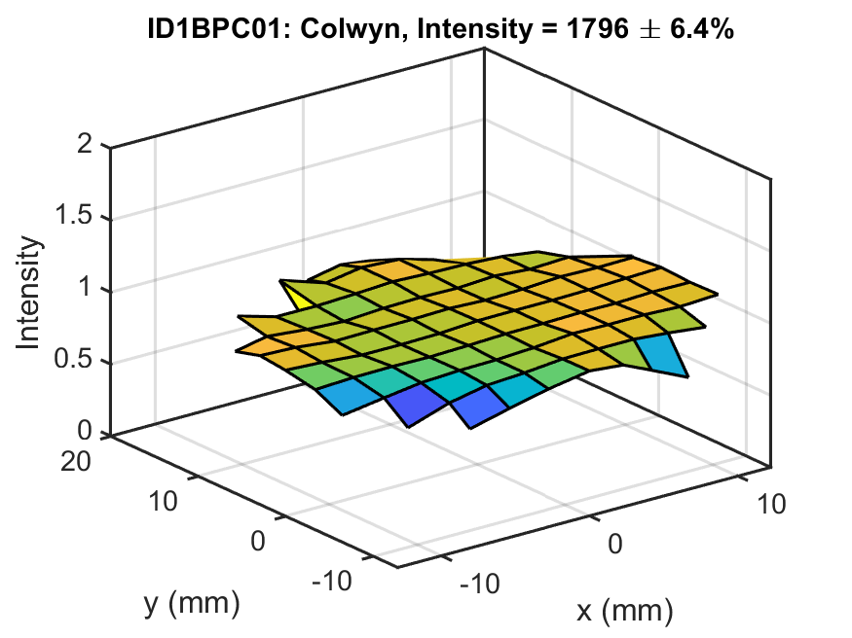
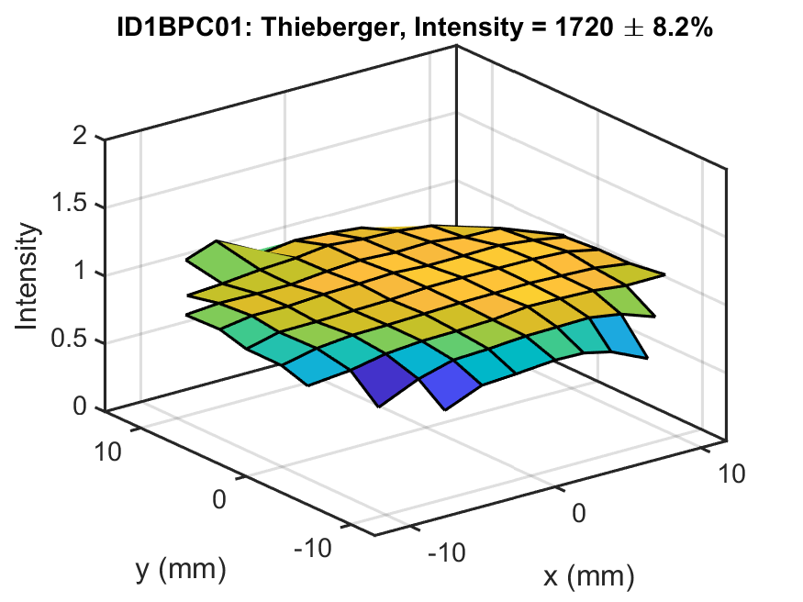
ID1BPC01

Slide 6
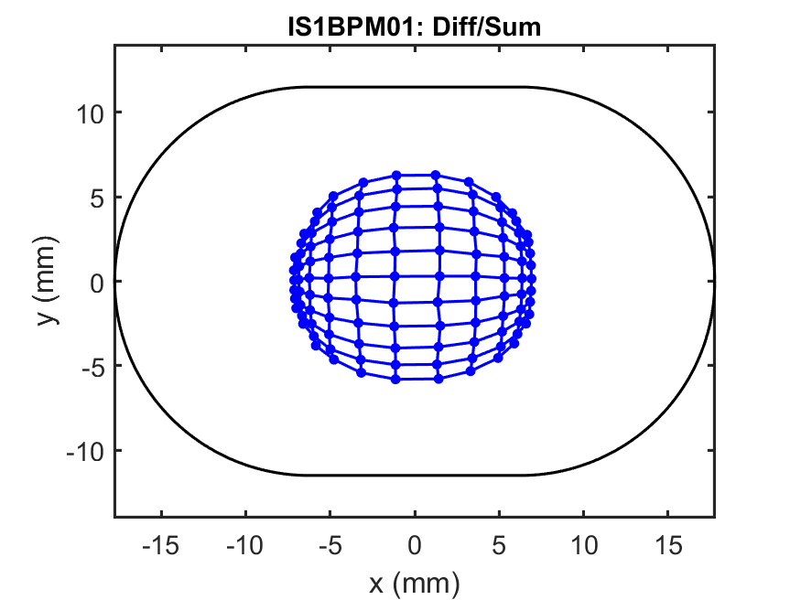
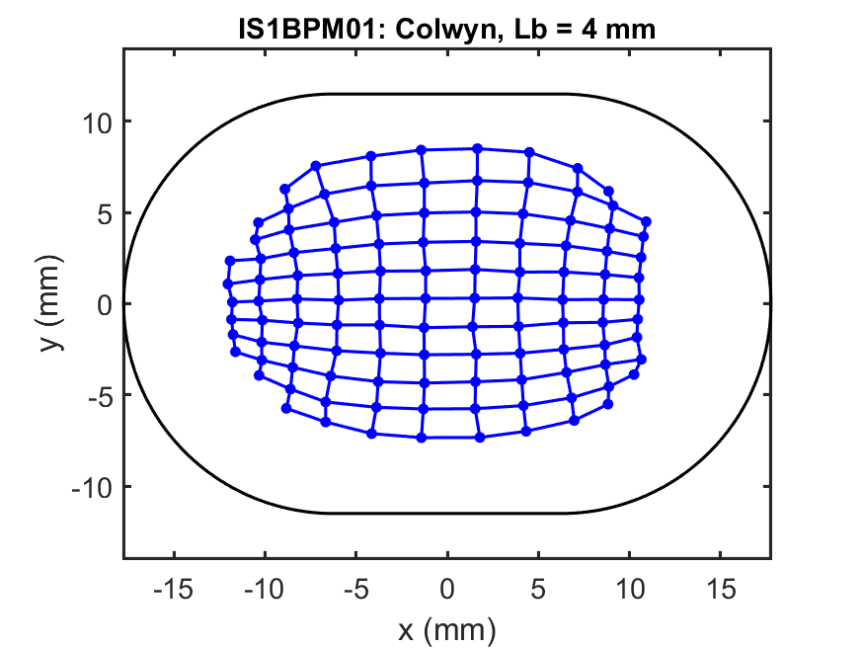
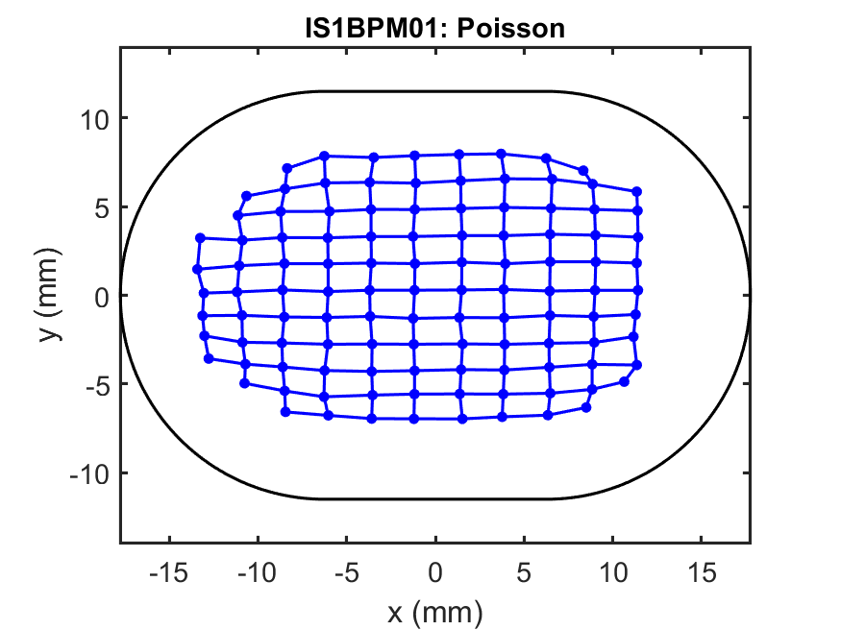
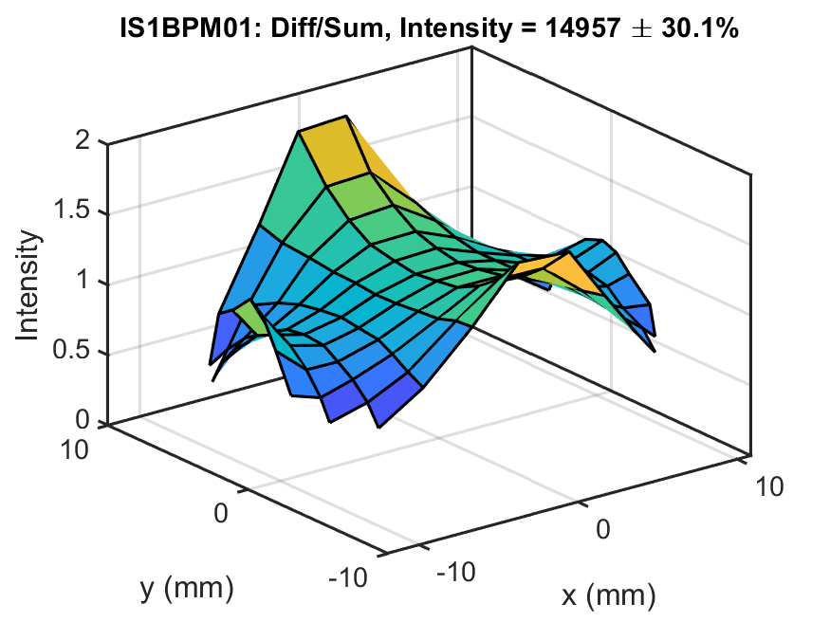
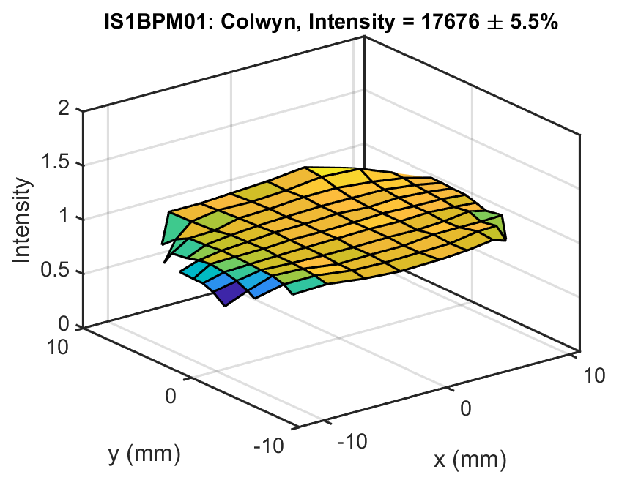
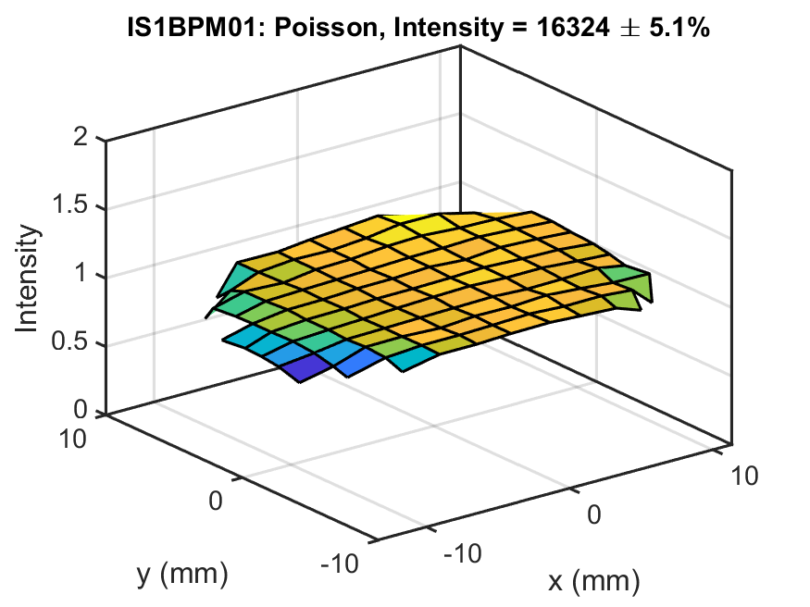
IS1BPM01

Slide 7
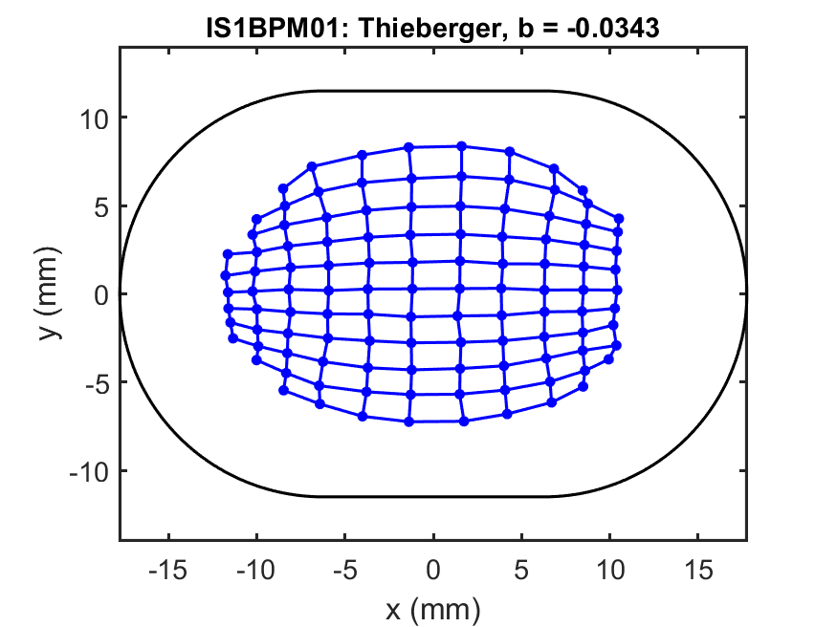
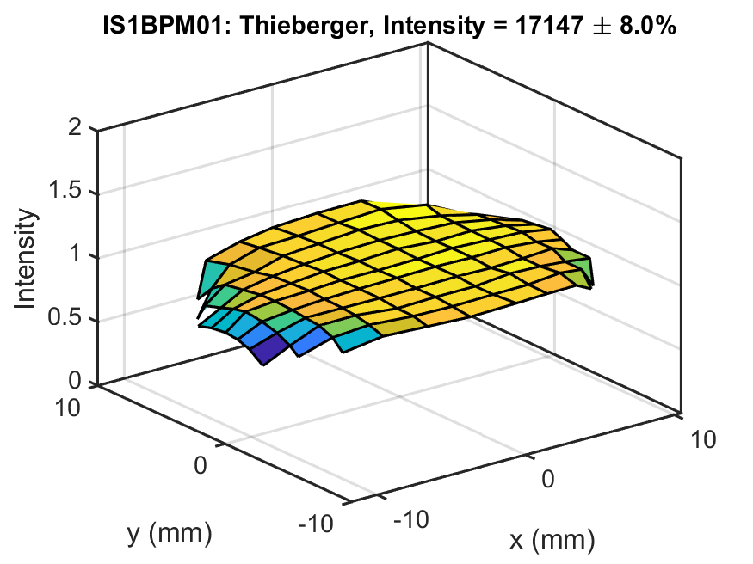
IS1BPM01

Slide 8
Conclusions
The diff/sum method can not be used for beams far off center as will be the case in the CBETA FFA
The Poisson model produces the most accurate results
Colwyn’s analytic model and Peter Thieberger’s analytic model produce similar results
Peter Thieberger’s method has the advantage that it is a direct formula and can be incorporated into gate array code for real-time processing, including for fast equipment protection requirements
The Poisson, Colwyn and Thieberger models all have “fudge factors” to give some freedom in best fitting the nonlinearity, and the fudge factors depend on the geometry and have already been chosen to make the data look as good as possible

Slide 9
Other Notes
A pincushion measurement on the FFA style round pipe with buttons has not yet been performed, but is hoped to be done at some point.
Regarding the fudge factors for the FFA style BPM, values used for IB1BPC03 are recommended since they are very close to a scaled up version of that BPM.

Slide 10
Plans
The Thieberger method will be incorporated in the V301 gate array code for fast bunch position calculations and used for machine protection threshold checks
The Poisson method will be implemented in the V301 IOC code to provide slower (1 Hz or possibly 10 Hz) calculations with the best possible accuracy.
Development and testing is required to confirm the viability of this plan.

