Slide 1
ERL Master Oscillator:
The existing ERL Master Oscillator produces a number of frequencies:
1300 MHz – for RF
1287.5 MHz – local oscillator signal for LLRF system mixers ( 12.5 MHz IF) and Cornell style ERL BPM system
50 MHz and 12.5 MHz for
  LLRF system data acquisition ADC clock
  BPM system data acquisition ADC clock
  timing system clock
These signals are all derived from a single reference (frequencies are phased locked)
To accommodate the tuning range of the MLC the RF frequency has been changed from 1300 MHz to 1299.9 MHz. The reference signal (previously 10 MHz crystal) is now a signal generator at 9.99923 MHz. Where 1300 MHz appears I the following it is actually 1299.9 MHz.

Slide 2
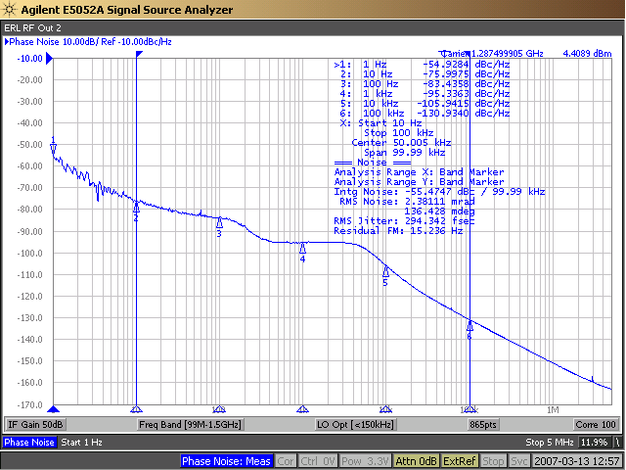
Measured phase noise of Master Oscillator (2007) ~ 0.3 pS
(10 Hz to 100kHz ? using built-in 10 MHz reference)

Slide 3
ERL Master Oscillator and Laser:
In ERL and FAT operation the laser pulse repetition rate was either 1300 MHz or 50 MHz.
Laser was phased locked to 1300 MHz.
In the case of the 50 MHz laser the phase between the laser 50 MHz and the Master Oscillator 50 MHz was subject to change when laser lost phase-lock (the relative phase shifts by a random number of 1300 MHz cycles).

Slide 4
CBETA Laser:
The CBETA laser operates at 1300/31 ≈ 41.935 MHz (frequency chosen to produce desired ‘pyramids’)
Laser is phase locked to 1300 MHz.
N.B. The LLRF data acquisition system will continue to use the original master oscillator signals at 1300 MHz, 1287.5 MHz (local oscillator), 50 MHz and 12.5 MHz ( ADC clocks)
A consequence of this is that LLRF system events can only be timed to an accuracy ~ one 50 MHz clock cycle.
Affects:
feed-forward
50 MHz data buffers

Slide 5
CBETA BPMs:
The CBETA BPM data acquisition electronics (BNL V301 board) require a new timing source matched to the new laser repetition rate.
CBETA BPMs will receive a 41.935 MHz clock which will be multiplied by 19/4 to ≈ 398.4 MHz
The V301 board applies a delay to this clock as needed to position the ADC sample at the peak of the BPM signal waveform.
Note that this delay is specific to beam species, e.g. 42 MeV accelerating bunch. Hence data acquisition is for one species at a time. When there are multiple species the BPM electronics divides its acquisition time between the various species.

Slide 6
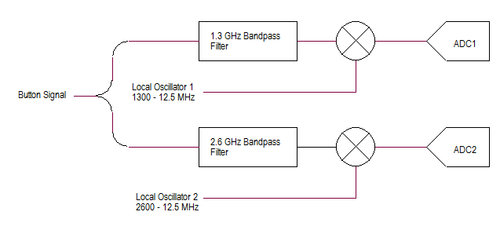
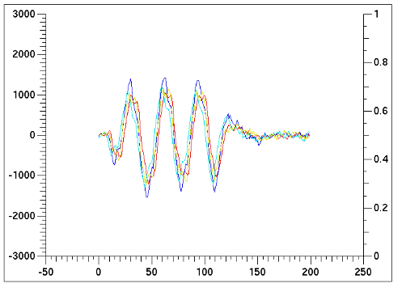
CBETA BAMs:
The CBETA BAMs are essentially RF BPMs. The signal from the pick-up is mixed with a local oscillator signal to produce an RF signal at a lower frequency
V301 board
Local Osc 1
Local Osc 2

Slide 7
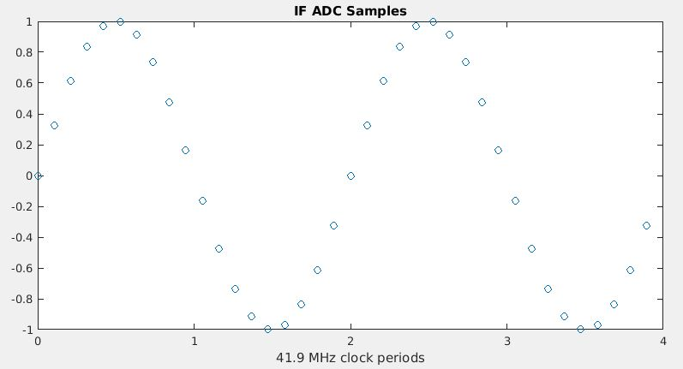
CBETA BAMs:
We need to generate a local oscillator for the 1300 MHz mixer and a local oscillator for the 2600 MHz mixer so that the resulting intermediate frequency works with the V301 board ADC timing. One choice for intermediate frequency is 41.935/2 ≈ 20.97 MHz.
The required local oscillator frequencies are then:
1300 – 20.97 ≈ 1279 MHz
2600 – 20.97 ≈ 2579 MHz

Slide 8
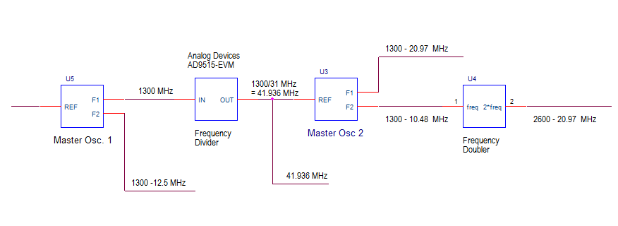
CBETA BAMs:
Proposed scheme for generating local oscillator signals
ERL Master Oscillator
Reprogrammed spare ERL Master Oscillator

Slide 9
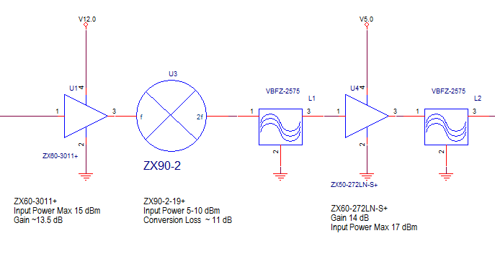
CBETA BAMs:
Frequency Doubler:

Slide 10
CBETA ERL style BPMs:
The Cornell designed ERL style BPMs are similar to the CBETA BAMs. They include a mixer and data acquisition module. These too would need to be converted to run with a new local oscillator frequency and new data acquisition clock.
Initial tests indicate that this hardware will work with either:
IF ≈ 10.48 MHz, ADC clock ≈ 41.93 MHz
IF ≈ 20.97 MHz, ADC clock ≈ 2 * 41.93 MHz ≈ 83.87 MHz
Note that specifics of the hardware require construction of a new clock encoder module. This module provides a signal combining both clock and control data for the BPM module.
There are nine ERL style BPMs in use. There are no spares. I would hope in the future to reduce the number on these in use so that one module could become a spare.

Slide 11
Still need to:
verify that existing ERL Master Oscillator can go as low as 1300 – 21 MHz. ( depends on installed VCO )
Perform phase noise measurement on new arrangement
Design and build ERL style BPM clock encoder module
Design and build laser pattern generator (details covered elsewhere).
Design both clock and local oscillator distribution (with some attention to cable delay vs. temperature)

