Slide 1
CBETA clock/trigger fan-out
Texas Instruments CDCLVC1112 is a 1:12 LVCMOS Clock Buffer with low skew and low jitter.
This IC is available on an evaluation board CDCLVC1112_EVM
Would like to construct a digital fan-out based on this evaluation board.
CDCLVC1112 Data-sheet:
  http://www.ti.com/lit/ds/symlink/cdclvc1112.pdf
CDCLVC1112 User-guide:
  http://www.ti.com/lit/ug/scau042/scau042.pdf

Slide 2
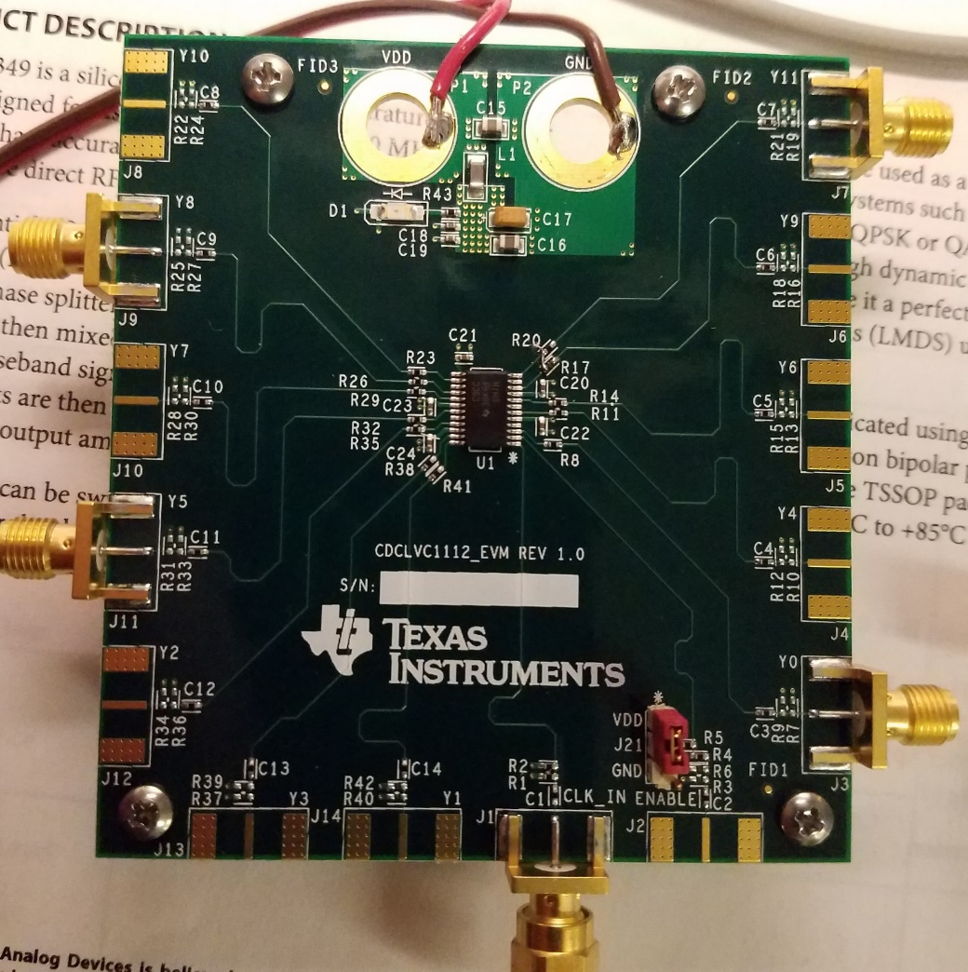
CBETA clock/trigger fan-out
CDCLVC1112_EVM:
Note: the boards comes with two banana jacks installed. These have been removed.

Slide 3
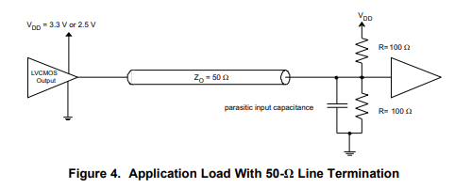
CBETA clock/trigger fan-out
The CDCLVC1112 is intended to drive a termination of 50 Ω to VDD/2

Slide 4
CBETA clock/trigger fan-out
The CDCLVC1112 can source and sink 12 mA producing logic levels at the termination load of
VDD/2 ± 12 mA* 50 Ω = VDD/2 ± 600 mV
Receivers differ in their input logic levels
  The CDCLVC1112 has logic thresholds of VDD/2 ± 600 mV
  The SN65LVDS104, the clock receiver at the BPM electronics rack will use this, has logic thresholds of VDD/2 ± 100 mV

Slide 5
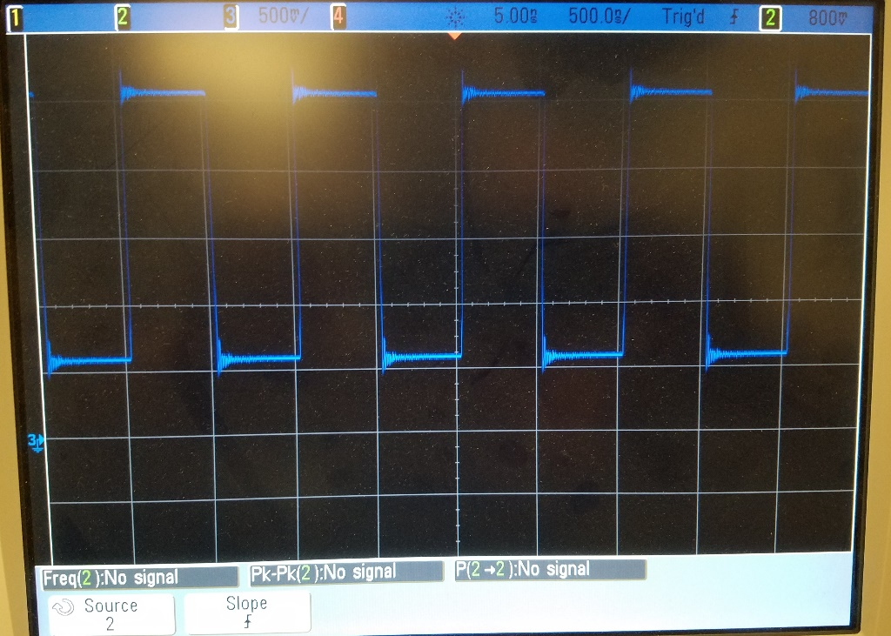
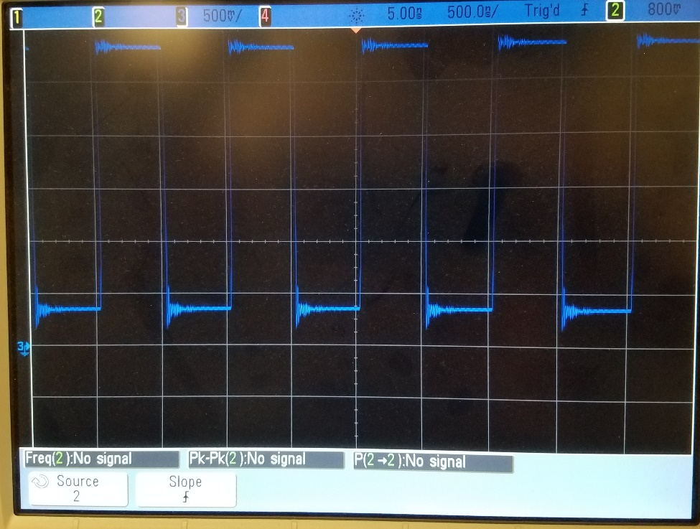
CBETA clock/trigger fan-out
Note:
The output drive of the CDCLVC1112 can be increased by connecting two outputs in parallel:
Single Output, 50 Ω load
Parallel Outputs, 50 Ω load

Slide 6
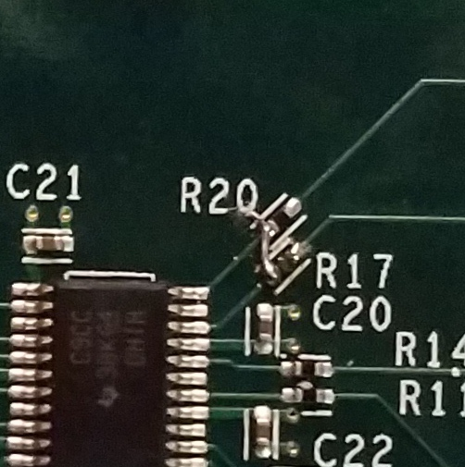
CBETA clock/trigger fan-out
Plan to create a 1:5 fan-out by connecting CDCLVC1112 outputs in parallel.
This image shows the zero Ω resistor R17 removed and the connection of Y11 and Y9
Similarly join:
Y6, Y4
Y3, Y1
Y5, Y2
Y8, Y10
(pairings based on pinout of CDCLVC1112)

Slide 7
CBETA clock/trigger fan-out
Note:
CDCLVC1112 ships with SMA connectors on outputs Y0 (J3), Y5 (J11), Y8 (J9), and Y11 (J7)
We will need to add an SMA connector on output Y3 (J13)

Slide 8
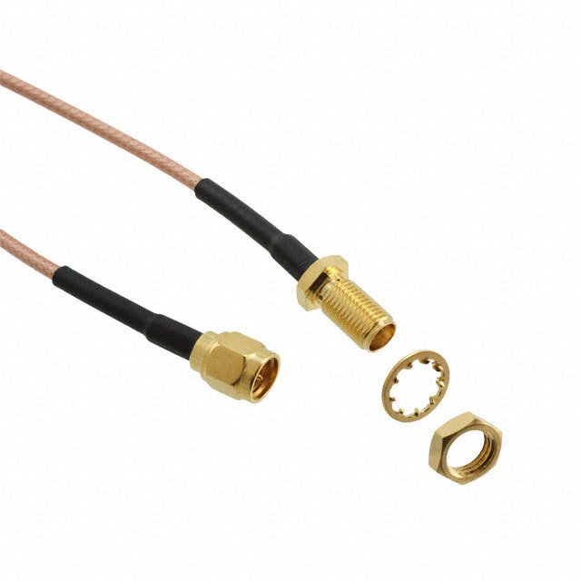
CBETA clock/trigger fan-out
Packaging plan:
Mount two CDCLVC1112_EVM in a 1U chassis (to create dual 1:5 fan-out)
Connect CDCLVC1112_EVM input and outputs to front panel using SMA cables, e.g.
Digikey P/N J3912-ND

Slide 9
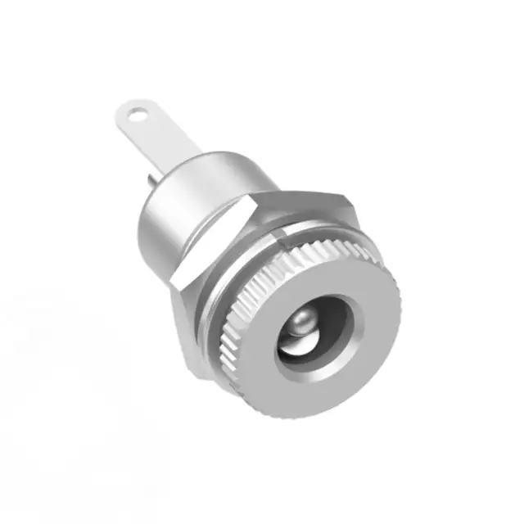
CBETA clock/trigger fan-out
Packaging plan:
Supply power through panel mount barrel connector, e.g.
Digikey P/N 839-1292-ND

Slide 10
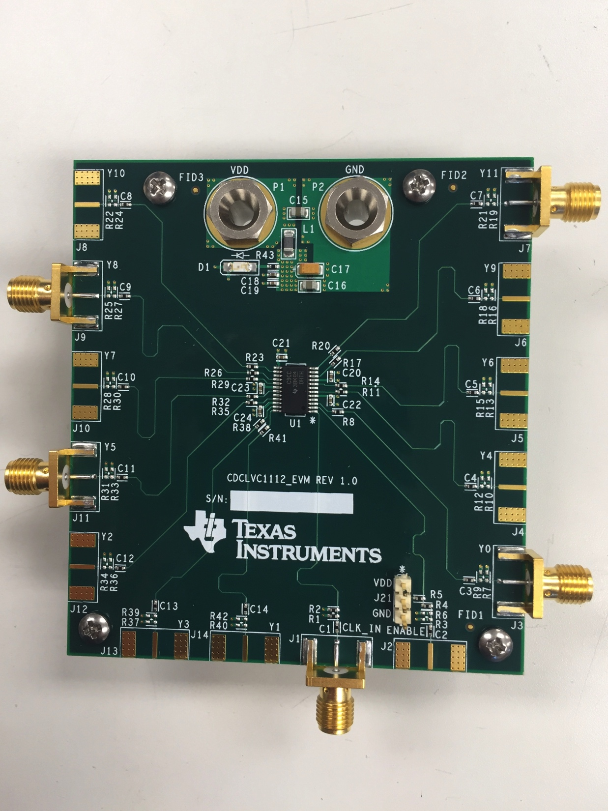
CDCLVC1112_EVM Board Modifications
Add SMA connectors to the following locations: connectors:
J10
J5
J13
Remove VDD and GND banana plugs, and solder wires to power supply.

Slide 11
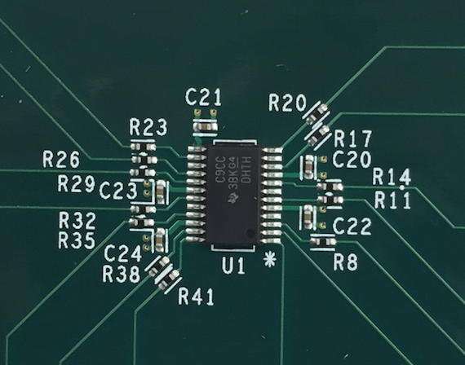
CDCLVC1112_EVM Board Modifications
Remove the following resistors (identified by red circles):
R11
R41
R35
R23
R17
Add jumper wires between each of the following resistor pairs on the U1 connection side. (identified by yellow lines):
R11
R41
R35
R23
R17

Slide 12
CBETA Clock and Trigger Fanout Front Panel Layout
CBETA Clock and Trigger Fanout
Input
1
3
5
6
Input
1
3
5
6
2
4
7
2
4
7
High Level Outputs
Low Level Outputs
High Level Outputs
Low Level Outputs
Board to front panel connections
Input: J1
Output 1: J9 Output 6: J10
Output 2: J11 Output 7: J3
Output 3: J13
Output 4: J7
Output 5: J5
Outputs 1-5 are high level outputs
Outputs 6-7 are low level outputs

