Slide 1

CBETA
Fast Beam Loss Monitor
Julio C. Renta
Notes:
My Name, Building# 924, Fall under Rob Michnoff, Project start date: Oct 2019, 4 months later received the 1st Live Test date: Jan 29th 2020.
Speak Slow-Medium and Clear

Slide 2
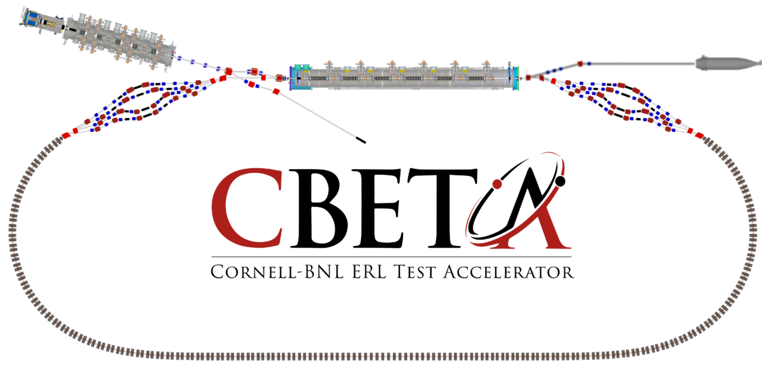
TOPICS
Project Overview
  Purpose
  FBLM Chassis
  Interconnectivity
Subsystem Design
  Hardware
  Firmware
  Software
Project Status
  Output Latch Delay
  Real Data from CBETA
Current Work In Progress
References
Q & A

Slide 3
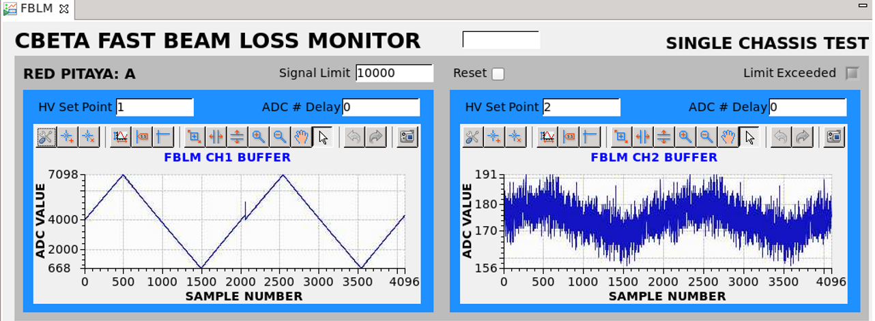


Project Overview - Purpose
Used for Measuring and Alerting
  Measure beam loss
  Used to inhibit the beam
  Sends a signal to disable the laser
Used for machine protection
  Halbach Permanent Magnets
  Prevent Demagnetization
  Must Limit Beam Loss < 100pA of continuous current
Notes:
The FBLM Chassis is designed to provide a fast shutdown system for the protection of accelerator system components.

Slide 4
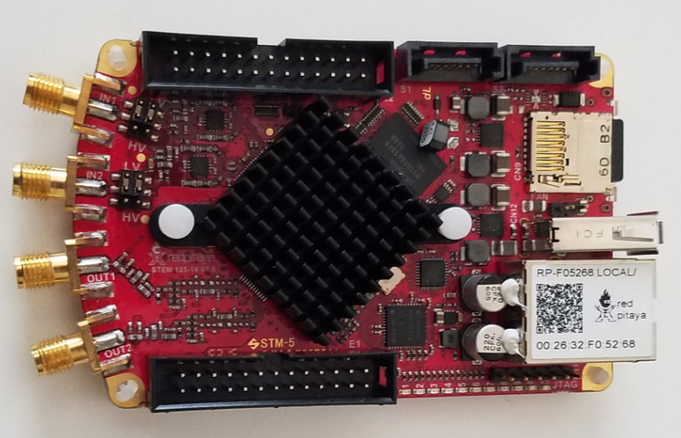
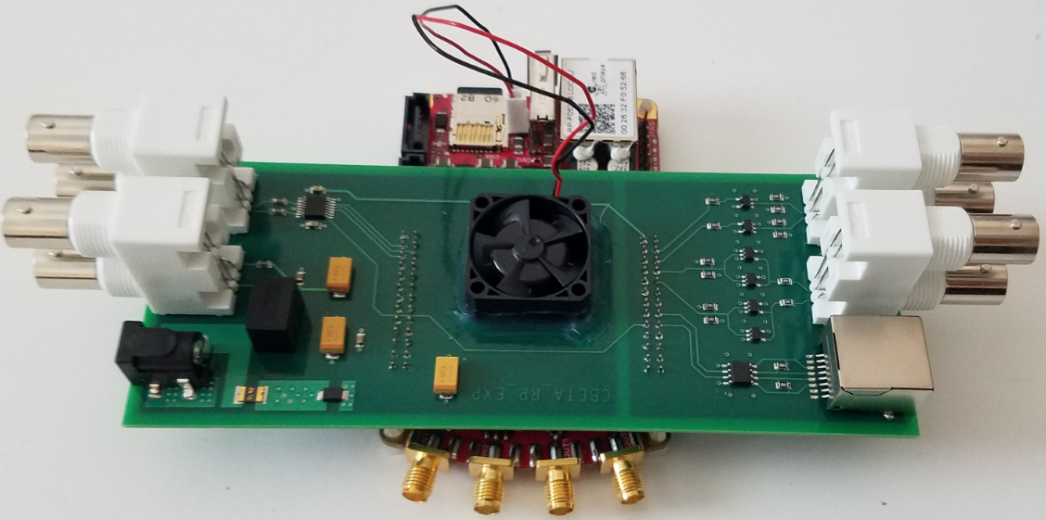
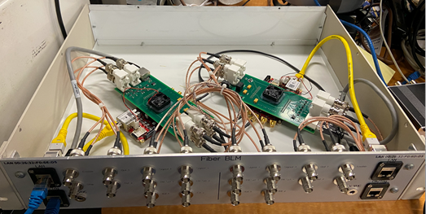
Project Overview - FBLM Chassis (Brief)
Red Pitaya
  laboratory measurements
  controlling Instrumentation
Expansion Board
  Connects to RP
  Extends I/O’s to BNC
Chassis
  2x Red Pitaya
  2x Expansion Bds
  Connects to 4 PMTs
Notes:
The Red PItaya is a low cost alternative for laboratory equipment. It is used for measuring and controlling instrumentation. You can connect 2 PMT’s to the Red PItaya.
The Expansion Board:
Extends the I/O’s from the RP to the Front panel of the chassis via BNC connection
The FBLM chassis is able to connect to 4 PMT’s

Slide 5
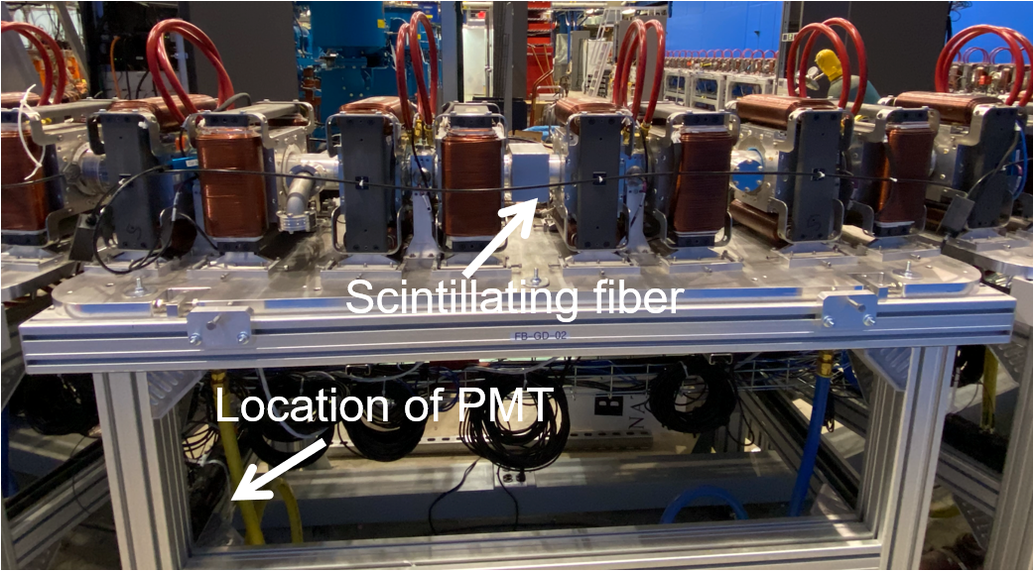
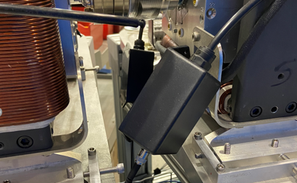
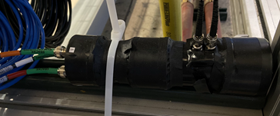
Project Overview - Interconnectivity
Scintillating Fiber
PMT Power Supply Assembly
Notes:
A scintillating fiber is used to detect beam loss.
This fiber is protected within a black plastic tubing.
This is a picture of one of the FFA Girders in Cornell with a scintillating fiber dressed across 8 magnet assemblies. There is another fiber on the other side and both fibers are connected to 1 PMT strapped to the bottom of the Girder.
Hard to see but there are 3 connections to the PMT Socket. High Voltage Set Point, Operating Voltage and the Signal Out.

Slide 6
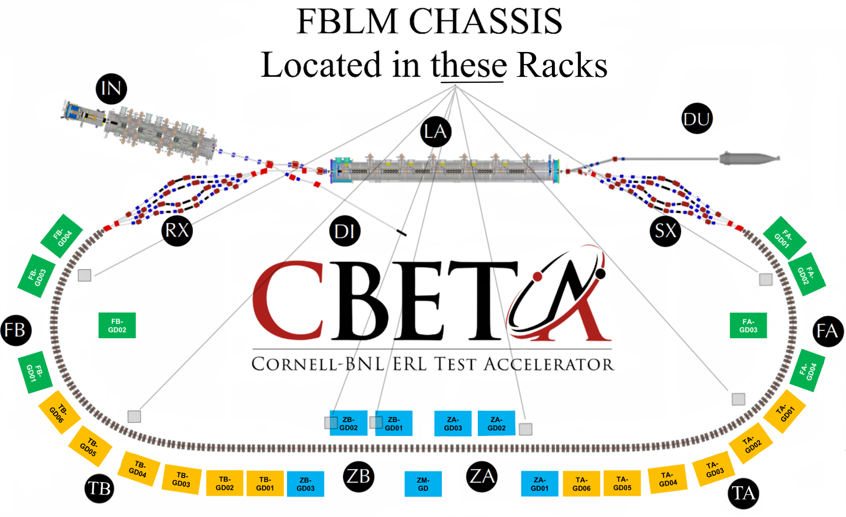
Project Overview - Interconnectivity
Fiber Coverage
Rack Locations
Notes:
This is a bird’s eye view of CBETA
The scintillating fibers discussed in the previous slide cover the regions from FA on the right, down and around to FB on the left.
There are 7 racks that contain an FBLM Chassis.
Each rack is located in the small gray squares in this picture. They are in the same rack as the BPM Chassis.
Additional PMTs will be added in the future for the splitter beam pipe RX and SX sections.

Slide 7
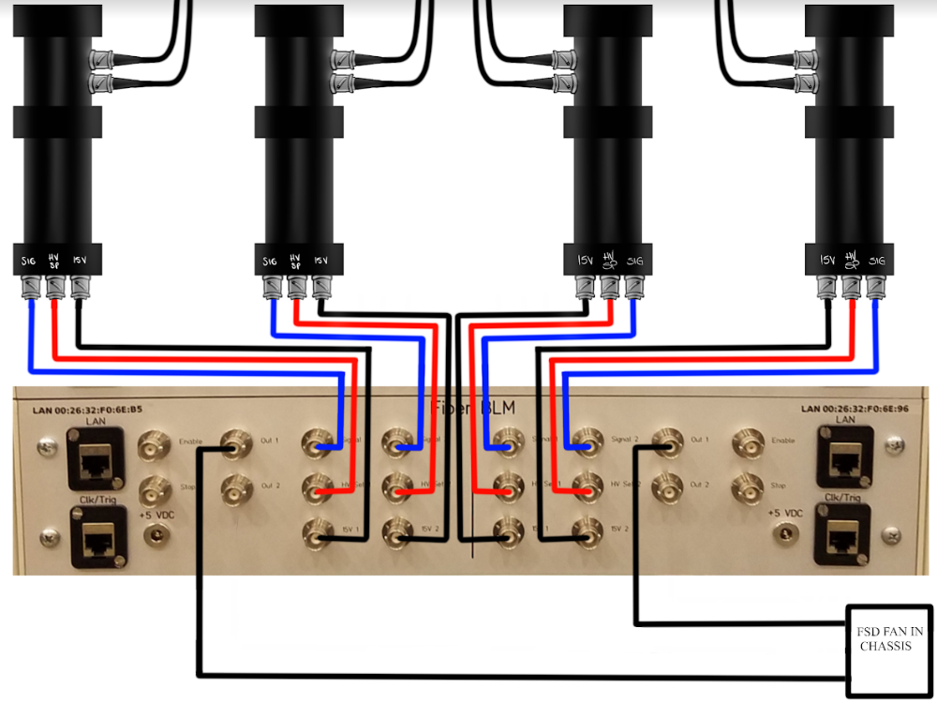
Project Overview - Interconnectivity
2 Sections (Left and Right)
Connections
  Signal (From PMT to FBLM)
  HV SET (0 to 5V)
  15V (Operating Voltage)
  OUT 1 (Out to FSD Fan IN)
  OUT 2 (For debugging)
  LAN (Local Area Network)
  CLK/TRG (BPM CLK/TRG)
  Enable (For Debugging)
  Stop (For Debugging)
Notes:
The chassis has a vertical line on the center of the front panel. The connections on the left are mirrored on the right. Each of these sections go to its own Red Pitaya.
The Output signals of the FBLM Chassis get connected to another instrument which is called: The Fast Shut-Down (FSD) FAN IN Chassis shown in the bottom right
Clk/Trg:
BPM Clock and trigger gets connected to the clk/trg port
OUT2, Stop and Enable are currently for debugging but can be available for extended future functionalities.

Slide 8
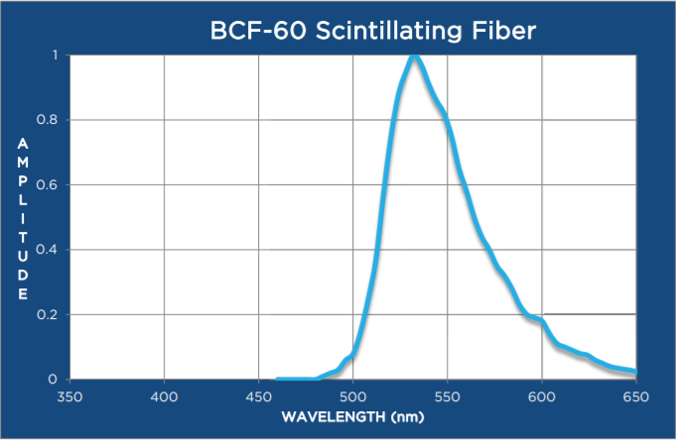

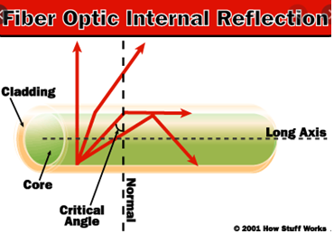
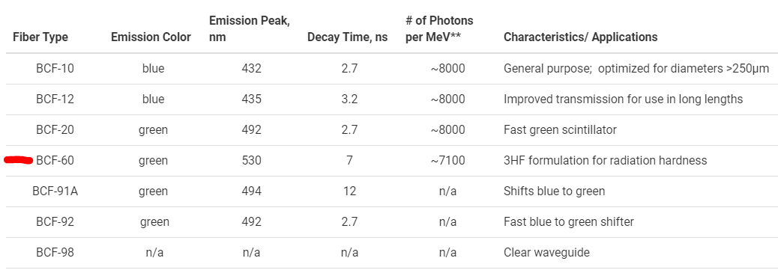
Subsystem Design - Hardware (Scintillating Fiber)
Notes:
The Scintillating Fiber we use is the same one in LEREC. (Saint Gobain BCF-60)
The Emission Spectra peaks at around 535nm.
This fiber is 1mm in diameter and is a multiclad type with a black sheath.
The Multi-cladding is made with Acrylic and Fluor-acrylic to help guide more photons down the fiber (as opposed to Single Cladding)
The fiber is kept within a black tube for protection.
The tube is a crack-resistant polypropylene tube with an ID of ⅛” and OD of ¼”
*** Extra info if asked ***
Trapping efficiency (5.6% min)
Fluor as in Fluorescent

Slide 9
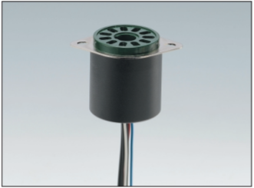
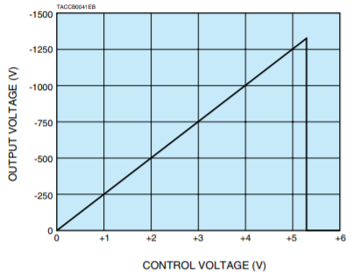
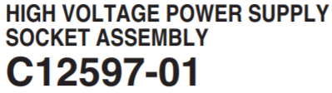
Subsystem Design - Hardware (Power Supply, PMT)
Notes:
This PMT socket assembly has its own power supply.
The High voltage setpoint from the FBLM Chassis goes into this socket to provide the control voltage
Since the PMT’s max voltage is -1250V, having a 5V DAC as the High Voltage Setpoint prevents overvoltage

Slide 10
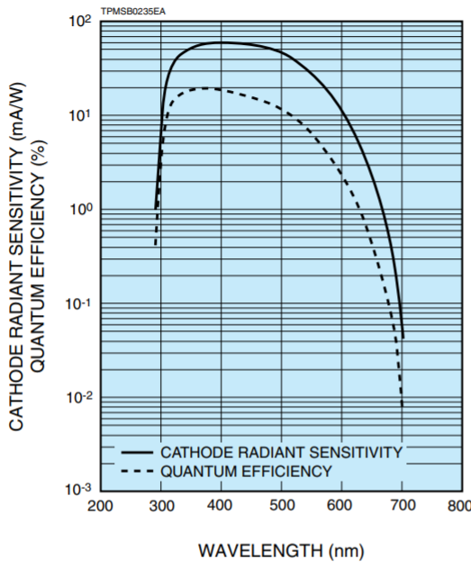
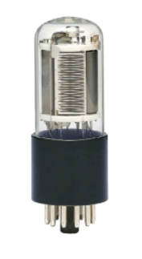
Subsystem Design - Hardware (PMT)
Hamamatsu R11558
Same one used in LEReC
Spectral Response
  300 - 600 nm
Notes:
The PMT is a Hamamatsu R11558 with a spectral response of 300nm to 650nm
The Anode to Cathode max voltage is 1250V
The Anode to Cathode max current is 0.1mA (100uA)
This is the same one used in LEREC
*** Extra info If asked ***
This PMT has 9 Dynode stages
Anode Pulse Rise Time: 2.2ns
Electron Transit Time: 22ns
Anode Dark Current(After 30 minutes in dark storage): 1 to 10nA
Gain of 10^7
Quantum Efficiency is 18.6% at 400nm

Slide 11
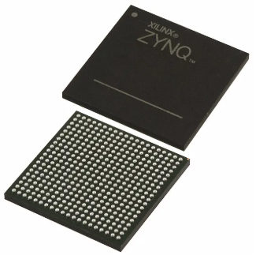
Subsystem Design - Hardware (Detail)
FPGA
  Series: Zynq 7000
  Core Processor: Dual ARM Cortex-A9
  400 Pin BGA
Red Pitaya (14 Bit Resolution)
  2 Input & 2 Output Channels
  ADC Sample Rate: 125 MS/s
  Downside: 1V DAC
Expansion Board
  Dual 5V DAC (16 Bits with SPI Interface)
  Connections: 2x 26 pin headers to BNC
  Provides FPGA Cooling
Notes:
FPGA:
Zynq 7000 Series FPGA, Dual ARM Cortex-A9 (Artix with 28K Logic Cells)
RAM: 256KB, 86 I/O’s, CPU Freq up to 1 GHz, 1V operating voltage, Dimensions 17 x 17 mm
Red Pitaya:
Inputs: +/-1V or +/-20V
DAC: Only +/-1V
Expansion Board:
Designed by John Dobbins from Cornell University
It has a 16BIT dual DAC, P/N: AD5689
I/Os: Able to connect to the Red Pitaya’s I/O pins with BNC Cables
*** Extra Info if Needed ***
RP’s Bandwidth is 40MHz

Slide 12
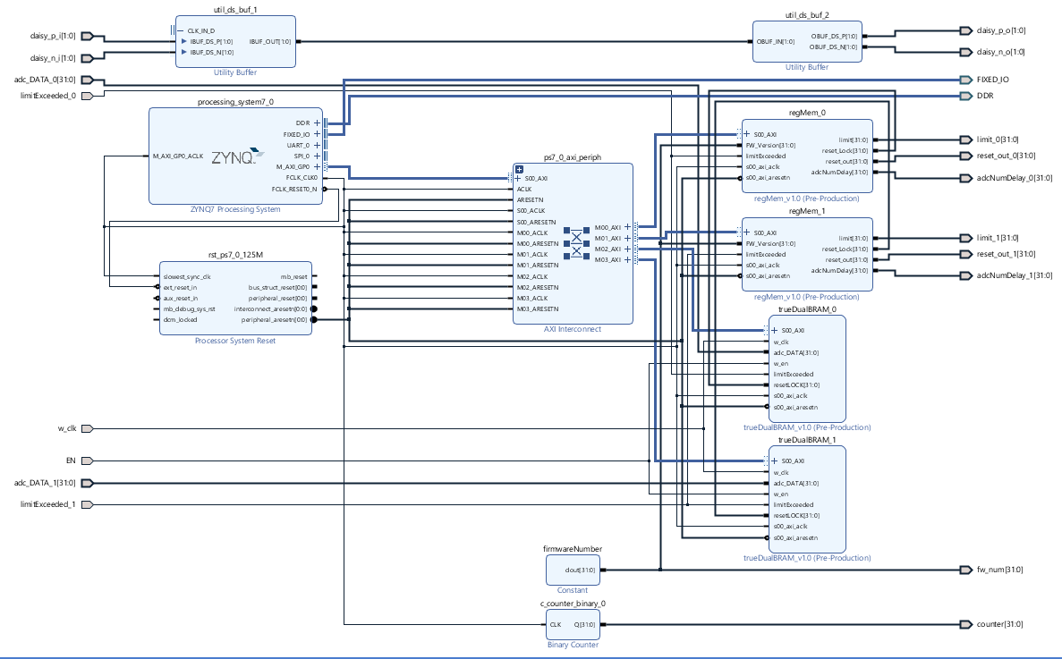
Subsystem Design - Firmware
Vivado (2019)
ZYNQ Processing System
True Dual Port Block Ram
Register Memory
Notes:
Firmware development for the FPGA was done using Vivado 2019.
This illustration shows the interconnectivity of some of the preconfigured logic functions for the ZYNQ processing system and how it connects to my True Dual Port Block Ram and Register Memory via the Advanced eXtensible Interface (AXI) BUS.
There is a block called “FirmwareNumber” which is used to keep track of the version number and translates that out in Binary Code to some LEDs found on the Red Pitaya with LED0 being the Least significant bit.

Slide 13
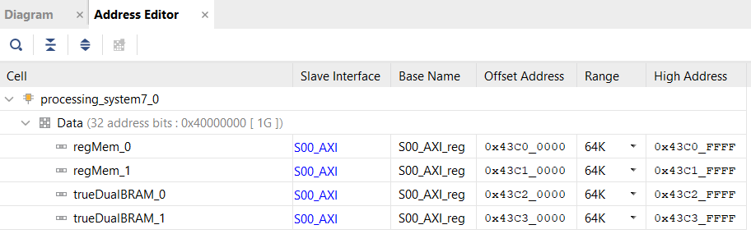
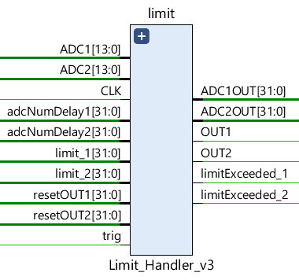
Subsystem Design - Firmware
Address Editor
  Base Address
  High Address
Limit Handler
  2 Channel
  Limit
  ADC Num Delay
  ADC Output
Notes:
The picture on top is the Address Editor.
The Address Editor provides the Base and High Addresses so that we can access the data from memory.
This data can then be viewed with the EPICS IOC or CS-Studio App discussed later.
The Limit Handler, shown in the image below, is responsible for taking in the 14-bit ADC sample from the PMT every 8 nanoseconds.
Each ADC sample is sent to the buffer while at the same time compared to a user-defined limit.
A counter starts every time a sample is equal to or greater than the LIMIT.
The counter is compared to a user-defined limit window and latches the Output to a low level as soon as the condition is met.
It is at this time that a limitExceeded signal is sent to the buffer which tells it to finish filling up and lock it so we can use the data for post mortem analysis.

Slide 14
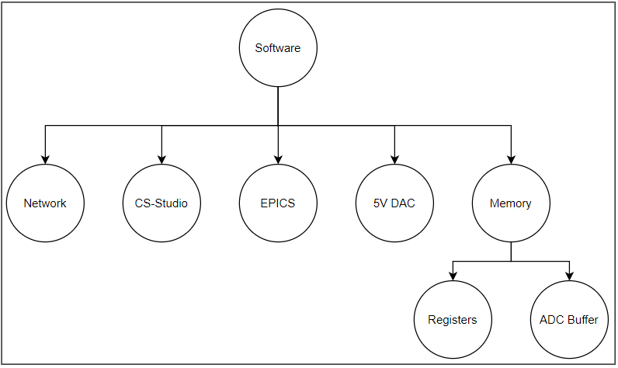
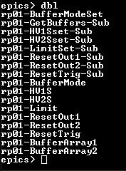
Subsystem Design - Software
Software Development
  Network
  EPICS IOC
  5V DAC
  CS-Studio
  Memory
Notes:
Software was developed for the following five sections:
For Network,
It became problematic to load the hostname and IP address over DHCP on the Red Pitaya so it was just manually set for each SD Card since there were a small quantity of Red Pitaya’s in this project.
All of the files necessary to start the EPICS IOC was loaded as soon as the SSH Protocol on the Red Pitaya was up and running.
EPICS IOC
EPICS which stand for Experimental Physics and Industrial Control System contains an Input/Output Controller that handles data structures, records and devices.
An example of those records within the database, for this project, are shown in the image with the black background and include High Voltage Setpoint, Limit and the Buffers.
These records are also used in the FBLM APP made with CS-Studio which provides a clean plot of the data stored in the buffers.
DAC & Memory
The Code for the Dual DAC on the Expansion Board was developed as well as the code that accesses all memory from the Block Ram and Register Memory discussed earlier.

Slide 15
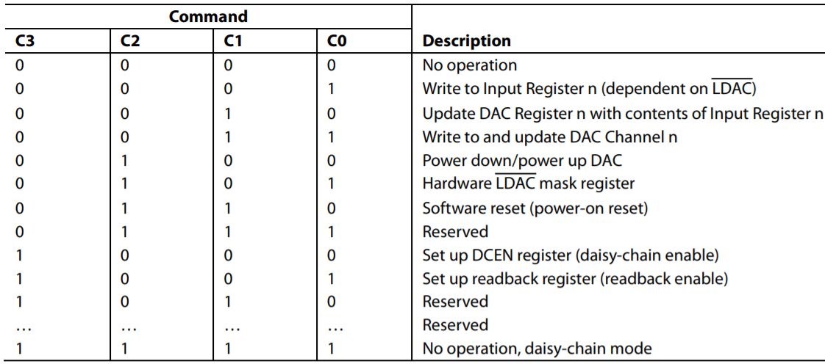
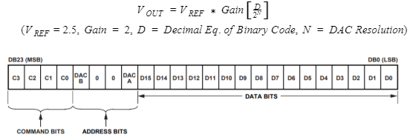
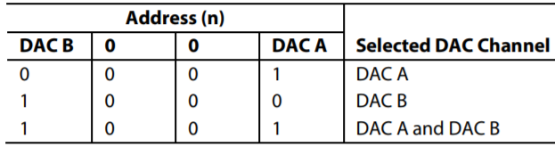
Subsystem Design - Software (Dual DAC)
SPI Communication
24 Bit Input Shift Register
  Command Bits
  Address Bits
  Data Bits
Output voltage formula
Notes:
The dual DAC on the Expansion board: P/N: AD5689 uses SPI communication and takes 24 Bits on its input shift register.
The Most Significant 4 bits set the Command
For this case, the Command was set to 0001 which writes to both internal registers.
The 4 Address Bits were set to 1001 so that both channels A and B in this Dual DAC receive the same Data found in the Least Significant 16 bits.

Slide 16
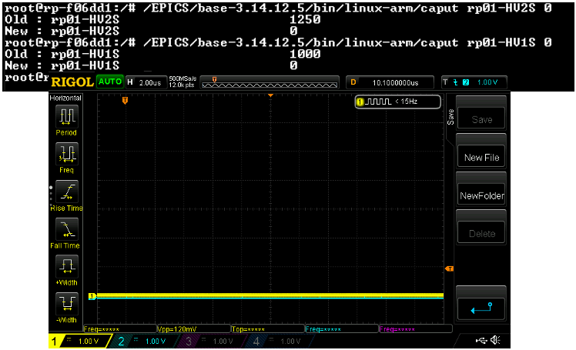
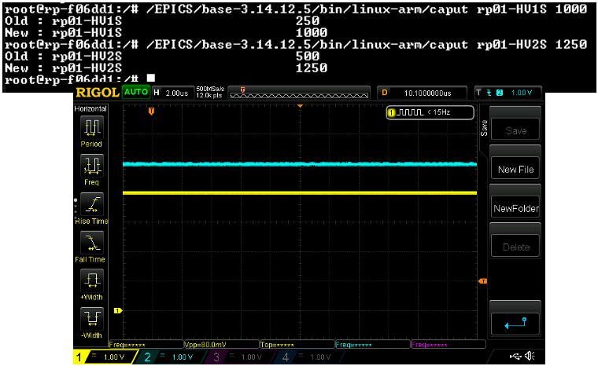
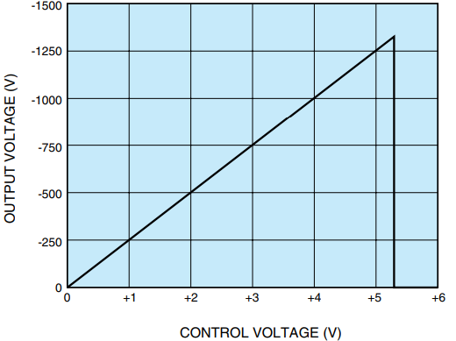
Project Status - DACs on Scope
Both DACs are OFF
DAC 1 set to 4V (YELLOW)
DAC 2 set to 5V (BLUE)
Notes:
Here are some pictures from when I was testing the DACs
The two images in black are taken from an Oscope during that time
It may be a little hard to see but the Scope was set to 1V per division.
The Yellow and Blue Traces are DAC 1 and 2 respectively
Above the scope traces is a snapshot of a command from the EPICS IOC. All the user needs to do is enter the prefered output Voltage they want the PMT to turn ON at and the software will send the appropriate Control Voltage signal.

Slide 17
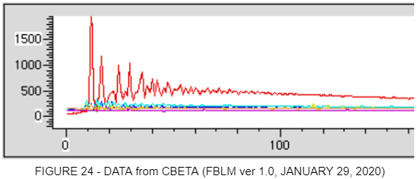
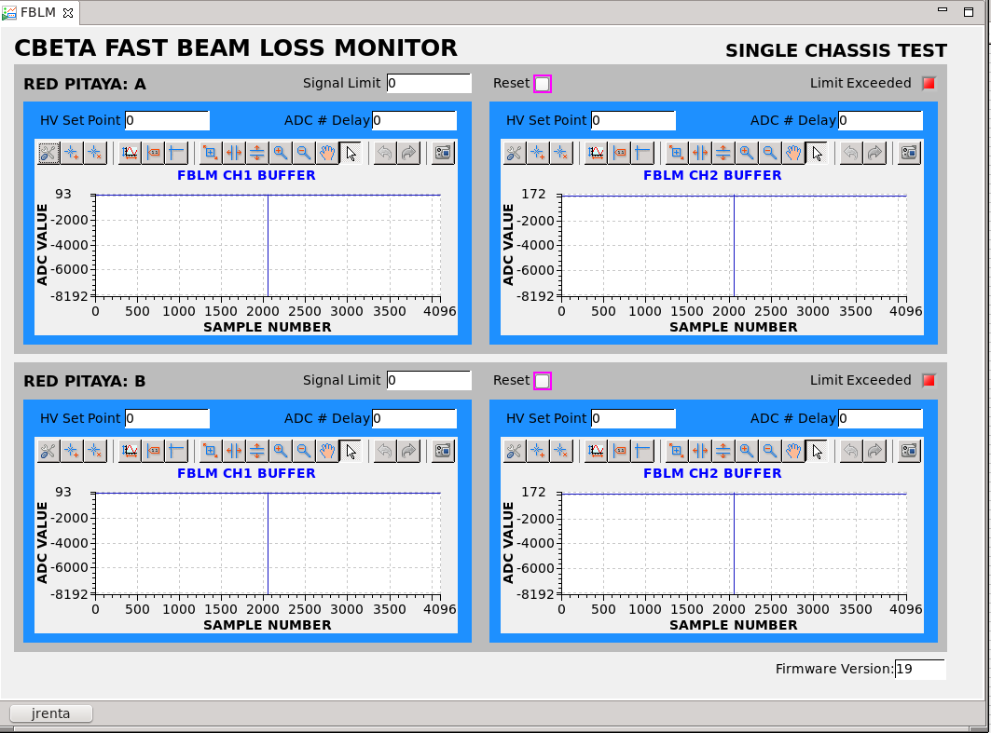
Project Status
1st Data obtained from CBETA
CS-Studio: FBLM App Test
  Triangle wave from Func Gen.
  Freq: 62.5KHz
  Sweep: (~100 to ~800)mV
Limit Exceeded (Red Light)
  Buffer get Locked
  Post Mortem Analysis
Notes:
The plot above was real data from CBETA on the 29th of January
This was before I designed the FBLM App on CS-Studio shown below.
Top left plot
I set a triangle wave on a Function Generator to sweep from around 100mV to 800mV at 62.5KHz for testing purposes. You can see the triangle wave on the top left plot.
There are roughly 2000 samples per period 2000 samples * 1/125MHz(sampling frequency) = 2000 * 8ns = 16us, 1/16us = 62.5KHz (Input Frequency)
Red Light
The graph on the bottom right has a red light on the top corner which indicates that a Limit has been exceeded.
When this happens, the buffer is locked and can be displayed here for postmortem analysis.

Slide 19

Current Work In Progress
Fix a glitch in CS-Studio Graph
Fix err: EPICS out of CA Memory
Implement Slow HV Ramping for PMT via software
Maximize Memory
Optimize the Inference of Block RAM in Firmware

Slide 20
References
[1] (CBETA FBLM Software, 2019) https://gitlab.pbn.bnl.gov/Instrumentation_System_Integration_Group/CBETA_FBLM_SOFTWARE/
[2] (IP Form)
http://corvette.ags.bnl.gov/cgi-bin/IP/ipForm.pl
[3] (rp_spi.c, ver 1.1, 2019)
https://gitlab.pbn.bnl.gov/Instrumentation_System_Integration_Group/CBETA_FBLM_SOFTWARE/-/blob/master/rp_spi.c
[4] (ReadData.c, ver 1.0, 2019)
https://gitlab.pbn.bnl.gov/Instrumentation_System_Integration_Group/CBETA_FBLM_SOFTWARE/-/blob/master/ReadData.c
[5] (EPICS Record Manual, ver 3.13 1995)
https://epics.anl.gov/EpicsDocumentation/AppDevManuals/RecordRef/Recordref.pdf
[6] (HVSP2V.py, ver 1.0, 2019)
LINK TBD
[7] (CBETA_FBLM_FPGA, ver 1.0, 2019)
https://gitlab.pbn.bnl.gov/Instrumentation_System_Integration_Group/CBETA-Fast_BLM
[8] (BCF60-MC Scintillating Fiber)
https://www.crystals.saint-gobain.com/sites/imdf.crystals.com/files/documents/fiber-product-sheet.pdf
[9] (9349T1 Crack Resistant Tubing)
https://www.mcmaster.com/9349t1
[10] (R11558 28mm dia. Bialkali PMT)
https://www.hamamatsu.com/jp/en/product/type/R11558/index.html
[11] (XC7Z010-1CLG400C FPGA)
https://www.avnet.com/shop/us/products/xilinx/xc7z010-1clg400c-3074457345625988368/

Slide 21
Q & A

