Slide 1
CBETA Fast Shutdown System
-Tommy Tang

Slide 2
Topics
System Overview
System Layout
System Control Demonstration
Design Function Diagram
Design Details
Future Work

Slide 3
System Overview
Purpose – Combining the input signals to inhibit the beam when one or more digital input signals indicates a “FAIL” condition.
The system includes a total of three chassis, each of which comprised the following:
  MicroZed 7010 (Zynq™-7000 AP SoC XC7Z010-CLG400-1)
    Xilinx programmable logic provides customized gate array firmware
    ARM Cortex A9 Processor provides customized Petalinux to host EPICS IOC software system.
  Sixteen single ended digital inputs with BNC connection
    Logic 1 => “Normal” state Logic 0 => “Failed” state
    Each input signal can be enabled or disabled
  Two single ended digital outputs with BNC connection
    Logic 1 => “Normal” state Logic 0 => “Failed” state
    Usage:
        Monitor the system status
        Cascade the other fast shutdown chassis
        Inhibit the beam when connected to the machine protection system

Slide 4
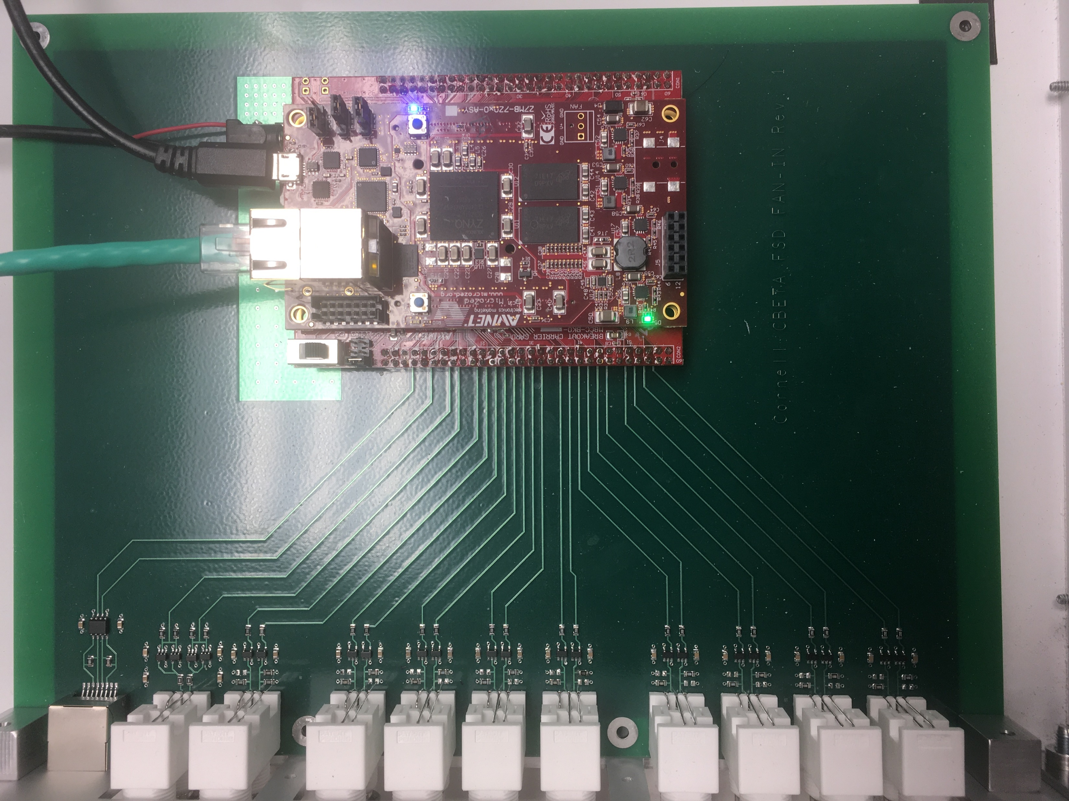
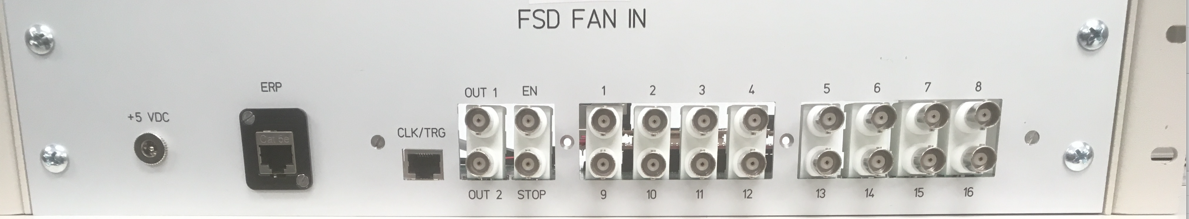
System Layout
Machine Protection System
Beam Loss Monitor
Beam Loss Monitor
Beam Loss Monitor
Beam Loss Monitor
Beam Loss Monitor
Beam Loss Monitor
Beam Loss Monitor
Beam Loss Monitor
Blue – Output Signals
Red – Input Signals
Beam Loss Monitor
Beam Loss Monitor
Beam Loss Monitor

Slide 5
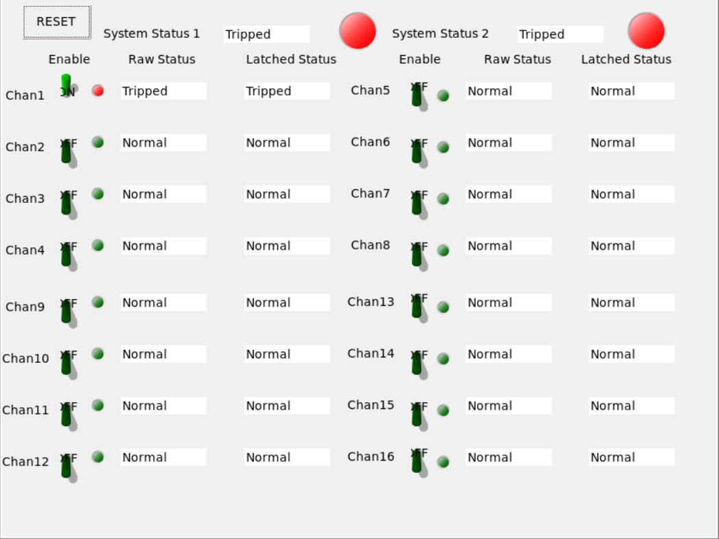
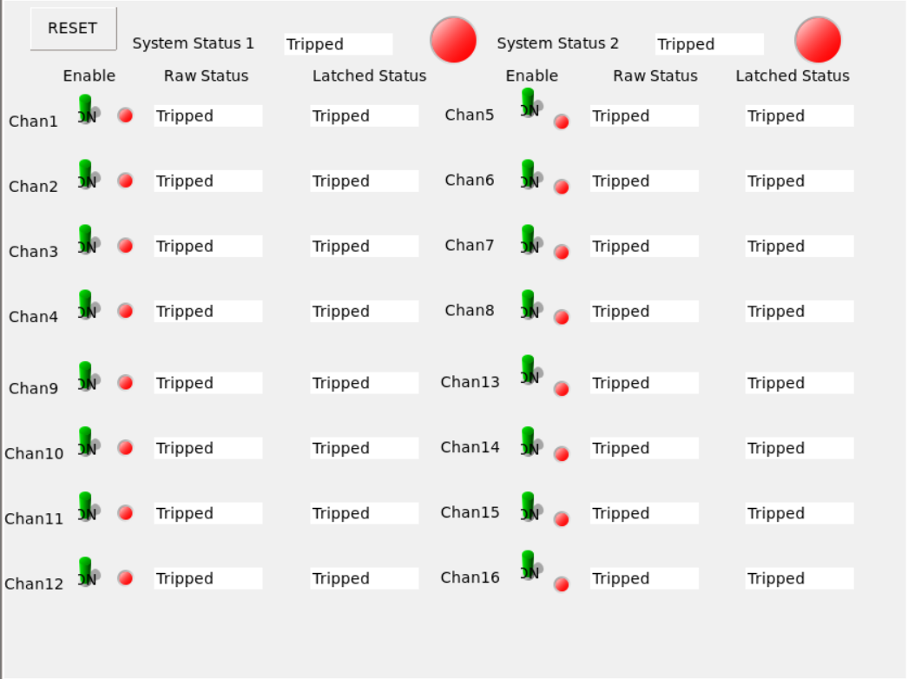
System Control Demonstration
The figure showed when one of the devices was tripped, both outputs were tripped. When the input was tripped, the latched output was tripped immediately. Both System status 1 and 2 are changed to “Tripped”
The figure verified all the channels were working as expected.

Slide 6
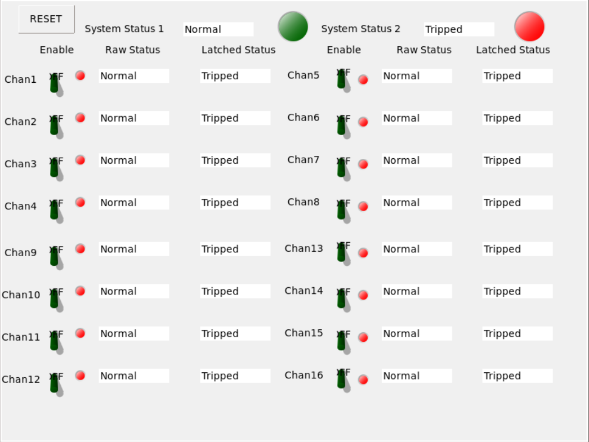
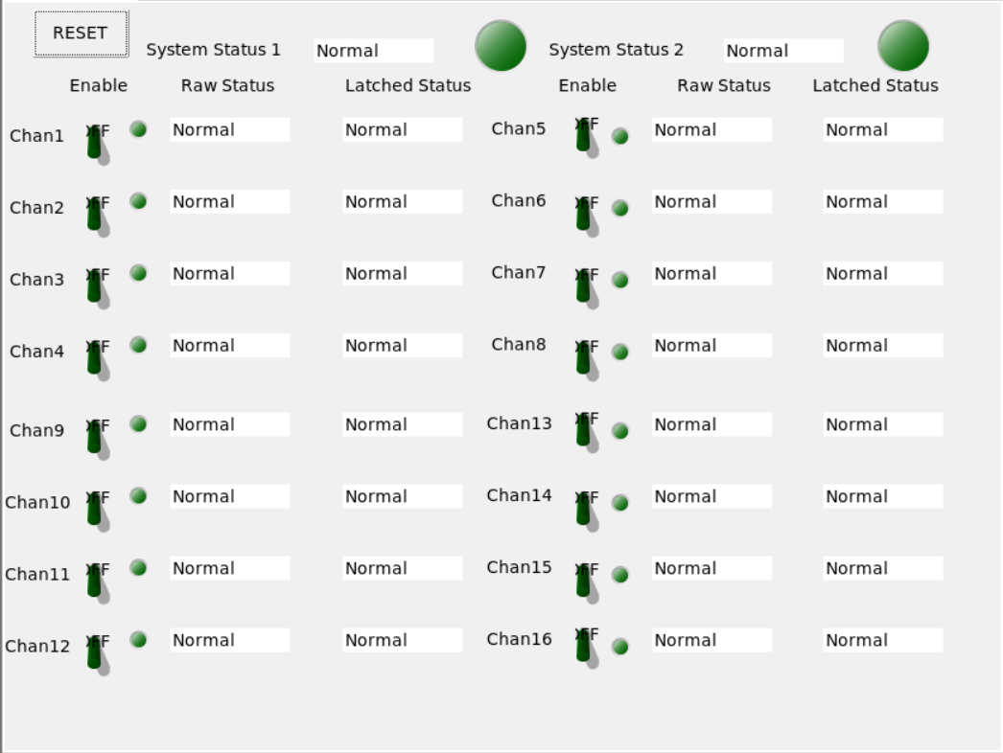
System Control Demonstration
The figure showed when the raw status became normal, the latched status was tripped until the reset was pressed. The system status 2 which is based on the latched status was still tripped. All the channels were working as expected.
The figure showed that when the reset was asserted, the latched status was released and followed the raw status to show the “Normal” state. Both system status 1 and 2 were changed to “Normal”.

Slide 7
Design Details – Input Signal Logic & AND Gate
The input signal logic block is a combination of different logical circuits in the firmware. It is designed in a such way that if enabled, the input signal will be latched when there is a transition from logical high to logical low. The latched signal can be reset back to one if the input signal is at logical high.
Ena
CLK
Input Signal Logic
(Registers & Latches)
Signal Status
Data
RST
AND GATE
Output
Ena
CLK
Input Signal Logic
(Registers & Latches)
Signal Status
Data
RST

Slide 8
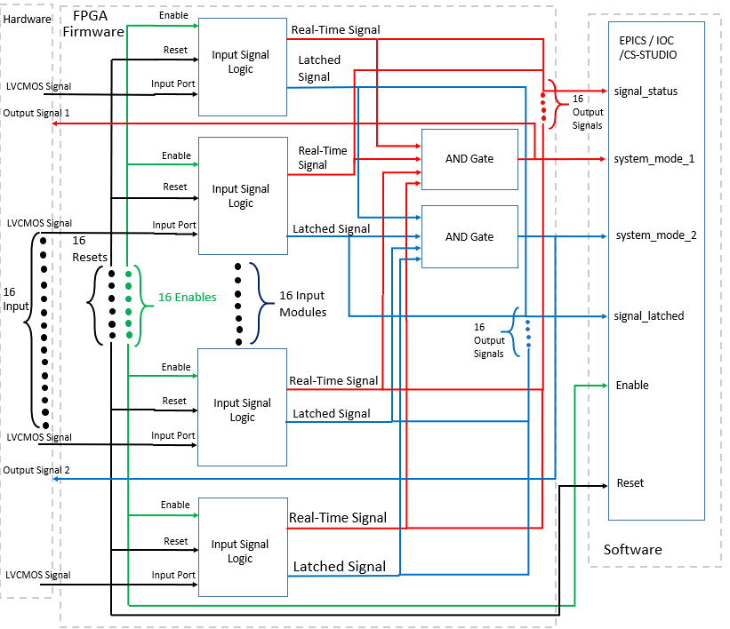
Design Function Diagram

Slide 9

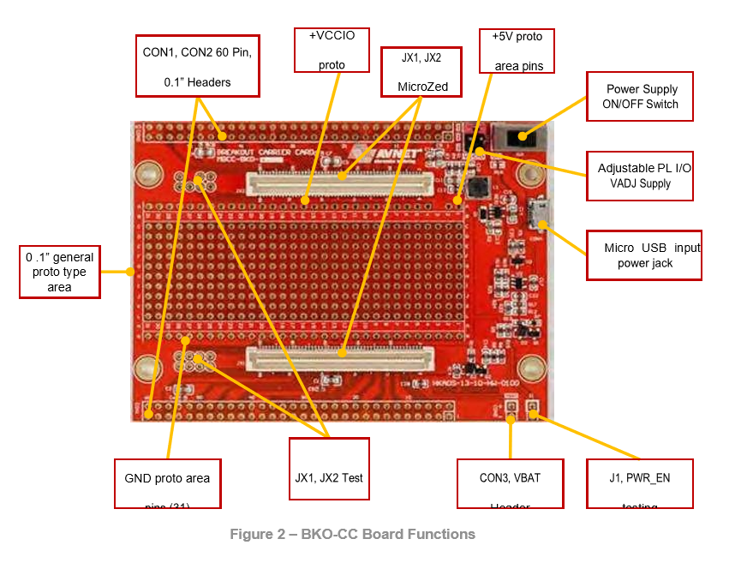
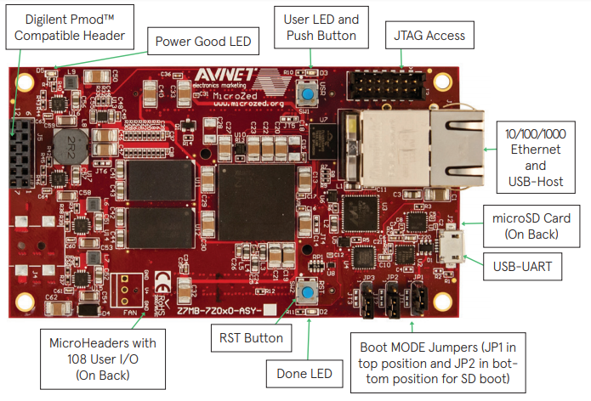
Design Details-Hardware
Carrier Board
Breakout Board
MicroZed Board

Slide 10
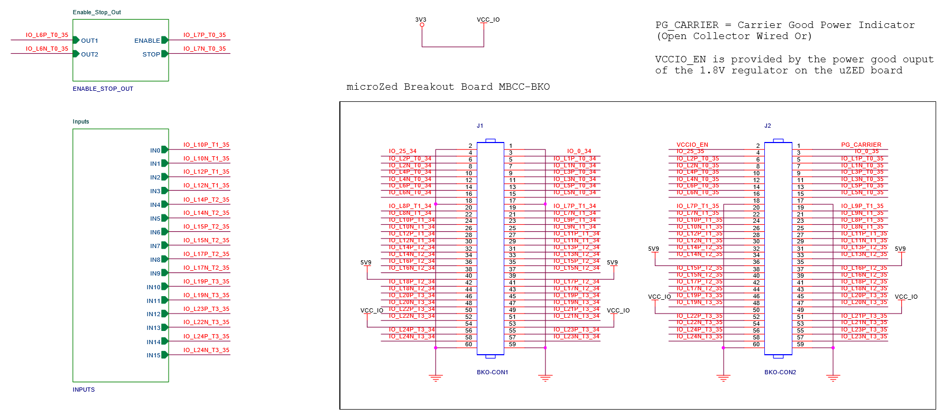
Design Details – Pinout Connections

Slide 11
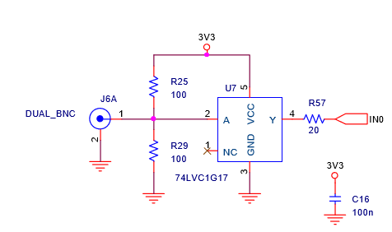
Design Details - Carrier Board
A pair of paralleled resistors force the unconnected or disconnected signal to be at the mid-level between logical 0 or logical 1. In case when a signal was disconnected when it was previous in a logical high state, the signal would be latched to a high state. It would fail to detect an error. To be in a safe operation mode, an unconnected signal must be detected as logical 0

Slide 12
Design Details – EPICS IOC System
A total of 51 Process Variables
  16 Process Variables - Enable(0) or disable(1) the input signals
    $(bpmName)-inputEna#S (# is a number from 1-16)
  16 Process Variables – Raw input signal status: “Normal” or “Tripped”
    $(bpmName)-inputStatus#S (# is a number from 1-16)
  16 Process Variables – Latched input signal status: “Normal” or “Tripped”
    $(bpmName)-inputLatch#M (# is a number from 1-16)
  1 Process Variable – Reset the latched input signal
    $(bpmName)-ChannelRestA
  2 Process Variables – System output signal status: “Normal” or “Tripped”
    $(bpmName)-systemMode1M $(bpmName)-systemMode2M

Slide 13
Future Work
Check and measure the exact delay between the output signal and the input signal when one of the devices is tripped
Correct the wrong labels on the front panel
Conduct a final test for the system when it receives different kinds of signals as inputs

Slide 14
Reference
1. MicroZed Breakout Carrier Card Zynq System-on-Module Hardware User Guide:
http://zedboard.org/sites/default/files/documentations/5271-UG-MBCC-BKO-V1.2.pdf
2. MicroZed Schematic Rev G:
http://zedboard.org/sites/default/files/documentations/Schematic_G-04-02.zip
3. Xilinx 7 Series FPGA Libraries Guide for Schematic Designs:
https://www.xilinx.com/support/documentation/sw_manuals/xilinx13_2/7series_scm.pdf
4. MicroZed Hardware User Guide:
http://zedboard.org/sites/default/files/documentations/5276-MicroZed-HW-UG-v1-7-V1.pdf
5. MicroZed Quick Starter Guide:
http://zedboard.org/sites/default/files/documentations/QSC-Z7MB-7Z010-G-V1.pdf
6. CEBTA Fast Shutdown Fan-In Schematic

