Slide 1
Scintillating Fiber BLM with PMTs
Brookhaven National Lab
Toby Miller
3/27/17

Slide 2
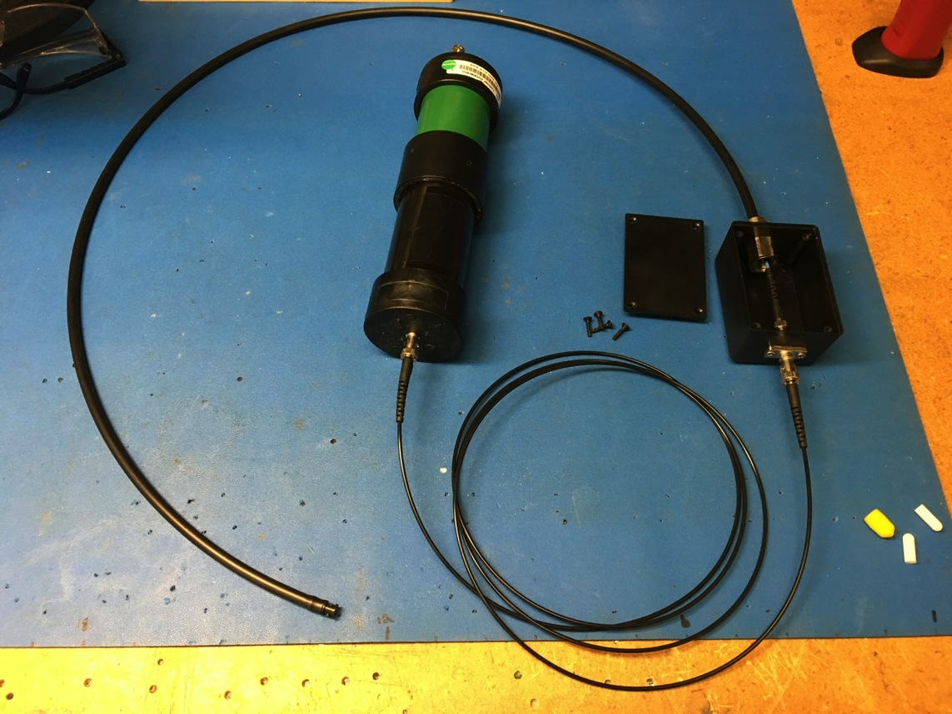
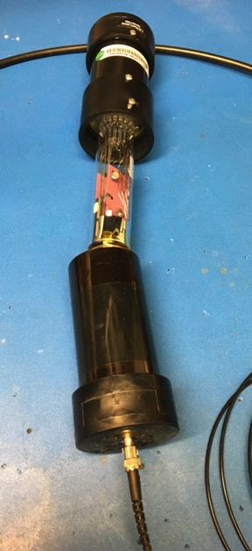
PMT and Fiber Scintillator Assembly
PMT Holder
Head On Type shown open
Fiber Inter-connect Box
Scintillating Fiber in PVC protective tube
1mm POF ST patch cord
End
Plug

Slide 3
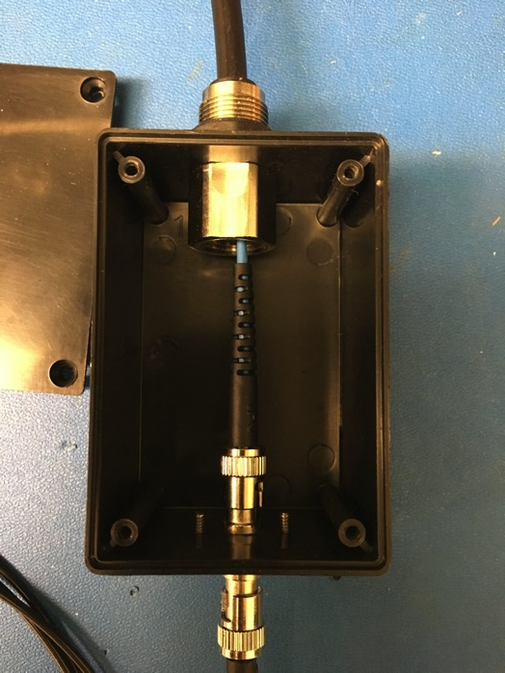
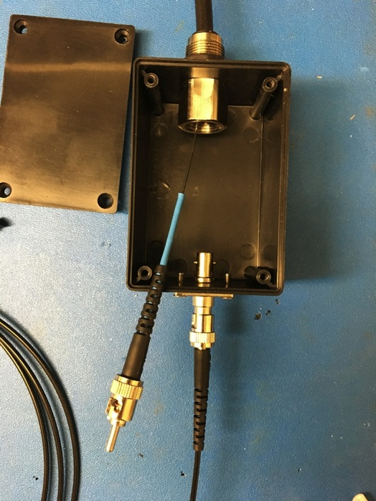
e
 | Components
1 | Scintillating Fiber
2 | ¼” Tubing connector
3 | ¼” PVC tubing
4
5 | ST Fiber feedthrough
6 | ST fiber connector for 1mm POF
7 | 1mm POF patch cord, ST connectors
8 | Plastic box with cover
9 | Heat shrink tubing
3
2
1
8
9
5
6
7

Slide 4
Saint Gobain Fibers
Two types will be tested
  Single-clad
  Multi-clad

Slide 5
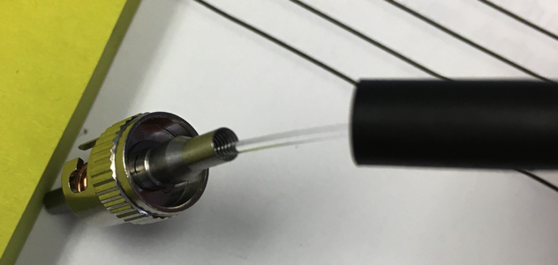
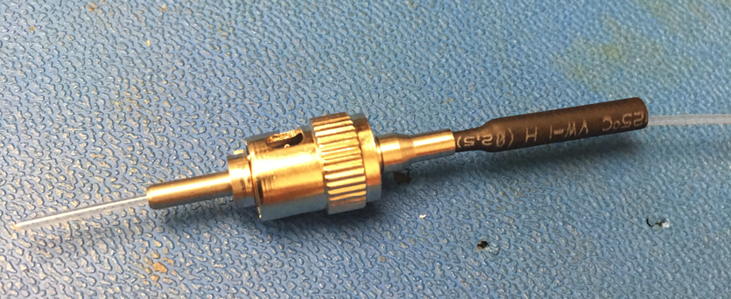
ST connector for 1mm POF
(plastic optical fiber)
Saint Gobain scintillating fiber has not outer jacket.
Needs heat shrink tubing to take the place of the outer jacket
Epoxy required to cement fiber into connector (see connector assembly instructions)
Fiber end is finally cut and polished. Polishing kit for POF is required (see material list)
Fiber without jacket
Connector shown assembled before epoxy, cut and polishing.
Heat shrink tube only partially shrunk for illustration purposes only.

Slide 6
1mm POF ST connector assembly

Slide 7
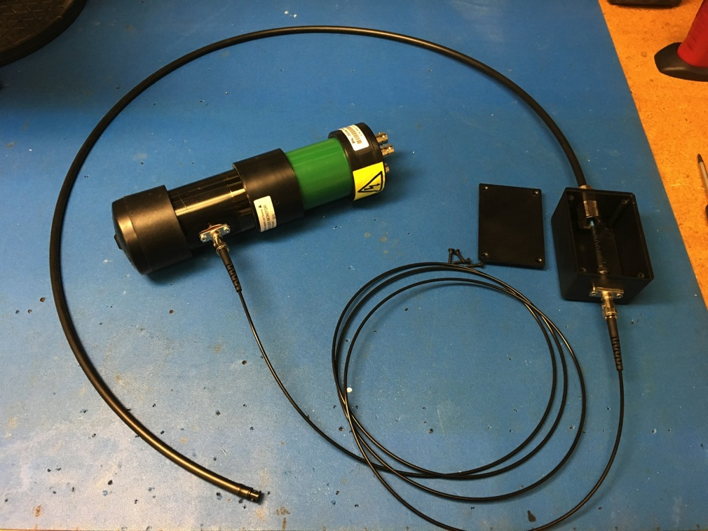
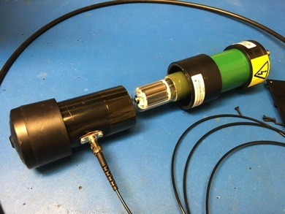
Side-On Type PMT assembly with Scintillating Fiber
PMT Holder
Side On Type shown open

Slide 8
Material List
No. | Description | Supplier | Part Number
1 | Scintillating fiber, 1.0mm diameter, single clad, no outer jacket | St. Gobain | BCF60S- D1.00N
2 | Black UV-Resistant Polypropylene Tube Fitting, Straight Adapter for 1/4" Tube OD x 1/8 NPTF Male | McMaster | 5562K111
3 | Polyethylene Tubing , Black, 0.17" ID, 1/4" OD, 25 ft. Length | McMaster | 5384K535
4 | Durable Nylon Tight-Seal Barbed Tube Fitting Plug for 5/32" Tube ID, Black, Packs of 10 | McMaster | 5463K76
5 | ST fiber feedthrough connector | L-com | FOA-011A
6 | ST fiber connector, for 1.0mm plastic optical fiber | Ind. Fiber Optics | 51 00067
7 | Fiber optic patch cord, 1mm plastic optical fiber, ST connectors, 2.0m long | Ind. Fiber Optics | IF 121O-2-0
8 | Plastic enclosure, black, 2" x 3" x 1.5", mounting tabs | Digikey | CU-790-MB
9 | Heat Shrink Tubing, Black,1/8" dia x 1.50" L, pkg 50 pcs, 1.0mm dia x 0.55mm thick recovered | Digikey | SFTW2018K-1R5-ND
10 | Epoxy for PMMA plastic optical fiber | Digikey | FB194-ND
11 | Plastic Optical Fiber (POF) Termination Kit | Ind. Fiber Optics | IF TK4

