Slide 1
A Hard X-ray to Gamma Ray Source using an ERL with Compton Backscattering
Val Kostroun and Bruce Dunham
August 1, 2014

Slide 2
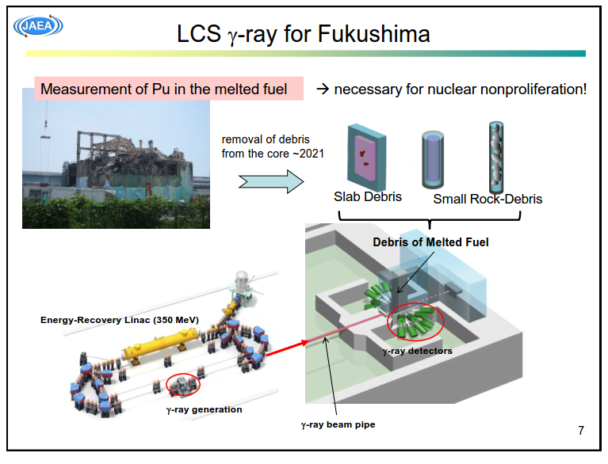
Who is interested in such sources?
R. Hajimi, 2nd IZEST meeting, 2012

Slide 3
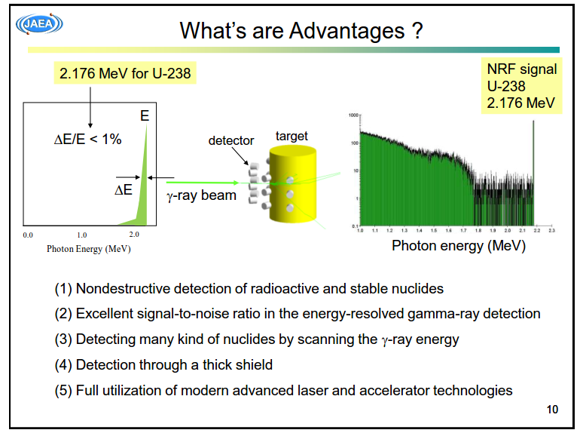

Slide 4
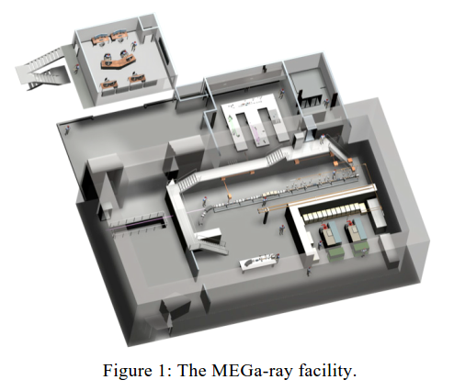
Lawrence Livermore National Lab
FINDER – Fluorescence Imaging in the Nuclear Domain with Energetic Radiation
This design uses a 250 MeV, low average power electron linac with a ~1 Joule laser to make gamma rays for Nuclear Resonance Fluorescence measurement.

Slide 5
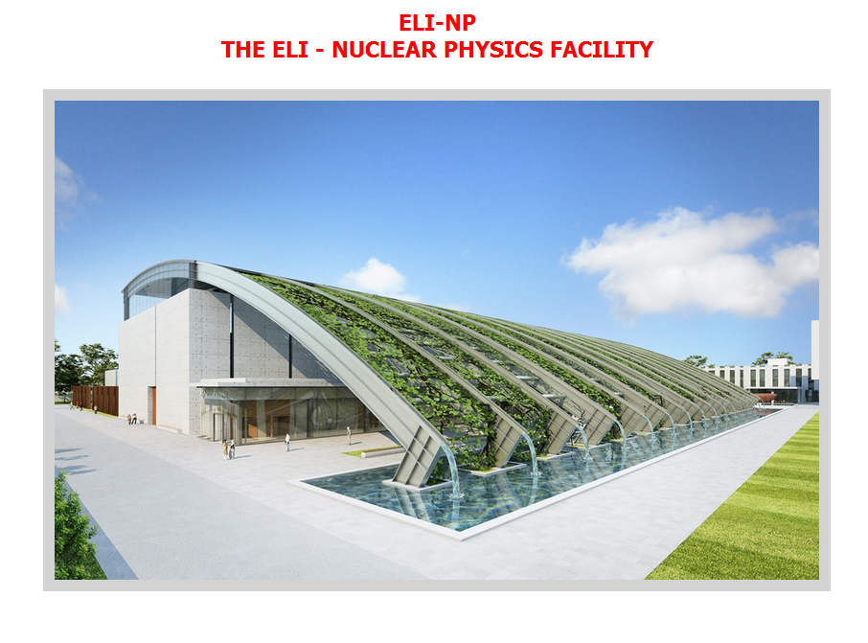
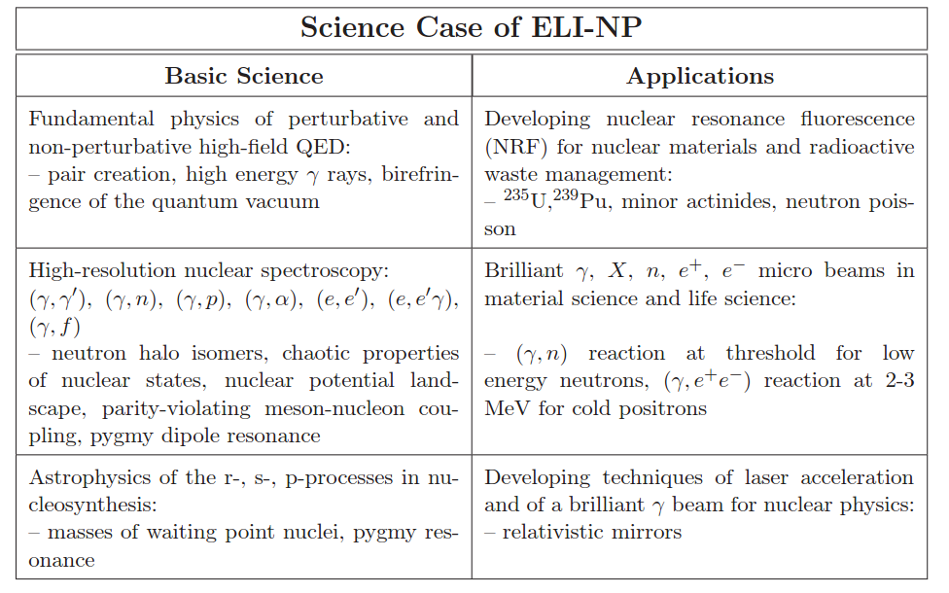
The Extreme Light Infrastructure for Nuclear Physics (ELI-NP) is now being built in Romania for $400 million.
It will house 2-10 pentawatt lasers and an 700 MeV linac (non-ERL)

Slide 6
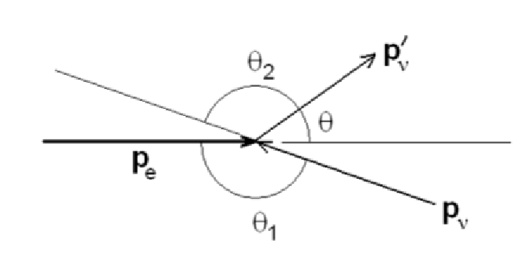



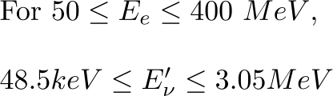
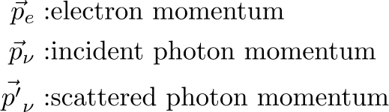
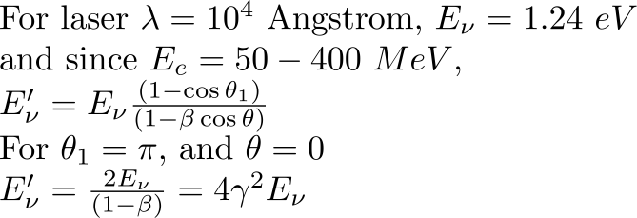
Basic inverse Compton geometry

Slide 7








These are expected parameters for an ERL electron beam and a laser that are used for calculating the gamma ray parameters
Property | ERL | Laser
Particle Energy
Number of Particles
Pulse Duration
Focal Spot Radius
Energy Spread
Transverse Phase space

Slide 8
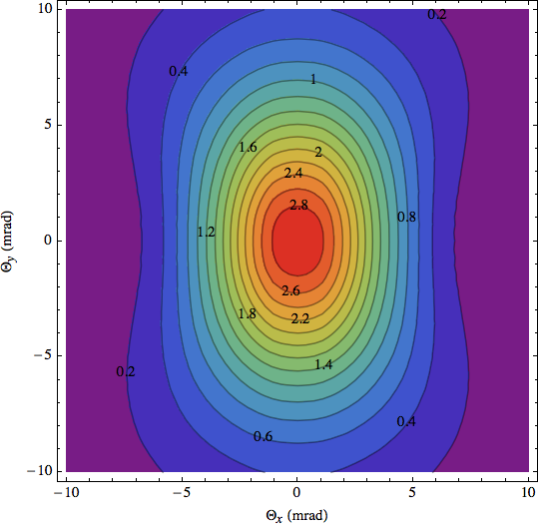
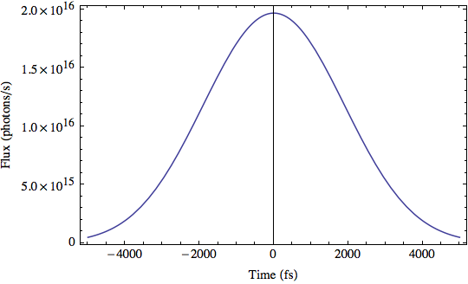
E_{e}= 50 MeV
Photons/s
Angular distribution of radiation
Integrated dose, N_{x}=9.15 x 10 ⁴photons. For 30 kH_{z} laser, (0.005 J x 3 x 10⁴ pulses/s = 150 W), have 2.74 x 10 ⁹ photons/s

Slide 9
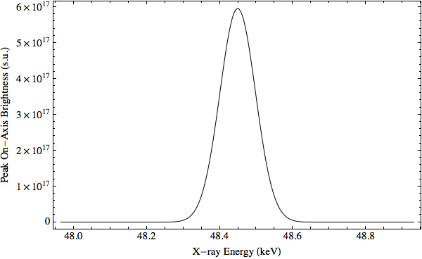
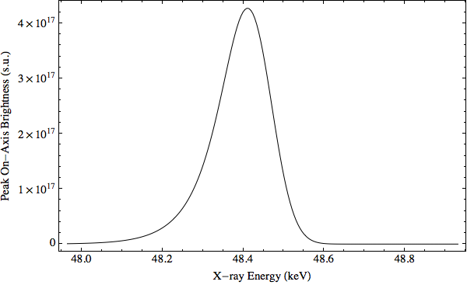

Brightness at E_{e}= 50 MeV
s.u.-synchrotron unit = photons/(mm² - mrad² –s- 0.1% bandwidth)
-Brightness scaling

Slide 10
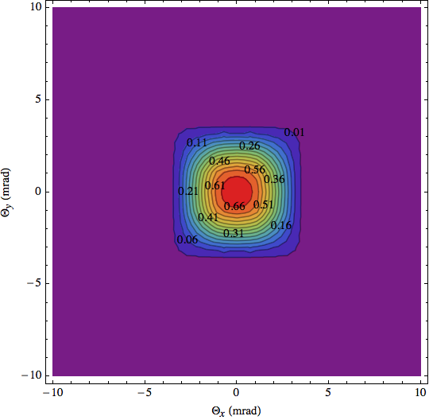
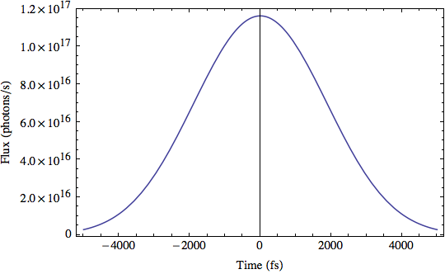
E_{e}=400 MeV
Photons/s
Angular distribution of radiation
Integrated dose, N_{x}=5.37 x 10 ⁵ photons. For 30 kH_{z} laser, (0.005 J x 3 x 10⁴ pulses/s = 150 W), have 1.61 x 10 ¹⁰ photons/s

Slide 11
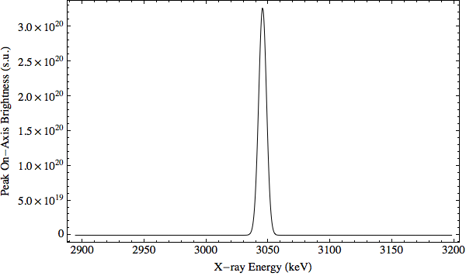
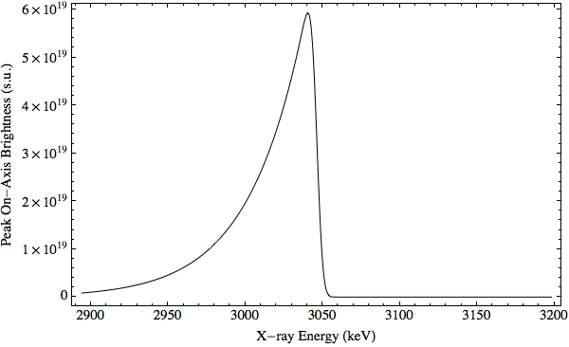
Brightness at E_{e}=400 MeV
s.u.-synchrotron unit = photons/(mm² - mrad² –s- 0.1% bandwidth)

Slide 12
Possible Applications of inverse Compton scattering
Assuming a photon energy range from 50 keV to 3 MeV, the following applications come to mind:
High energy x-ray diffraction (50-150 keV and higher)
Nuclear resonance fluorescence applications, nuclear and astrophysics
Special Nuclear Materials (SNM) identification
High energy x-ray diffraction, advantages thereof*
a) Access to high momentum transfers-this leads to high real space resolution in the pair distribution function.
b) High penetration of x-rays allows experiments to be done in air and in the transmission geometry.
c) Photo-absorption reduced at higher energies, so samples containing heavy elements can be used.
d) Radiation damage, particularly in biological samples is greatly reduced.
e) Measured structure factors and corresponding pair distribution functions are directly comparable to neutron diffraction studies measured over a similar range of momentum transfers.
*C. J. Benmore, “A Review of High-Energy X-Ray Diffraction from Glasses and Liquids”, ISRN Material Science Vol. 2012, Article ID 852905

Slide 13
Nuclear resonance fluorescence
Inverse Compton scattering off 400 MeV electrons provides up to 3.05 MeV photons with a 1064 nm laser, and 6.1 MeV photons with a 532 nm laser. With 150 MeV electrons, the photon range extends to 0.43 and 0.86 MeV.
In the ~3 MeV photon energy range, there are a number of excited states that decay to lower energy states via E1 transitions.
Possible applications include :
Isotope analysis of samples, (the energies of the excited states formed and the emitted gamma -rays are specific to a given nucleus)
Determination of the instantaneous velocity of the scattering nucleus
Determination of the zero-point kinetic energy of vibration of a nucleus in a particular chemical compound or lattice *
*R. Moreh, Nucl. Instr. Methods, 166, 45 (1979).

Slide 14
Conclusion
A hard x-ray/gamma ray source utilizing Compton backscattering from a high brightness electron beam can produce high brightness photons with very narrow linewidths.
Our ERL can produce short electron bunches with low emittance – the resulting photon brightness scales with 1/emittance^2 and 1/t. Combined with a high average power, high rep rate laser, a high intensity gamma ray beam can be produced.
Applications range from materials research (CHESS users) on the low end (100’s of keV) to nuclear spectroscopy and special nuclear materials detection on the high end (1-3 MeV)

Slide 15






Peak brightness of Compton scattering light sources for head-on collisions depends on the following:
The x-ray flash duration is equal to that of the electron bunch; short and compressed beams produce the highest brightness. The following are sources of spectral broadening of scattered x rays:
Broadening Parameter | Origin
 | Fractional laser bandwidth
 | Laser focusing
 | Electron beam energy spread
 | Electron beam focusing
 | Nonlinear ponderomotive force
 | Compton scattering recoil

Slide 16


For collinear and cylindrically symmetric beams colliding head-on, the temporal behavior of the x-ray pulse can be described by
In the electron rest frame, the incident photon energy is . At 400 MeV, this corresponds to 1.94 keV, and 1.94 keV << 511 keV, the electron rest mass, so use Thomson cross section.
Two articles of interest, based on work done at LLNL:
[1] "Three-dimensional time and frequency-domain theory of femto-second x-ray pulse generation through Thomson Scattering", W. J. Brown and F. V. Hartemann, Phys. Rev. STAB 7, 060703, (2004).
[2] "High -energy scaling of Compton scattering light sources",
F. V. Hartemann et al., Phys. Rev. STAB 8, 100702, (2005).

