Slide 1
OSC simulation update
Suntao Wang
10/06/2017

Slide 2
Transit-time optical stochastic cooling (TTOSC)
Particle receives the energy kick δp/p from the kicker undulator:
where ξ₀ is the amplitude, k=2π/λ,
M_{5n} are the elements of the 6x6 transfer matrix from the pickup undulator to the kicker undulator, (x, θ_{x}, Δp/p) are the particle horizontal coordinate, angle, and relative momentum deviation in the pickup.
g: Optical amplifier gain
q: electron charge
ε₀: EM wave amplitude of the light from the pickup
N_{u}: number of kicker undulator periods
λ_{u}: the period length of the kicker undulator
K: the pickup undulator K parameter
E_{b}: electron beam energy
γ: 948 @ 500MeV
In simulation, ξ₀ is one parameter

Slide 3
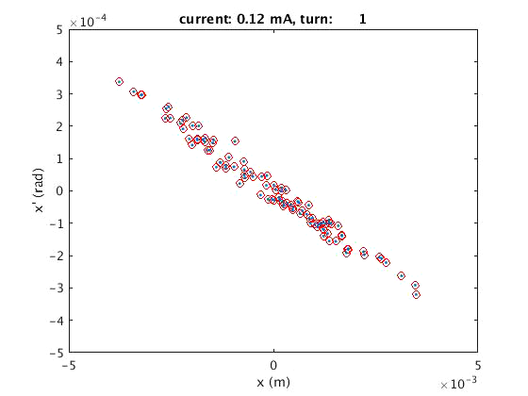
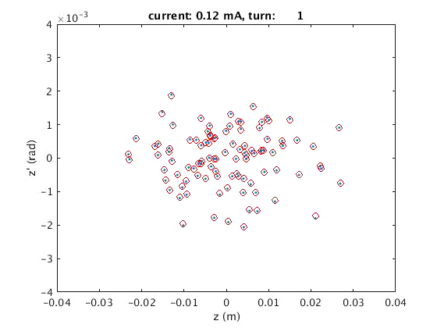
Single element test: 100 particles, track for 50 turns, excitation and damping turned on
Normal emittance are extracted from the sigma matrix every turn
Q45E: large horizontal dispersion 2.05 m in the test lattice (2.1GeV CesrTA lattice)
M₅₁: -1.35E-7, M₅₂=1.26E-6, M₅₆= 3E-8,
undulator light wavelength: λ=1 μm, gain: ξ₀=1E-2
Each particle receives the energy kick based on its own (x, x’, z’)
Only horizontal emittance reduced. The energy spread and bunch length slight increased.

Slide 4
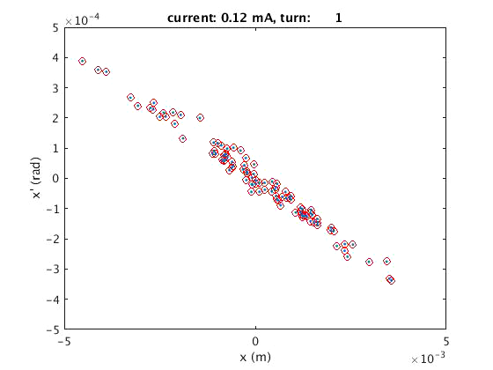
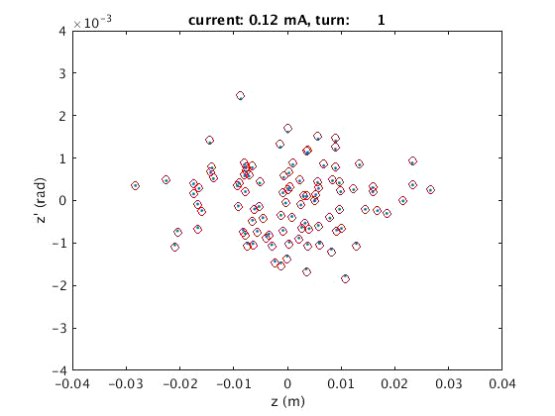
Single element test: 100 particles, track for 50 turns, excitation and damping turned on
Q45E: large horizontal dispersion 2.05 m in the test lattice (2.1GeV CesrTA lattice)
M₅₁: -1.35E-7, M₅₂=1.26E-6, M₅₆= 1E-6,
undulator light wavelength: λ=1 μm, gain: ξ₀=1E-2
Each particle receives the energy kick based on its own (x, x’, z’)
Both horizontal and longitudinal emittance reduced. The energy spread reduced either.

Slide 5
Now the particle receives a energy kick based on the average x position in a slice.
x
z
Slices based on the particles longitudinal position z
N_slice= 62
Slice_width = 1 mm
When using slice x position, the cooling rate reduced.

Slide 6
Simple line test:
Q48W
Q48E
Und_pick
Und_kick
In tracking simulation at each turn:
Record the particle distribution in z at the end of Und_pick
Particle receive the energy kick at the end of Und_kick
M₅₁: -3.09E-5, M₅₂=9.47E-5, M₅₆= 7.6E-7,
undulator light wavelength: λ=1 μm, gain: ξ₀=3E-3
Cooling depends on the gain.

Slide 7
Summary:
Based on the TTOSC principle, simulation shows the cooling seems to work.
Will incorporate MPE’s bypass line into CESR lattice for simulation test

