Slide 1
Test of Optical Stochastic Cooling in CESR
September 1, 2017

Slide 2
bypass
beam
9cm
pickup
kicker
Q48W
amplifier
Q48E
ΔS = 2mm
L3

Slide 3
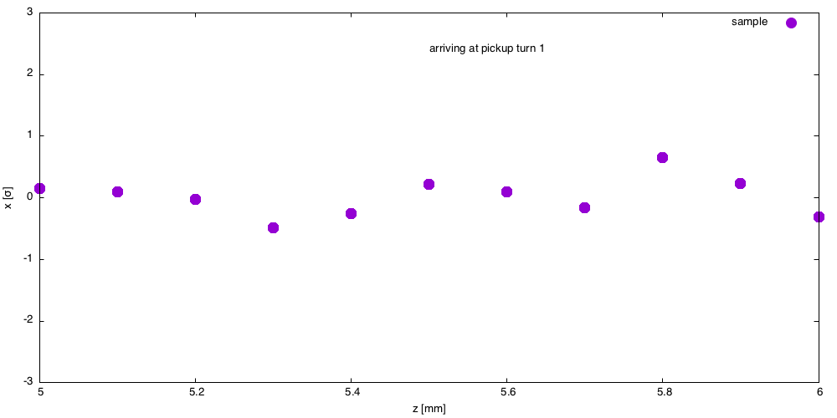
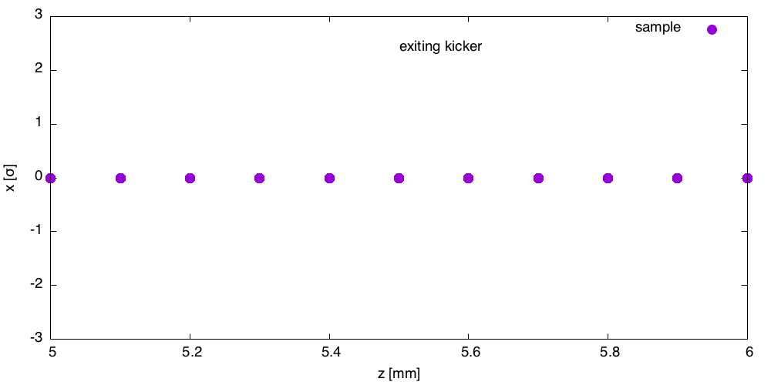
Multi bunch Feedback
Kicker corrects offset
Pickup measures offset
Each represents centroid of distributon of particles

Slide 4
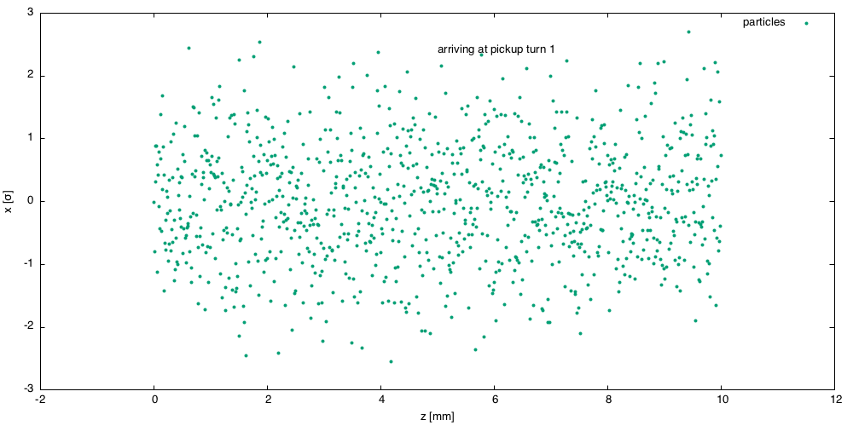
Each bunch is a collection of particles
Goal: reduce bunch width (emittance)
=> cool the beam
Bunch width σ_{x} = 1
Bunch length = 10 mm

Slide 5
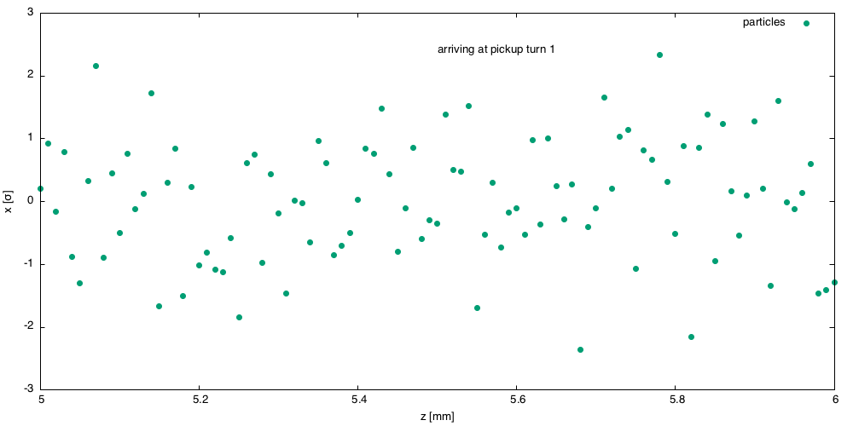
0.1 mm slice of the distributioin

Slide 6
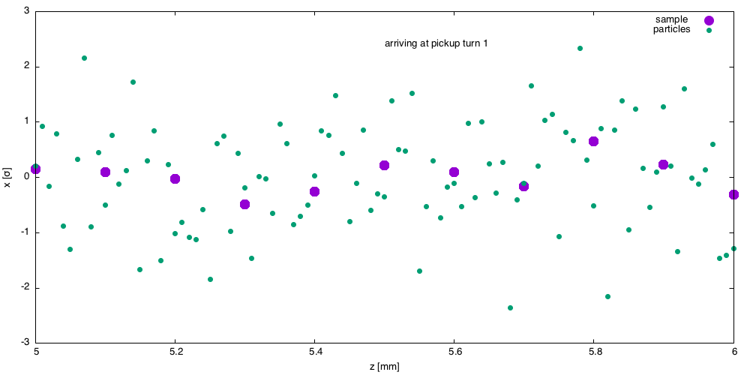
Centroid of 0.1mm sllice

Slide 7
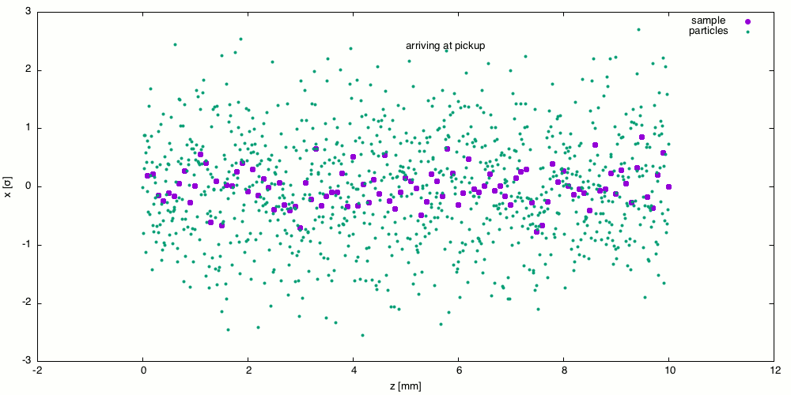


Slide 8
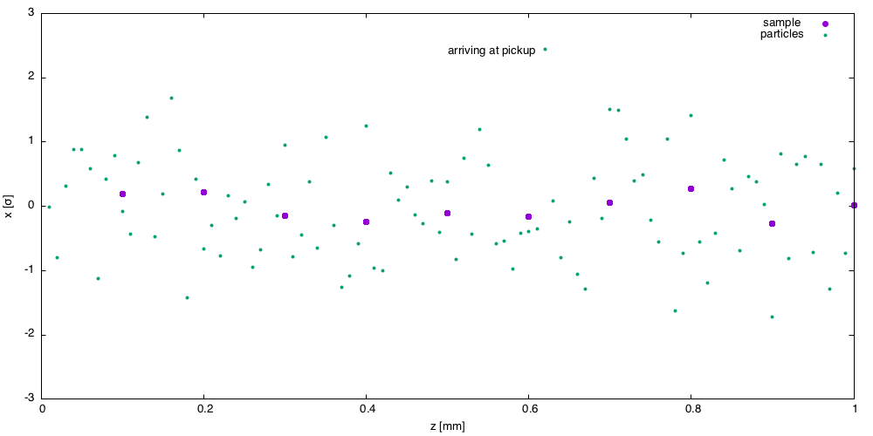

Slide 9
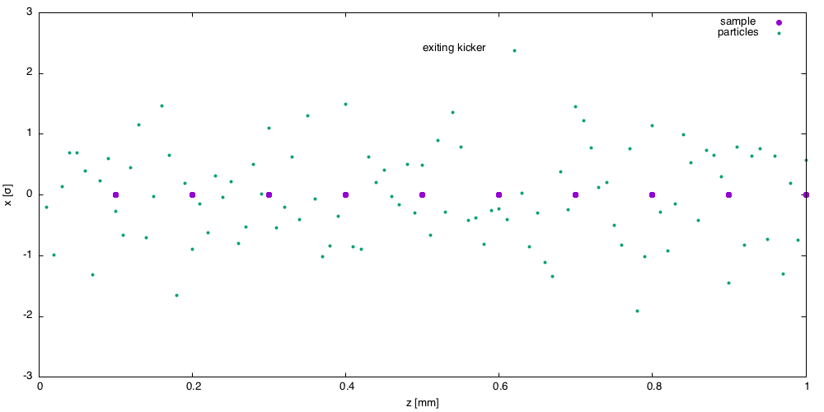

Slide 11
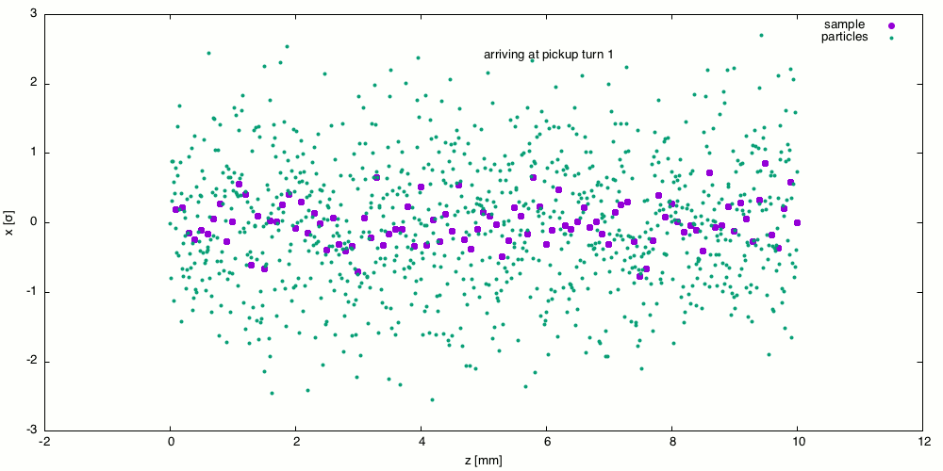


Slide 12
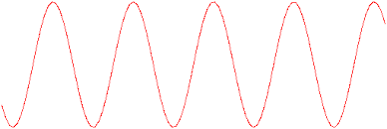
Pickup
Particles oscillate transversely in pickup undulator.
The wavelength of the radiation
E-field
k
E-field
k

Slide 13
Kicker
Particles oscillate transversely in kicker undulator.
S
N
S
N
E-field
k

