Slide 1
OSC for 1 TeV protons¹
Hypothetical scenario for OSC: I Suppose we are allowed 70 m of space to build the cooling insertion. We will use 60 meters for pickup+kicker, the other 10 for the bypass. For simplicity we will assume equal damping rates in the longitudinal and horizontal planes. We will set the longitudinal cooling range to 4σ to determine the M56 (we also assume the simple relation 2Δs=M₅₆ to relate optical delay to the cooling rate). We also set the peak magnetic field in the undulators to be 8 T.
Amplifier gain is computed assuming an ideal amplifier, neglecting incoherent kicks and set to achieve 5 hours damping time in longitudinal and horizontal planes.
¹‘Optical Stochastic Cooling in the Tevatron’ (Lebedev) is used as a rough guide for some parameters.

Slide 2
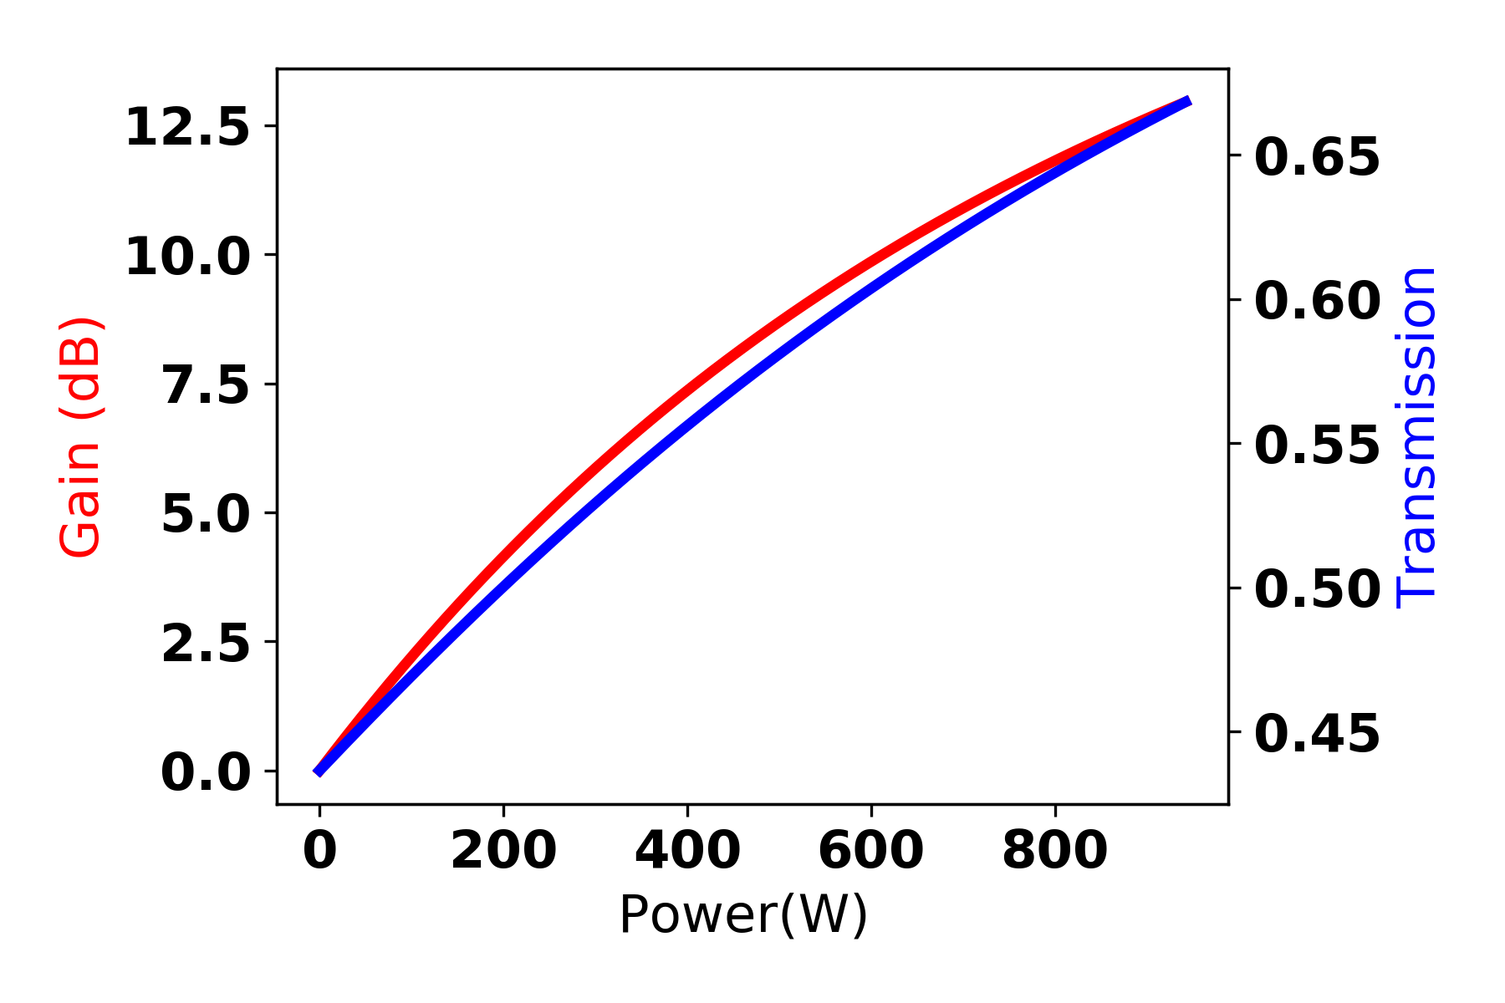
Amplification at 800 nm (Ti:sapphire)
Initially the 11 dB seems very doable. However note the required value of M₅₆, it means an optical delay of only 635μm corresponding to a crystal thickness of 830 μm.
If we assume the pickup radiation can be focused to 100 μm radius the required pump laser power (at 532 nm) is an order of magnitude larger than current laser technology (even if the pump could be made, the ti:sapphire crystal could probably not stand 800 W CW power!)

Slide 3
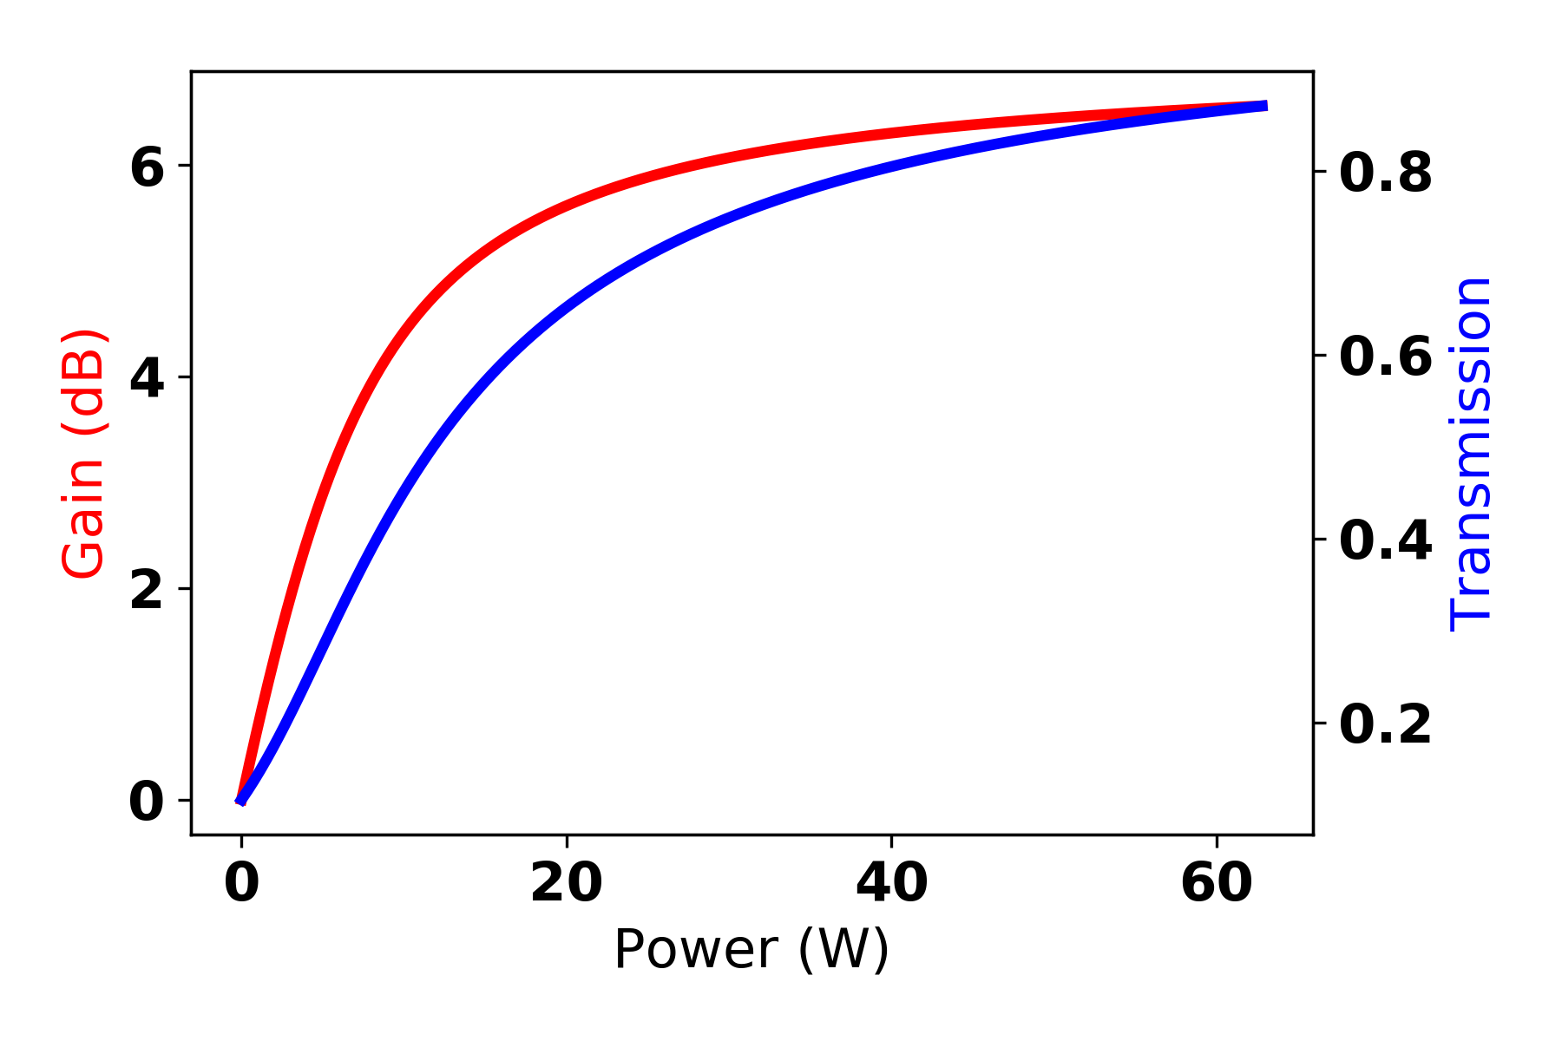
Amplification at 2400 nm (Cr:ZnSe)
For the case of Cr:ZnSe we run into a different problem. Here we want to achieve 22 dB of gain. As the power increases the ground state becomes depleted and the crystal can not absorb any more power. This limits the gain to ~ 7 dB for a 1.3 mm thick crystal (set by the M56).

Slide 4
Optical Stochastic Cooling for eRHIC
Recently a paper came out computing the damping rate using Coherent-Electron-Cooling for eRHIC² without amplification and found it to be about 41 hours (this is for pure longitudinal cooling). By comparison using identical undulator constraints from the 1 TeV proton example, the damping time (split between longitudinal and horizontal planes) for the passive OSC is 56 hours.
IBS growth in eRHIC is estimated to be about 2 hours and therefore any cooling system needs to match this.
²G. Stupakov
Phys. Rev. Accel. Beams 21, 114402
* Estimated from Peak proton current and bunch length

Slide 5
Optical Parametric Amplification for the OSC
We saw that in the case of the two laser gain mediums considered the achievable gain is limited by amount of optical delay, leading to either saturation effects or an unreasonable pump laser power. An optical parametric amplifier could achieve these gains. However the pump laser is again a challenge.
In order for an OPA to work the signal (pickup radiation,~3 ns for TeV protons, 200 ps for eRHIC) must overlap the pump pulse both spatially and temporally. This gives that the pump pulse is ~mJ and bunches come on the order of MHz bringing the required pump power to greater than a kW.
Unlike in an a laser gain medium, OPA’s (ideally) do not absorb any power. This has two advantages,
They have no thermal effects associated to the high pump power.
It allows for the possibility of the pump laser to re-used with some recirculating cavity. This idea was discussed at Fermi from time to time but never seriously pursued.
The signal energy is on the order of a nJ for TeV protons, after 30dB of gain it becomes a μJ and therefore the pump pulse was depleted by ~0.1%. If the pump pulse can be recirculated ~100 times the pump power becomes reasonable. But this is difficult to do since a MHz rep rate (to match the accelerator) implies a cavity length of ~100 m. The cavity can of course be a harmonic but this introduces more mirror bounces and consequently losses.
Here I think there is maybe the possibility of collaboration between Cornell and Fermilab. An amplifier like this would be more difficult in CESR due to the short wavelength, and high susceptibility to glass dispersion. However Cornell has more laser experience (both within CLASSE and perhaps outside of it).

Slide 6
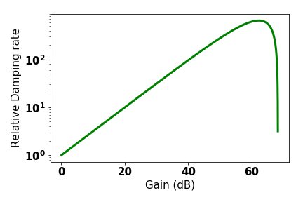
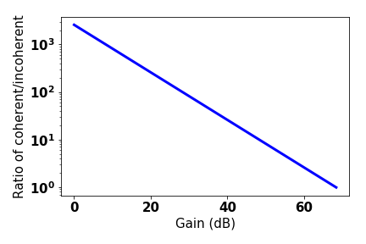
Incoherent effects in high energy cooling
In Tuesdays discussion it was suggested we can study a regime where incoherent kicks are relevant during cooling and that, since this is a regime which can not be studied in IOTA due to IBS at their lower energy, that this is complimentary to their research. Although this is true incoherent kicks are probably not going to be important for OSC with high energy protons. Therefore I don’t think this is worth mentioning in any proposals.
For simplicity assume only longitudinal cooling for the 2400 nm case of 1 TeV protons. Using the expression from S.Y. Lee’s OSC paper I find that at the gain (22 dB) the incoherent kick contributions are ~100 times smaller.

