Slide 1
DR 3.2 km Lattice
Webex meeting
24 May 2011
D. Rubin

Slide 2
Modification of DCO4
Start with DCO4 with 6.4m circumference
Eliminate one of two circumference changing chicanes
Eliminate 5 of 12 phase trombone cells
Reduce number of wiggler cells from 44 to 24
Include all 5 RF lattice (20 cavities)
Eliminate 4 of 7 FODO cells in injection straight
Circumference =3.2km, straight = 712m, arc= 911m

Slide 3
3.2485km circumference
(75 vs 65 arc cells yields improved da)
Phase trombone
rf
wigglers
364m
100m
204m
712m straight
911.6m arc
(including dispersion suppresser)
chicane
Injection/exrtaction
The arc is assembled from 75 FDBDF (focus/defocus/bend/defocus/focus/ “alternative” arc cells.
Cell length = 10.931m
Bend length = 3m

Slide 4
Arc cell - FDBDF

Slide 5
Bmad_7-27wig. – 712m straight

Slide 6
wiggler
DCO4 wiggler params
12 poles
40cm period
Wiggler length = 4.8m
Cell length = 8.5 m
24 wiggler cells
32cm wiggler params
12 poles
32cm period
Wiggler length = 3.84
Cell length = 7.56 m
27 wiggler cells
2 32cm wiggler cells

Slide 7
3.2km ring with FDBDF arc cells and 700m straight
Parameter | 10 Hz | 5 Hz
Circumference | 3.2 km | 3.2 km
RF frequency | 650 MHz | 650MHz
τ_{x}/τ_{y [ms]} | 13.5 | 24.1
Σ_{s} [mm] | 6 | 6
σ_{δ} | 0.134% | 0.11%
α_{p} | 3.3 X 10⁻⁴ | 3.3 X 10⁻⁴
Γε_{x} [ μm] | 2.7 | 4.4
RF [MV] (20 cavities) | 19.7 | 14
ξ_{x}/ξ_{y} | -51.5/-44.6 | -51.5/-43.9
Wigglers- N_{cells}@B[T] | 27@2.1 | 27@1.5
Energy loss/turn [MeV] | 8.0 | 4.5
sextupoles | 3.41/-4.34 | 3.41/-4.34
Power/RF coupler @400mA [kW] | 160 | 90

Slide 8
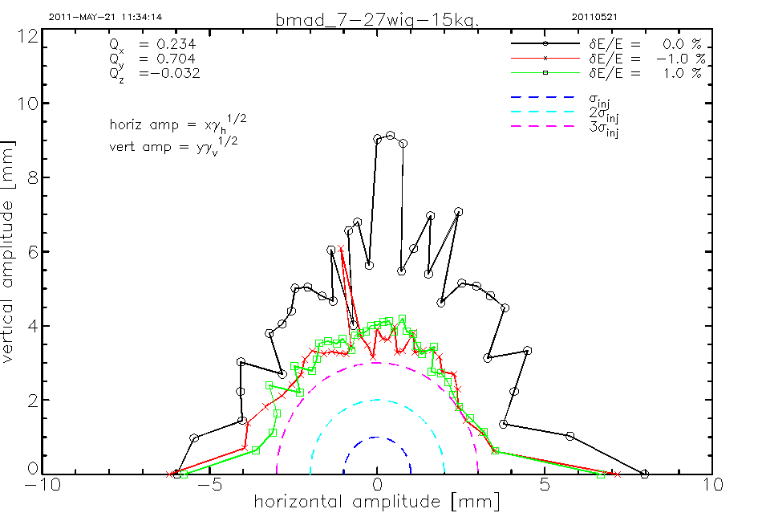
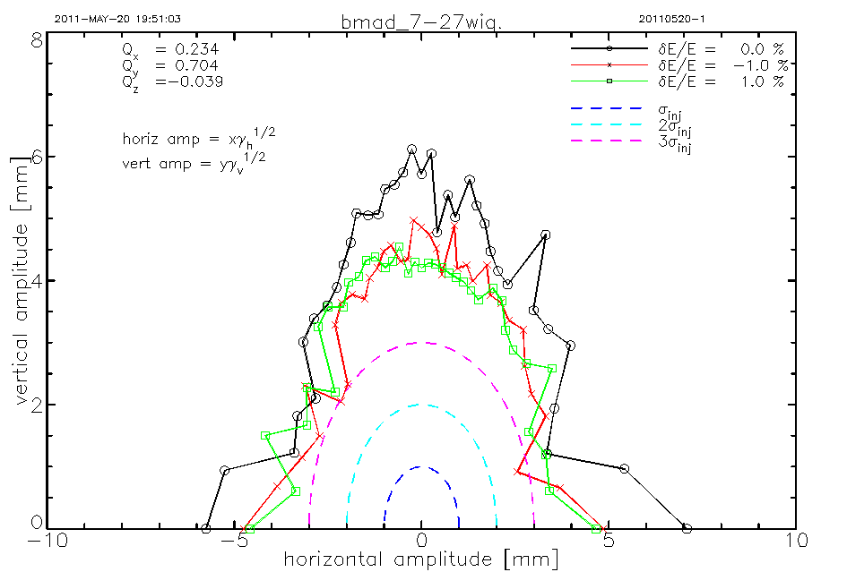
Dynamic aperture
5 Hz
10 Hz
Periodic type wiggler model, includes vertical focusing and cubic nonlinearity

