Slide 1
2011 Damping Rings Lattice Evaluation WebEx Meeting June 28, 2011
Mark Palmer
Cornell University

Slide 2
Agenda
Today’s Tasks:
Review our Selection Criteria
Updates on the Status of the Lattices
Baseline Lattice Specification
Alternate Lattice Specification
Today’s Presentations
This Talk Summarizing the Selection Status,Today’s Down-Select Process, and Preparations for the DR Technical Baseline Review
Update on Re-designed RF/Wiggler and Injection/Extraction Straights + Update on the TME-like Lattice – Dave Rubin
Update on the DMC Lattice – Wang Dou
Update on the DSB Lattice – Susanna Guiducci
Baseline and Alternate Lattice Selection

Slide 3
Key Design Modifications (ALCPG11)
Reduction in circumference – 6.4km a 3.2km
“Low power” operation with 1300 vs 2600 bunches (new baseline)
Maintain beam current and bunch structure a minimal impact on performance with respect to collective effects
Pursue lower momentum compaction design (target a fixed momentum compaction somewhere in the range of 1.7 to 2.7 × 10⁻⁴)
If the lattice allows the momentum compaction to be tuned, then we would be able, in the low power configuration, to go to higher momentum compaction if commissioning indicates problems with instability thresholds. Note that this depends on the fact that the baseline lattice leaves room for larger RF complements needed for high power and/or 10Hz operation.
Less conservative design with respect to collective effects
Smaller RF requirements for 6mm bunch length
Updated Specification for Straights
Minimize length consistent with 3.2km design requirements
Maintain injection/extraction layout
Minimize phase adjustment trombone
Adjust circumference chicane
Space in RF & wiggler sections for all design options (low & high power, 10Hz ops)
Added space in wiggler section for photon absorbers
Preserve CFS interface
Energy Acceptance Specification
Injection ±0.5%
For quantum lifetime desire at least ±0.75% a lattice evaluations at ±1%

Slide 4
Present Status
Unfortunately, we have not been able to move as rapidly as hoped with updates and documentation of the updated lattices
Too much work in progress
Too few people available
Too little time available
Today we will have to review the status during this meeting and reach a provisional decision to take to next week’s review
This is unfortunate but necessary
Also we must make a lattice available for immediate simulation work

Slide 5
Lattice Readiness Comparisons

Slide 6
2011 Evaluation Criteria
Lattice Design and Dynamical Properties
Magnets, Supports and Power Supplies
Vacuum System and Radiation Handling
RF System
Space for Instrumentation and Diagnostics
For today we will focus
on the 3 remaining distinguishing areas

Slide 7
Ranking Criteria I
5 Item has been addressed in the lattice design and fully meets the DR specifications. In cases where lattice flexibility is required, the range of parameters has been thoroughly explored and meets the DR specifications for the entire parameter range. In cases where technical systems impact is being evaluated, the lattice design results in a technically feasible design with minimum cost.
4 Item has been addressed in the lattice design but some refinement is still required to meet the DR specifications. In cases where lattice flexibility is desired, work remains to ensure that the DR specifications can be met for the entire parameter range. In cases where technical systems impact is being evaluated, the lattice design results in a technically feasible design, but technical issues remain and/or cost is not the minimum. In all cases, there is a high expectation that a successful design can be completed

Slide 8
Ranking Criteria II
3 Item has only been partially addressed. Significant work remains in order to meet the DR specifications. In cases where technical systems impact is being evaluated, significant technical issues remain and/or significant cost optimization is required. In all cases, there is a reasonable expectation that a successful design can be completed.
2 Item has not been directly addressed in the lattice design. There is a reasonable expectation that a successful design can be achieved which meets DR specifications. In cases where technical systems impact is being evaluated, there is a reasonable expectation that technical and/or cost issues can be successfully addressed.
1 Item has not been directly addressed in the lattice design. Significant questions exist about achieving a successful design which meets DR specifications. In cases where technical systems impact is being evaluated, there are significant uncertainties that technical and/or cost issues can be successfully addressed.

Slide 9
Ranking Criteria Clarifications
For questions where relative rankings are required, the ranking of the best lattice will be calibrated with the above absolute rating scale. For cases where insufficient information exists to make an evaluation, an entry of “Ins.” (insufficient) will be recorded.
Within each major evaluation item, a weighted average of the rankings for each sub-item will be used to generate the overall ranking for that item. Setting the weights of each sub-item was carried out as part of the TILC08 evaluation process and we propose to maintain the same weights for the present evaluation. In order to obtain an overall score for each lattice, each of the overall item rankings will be summed. Each major evaluation item will be looked at separately between the lattices to evaluate both the absolute and relative preparedness of each.

Slide 10
Lattice Evaluation – Item 1
Lattice Design and Dynamical Properties
Is the design complete? Does it include all necessary systems, such as injection/extraction optics, RF, wiggler, circumference chicane, tune trombone, etc?
Is there sufficient margin in general dynamical parameters (damping times, equilibrium emittance and energy spread, etc.)?
Does the momentum compaction factor provide a good compromise between RF requirements, at 6 mm bunch length, and instability thresholds?
How does the lattice compare with others in terms of sensitivity to collective effects (such as impedance-driven instabilities, intrabeam scattering, space charge, ion effects, and electron cloud)?
How much flexibility is there in tuning the momentum compaction factor?
Is the dynamic aperture sufficient?
Are there any particular benefits or concerns with the dynamics, specific to the lattice?

Slide 11
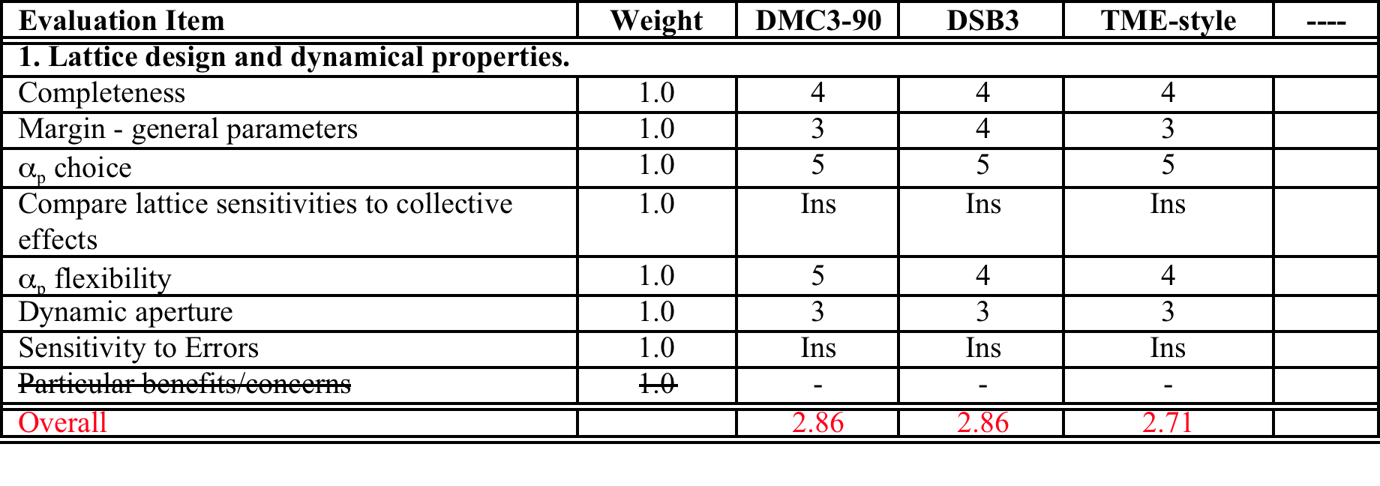
Lattice Design and Dynamical Properties

Slide 12
Lattice Evaluation – Item 2
Magnets, Supports and Power Supplies
How does the number of magnets, and the number of different styles of magnet, compare with the other lattices?
Are the magnet parameters (length, field strength or gradient, spacing) reasonable?
Compare the degree of magnet optimization required for the various lattices?
How do the alignment and stability sensitivities compare with other lattices? In particular, what is the sensitivity of emittance dilution due to these effects.
How do the numbers and types of supports required for the magnets compare with other lattices?
How do the numbers and types of individually powered magnets compare with the other lattice options?
Are there any particular benefits or concerns with the magnets, supports and power supplies, specific to the lattice?

Slide 13
Magnets, Supports and Power Supplies

Slide 14
Lattice Evaluation – Item 4
RF System
How feasible is the RF voltage required, for the targeted momentum compaction factor, to provide a bunch length of 6 mm?
Is there sufficient space in the lattice for all required RF cavities (allowing some margin for klystron failure)?

Slide 15
RF System

Slide 16
Today’s Presentations
Update on Re-designed RF/Wiggler and Injection/Extraction Straights + Update on the TME-like Lattice – Dave Rubin
Update on the DMC Lattice – Wang Dou
Update on the DSB Lattice – Susanna Guiducci

Slide 17
Damping Rings TDP Timeline
+ CFS Eval Meeting, June 2
Frascati Baseline Review, July 7-8

