Slide 1
SRF Results and Requirements
Internal MLC Review

Slide 2
MLC Requirements
Cavities: SRF performance
  16.2 MV/m (13 MV) average (5GeV from 384 cavities)
  20 MV/m max (16 MeV) for overhead
  Q₀ = 2*10¹⁰ on average at 16.2 MV/m (~11 W per cavity)
  Field stability (assuming non-correlated errors):
    Relative amplitude
      Baseline (1 sigma): 10⁻⁴
      Allowable (1 sigma): 6*10⁻³
    Phase
      Baseline (1 sigma): 0.1 deg
      Allowable (1 sigma): 1 deg

Slide 3
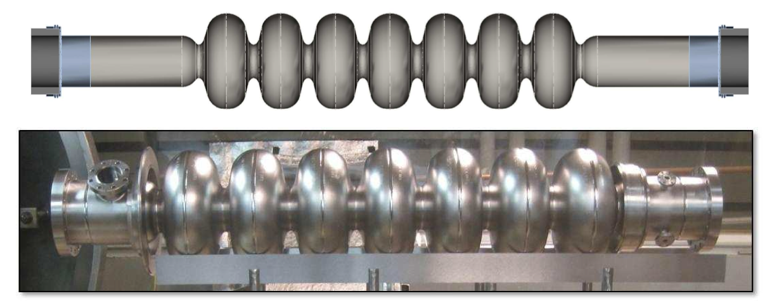
Beamline: SRF Cavity
Parameter | Value
Accelerating mode | TM010 π
Fundamental frequency | 1300 MHz
Design gradient | 16.2 MV/m
Intrinsic quality factor | >2⋅10¹⁰
Loaded quality factor | 6.5⋅10⁷
Cavity half bandwidth at Q_{L}= 6.5⋅10⁷ | 10 Hz
Operating temperature | 1.8K
Number of cells | 7
Active length | 0.81 m
Cell-to-cell coupling (fundamental mode) | 2.2%
Iris diameter center cell / end cells | 36 mm / 36 mm
Beam tube diameter | 110 mm
Geometry factor (fundamental mode) | 270.7 Ohm
R/Q (fundamental mode) | 387 Ohm
E_{peak}/E_{acc} (fundamental mode) | 2.06
H_{peak}/E_{acc} (fundamental mode) | 41.96 Oe/(MV/m)
Δf/ΔL | 1.6 kHz/mm
Lorentz-force detuning constant | ~1.5 Hz / (MV/m)^2
Cavity longitudinal loss factor for σ=0.6mm, non-fundamental | 13.1 V/pC
Cavity transverse loss factor for σ=0.6mm | 13.7 V/pC/m
 | Static Heat Load | Dynamic Load
2 K | <1 W | 11 W/cavity

Slide 4
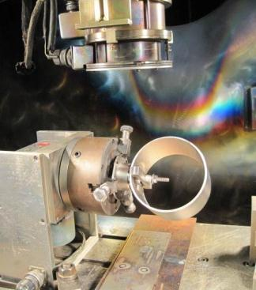
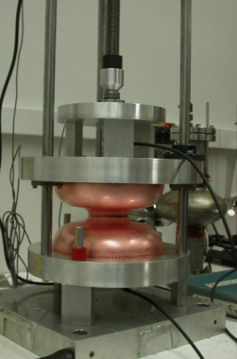
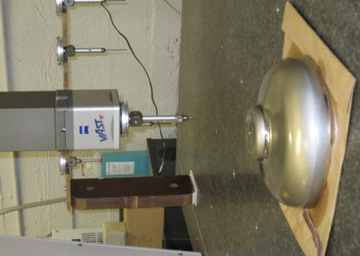
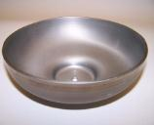
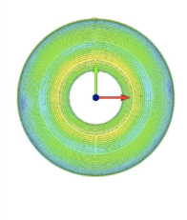
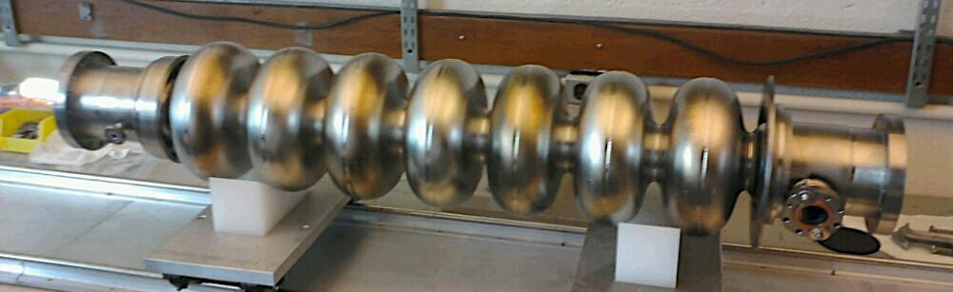
Prototype Cavity Fabrication
Electron Beam Welding
Quality control: CMM and frequency check
Finished main linac cavity with very tight (±0.25 mm) shape precision ⇒ important for supporting high currents (avoid risk of trapped HOMs!)
Notes:
Mention CMM!

Slide 5
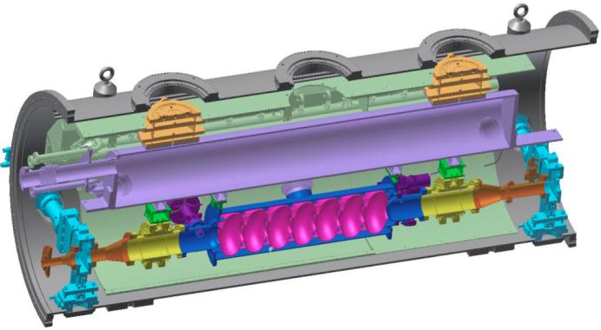
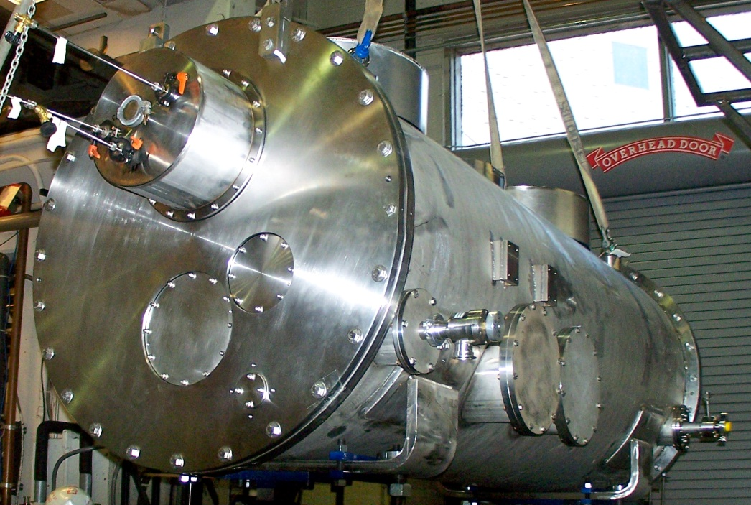
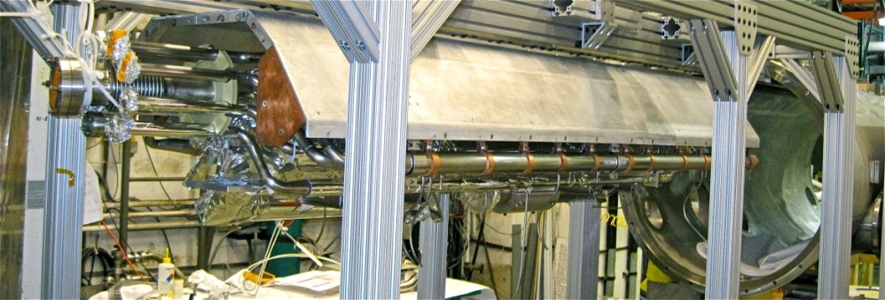
One-Cavity ERL Main Linac Test Cryomodule
80K shield
HGRP
Assembled and currently under testing at Cornell:
  First full main linac system test
  Focus on cavity performance and cryogenic performance
HOM load
cavity
HOM load
Gate valve

Slide 6
Test Results of First ERL Main Linac Cavity in Test Cryomodule
Cavity surface was prepared for high Q₀ while keeping it as simple as possible: bulk BCP, 650C outgassing, final BCP, 120C bake
Administrative limit. Cavity can go to higher fields
Cavity exceeds ERL gradient and Q₀ specifications: Q₀=4 to 6⋅10¹⁰ at 1.6K in a cryomodule!
The achievement of high Q is relevant not only to Cornell's ERL but also to Project-X at Fermilab, to the Next Generation Light Source, to Electron-Ion colliders, spallation-neutron sources, and accelerator-driven nuclear reactors.

Slide 7
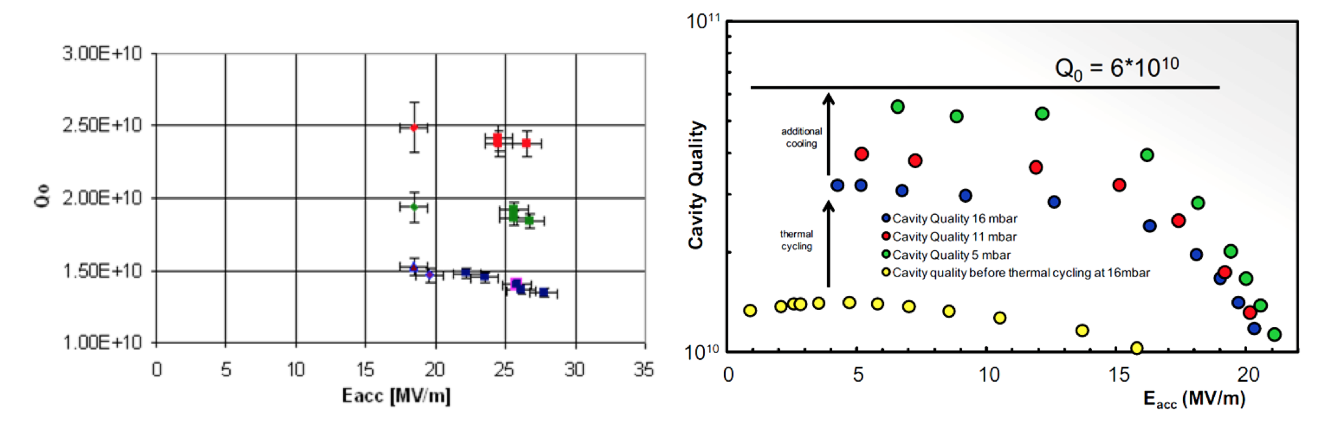
High Q₀ Results from Elsewhere
Average performance of eight 9-cell cavities in a FLASH cryomodule at DESY
9-cell Cavity test in Horizontal Test Cryostat at HZB
1.6K
1.8K
2K
Q₀ ~ 2*10¹⁰ at 16 MV/m and 1.8 K
Q₀ > 2*10¹⁰ at 16 MV/m and 1.8 K

Slide 8
MLC Requirements
RF input coupler:
  5kW peak
  2 kW CW average
  Fixed coupling with Q_{ext} = 6.5*10⁷
Superconducting quadrupole
  Maximum current: 110 A
  Maximum gradient: 19.4 T/m

Slide 9
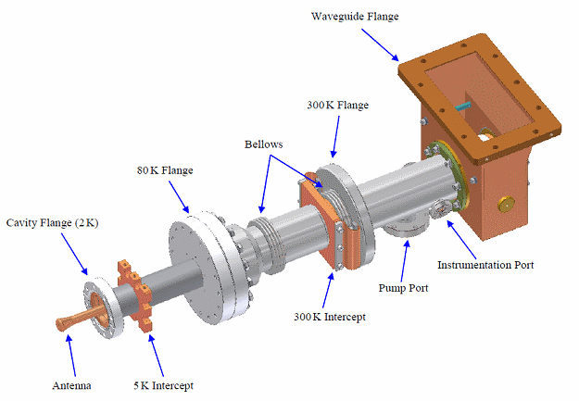
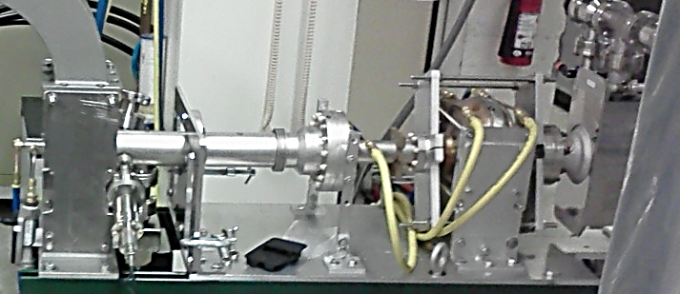
Beamline: Input Coupler
2 kW average RF power
5 kW peak RF power
Fixed coupling
Large transverse flexibility (1 – 2 cm offsets)
5K and 40 – 80 K intercepts
Prototype tested successfully to full power
 | Static Heat Load | Dynamic Load at 2 kW CW
2 K | 0.03 W | 0.15 W
5 K | 1.55 W | 1.94 W
80 K | 2.26 W | 9.33 W

Slide 10
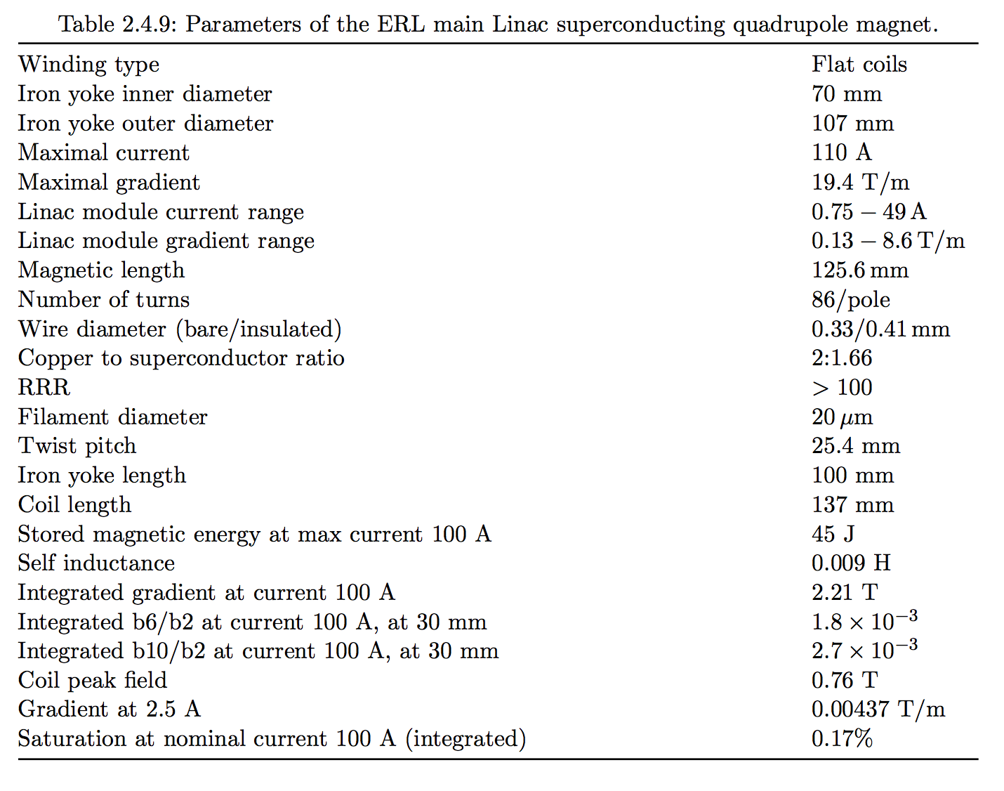
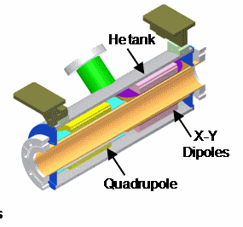
Superconducting Magnet
One superconducting quadrupole
X-Y dipoles
Cooled at 1.8 K

Slide 11
MLC Requirements
Beam and HOM damping:
  Maximum beam current: 2 * 100 mA (ERL mode)
  Bunch charge: 77 pC
  Bunch length: 0.6 mm (2 ps)
  Longitudinal loss factor of cavity: 13.1 V/pC
  Average HOM power per cavity: 200 W
  Peak HOM power per cavity: >400 W
  Average HOM power per module: ~1.4 kW

Slide 12
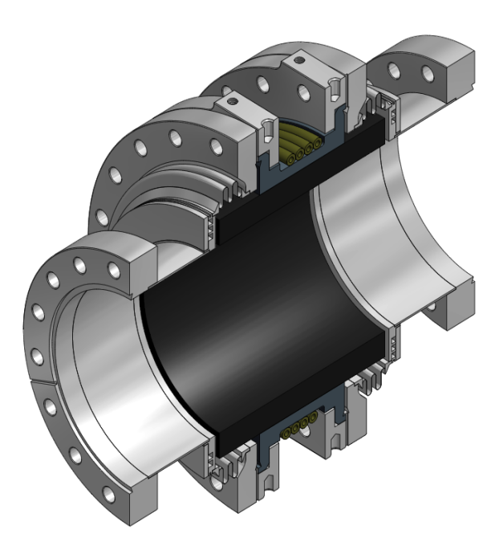
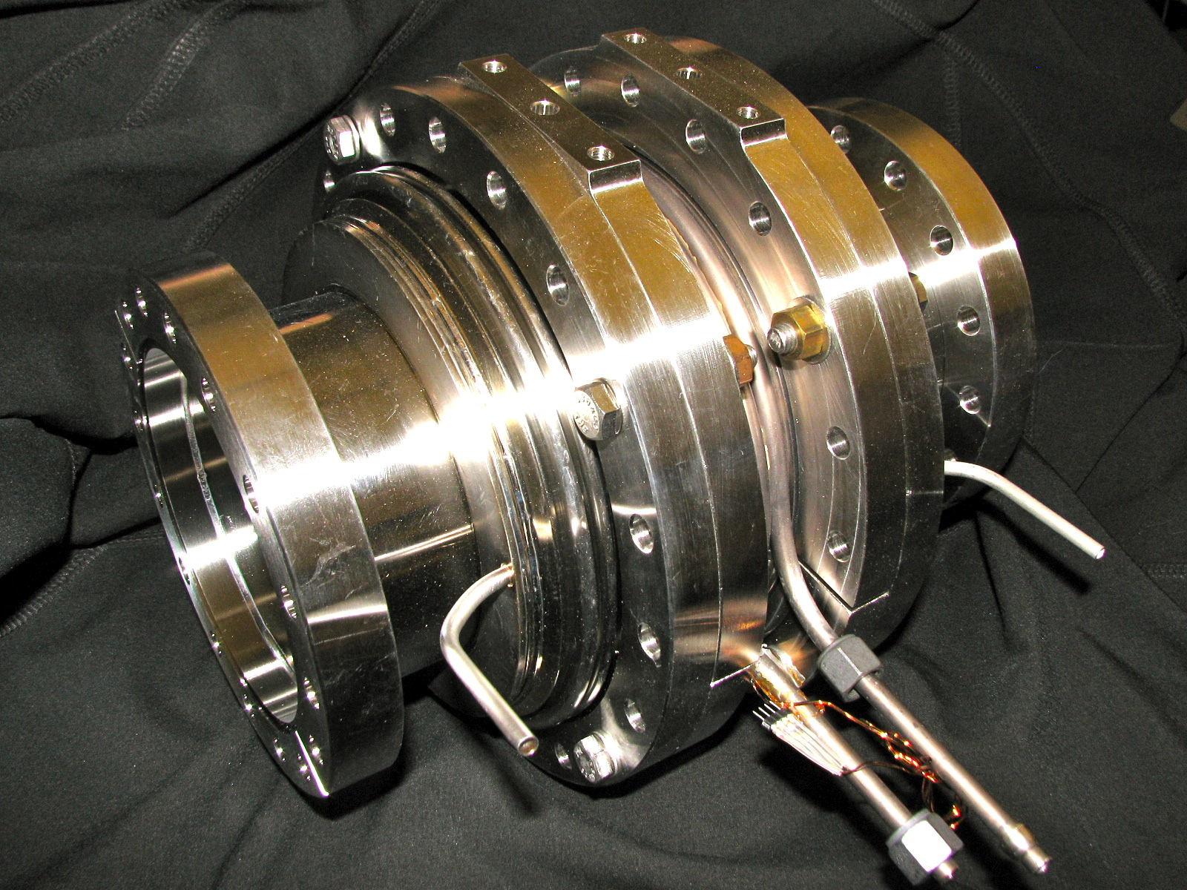
HOM Beamline Absorber
HOM beamline absorber at ~80K
Includes bellow sections
Concept based on first generation ERL HOM load, but greatly simplified
Graphite loaded SiC gives effective, broadband absorber (ε ~ 50 – i25)
Prototype fabricated and test successfully
Flange for disassembly
40 to 80K intercept
5K intercept
Flange to cavity
SiC absorber ring brazed to metal ring
Shielded bellow

Slide 13
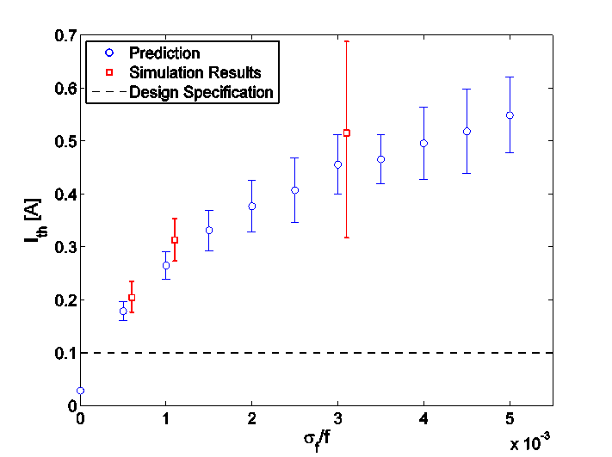
Beam-Break-Up simulations
Note: includes realistic fabrication errors and HOM damping materials!
±0.5mm
±0.25mm
±0.125mm
±1mm
Optimized cavity with ±0.25 mm shape imperfections supports ERL beam currents well above 100 mA!

Slide 14
MLC Requirements
Frequency tuner and microphonics:
  Slow tuner range: ~500 kHz
  Fast tuner range: >1 kHz
  Peak microphonics detuning: <20 Hz
    Sigma ~ 3.3 to 4 Hz (assuming peak = 5 to 6 sigma)
    Peak detuning counts (determines maximum RF power)!
      5 kW sufficient for 16.2 MV/m and 20 Hz detuning

Slide 15
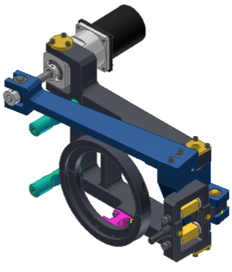
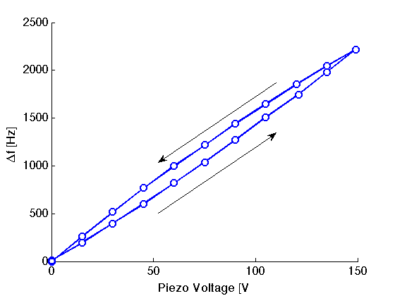
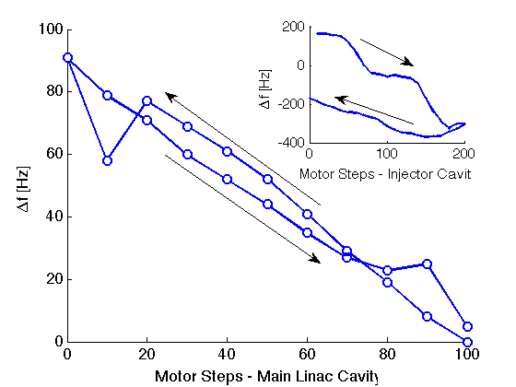
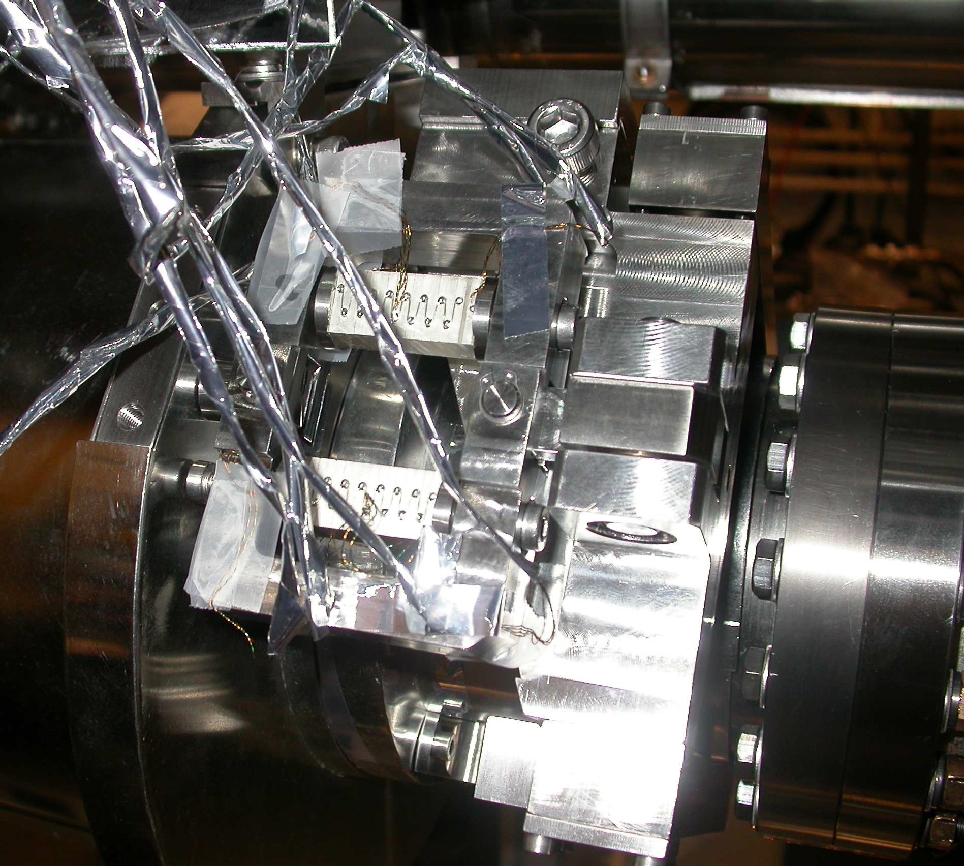
Frequency Tuner and Magnet
Includes slow and fast tuner
Prototype tested successfully with prototype main linac cavity in test cryomodule
  Excellent linearity and very small hysteresis with >400 kHz slow tuning range
  2 kHz piezo tuning range

Slide 16
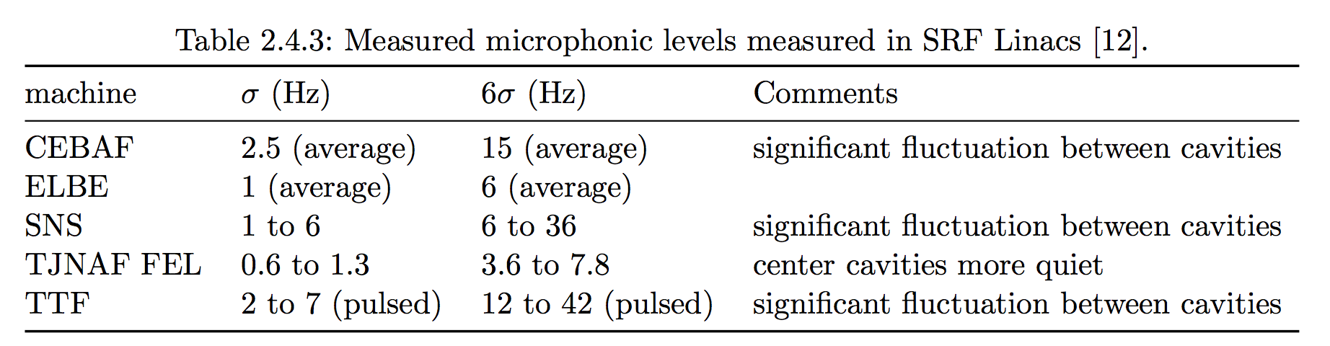
Microphonics Results From the HTC and Elsewhere
80K shield
HGRP
Sigma = 4.6 Hz
Peak = 18 Hz
HOM load
cavity
HOM load
Gate valve

Slide 17
MLC Requirements
Alignment (from PDDR):
  Cavities:
    Transverse offset (x,y)
      Baseline (1 sigma): 0.5 mm
      Allowable (1 sigma): 2 mm
    Pitch
      Baseline (1 sigma): 1 mrad (0.8 mm over length of cavity)
      Allowable (1 sigma): 1.5 mrad (1.2 mm over length of cavity)
  Quadrupole
    Transverse offset (x,y)
      Baseline (1 sigma): 0.3 mm
      Allowable (1 sigma): 1.6 mm

Slide 18
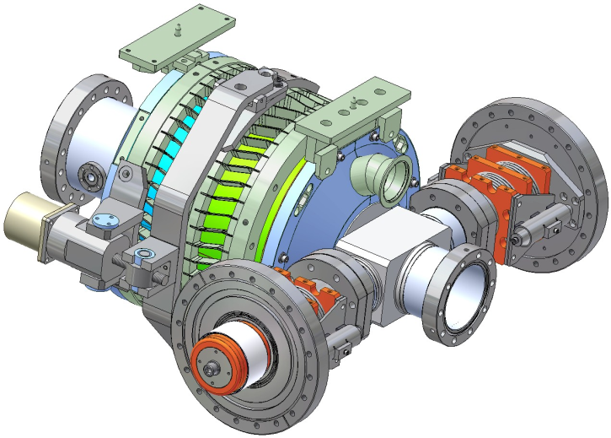
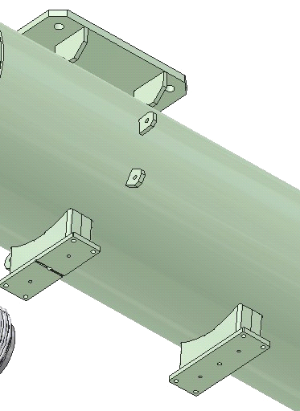
Alignment Results from the Injector Cryomodule using fixed Supports
High precision supports on cavities, HOM loads, and HGRP for “self” alignment of beam line
  Rigid, stable support
  Shift of beamline during cool-down as predicted
Cavity string is aligned to ±0.2 mm after cool-down!
1.00
0.50
X1 [mm]
0.00
X position [mm]
X3 [mm]
-0.50
ERL Injector Cooldown WPM Horizontal
X4 [mm]
X5 [mm]
-1.00
4/29/08 0:00
4/30/08 0:00
5/1/08 0:00
5/2/08 0:00
Date-Time

Slide 19
The End

